Slide 1
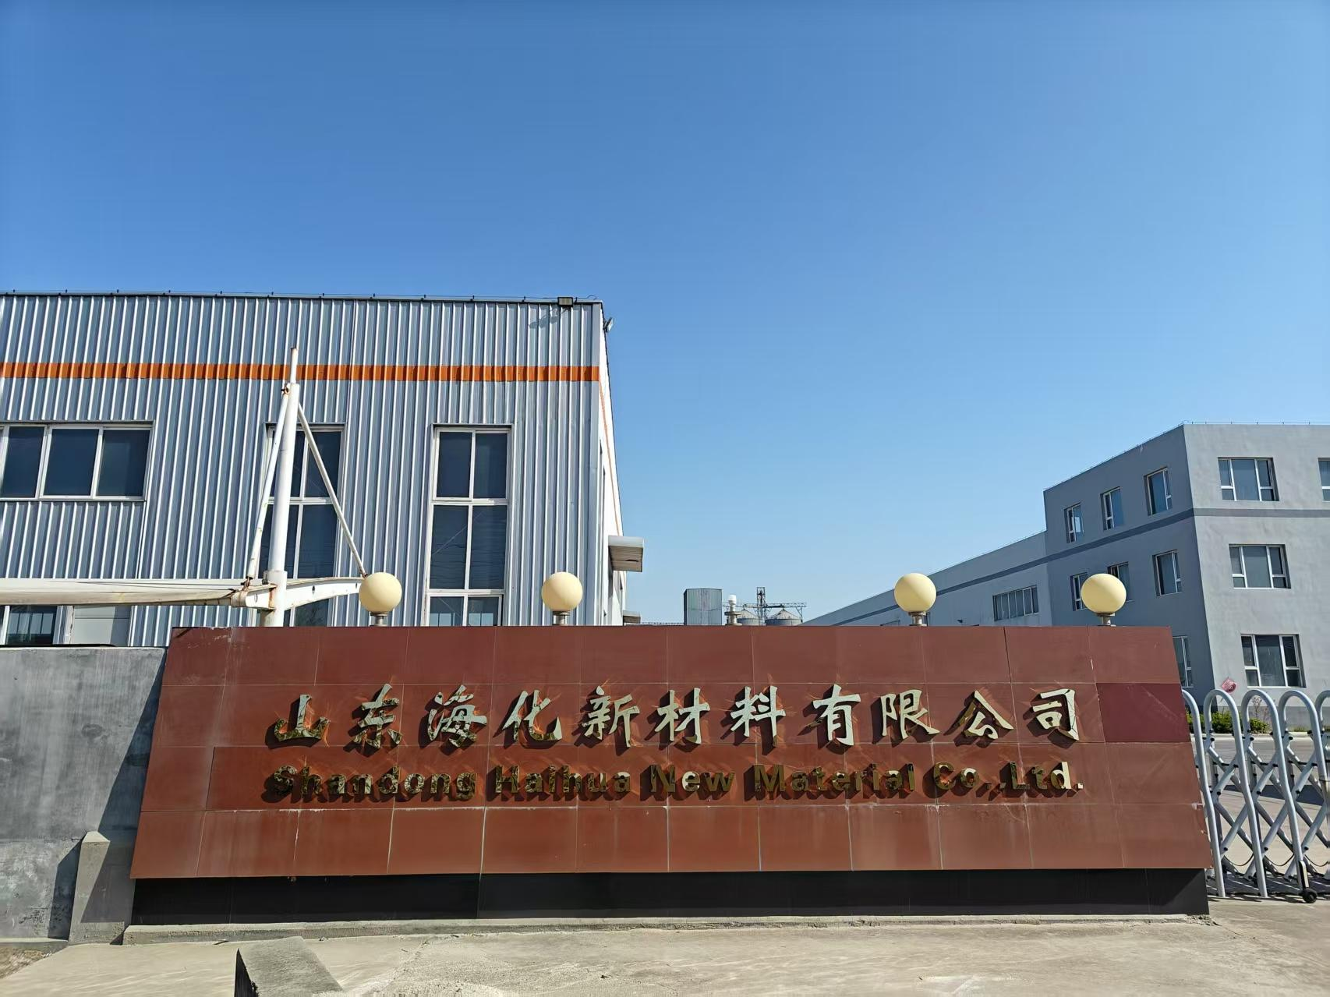
Company introduction
Shandong Haihua New Materials Co., Ltd., was established in 2018. mainly engages in the production of chemical products such as baking soda, soda ash, calcium chloride, magnesium chloride, sodium metabisulfite, mirabilite, snow-melting agent, soft water salt, refined industrial salt, feed salt, sodium sulfite, and sodium bisulfite.
Factory is located in the Weifang Binhai Economic Development Zone, a well-known production and export base for chemical products.
Factory Got ISO9000.ISO9001 certificate, can took OEM and ODM orders according to customer demand!

Slide 2
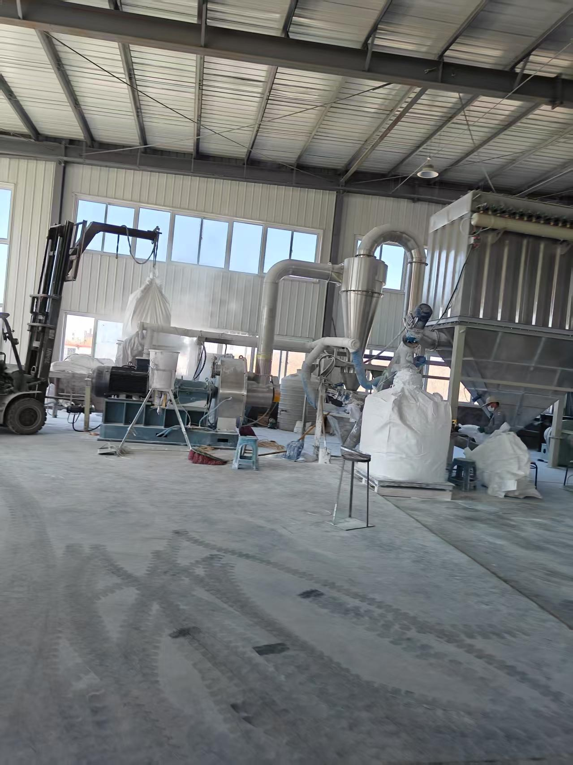
Advantages
One stop shopping
We provide one stop shopping for customer, plenty and various products in stock, fast and standard production, high quality, fast quotation and good service!
Innovative Product Lines
The company offers a diverse range of products, including high-performance composites and eco-friendly materials, designed to meet market demands.

Slide 3
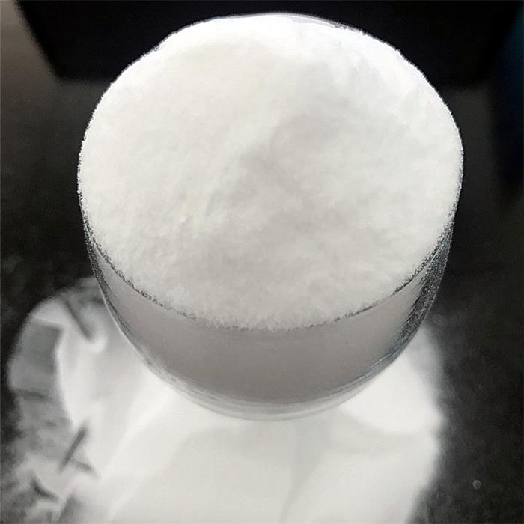
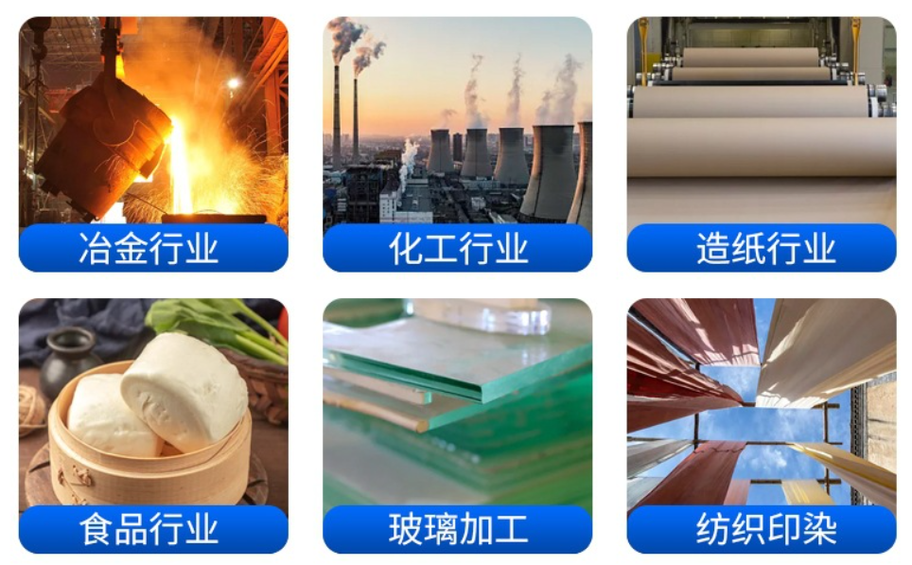
Product Characteristics and Applications
Sodium carbonate
Applications
Sodium carbonate is the inorganic compound with the formula Na₂CO₃ and its various hydrates. All forms are white, odorless, water-soluble salts that yield alkaline solutions in water.we export to south east asia, europe, latin america
Metallurgy, chemical , paper, food industry, glasses, textiles, printing and dyeing

Slide 4
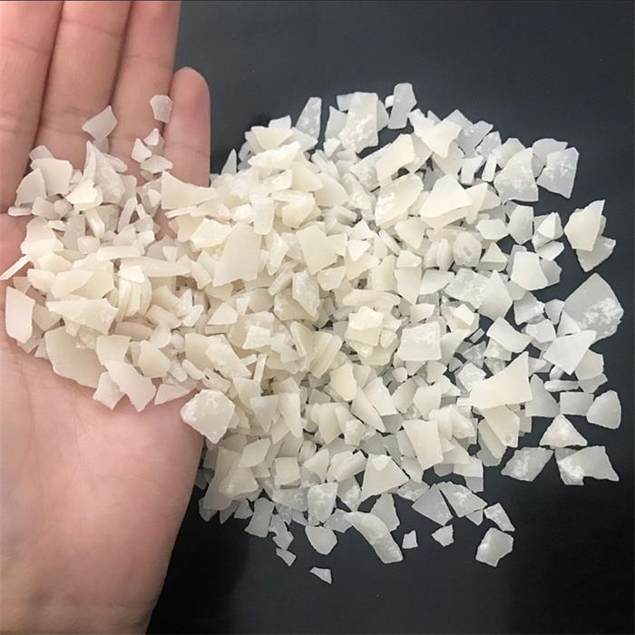
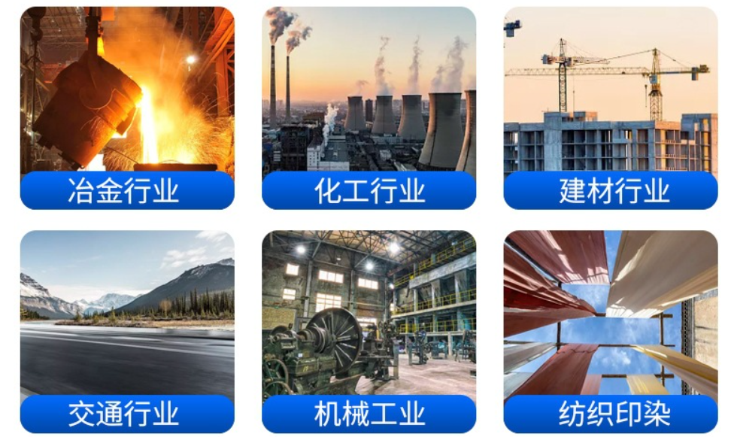
Product Characteristics and Applications
Magnesium chloride
Applications
Magnesium Chloride, often simply known as MgCl2, is a highly versatile and important inorganic compound. Primarily sourced from seawater, it plays a fundamental role in a variety of applications, from healthcare to agriculture and industry.
Metallurgy, chemical , constraction, transportation, machinery, textiles, printing and dyeing

Slide 5
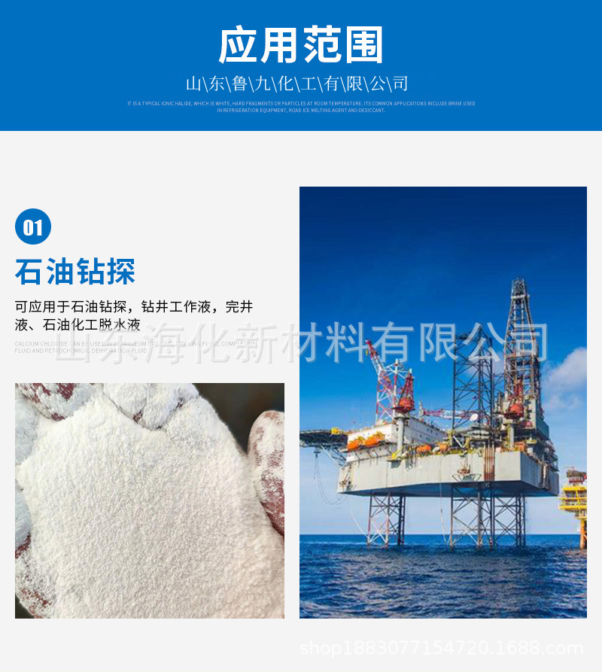
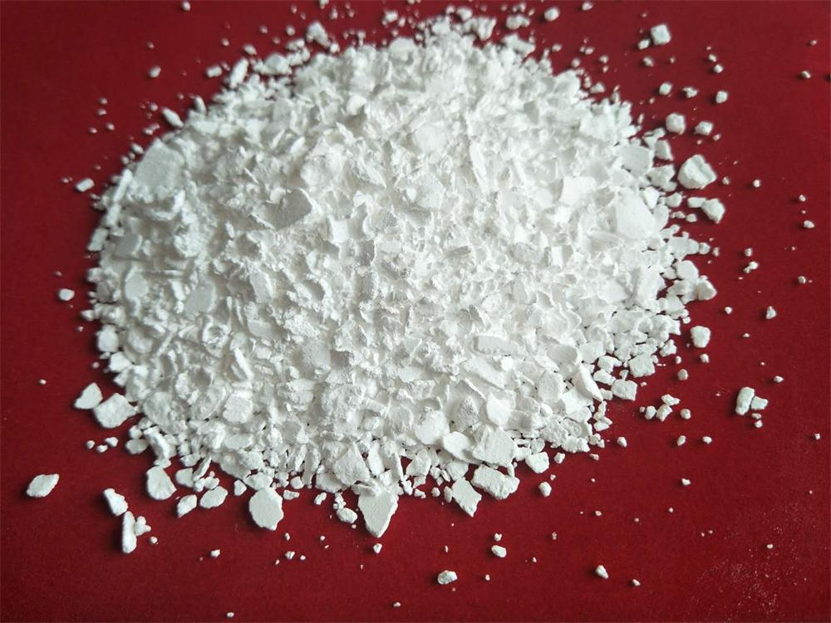
Product Characteristics and Applications
Calcium chloride
Applications
Calcium chloride is an inorganic compound, a salt with the chemical formula CaCl2. It is a white crystalline solid at room temperature, and it is highly solublein water.
Food industry, construction, medical, environmental control,oil industry

Slide 6
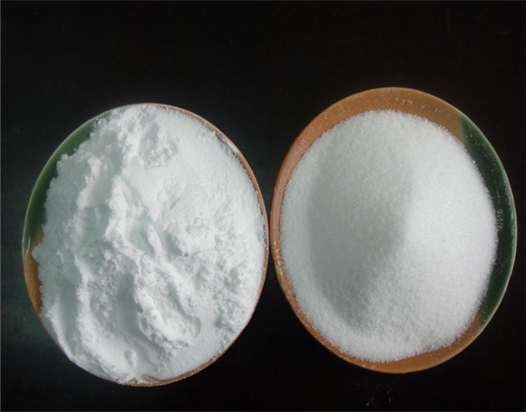
Product Characteristics and Applications
Applications
industry salt
Industrial salt is a highly purified form of sodium chloride (NaCl) that is extracted from natural sources, such as salt mines, seawater, or brine wells.
chemicals, food, water treatment, and de-icing

Slide 7
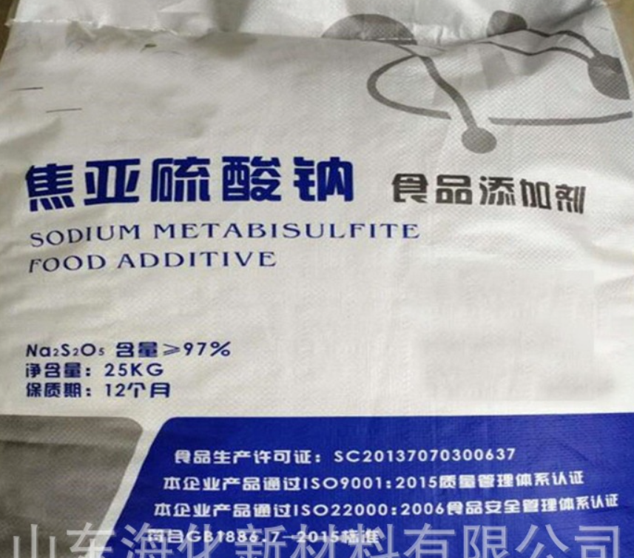
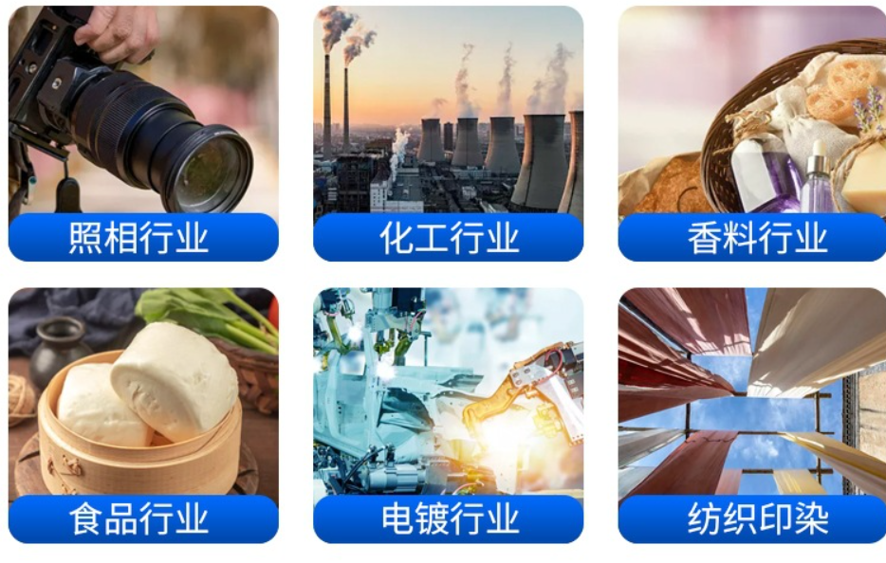
Product Characteristics and Applications
Sodium metabisulfite
Applications
Sodium metabisulfite or sodium pyrosulfite (IUPAC spelling; Br. E. sodium metabisulphite or sodium pyrosulphite) is an inorganic compound of chemical formula Na2S2O5
Applied to photography, chemicial, perfume, food industry ,febric and printing industry. It is used as a disinfectant, antioxidant, and preservative agent

Slide 8
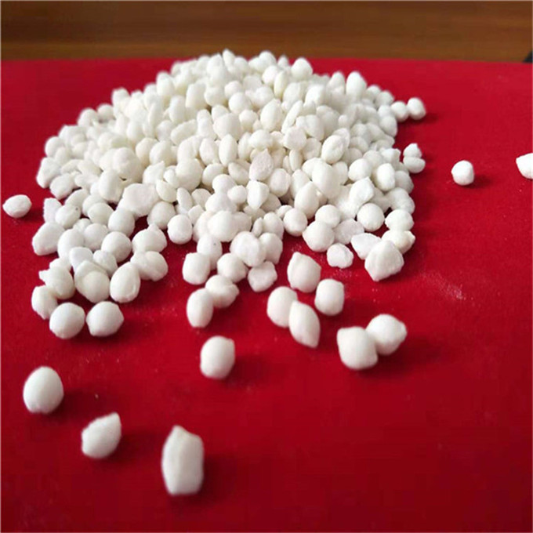
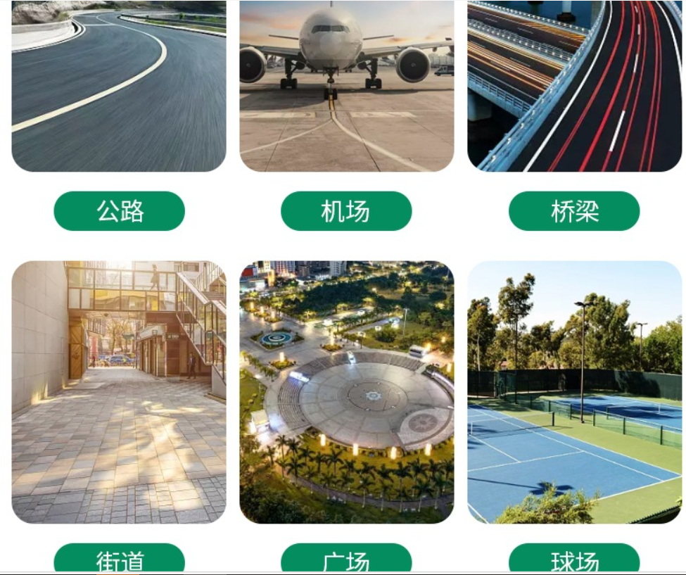
Product Characteristics and Applications
Snow melting agent
Applications
Snow melt agent is a chemical that can reduce the melting temperature of snow and ice. Mainly used for Snow removal in winter on roads, airports, urban streets and road freezing prevention.
Road, airport, bridges, street, sports squeer.

Slide 9
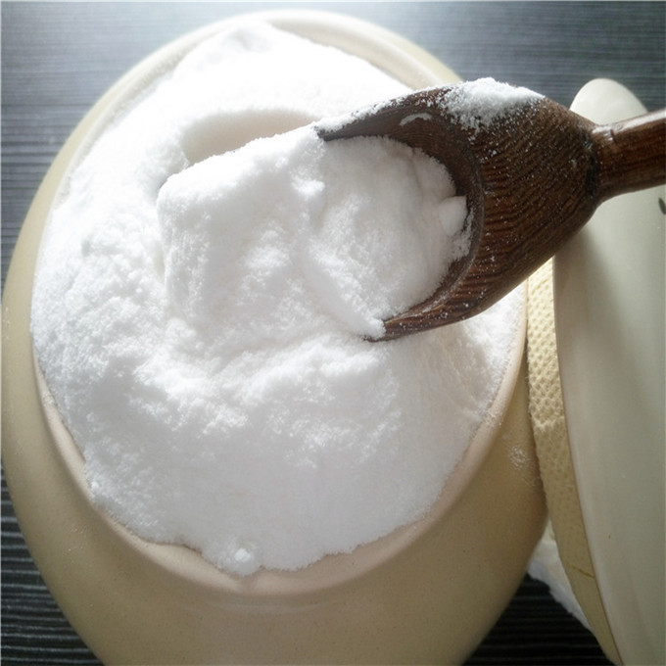
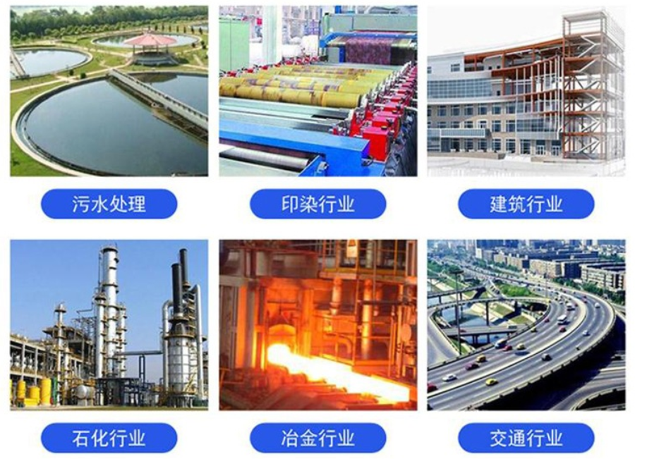
Product Characteristics and Applications
sodium bicarbonate
Applications
Sodium bicarbonate, also known as baking soda, is a white solid that is crystalline but often appears as a fine powder. It is composed of a sodium cation (Na⁺) and a bicarbonate anion (HCO₃⁻) and has a slightly salty, alkaline taste.
Watertreatment, printing, construction , metal, transportation, food industry. we can make superfine soda 300~3600 mesh according to customer demand

Slide 10
for more information please contact: https://www.shandonghaihua.com
Tel:008618669868863
Email:yiholdchina@gmail.com

