Slide 1
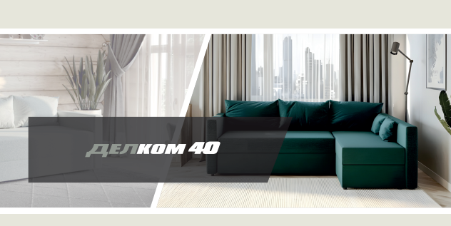

Slide 2
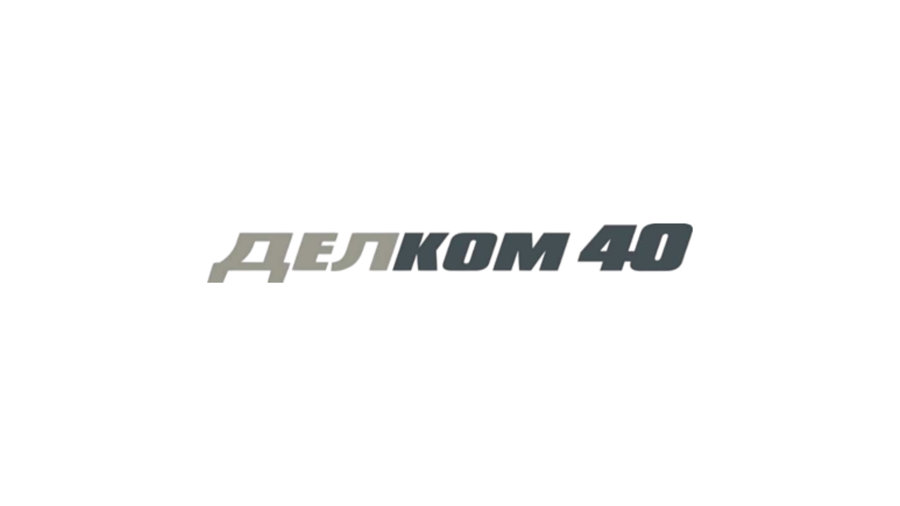
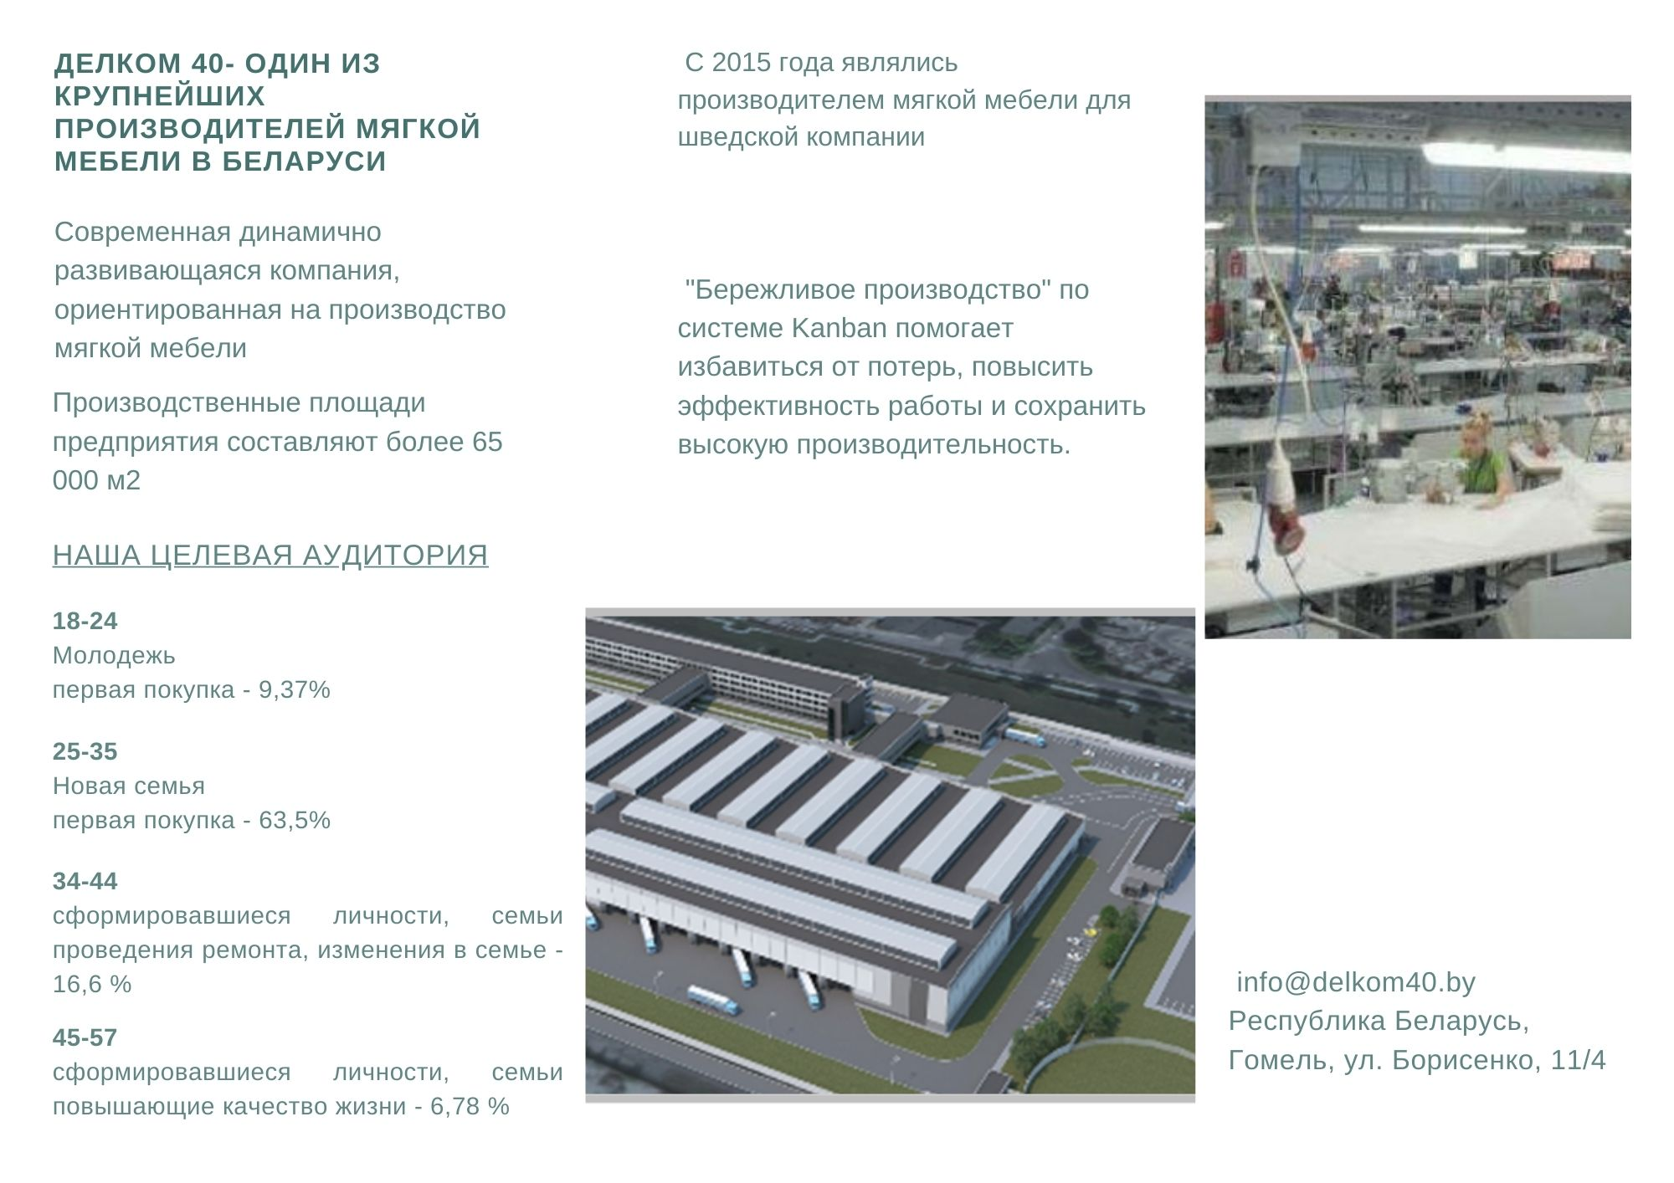
DELKOM 40 – one of the largest manufacturer of upholstered furniture in Belarus
A modern, dynamically developing factory specializing in the production of upholstered furniture.
Production areas exceed 65,000 m2
Company implemented the Kanban system which allows minimizing losses, increases work efficiency and ensures high furniture production capacities.
info@delkom40.by
Republic of Belarus
Gomel, 11/4 Borisenki street

Slide 3
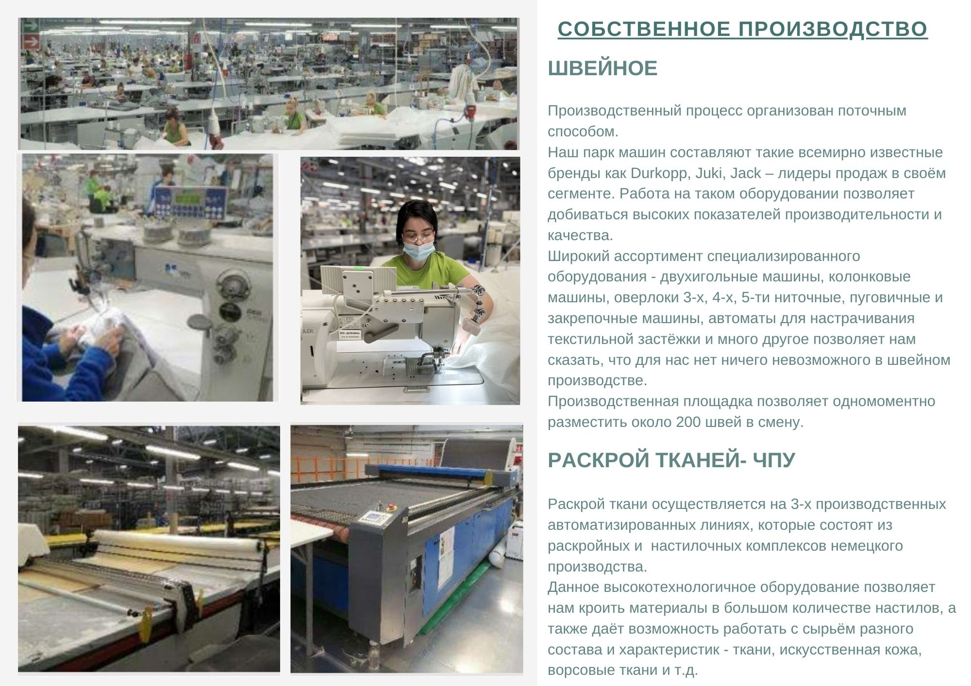
Own production - vertical integration
Sewing department
Production organized in a continuous system using high-quality machinery (Durkopp, Juki, Jack) allowing to maintain stable, repeatable quality and ensuring high efficiency. Wide range of specialized machines - two-needle, 3-x 4-x and 5-x thread overlocks, automatic machines for buttons, etc. enable sewing of practically all types of fabrics and knits. Qualified personnel - 200 needlewomen per shift.
Fabric cutting center
Fabric cutting is carried out on 3 fully automated German lines. The lines provide the ability to work with materials of different characteristics and parameters (fabrics, knitwear, leather, eco leather)

Slide 4
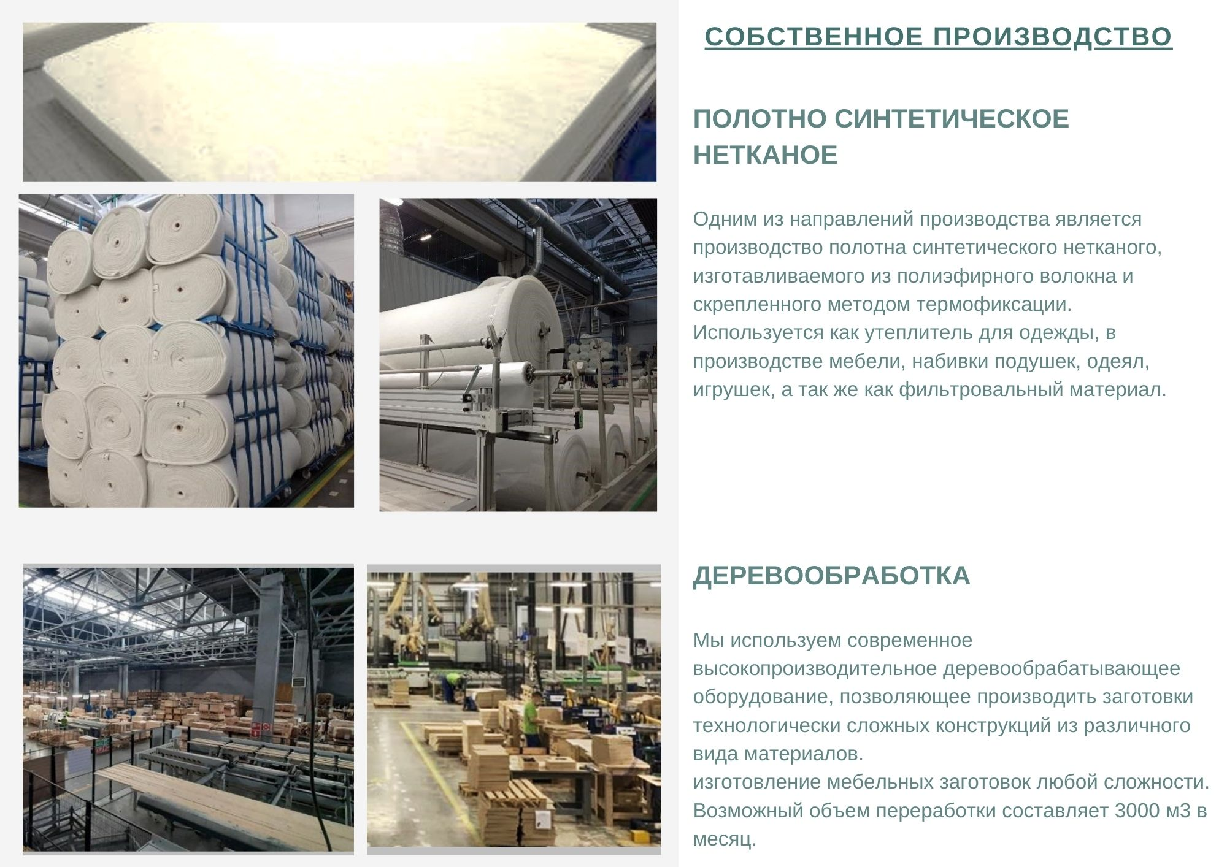
Own production - vertical integration
Nonwoven fabric
Production takes place on the Masias line – a leader in the textile machinery industry. Polyester fiber sourcing from leading local producers, as well as imported from Korea. The line is also adapted to the production of R-PET fiber. The types of nonwoven fabrics produced, apart from their own needs, are also implemented for the clothing industry.
Wood and wood-based materials processing
The carpentry is equipped with an automated line (from sawn timber to a finished 4-x planed elements) with humidity sensors, cameras for optimizing - cutting out - wood defects and a metal detector. It ends with a line for automatic sorting of elements depending on the given parameters (cross-section, length). The line allows processing 4000 m3 of sawn timber per month.
The board processing department is equipped with automatic machining centers (CNC) and a line for edge banding. Company has the ability to make elements of any degree of complexity.

Slide 5
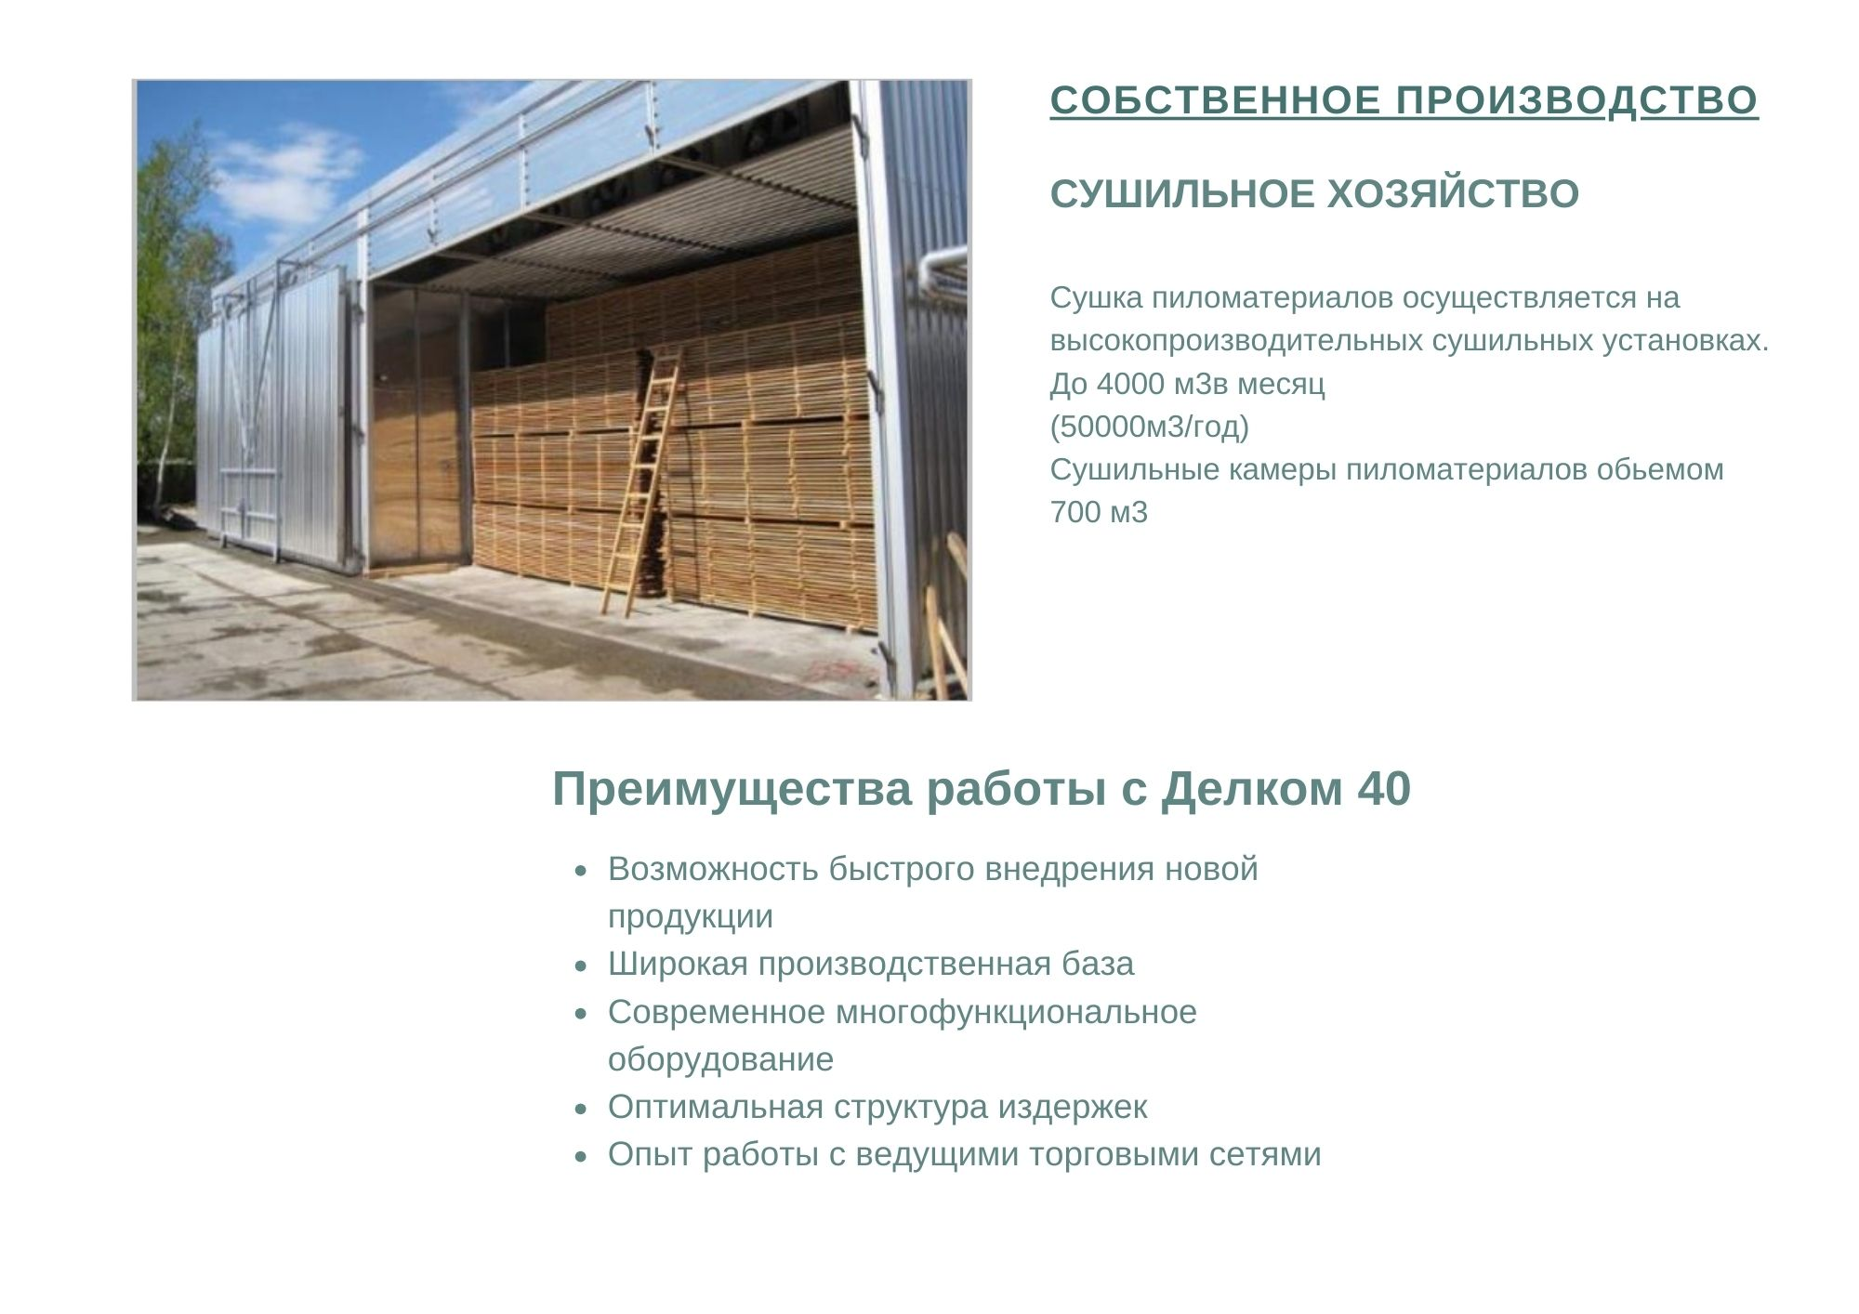
Own production - vertical integration
Dryers
In order to better control the parameters of wooden elements, Delkom40 is equipped with its own drying complex with a one-time input of 700 m3, with a capacity of 4,000 m3/month (50,000 m2/year)
Advantages of working with Delkom 40
the ability to quickly implement new products
modern and high-tech machinery park
optimal cost structure
experience in cooperation with leading retails

Slide 6
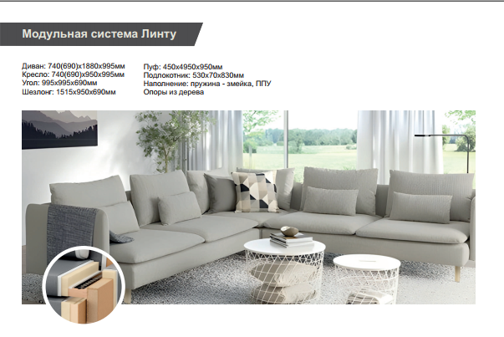
Lintu – modular furniture

Slide 7
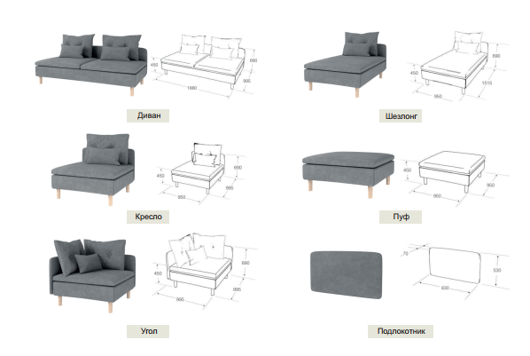
Sofa
Shezlong
Armchair
Footstool
Corner
Armrest

Slide 8
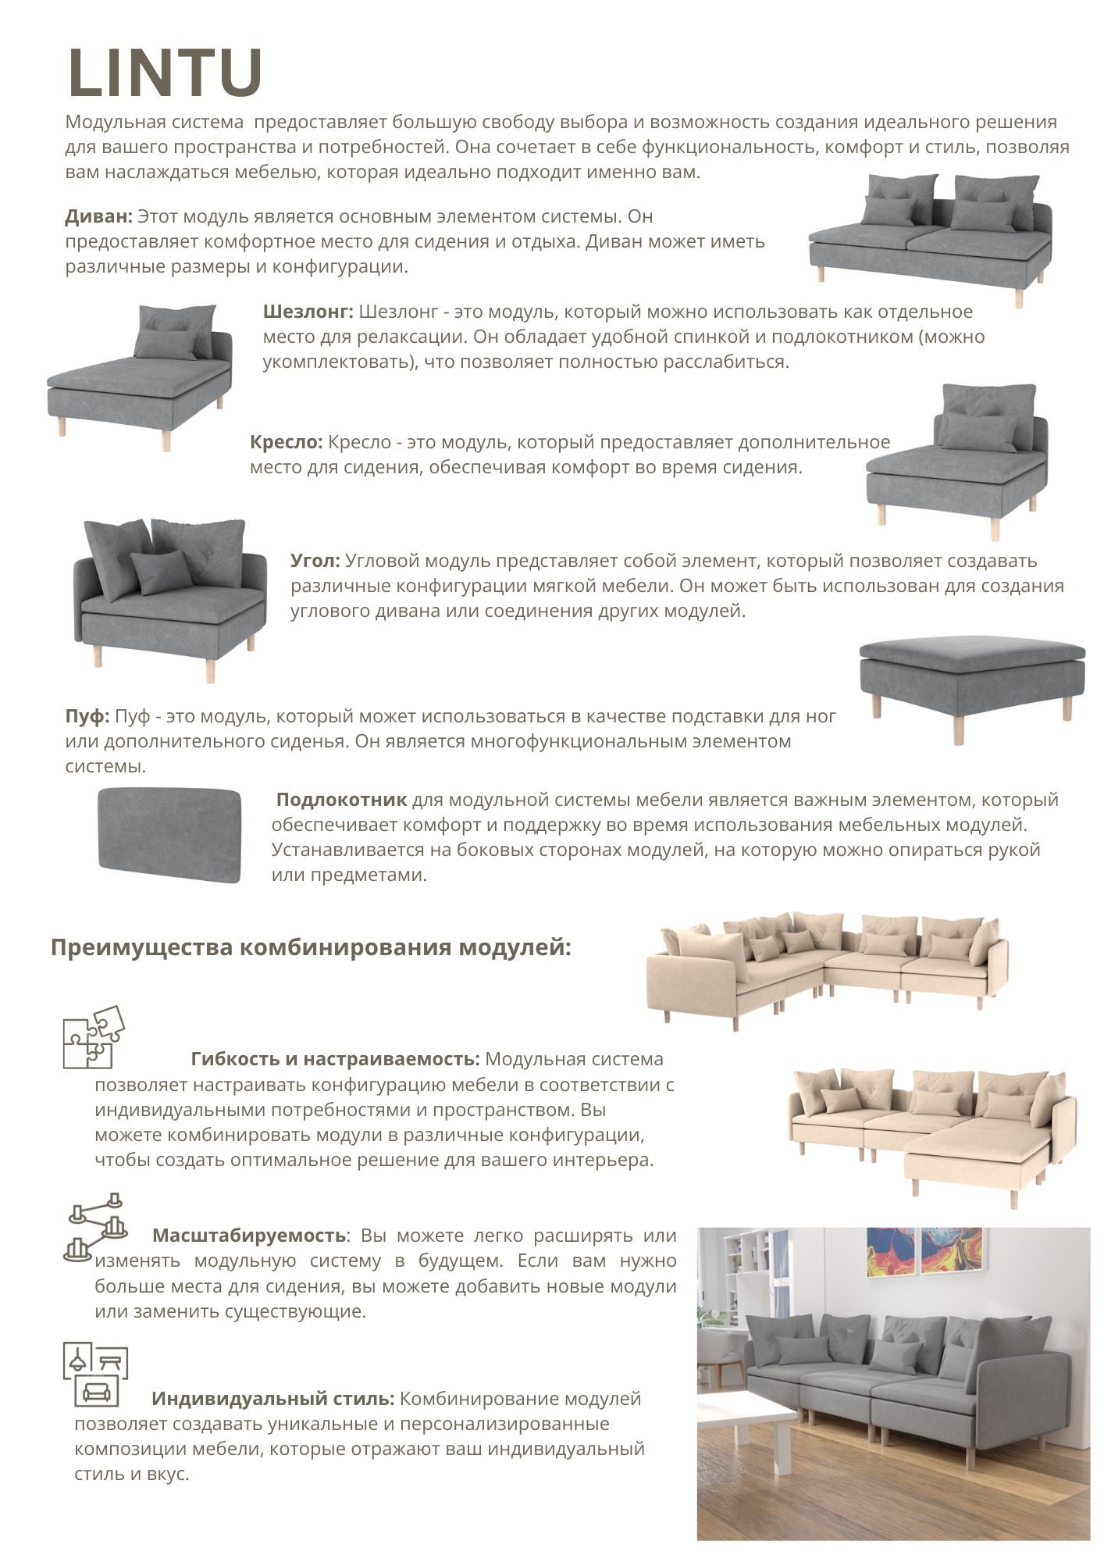
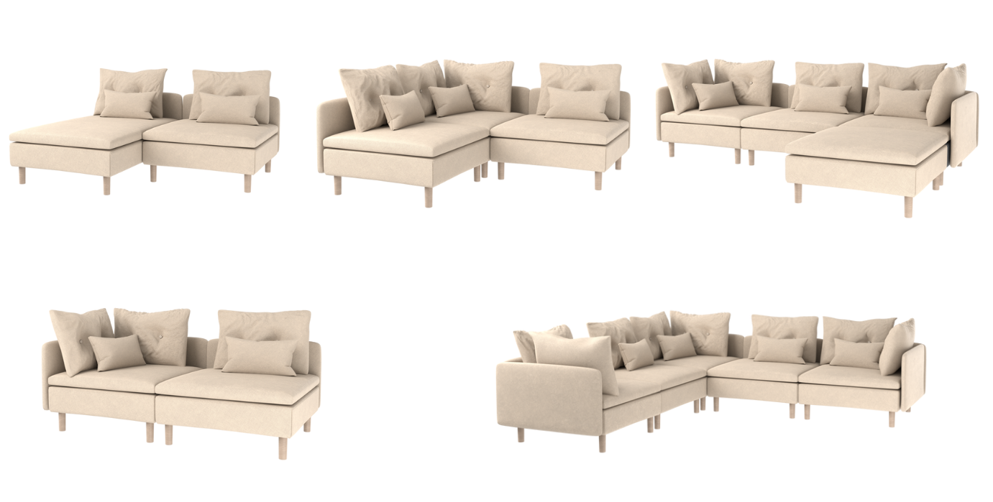
Combination examples and advantages:
individual style
great flexibility in design
possibility of expanding the collection later

Slide 9
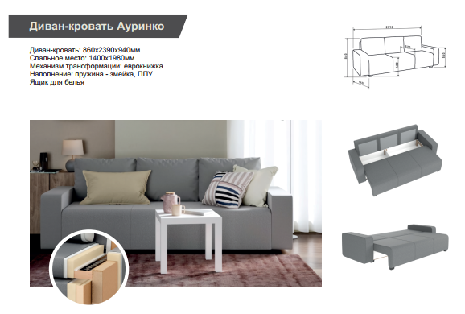
Aurinko – Sofa-bed

Slide 10
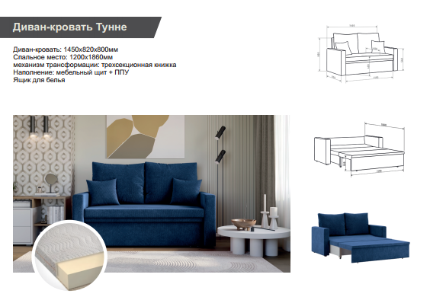
Tune – Sofa-bed

Slide 11
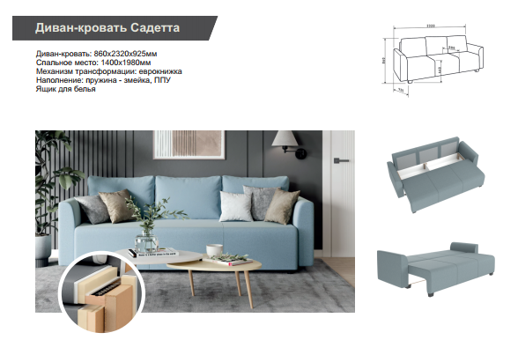
Sadeta – Sofa-bed

Slide 12
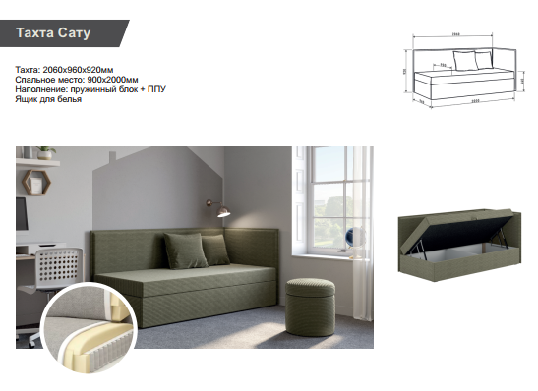
Satu

Slide 13
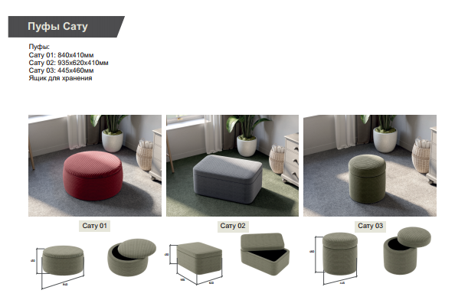
Satu
Satu 01
Satu 02
Satu 03

Slide 14
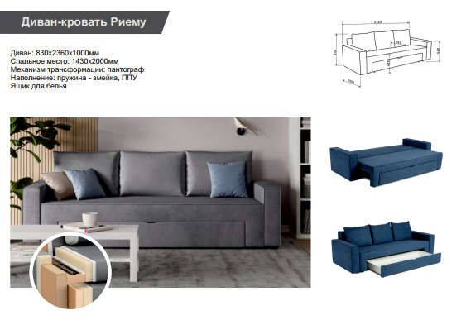
Riemu – Sofa-bed

Slide 15
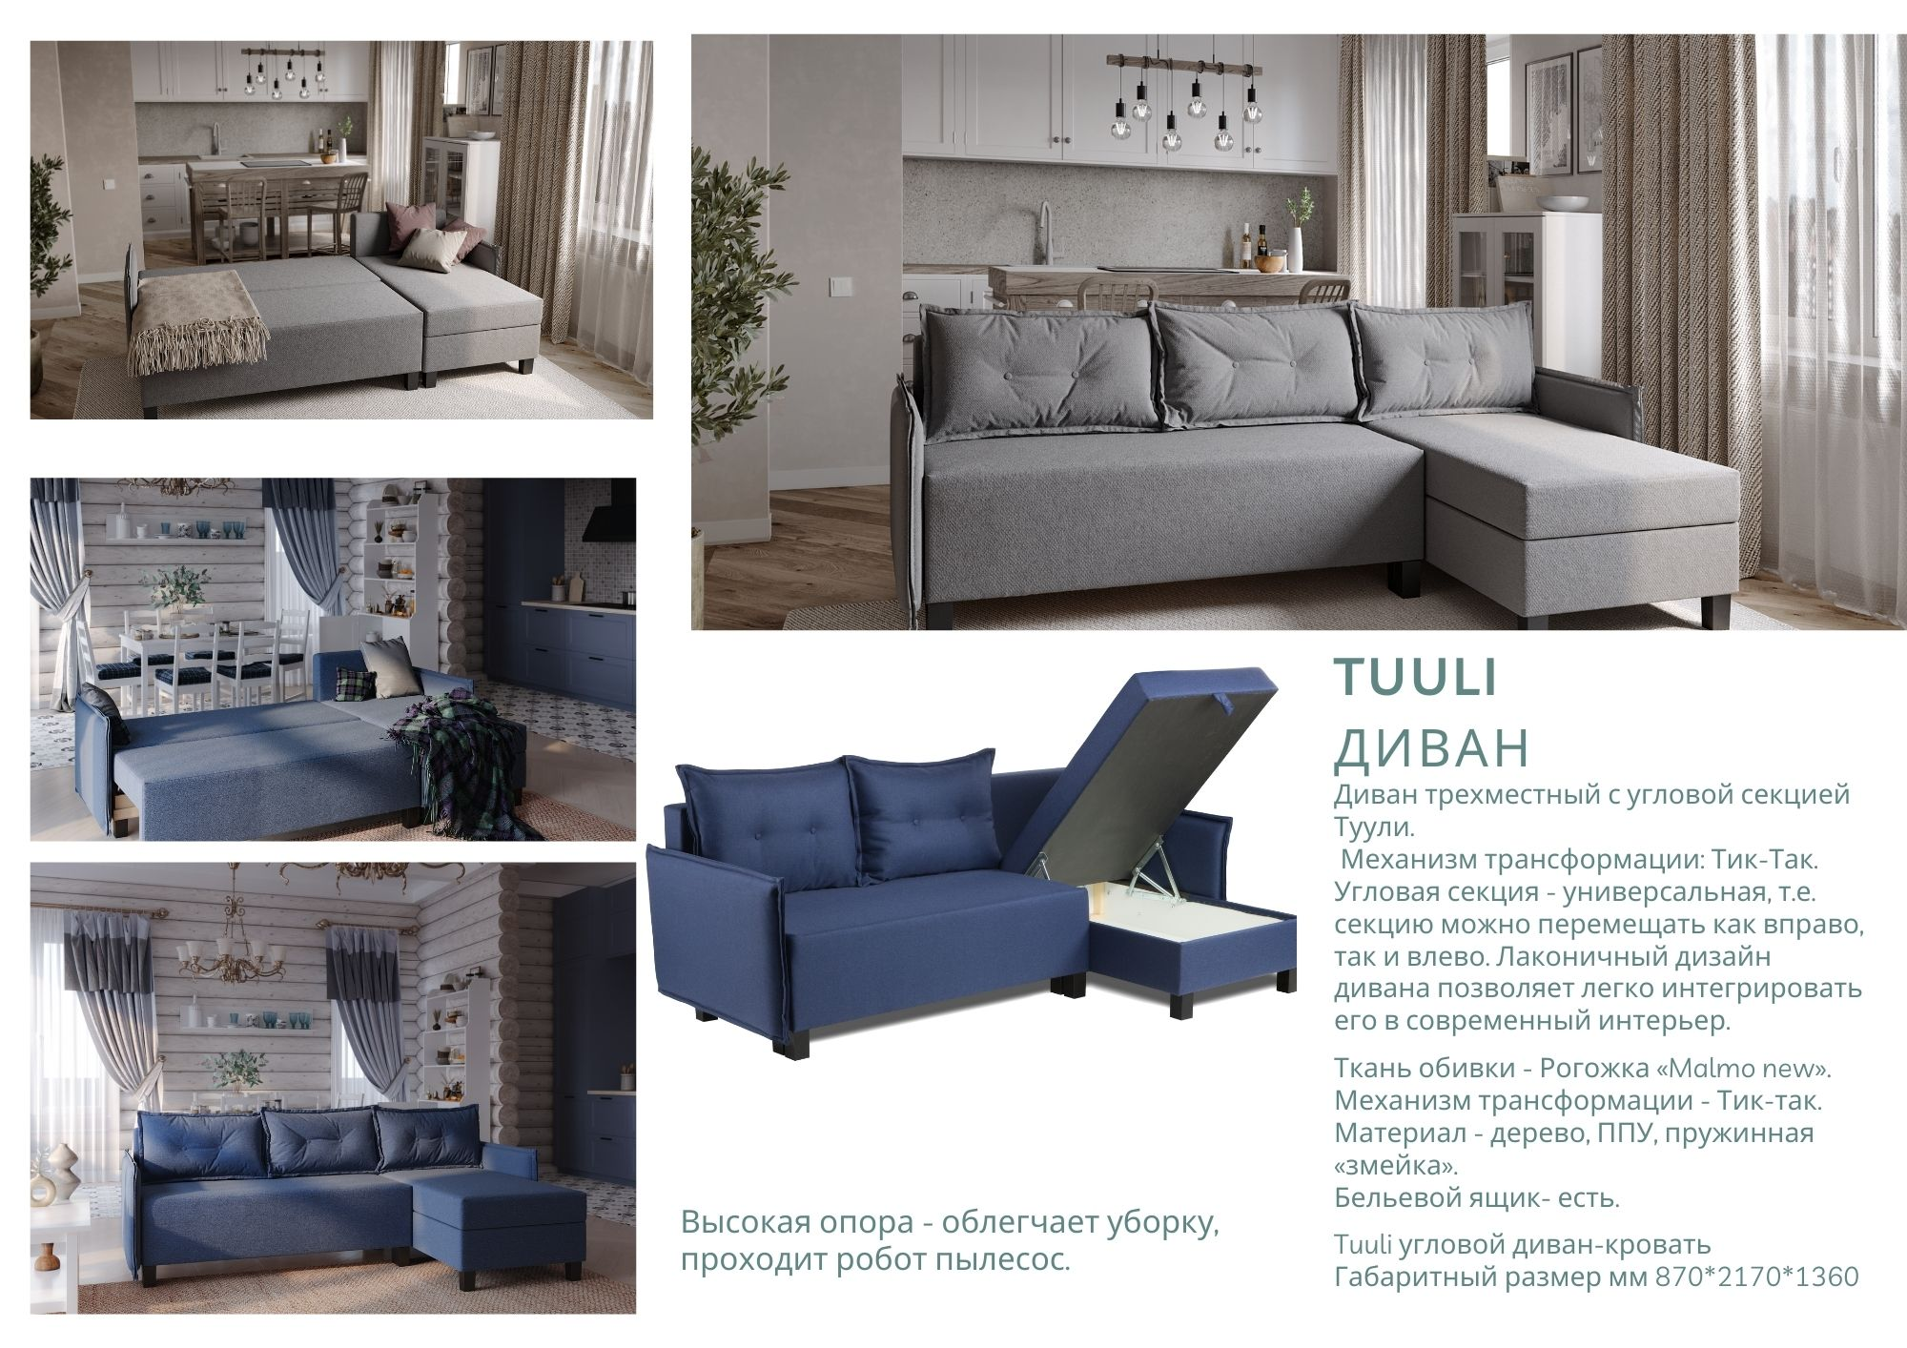

Tuuli – Sofa-bed

Slide 16
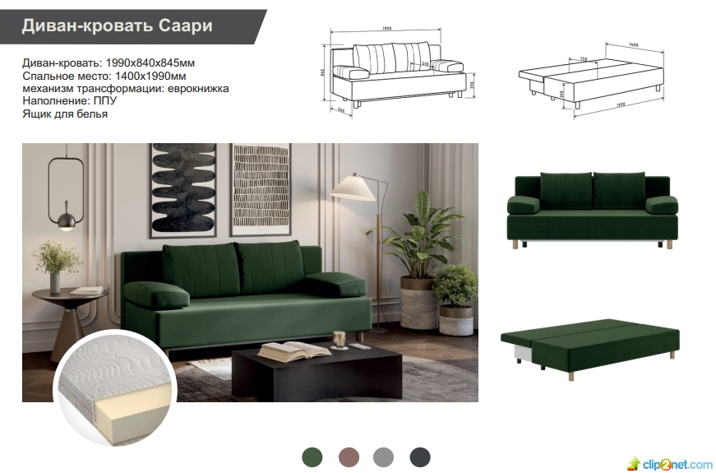
Saari – Sofa-bed

Slide 17
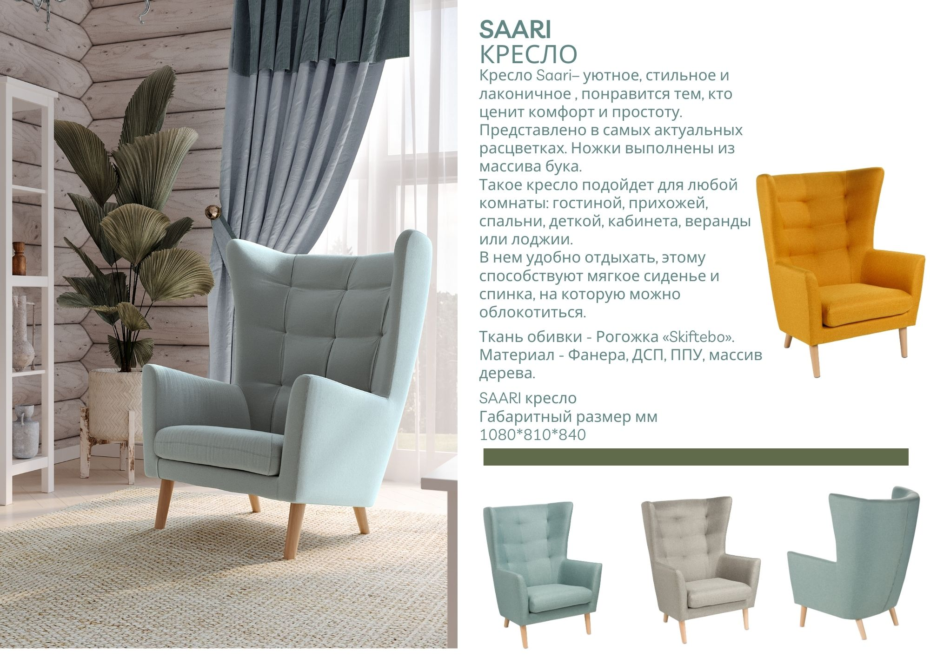
Saari – Armchair

Slide 18
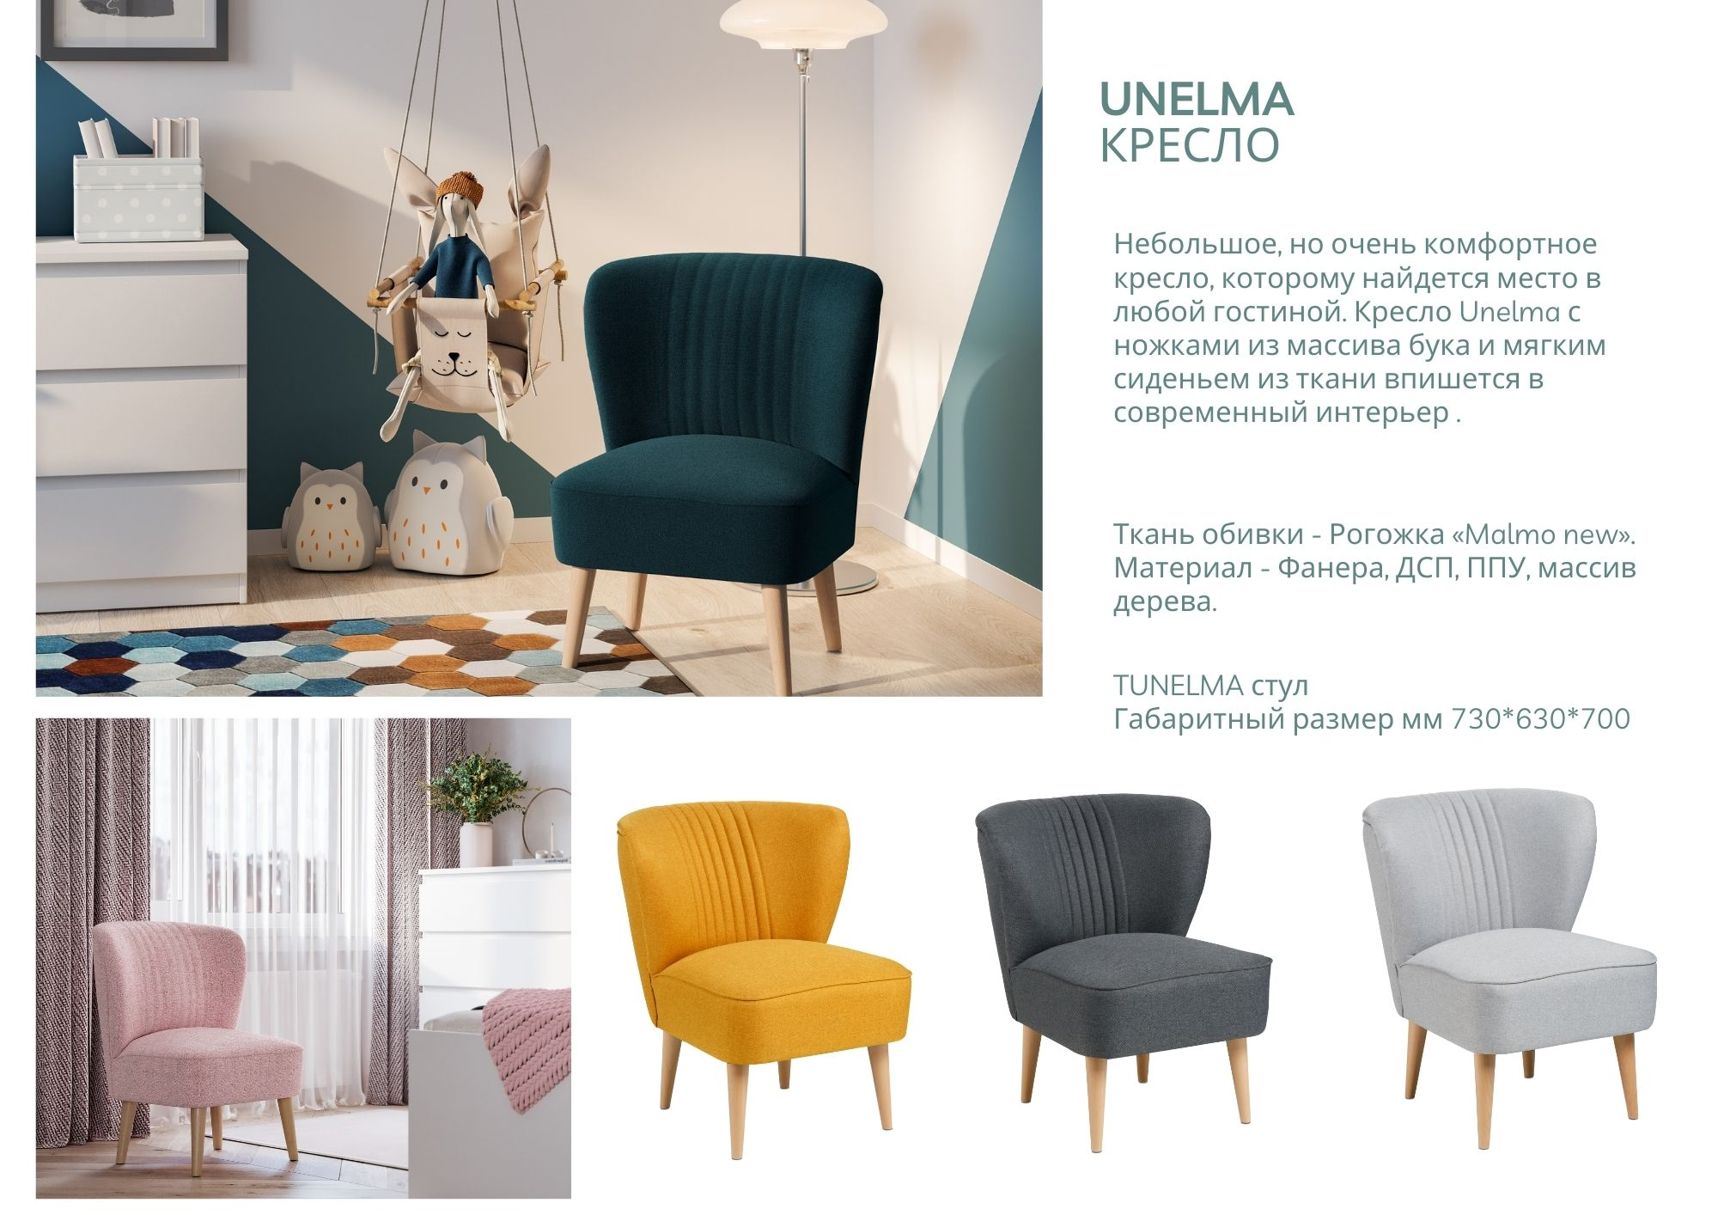
Unelma – Armchair

Slide 19
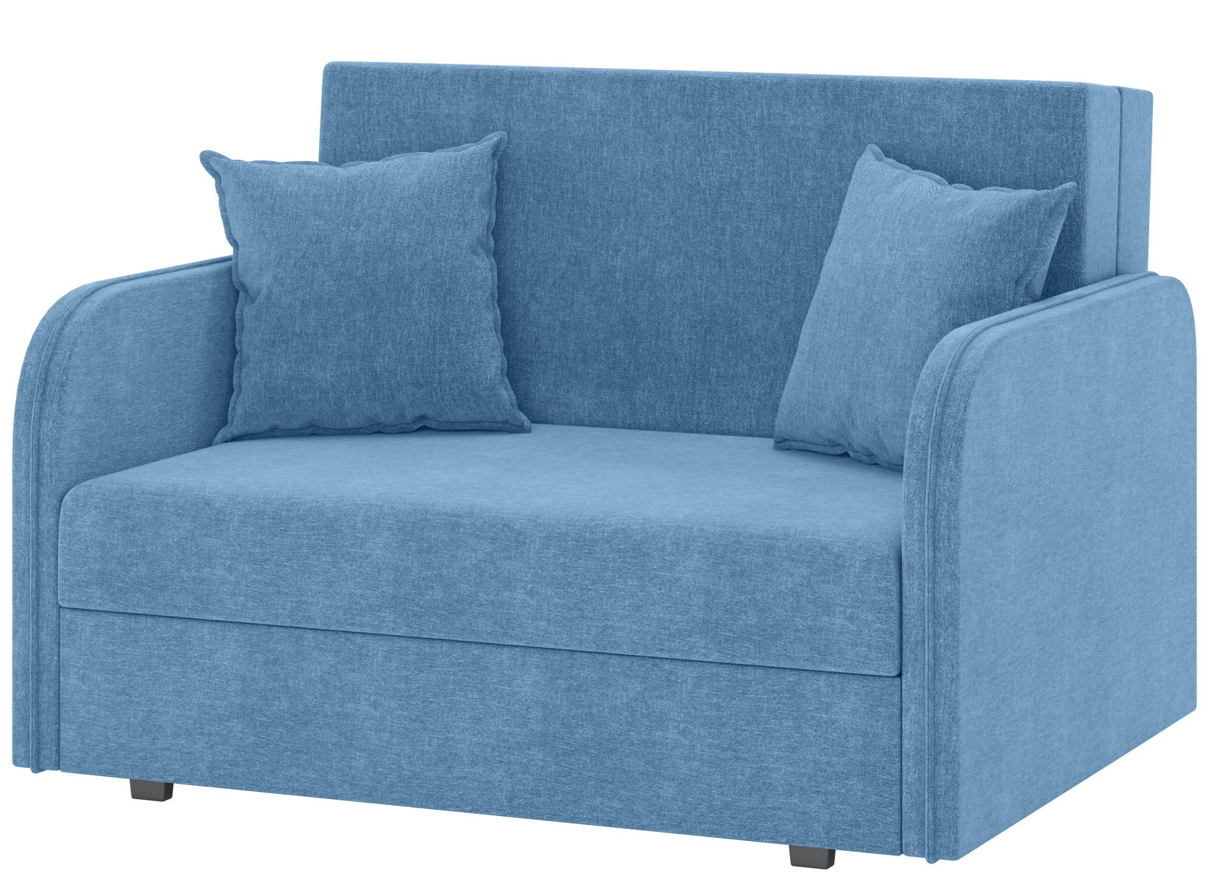
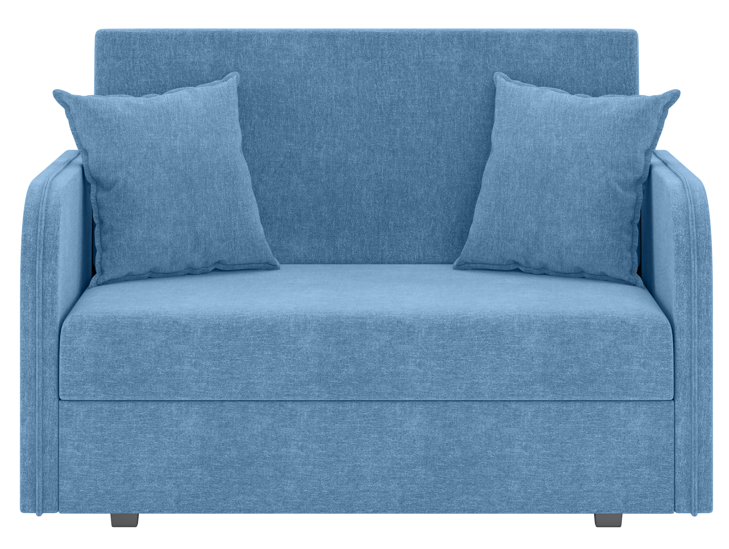
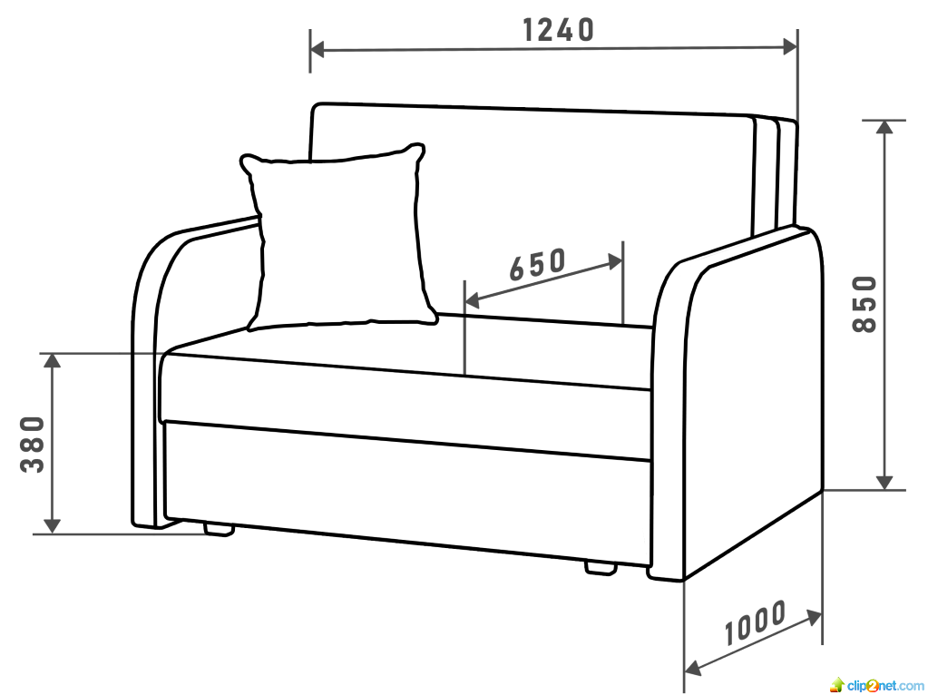
Anri – Sofa-bed

