Slide 1

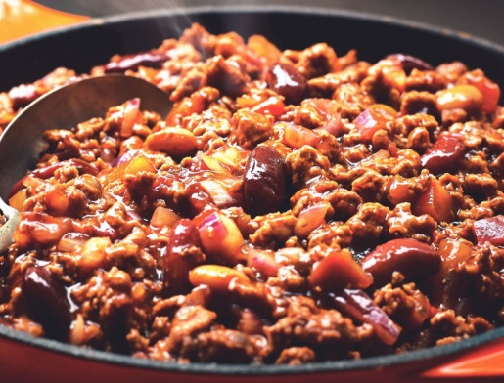
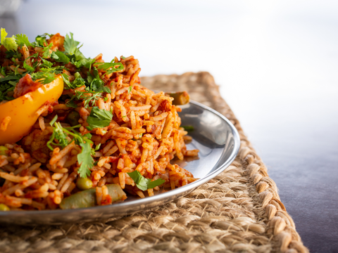
The Joy of Soy
Rice & Pasta Soy Meal Presentation

Slide 2
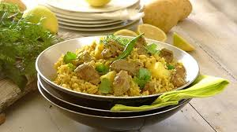
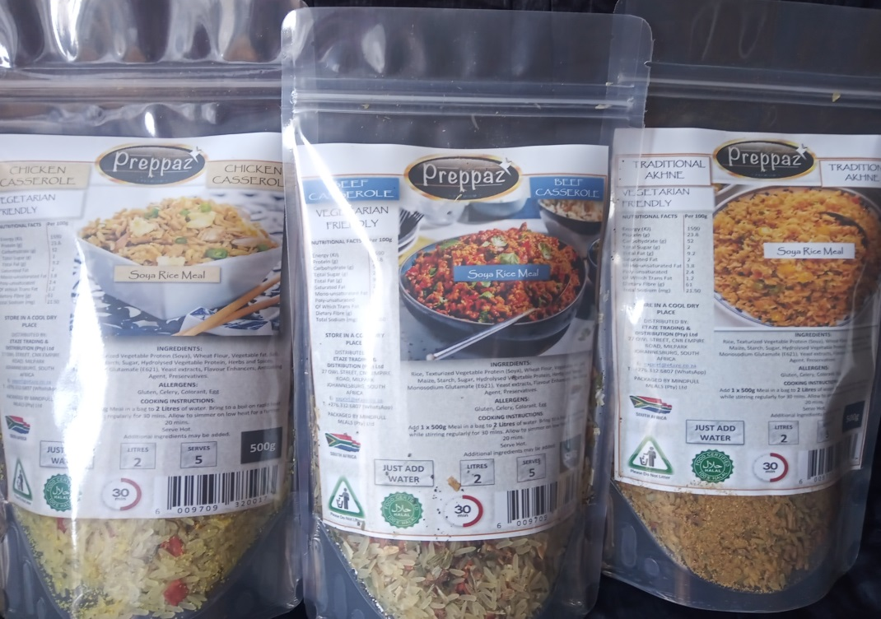
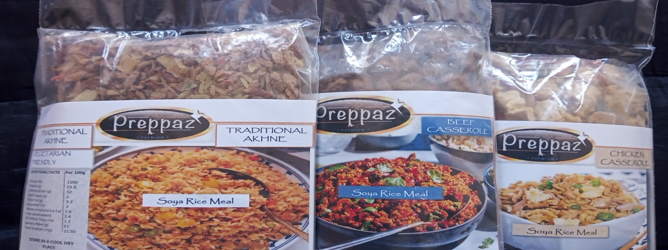
Soy Meal
Traditional Akhni
Beef Casserole
Chicken Casserole
Chicken Pasta
Clear Plastic Packaging
Stand Up Pouch Packaging

Slide 3
Product Description
PRODUCT DESCRIPTION (LSM 1- 4 & LSM 5)
SOY MEALS (RICE & PASTA - Just Add Water)
A COMBINATION OF FRAGRANT RICE, SOYA AND DEHYDRATED FRESH VEGETABLES WITH A DASH OF SECRET FAMILY SPICE & SEASONING.
Preppaz® PREMIUM FAMILY SOY MEALS range is filled with wholesome goodness presented in nutritionally balanced family meal packaging sizes between 500g and 1kg, feeding families of 5 or 10 people depending on packaging size.
PRODUCT FEATURES
Vegetarian Friendly |Easy Preparation |Just Add Water |Cooks in 30 Minutes
PRODUCT CERTIFICATIONS
Halal Certified
PACKAGING SIZES
500g – feeds a family of five people @USD $0,35c per 100g serving
1kg – feeds a family of ten people @USD $0,32c per 100g serving
5kg (by order request)
12 kg (by order request)

Slide 4
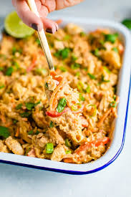
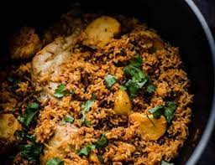
Soy Meal Dishes
Mouthwatering Flavours
Traditional Akhni Casserole
Chicken Casserole
Beef Casserole
Tomato Casserole
Seafood Casserole
Chicken Pasta
Seafood Pasta
Beef Tomato Pasta
Packaging Sizes
500g, 1kg,
5kg and 12kg bulk packaging

Slide 5
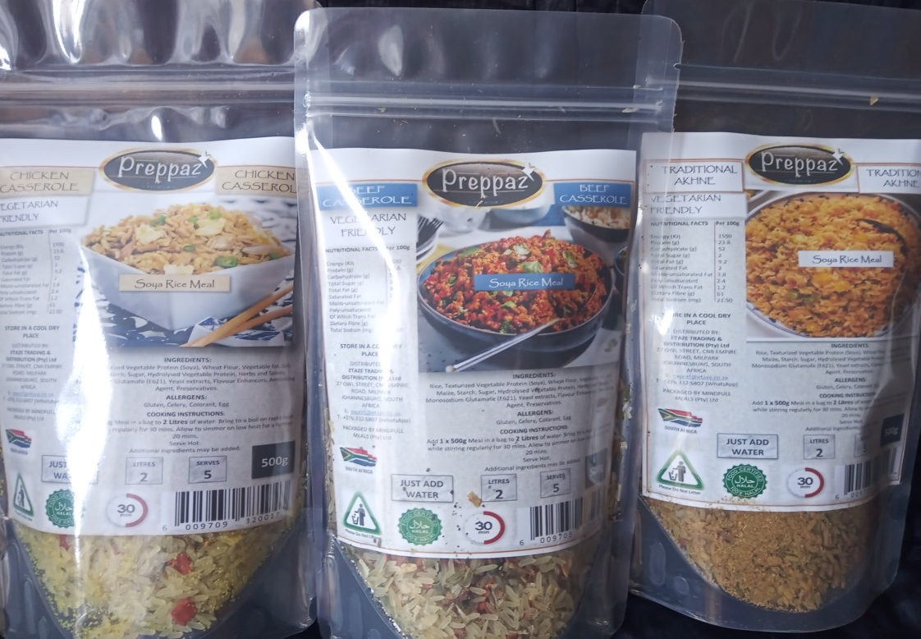
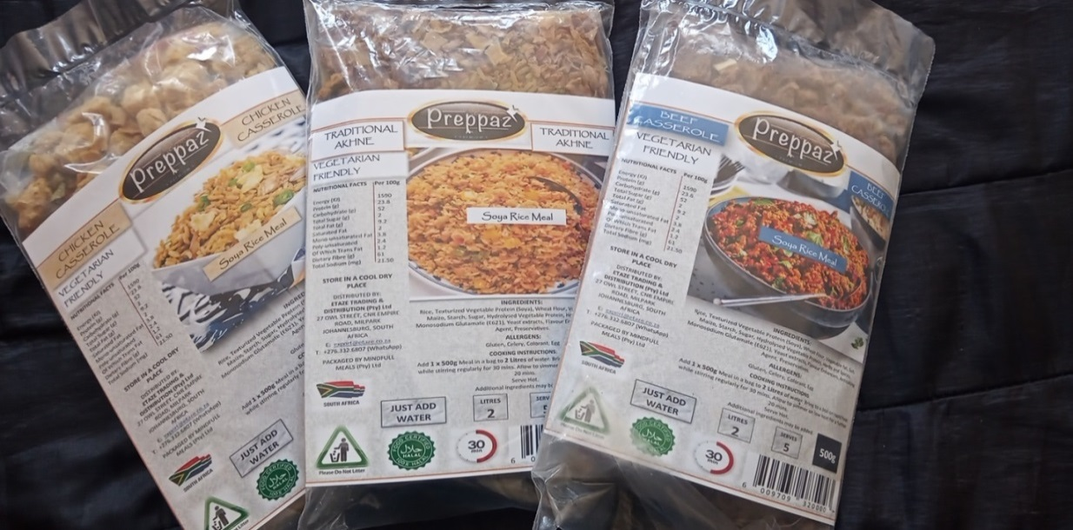
Packaging
Soy Meal Soy Meal Soy Meal Soy Meal Soy Meal
Available Sizes:
500g & 1kg

Slide 6
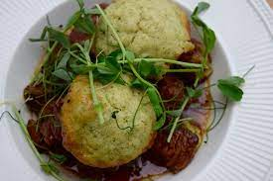

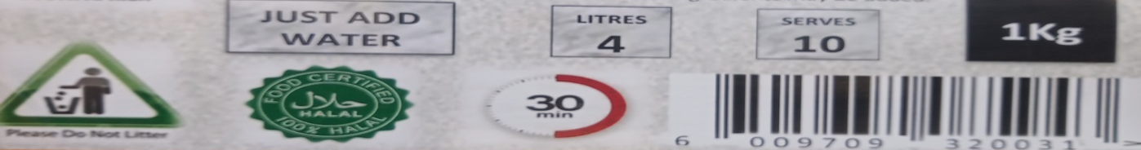
Quick Preparation
Just Add Water just add water Just Add Water just add water Just Add Water
Easy Preparation
Just add water to contents in a pot as indicated, as per packaging size
Bring to boil for 30 minutes while stirring regularly
Leave to simmer for another 20minutes before serving

Slide 7
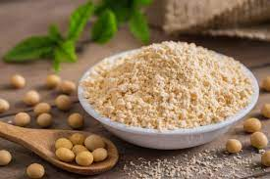


Contact Details
Contact Information
A.J. Isaacs
E: info.isaresource@gmail.com
M: + 2778.294.5363

