Slide 1


COMPANY OVERVIEW

Slide 2
ABOUT THE COMPANY:
Established in 2003 under the expertise of Mr. Inderjit Sachdeva & Started manufacturing Copper and Aluminum Wires
In 2007 started to manufacture Nickel Plated Wires with the involvement of Mr. Ashish Sachdeva & In 2008 Registered under MSME Company
In 2010 we became a certified vendor for Philips India Ltd.(VLF & MLF)
In 2017 became certified and sole supplier for Surya Roshni ltd(KSP) for Special Alloy & Strand wires.
In 2018 installed manufacturing unit of Wire Harness and Wires & Cable along with In house Lab testing facilities
In 2019 company became ISO 9001:2015 Certified company
In 2013 developed HID Frames with the in-house development of its machine )
In 2021 Added more advanced Wire & Cables Manufacturing facilities & taken BIS License for manufacturing of wires
In 2022 Developed Linear Heat Sensing & started supply to various Indian Steel, Cement & other industries
In 2024 Expand our business to Indian & Overseas market in multiple Industries Steel, Cement, Pharma, Lighting, Automobile , Govt. Organizations. & many more sectors.
In 2025 Applied for UL certification for our special wire,

Slide 3
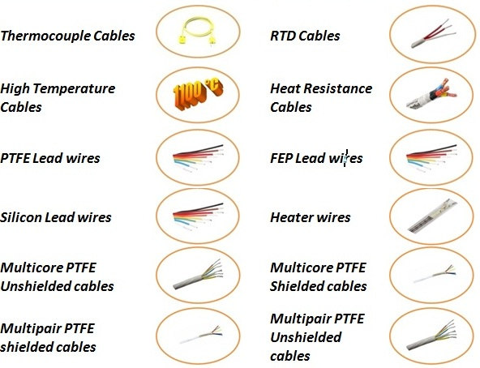
PRODUCT RANGE:

Slide 4
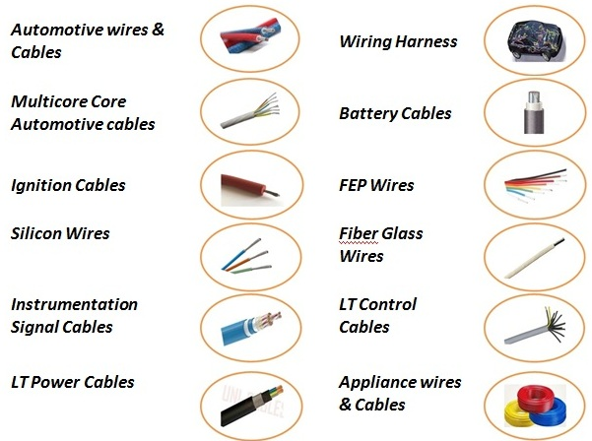

Slide 5
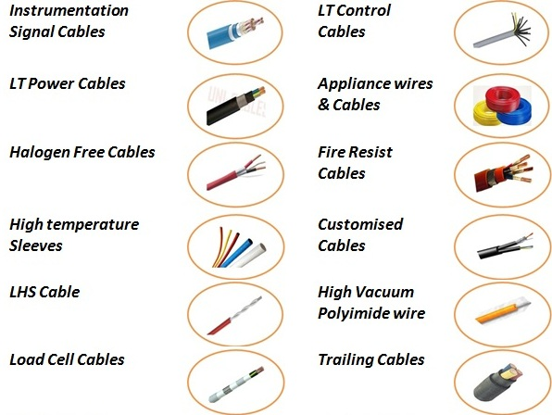

Slide 6
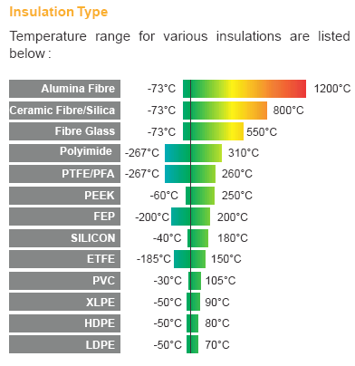
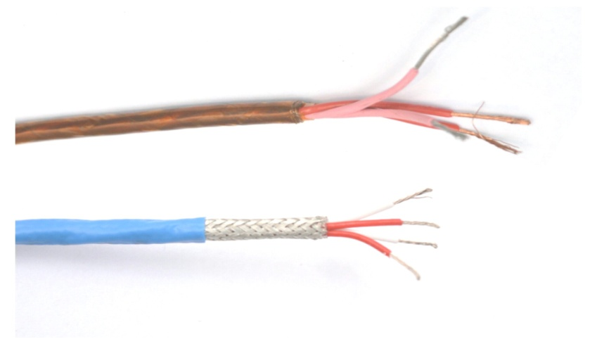
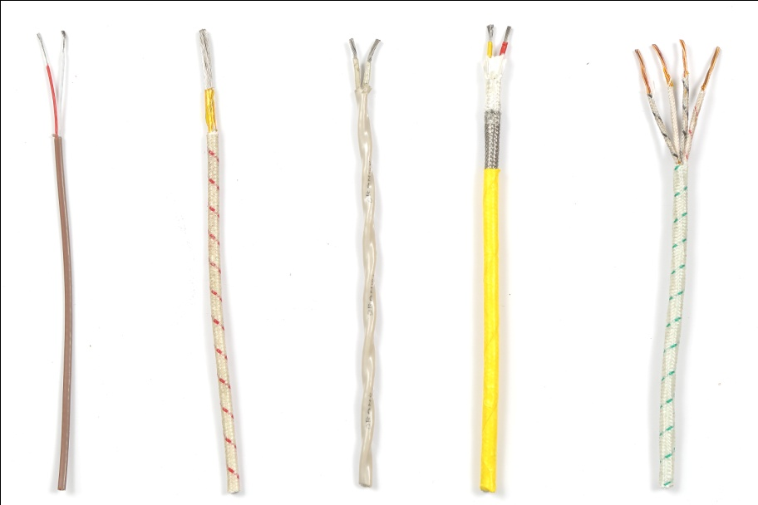
High Temperature Cables
Choosing the right high temp cable for high-heat environments reduces unnecessary replacements and avoids downtime. We offer a variety of products with woven glass-braid jackets, ceramic yarn, alumina yarn and fluoropolymer insulation to handle continuous temperatures from +150 °C to 1100°C. The high temperature products from A&A Alloy include instrumentation & control cable, thermocouple extension wire, heat resistance power cable and variety of high temperature sleeves.

Slide 7
PTFE & Polyimide Wires & Cables
We offer variety of standard and custom PTFE/Polyimide insulated wires and cables as per Indian defence & Military standard.
MIL Style No | Cable Design | Conductor Material | Temp.Range (°C)
MIL-27500-H / JSS 51038 | PTFE Multicore/Multipair Shieled & Unshielded Cables | SPC | 260
MIL-16878 / JSS 51034 | PTFE LEAD WIRE, 250V/600V/1000V | SPC | 260
MIL-JSS 51038 | Polyimide Wires | SPC | 200
MIL-DTL-22759/80 | PTFE/polyimide/PTFE tape and PTFE tape (light weight) | TPC | 150
MIL-DTL-22759/81 | PTFE/polyimide/PTFE tape and PTFE tape (light weight) | SPC | 200
MIL-DTL-22759/82 | PTFE/polyimide/PTFE tape and PTFE tape (light weight) | NPC | 260
MIL-DTL-22759/83 | PTFE/polyimide/PTFE tape and PTFE tape | SPC | 200
MIL-DTL-22759/84 | PTFE/polyimide/PTFE tape and PTFE tape | NPC | 260
MIL-DTL-22759/85 | PTFE/polyimide/PTFE tape and PTFE tape | TPC | 150
MIL-DTL-22759/86 | PTFE/polyimide/PTFE tape and PTFE tape | SPC | 200
MIL-DTL-22759/87 | PTFE/polyimide/PTFE tape and PTFE tape | NPC | 260
MIL-DTL-22759/88 | PTFE/polyimide/PTFE tape and PTFE tape | TPC | 150
MIL-DTL-22759/89 | PTFE/polyimide/PTFE tape and PTFE tape | SPC | 200
MIL-DTL-22759/90 | PTFE/polyimide/PTFE tape and PTFE tape | NPC | 260
MIL-DTL-22759/91 | PTFE/polyimide/PTFE tape and PTFE tape (light weight) | SPC | 200
MIL-DTL-22759/92 | PTFE/polyimide/PTFE tape and PTFE tape (light weight) | NPC | 260

Slide 8
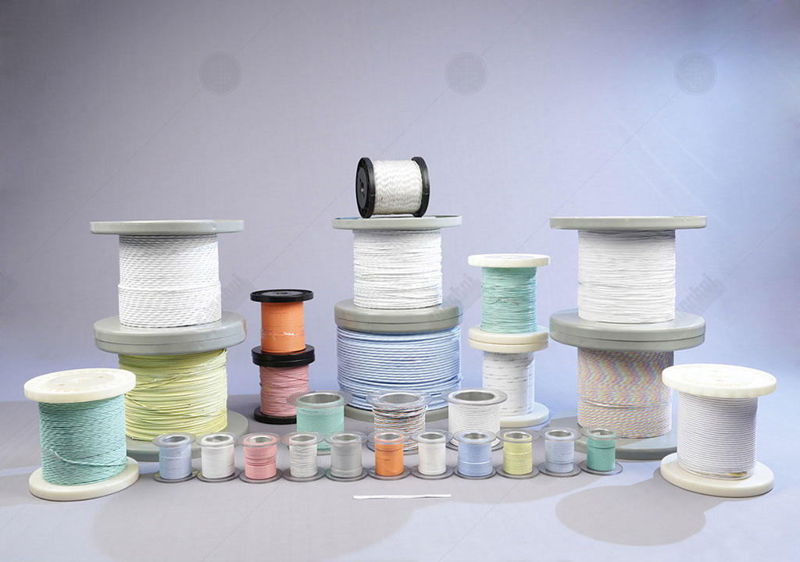
PTFE & Polyimide Wires & Cables

Slide 9
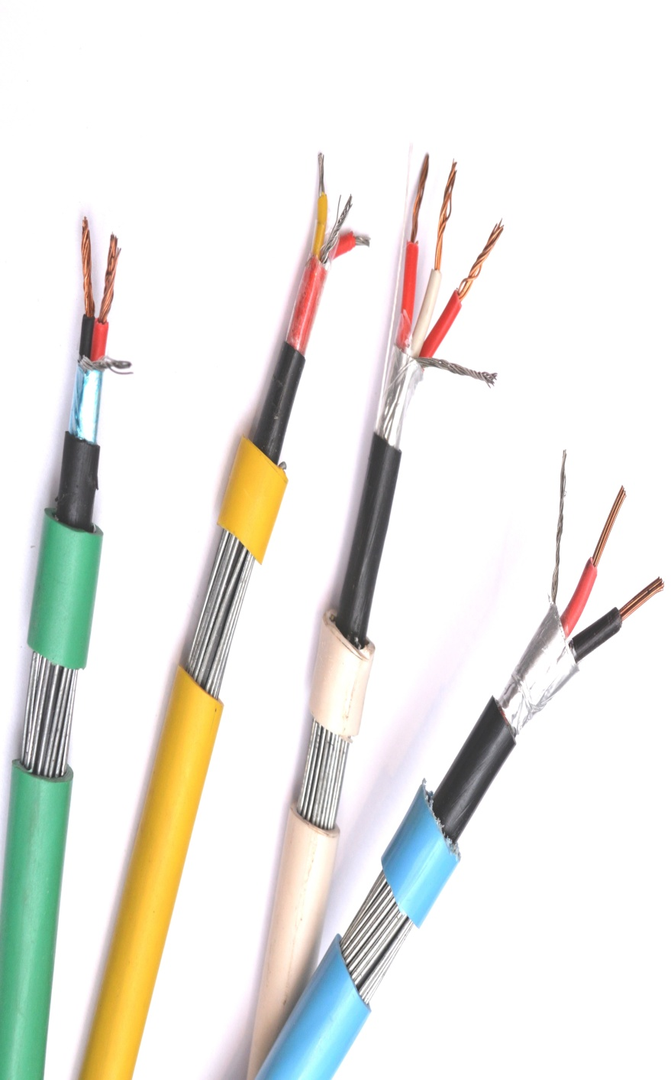
Control & Instrumentation Cables
Control cables are used for encoder/resolvers, flow meters, pressure meters, instrumentation, programmable limit switches, programmable controllers, load cell monitors and much more. Instrumentation cables are used in data acquisition systems, computer networking, PA systems, digital control / measuring & communication systems.
Category
Multicore/Multipair Unarmoured
Multicore/Multipair Shielded Armoured
Multicore/Multipair Shielded Un Armoured
Multicore/Multipair Armoured

Slide 10


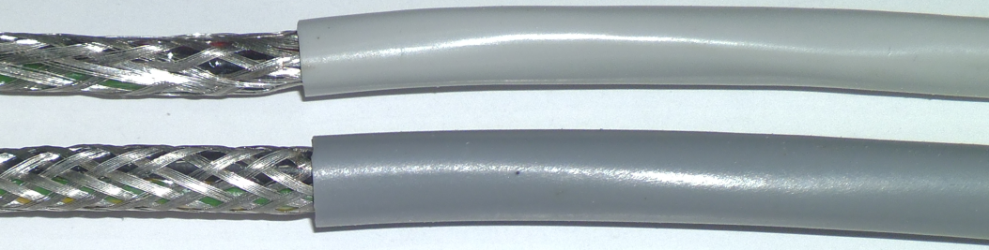
- Instrumentation Braid Screened Cables
Types of Braid screen cables
Single braid screen
Double braid screen
Of the above mentioned the Double Braid
screen performs the best at is shields the
signal carrying cores from any outward
Interference
But in all such case the screens have to be
necessarily grounded at the ends
Coverage provided up to 90%
Construction available LiYCY
Conductor Sizw : from 0.50 Sqmm =>4.0 Sqmm
No of Core : 2 =>48
Min Bending radius – 6D
Voltage range – 300/500V

Slide 11
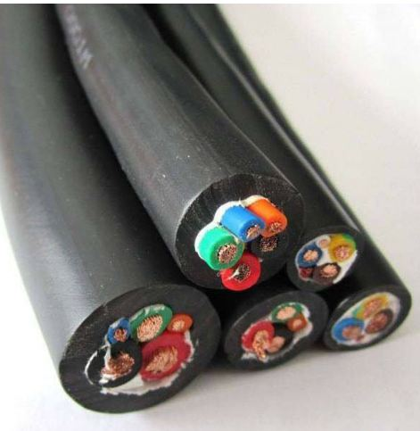
- Elastomeric Rubber Insulated Cables
Types of Cables
EPR Rubber Insulated & PCP Sheathed flexible Cords
EOT Cranes & Festoon Trailing Cables
Silicon Rubber Wires 200 Deg C
Silicon Rubber Insulated Multicore Shielded/Unshielded Cables 200 Deg C
Neoprene Rubber & TRS Rubber Cables
Welding Cables
Technical Specs :
Voltage Grade : Up to 1100V
Temperature Range : 90 Deg C, 200 Deg C
Bending Radius : 4 X OD
Application :
Wire Harness
Steel Plant (EOT Cranes, Festoon applications & Power applications)
Lighting Application
Thermocouple Cable connections wires

Slide 12
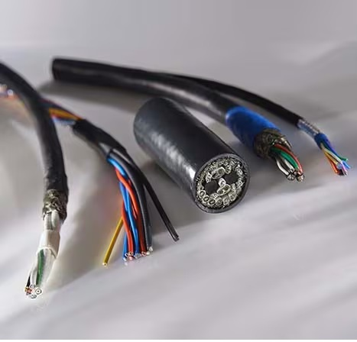
- SPECIAL LFH CABLES
We manufacture special application LFH cables. These are manufactured with using Limited Fire Hazard (LFH) insulation and sheath materials.
TECHNICAL SPECIFICATIONS
Type : Screened & Unscreened Cable
Voltage Grade : Up to 600V
Insulation & Sheath : Special LFH Insulation material (Limited Fire & Low smoke & Zero Halogen Material)
Screening : Braided Tinned Copper Screened
Special Features:
Low smoke Emission
Zero Halogen Free
Lower Weight & Compact Size
Low Toxicity
Voltage Grade up to 600V
Environmental Friendly
Applications:
Military
Marine Application
Radar
Missile launching system
Naval system

Slide 13
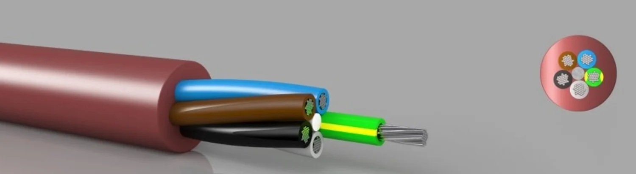
- Halogen free (HFFR / LFH /ZHHR CABLES)
Types of Cables:
Halogen Free & Flame retardant low smoke wire & cables are manufactured for special applications.
Temperature range : 90°C, 125 °C
Voltage Grade : 300V, 600V & 1000V
Standards used : IEC 60754-1, IEC 60332-1, IEC 60332-3, ASTM D 2843, ASTM D 2863
Type of Design : Single / Multicores
Type : Shielded / Unshielded Type
Option : Armoring on request available
Advantage over normal wires :
Very Low toxic gases & halogen gases emits that can help very much to escape under fire conditions.
Fire retardant properties self extinguish the fire after a short period.
Very low smoke generate under fire conditions.

Slide 14
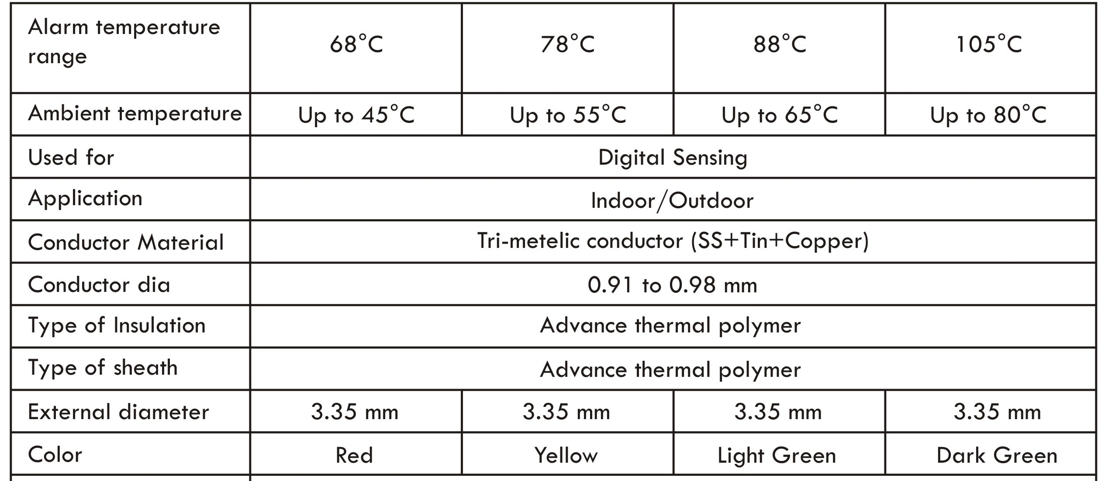
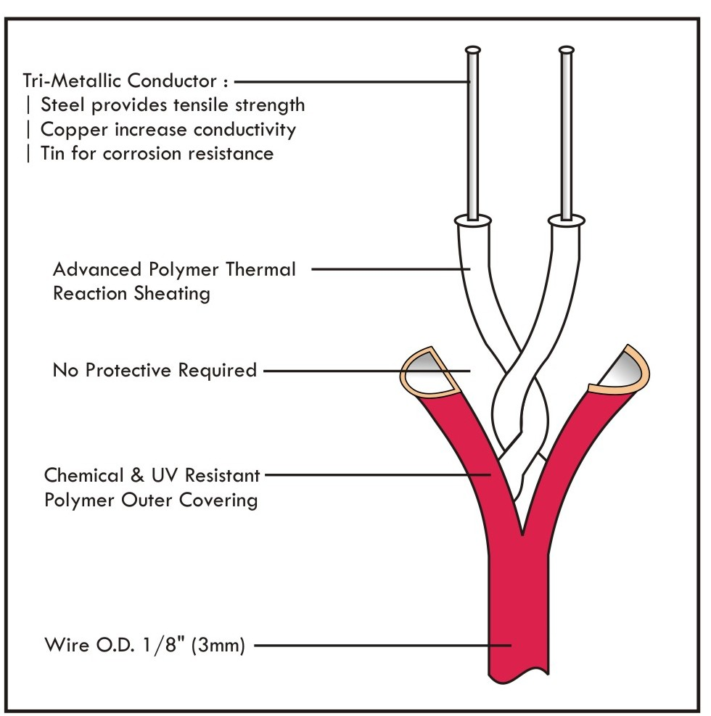
- Linear Heat Sensing Cables
Linear heat sensing cables is used to detect the fire condition in critical applications.

Slide 15
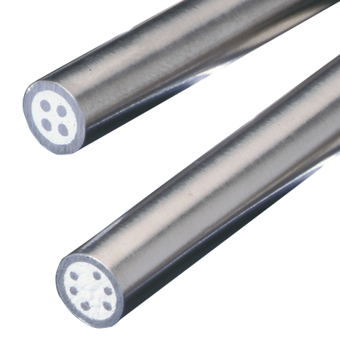
- Mineral Insulated Cables
A Mineral insulated cable (MI cable) is a specialized type of cable used in high temperatures or harsh environmental conditions because it has low flammability, even when operating at high temperatures
Technical Specifications
Conductor Wire : Thermocouple alloys, Copper, Nickel & others.
Insulation : MGO (Magnesium Oxide)
Metal Sheath : SS 304,310,316, Inconel 600
Cable Dimensions : 2,3,4,6,8 or as required
Application:
Thermocouple (K,T,J,E,N Simplex/Duplex)
RTD MI Cable (with Copper, Nickel copper conductor)
MI Heater
Customized Application for used in Harsh environment

Slide 16
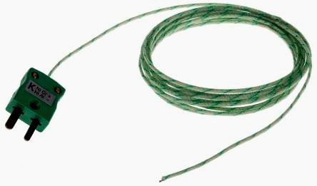
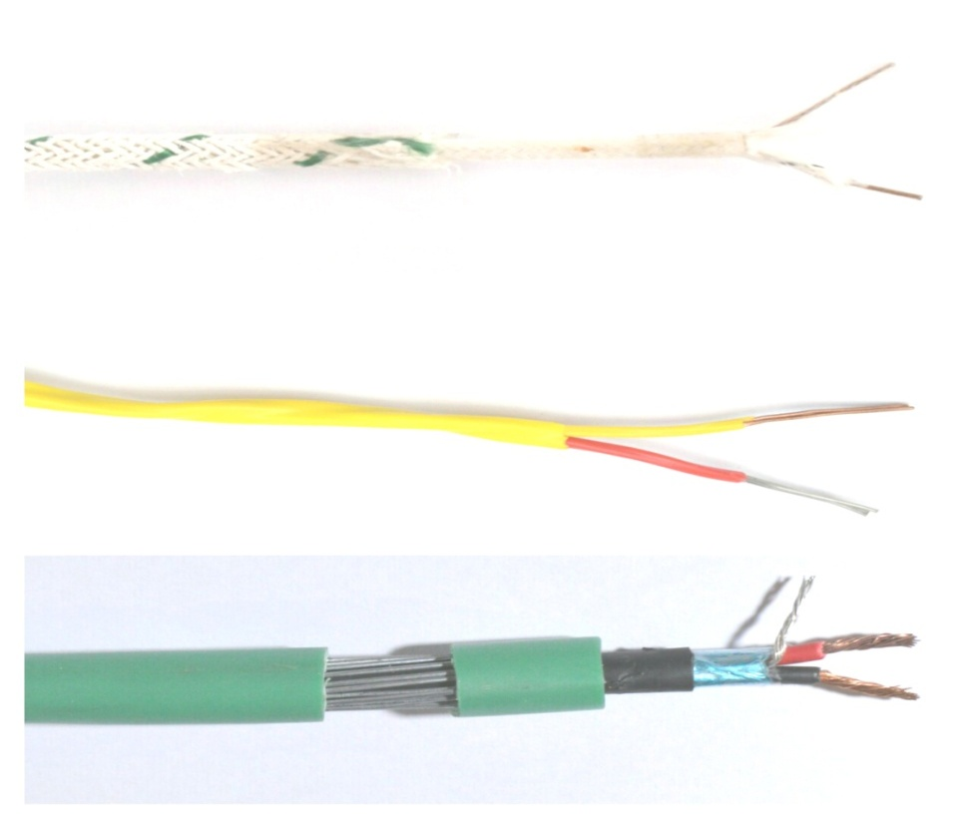
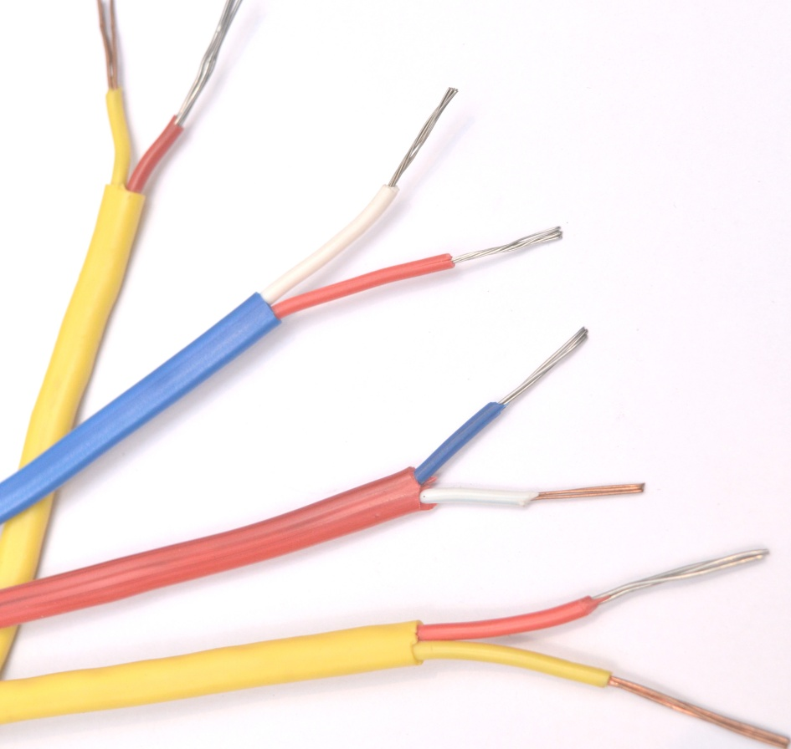
- Thermocouple Cables
Thermocouple cable is available in thermocouple grade, extension grade & compensating grade. Extension & compensating grade wire is recommended for use in connecting thermocouples to the sensing or control equipment. Whereas thermocouple grade wire is used to measure the temperature directly.

Slide 17
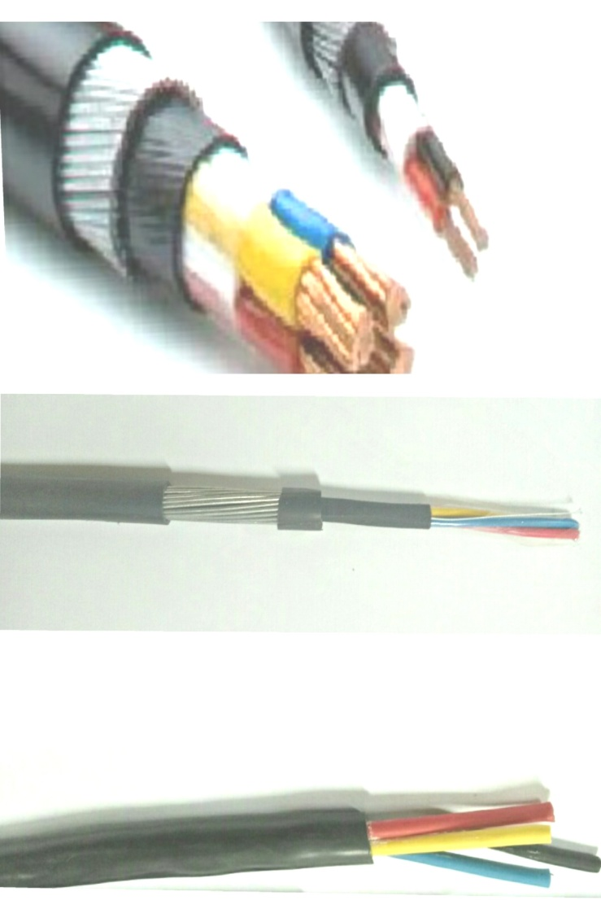
Power Cables
Power cables are used in connection of power supply in power plant, residential, commercial & industrial units, these are mainly confirming to IS 1554, IS 7098 & IEC 60502-1 standard.
High temperature option is also available in power cable with PTFE, FEP, Silicon & Fiber glass insulation.
Special Features
Available with Single / Multicores
Available with Solid / Flexible Bare Aluminium Copper, Silver Plated Copper & Nickel Plated Copper Conductors
Armoured/Unarmoured
Better selectivity of insulation range up to 600 Deg C as per your application
Voltage Grade selectivity up to 1100 V.

Slide 18
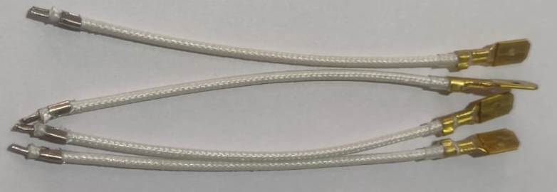
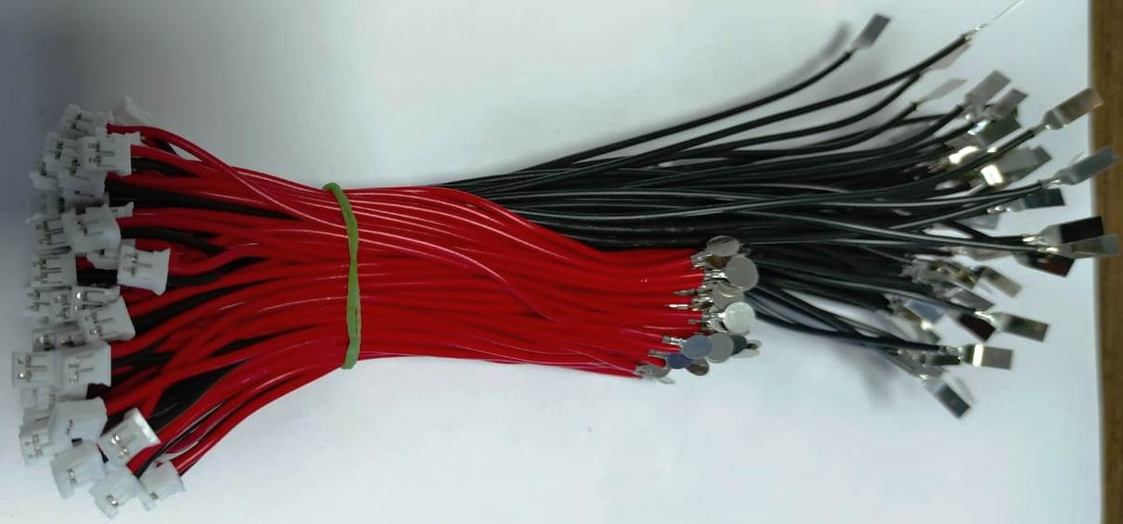
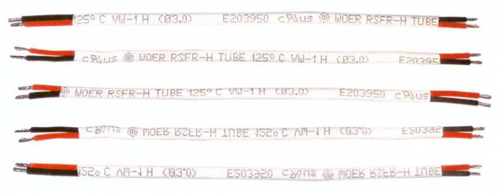
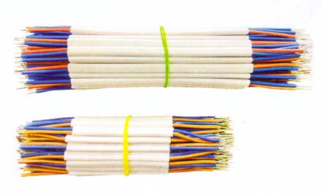
WIRE HARNESS
We are providing wiring harness solution to Automotive
& LED lighting industries.
Cables Used in wiring harness (Max 400 Deg C):
Halogen Free Wires HR PVC 105 Deg C
Flame retardant wires Silicon Wires
Cross linked Polyethylene Wires Fiber Glass Insulated Wires

Slide 19
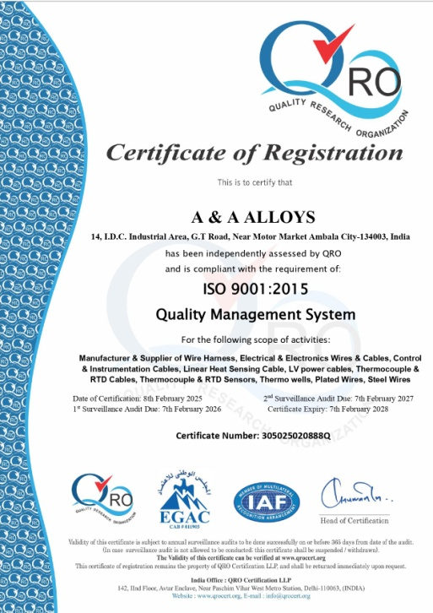
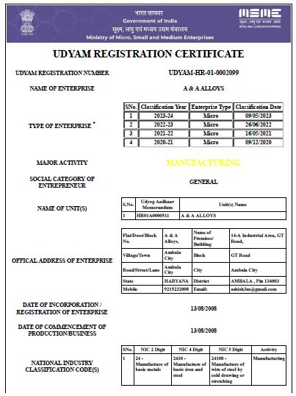
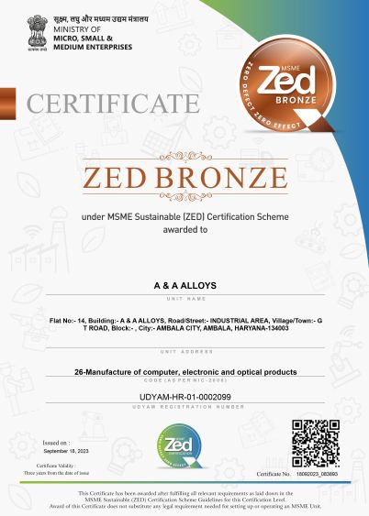
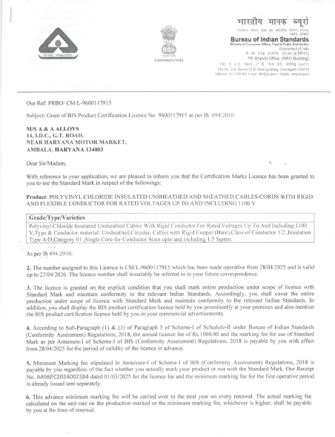
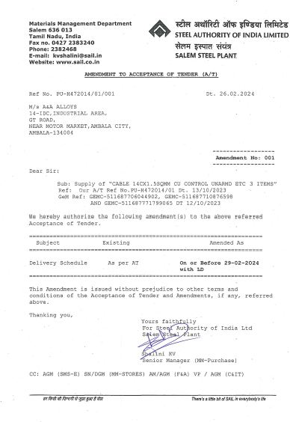
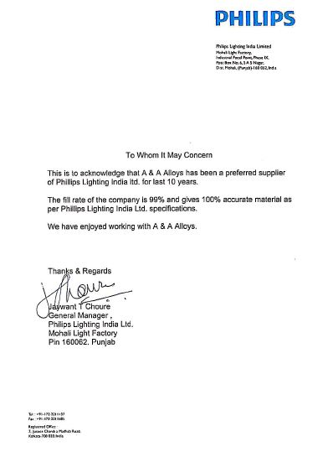
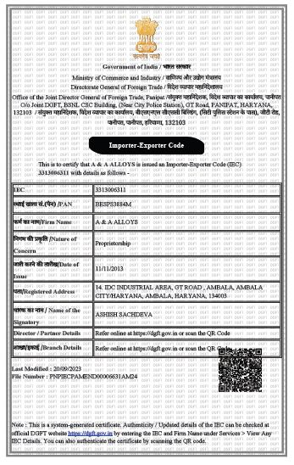
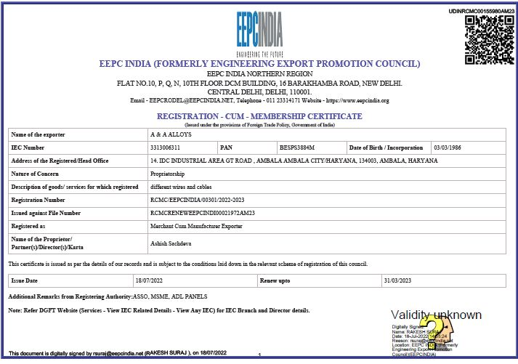
A&A ALLOYS
AN ISO 9001:2008 CERTIFIED COMPANY
CERTIFICATIONS & APPROVALS

Slide 20
































CLIENTELE

Slide 21
OUR VISION
To develop the special cables & promote Make in India products which are imported & used in defense as well as other sectors.
To serve Indian defense sectors for special Light weight wires, Polyimide wires, Linear heat detection cables etc.
To develop special wires & cables for Indian defense, which has only fewer or single supplier such as colored polyimide cables, Fire detector cables etc.
To develop & explore the Wire Harness products among all the industries.
Increase the export of our products up to 50 % of total sales.
Innovation of new products as per customer requirements & market demand
Recognize us as a Top Brand for special cable solution for special applications.

Slide 22

…and we look forward to see you again soon.

