Slide 1

Jiangxi Zhongbo Intelligent Equipment Manufacturing Co., Ltd

Slide 2
1
Company Profile
CONTENTS
Why choose us?
2
CONTENTS
3
Product technology and series

Slide 3
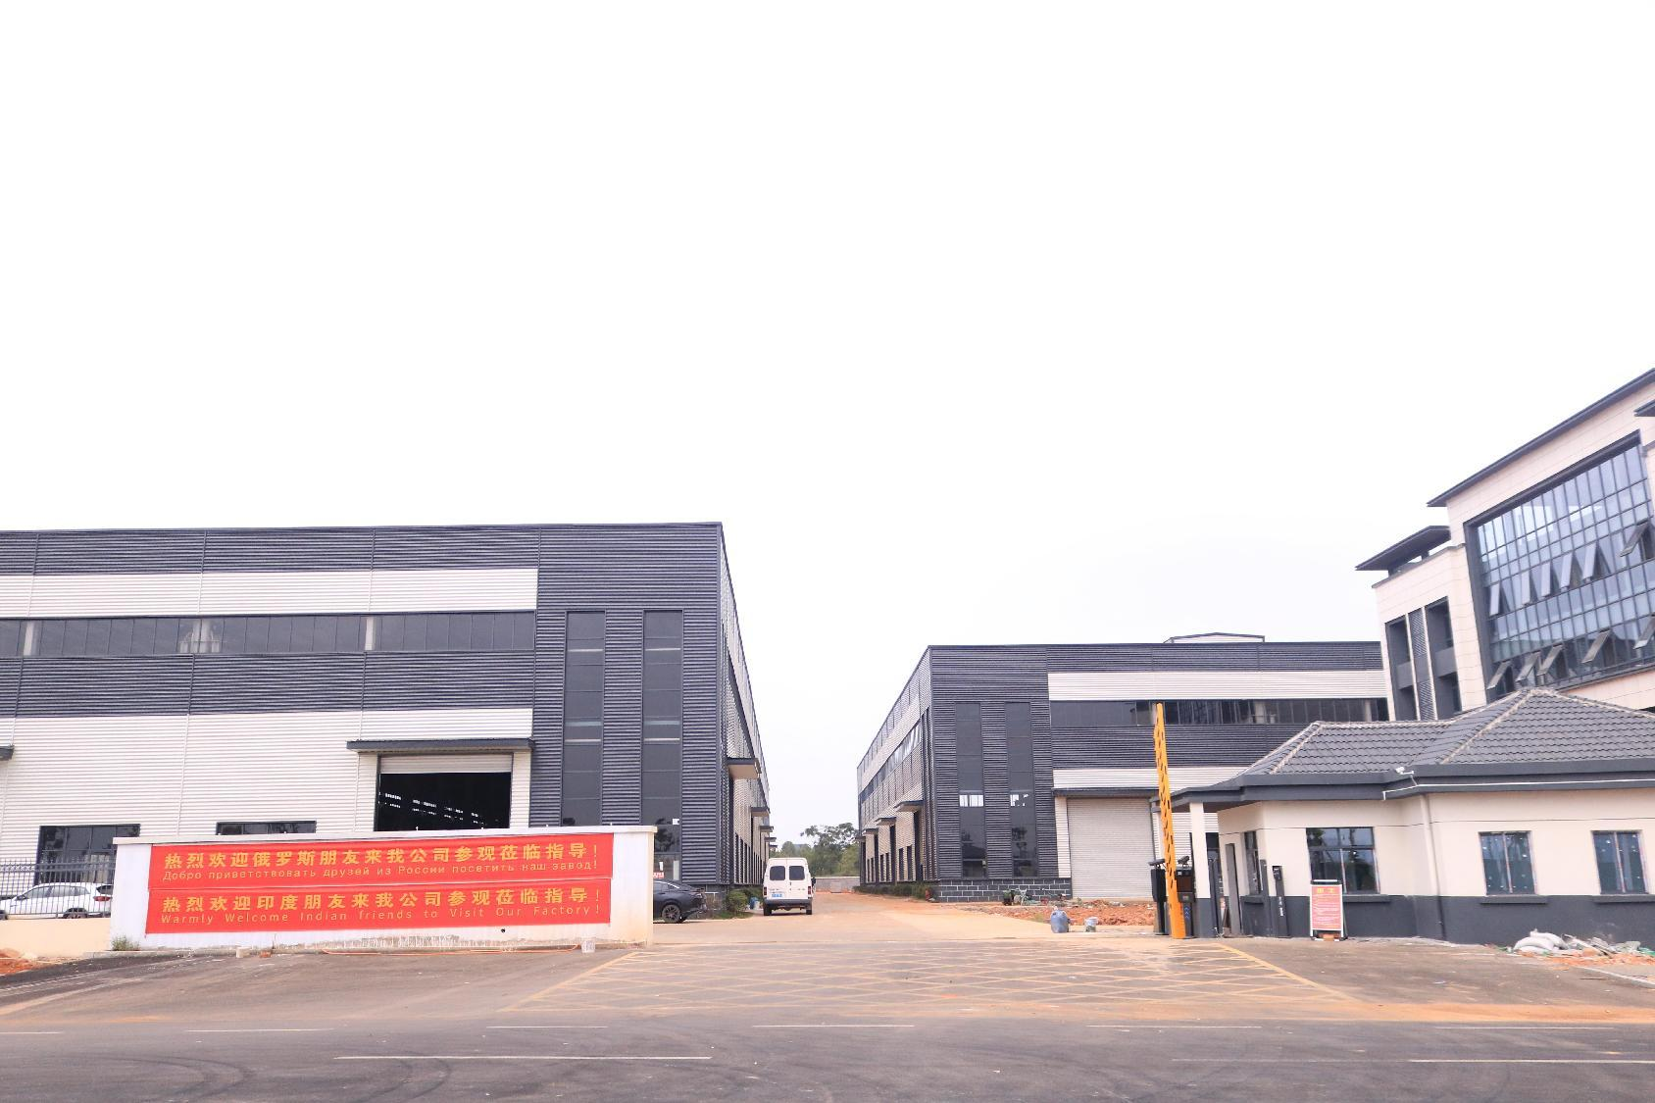
Company Profile
Founded in 2017, Jiangxi Zhongbo Intelligent Equipment Manufacturing Co., Ltd. is a leading high-tech enterprise specializing in R&D, design, production, and sales of advanced intelligent equipment.

Slide 4
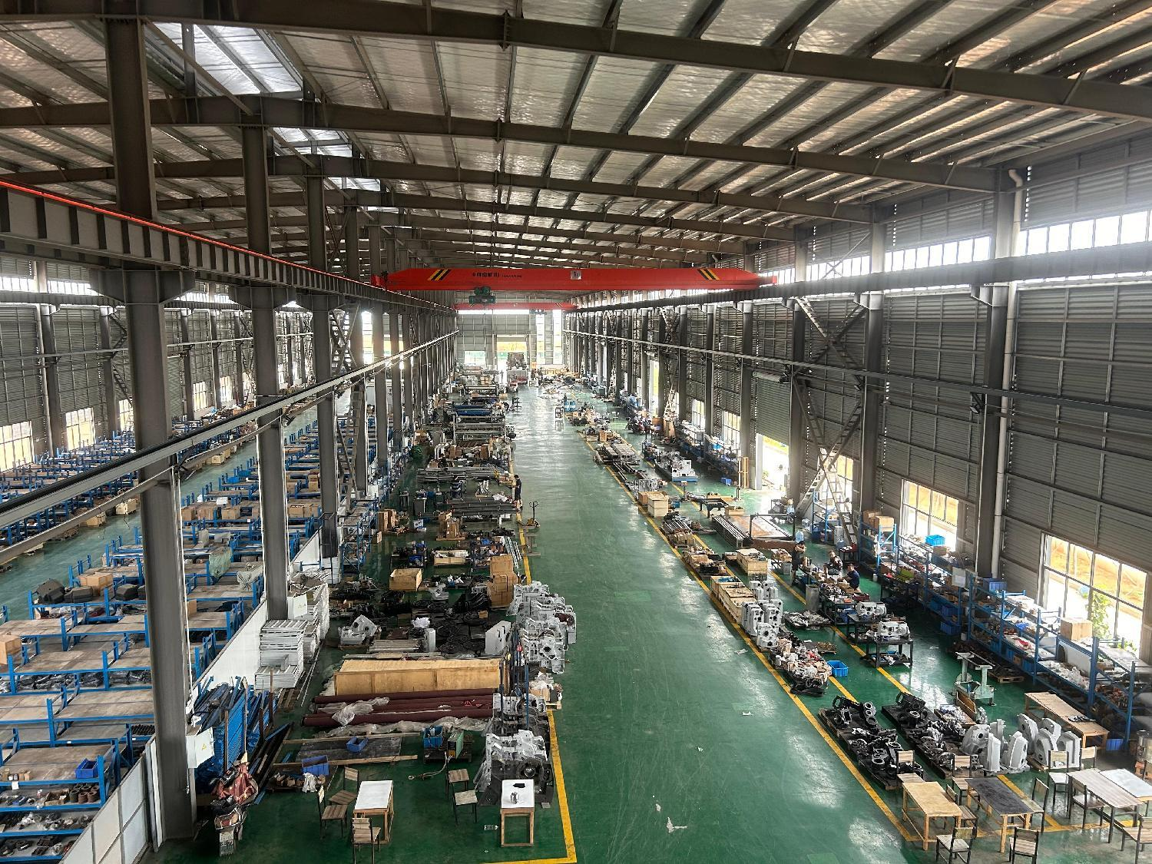
Company Profile
Jiangxi Zhongbo is committed to technological leadership, superior quality, perfect service, and win-win cooperation.
Our series of rapier weaving machines include: Zhenxiang, Jixiang, Shunxiang, Chengxiang, Ruixiang, and Mingxiang (towel machines).
These machines are widely applicable for denim, jacquard, labels, shoe materials, geotextiles, industrial fabrics, fiberglass, carbon fiber, and more. We are dedicated to serving our valued customers.

Slide 5
WHY CHOOSE US?

Slide 6
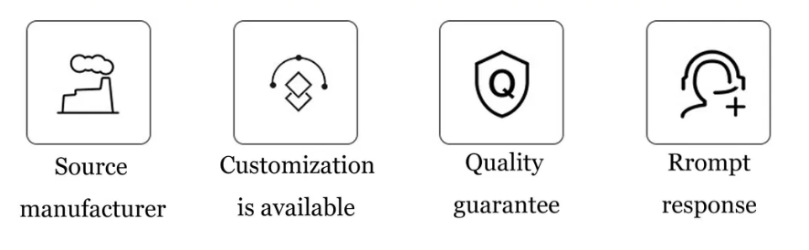

Slide 7
Born in response to the situation
The intelligent loom market is a huge cake, and we have a ready-made technical team, sales channels, procurement system, in such a big background, Jiangxi Zhongbo Intelligent Equipment Manufacturing Co., Ltd. came into being.
Our company is a new type of high-end intelligent equipment enterprise integrating R&D, production and sales.
Our company's main team members are the elite of the textile machinery industry, a collection of mechanical design, electrical design, software development, big data, cloud computing and other fields of talents, and the main members of the team have more than ten years of textile machinery design, manufacturing and rich sales experience.

Slide 8
Born in response to the situation
The company's products include Feilong 68 series rapier loom, Feilong 88 series rapier loom, ZB9000 series air-jet loom, ZB920M series towel loom, ZB920J series jacquard loom.
Weaving products cover denim fabrics, jacquard fabrics, shirt fabrics, industrial fabrics, home textiles, art calligraphy and painting, wall coverings, shoe materials, canvas, towels, bath towels and many other fields.

Slide 9
Product Technology

Slide 10
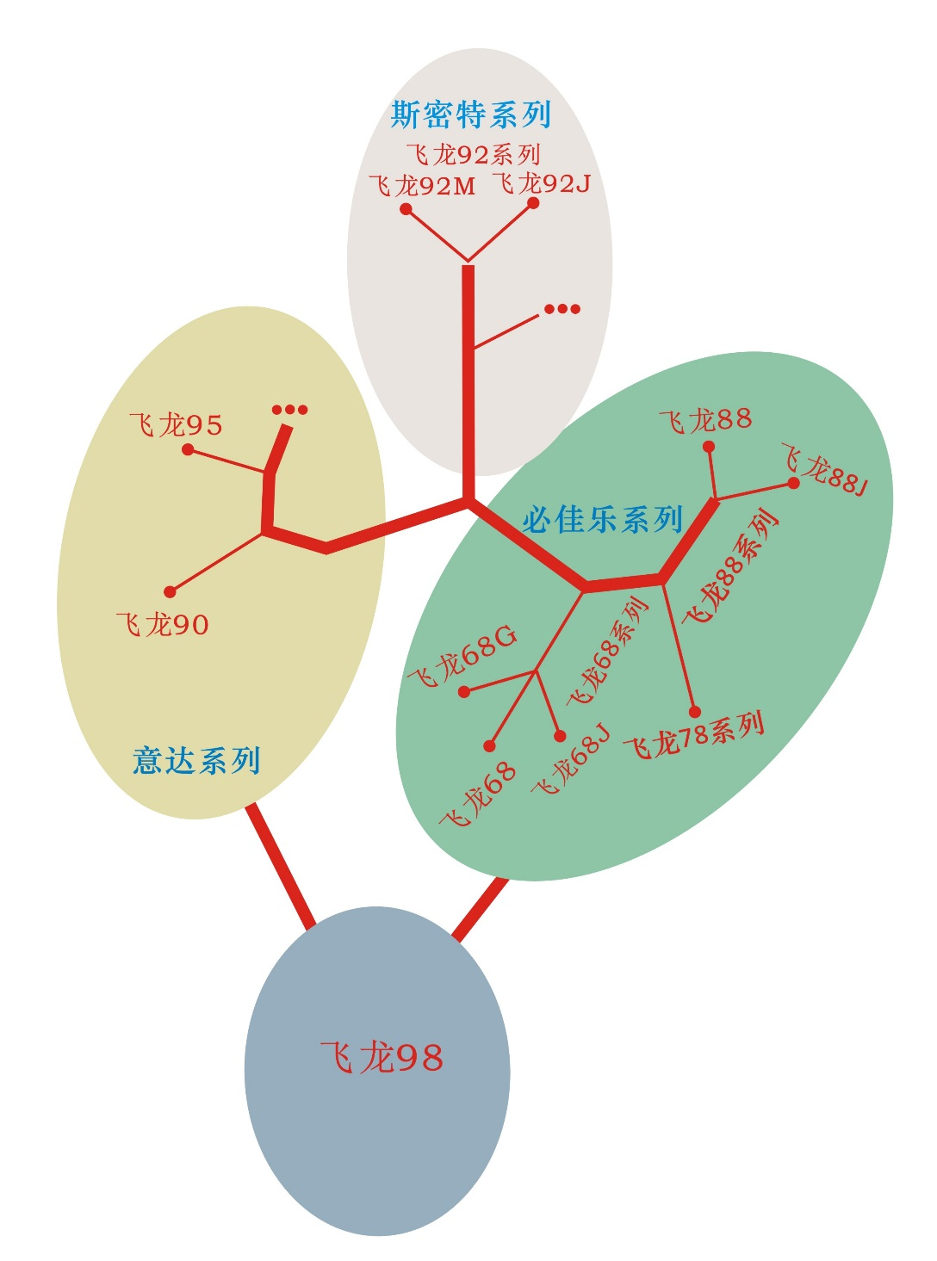
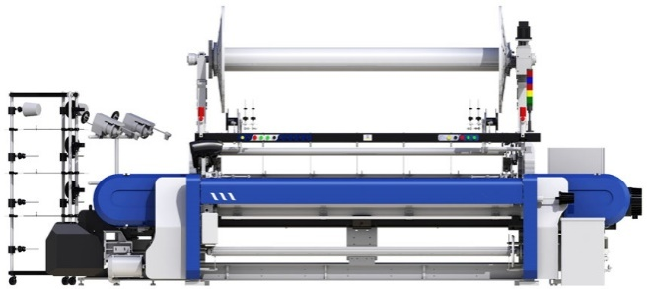
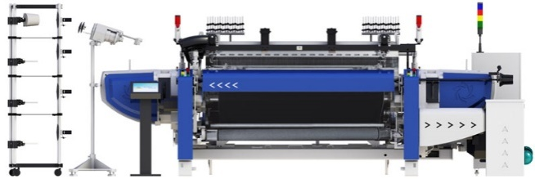
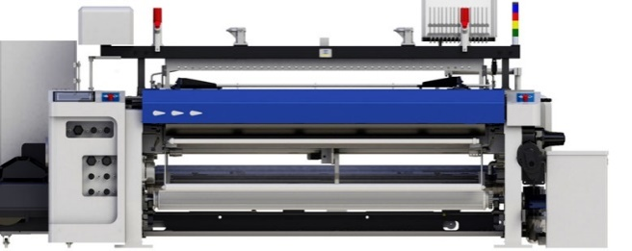
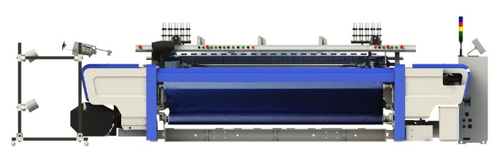
Product Technology
reed width：190.210.220.230.250.280.
300.320.340.360.420.580,600
Intelligent Feilong 92M
Intelligent Feilong92J
Intelligent Feilong 88 model
Intelligent Feilong88J jacquard
Intelligent Feilong 90model airjet loom
Intelligent Feilong 95model rapierloom
Intelligent Feilong 68 model
Intelligent Feilong 68J jacquard
Intelligent Feilong 98 model high speed rapier loom

Slide 11

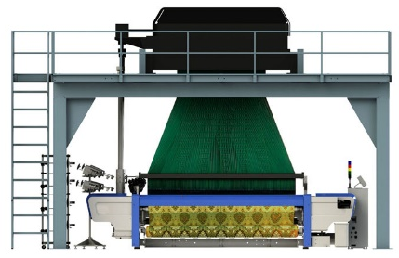
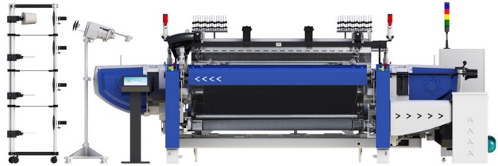
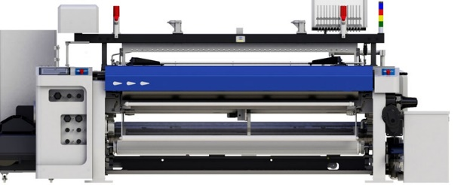

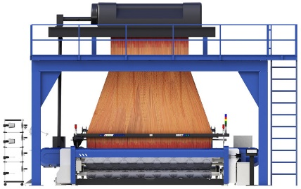
Product series
01
Intelligent Feilong 68 model
Intelligent Feilong 68J jacquard
02
Intelligent Feilong 88 model
03
Intelligent Feilong 90 model
Intelligent Feilong 92M terry towel
Intelligent Feilong 92J jacquard
04

Slide 12
Main features of intelligent loom:
1.The intelligence of the main transmission mechanism
Seq. | Item | Intelligent loom | Traditional loom
1 | driving way | direct driving | Asynchronous motors, flywheels, belts, pulleys, main clutches (starting and braking)
2 | Energy consumption | Energy saving of 20%, output torque according to the actual load | Energy dissipation, constant torque output
3 | Brake way | Cut off the power supply and brake against the electric potential | Clutch brakes
4 | Speed | Set the speed digitally | Replace the pulley to change the speed
5 | Stepping running | Program setting, automatic slow train | The addition of a slow motor, a slow mechanism, and a slow clutch can be realized
6 | weaving way | Variable speed weaving, different strength of weft yarn with different weaving speed, to reduce the weft break rate to a minimum | For weft yarns of different strengths, only the same speed can be weaved, and the weft break rate is high
7 | Starting and braking times | Reach normal speed or from normal speed to stop about 150° | More than 360°
8 | Problem rate | Rarely | There are many sources of faults, and it is easy to fail

Slide 13
Main features of intelligent loom:
2.The intelligence of the coiling mechanism
Seq. | Item | Intelligent loom | Traditional loom
 |  | Electronic take-up | Mechanical coiling
1 | Weft density setting | Digital settings | First, calculate the transmission ratio, the number of teeth, check the table, and replace the number of teeth to determine the approximate weft density
2 | Weaving characteristics | The same variety can be densely woven with variable weft | The same variety can only be densely woven at normal latitude
3 | Maintenance | easy | There's a whole bunch of gear to keep

Slide 14
Main features of intelligent loom:
3.The intelligence of the let-off mechanism
Seq. | Item | Intelligent loom | Traditional loom
 |  | Electronic let-off | Mechanic let-off
1 | Let-off style | Closed-loop control, constant tension let-off | Negative pull let-off Positive continuously variable transmission let-off
2 | Accuracy | The tension does not change from full shaft to small shaft | The tension fluctuates greatly and the error is large
3 | Fabric adaptability | All varieties can be woven | Coarse yarns, conventional varieties, and special varieties cannot be weaved
4 | Maintenance | Low cost | There are many sources of faults and many replacement parts

Slide 15
Main features of intelligent loom:
4.Intelligence of the shedding device
Seq. | Item | Intelligent loom | Traditional loom
 |  | Electronic dobby shedding device | Mechanic dobby shedding device tappet shedding device
1 | Organizational Design | Digital settings or UC interface input | Very long and long grain plate punching, or replacing the cam blade to take up space, the replacement is complicated
2 | Transform the variety | easy and fast | Complex and time-consuming
3 | Fabric adaptability | Any complex fabric design can be done | Only simple, conventional varieties can be made

Slide 16
Main features of intelligent loom:
5.Intelligence of other institutions
①The intellectualization of the color selection mechanism
②The intellectualization of the leno-selvage mechanism
③The intelligence of the weft finding mechanism
④Intelligent synchronous adjustment
⑤Intelligent fault detection
⑥Intelligent production management
⑦Group control networking and online diagnosis intelligence, etc

Slide 17
ZBMAX88 USED IN GLASS FIBER WEAVING

Slide 18

Feilong 88 model rapier loom
3
Technic Data
1. Design speed: 750r/min; The economic speed is 550~600r/min (width 190cm), which has reached the domestic leading and international advanced level.
2. Super motor direct drive mode: to achieve strong start, braking and slow action of the loom, can be used for variable speed weaving, to achieve the purpose of high speed, energy saving and emission reduction;

Slide 19
Feilong 88 model rapier loom
3
Technic Data
3. Adopt electric weft finding or hydraulic weft finding mechanism: cancel the weft finding clutch, slow clutch, slow motor, flywheel, belt, etc. commonly used in traditional rapier looms, reduce the source of failure, reduce the failure rate, and improve the weaving efficiency;
4. The rigid optimized design of the loom makes it more convenient to use and operate, the variety changes quickly, and it has room for development, realizing networking, informatization and intelligent technology.

Slide 20
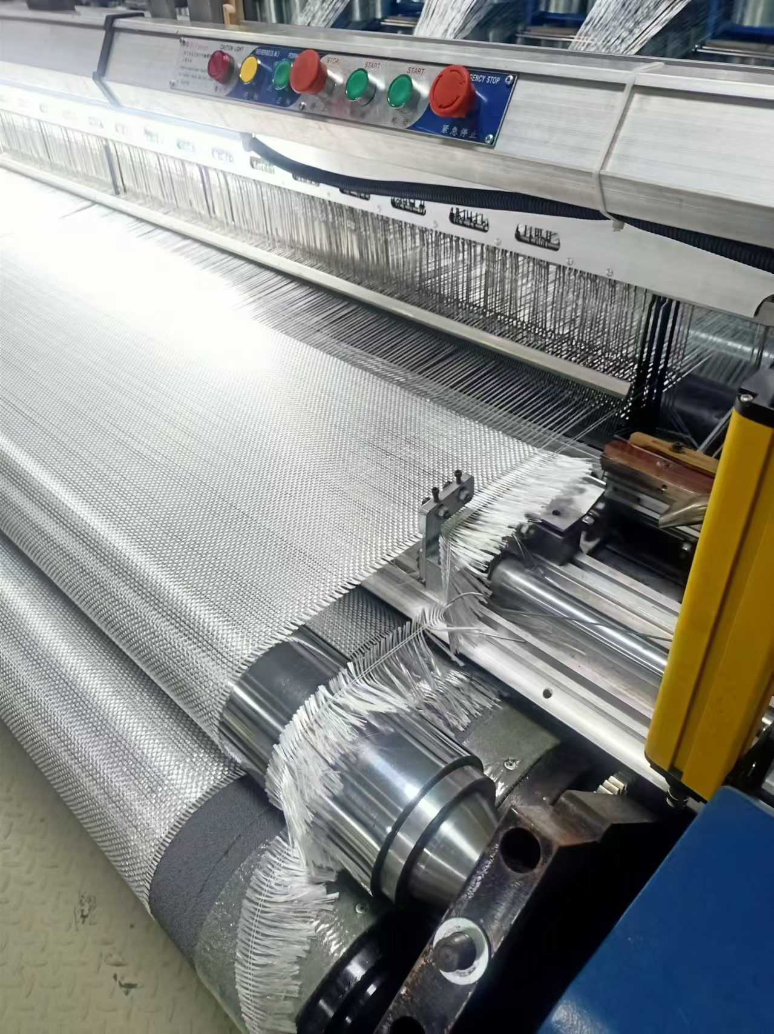
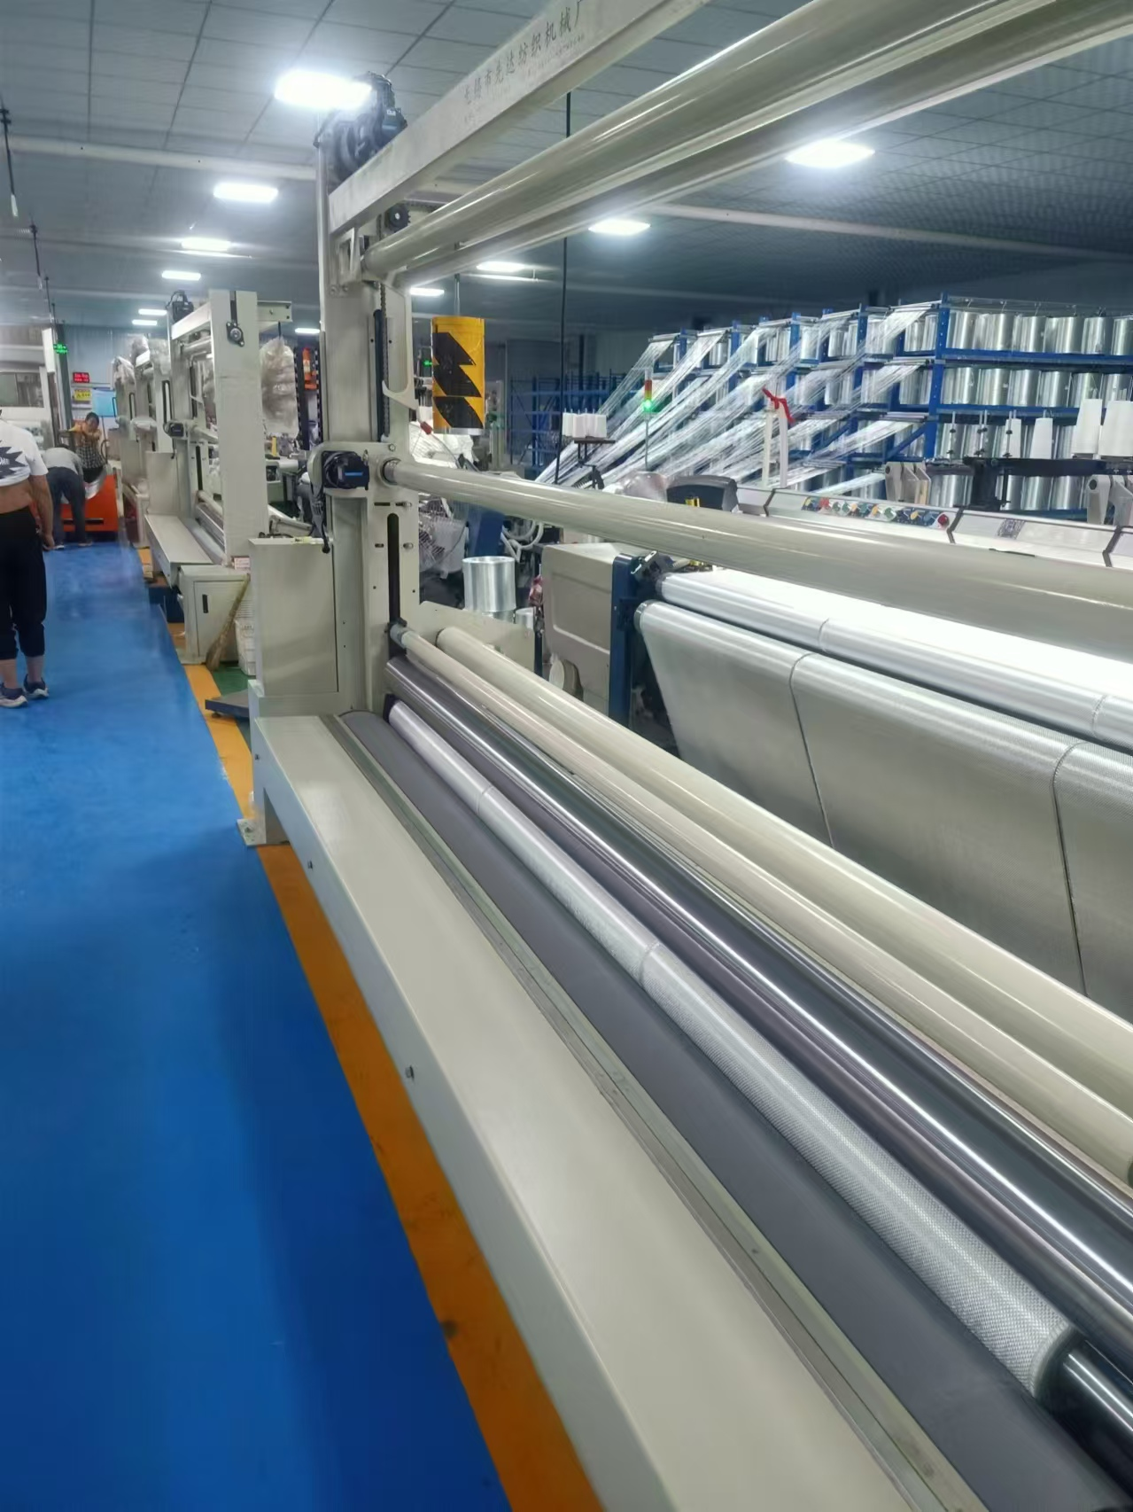
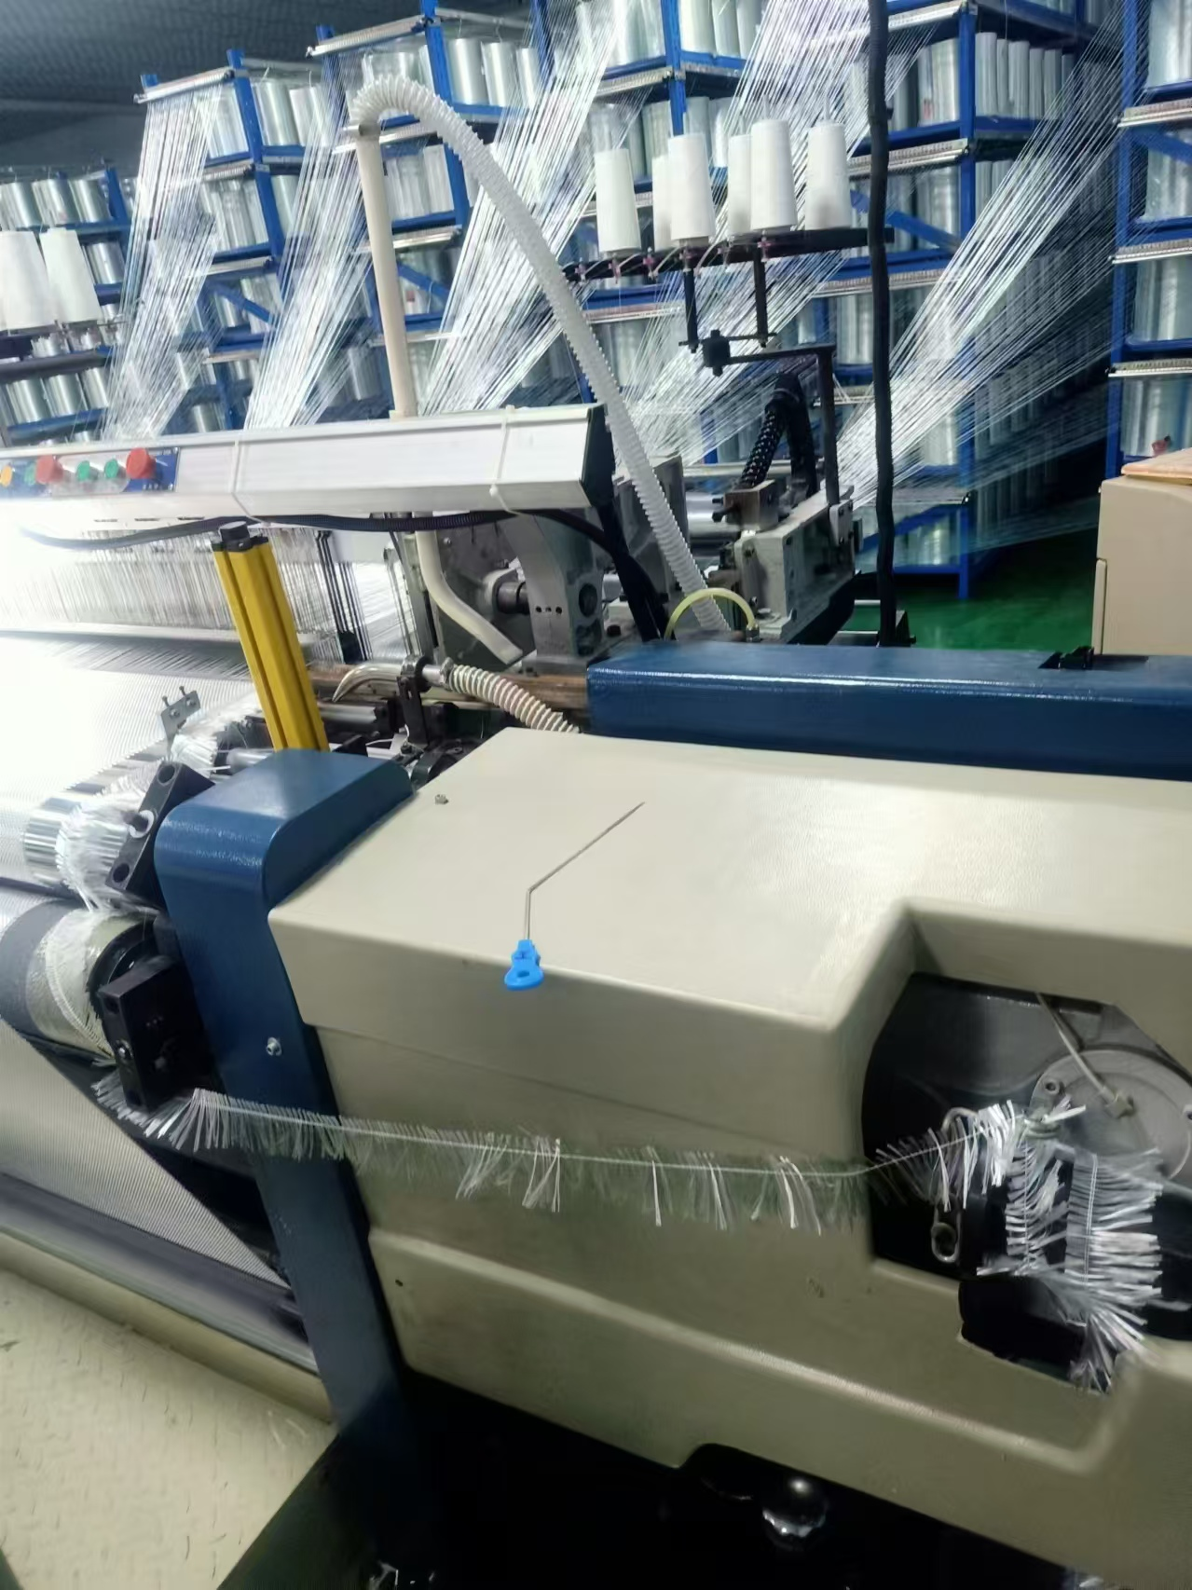
THIS MODEL USED IN GLASS FIBER YARN WEAVING
3

Slide 21
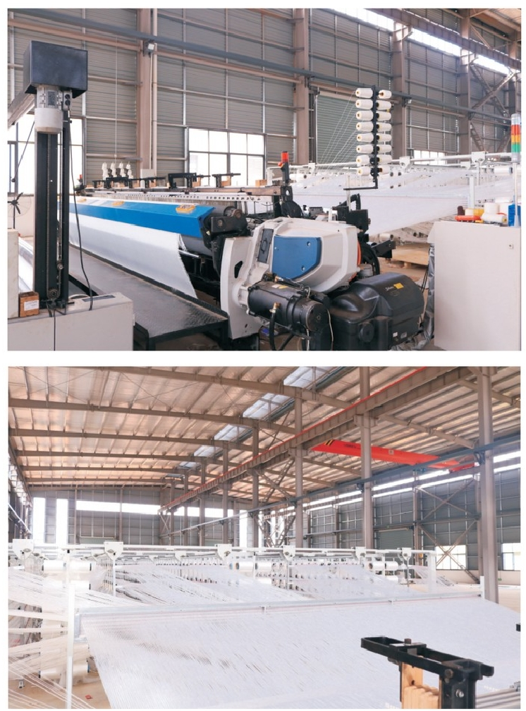
THIS MODEL USED IN GLASS FIBER YARN WEAVING
High production capacity
Excellent work efficency
Wide work fabric width up to 6m
Intelligent and easy human operation

Slide 22
T
HANK YOU!

