Slide 1

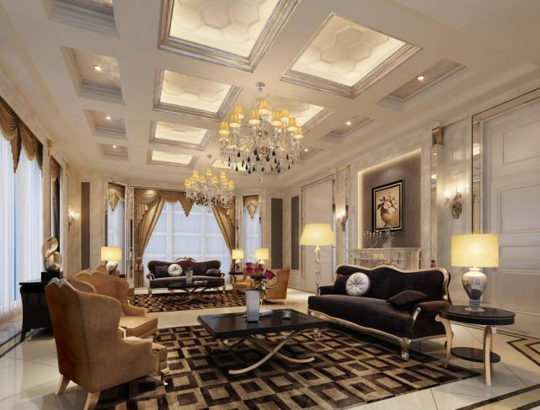
About us.
"We specialize in a diverse range of metal home decor products. Our collection includes a wide variety of meticulously crafted items designed to enhance the aesthetic appeal of your living spaces. From elegant lighting, wall art and sculptures to functional and stylish furniture pieces, we offer a comprehensive selection that caters to various tastes and preferences. Explore our catalog to discover high-quality metal home decor that adds a touch of sophistication and charm to your home."
OTL Categories
Home Décor & Wall Décor
Lighting, Furniture & Table Top
Kitchen ware & Barware
Garden Accessories
Cremation Urns / Jars

Slide 2
Company’s Characteristics
“Orion Trade LLC” is a manufacturing and exporting unit of all kind of Indian Handicraft Articles like Brass, Aluminium, Iron, Stainless Steel, Copper, Horn Bone, Shell, Wood, Marble etcetera. A well-established organization where everything from manufacturing to final packing is done inside factory premises. Along with the equipment of all the finishing plants inside one campus the unit is very well capable to execute any large number of the quantities as well.
Also, in case if we get an opportunity to get associated with you fortunately to be serving you, we assure and vouch you that we shall become one of your optimal vendor as we are a self-manufacturing unit and we can provide optimum competitive prices to you as well.

Slide 3
Company Profile
• Orion Trade LLC was established about a decade back under the supervision of Mr. Shahbaz Ahmad.
• The company has been segregated into various specialized departments – Metal, Wood, Glass
and Stone.
• Each Department has a well-equipped Manufacturing Unit with a fully integrated infrastructure to
complete all business operations in an efficient manner.
• Area : 5000 sq. ft.
• Export Share : 60% United States, 40% Europe & others.
• Core Strength : Wood , Metal , Stone, Bone , Horn in their best combination
• Product Category : Dec Acc , Candle Lighting , Accent Furniture , Wall Décor and Tabletop
• Machines: 30 approx.
ORION TRADE LLC

Slide 4
From the desk of C.E.O
“Our goal is to proactively offer a wide range of well-designed home decorative products and furniture. We offer our customers the best possible service, quality, selection and value. This requires innovation, technologies and commitment from our product builders to the management team. It is a combination of all that has enabled ORION TRADE LLC to become an ideas driven company.”
M. ALI YAWAR
Orion Trade LLC.

Slide 5
Our Major Clients
Kallau, USA
Anthropology, USA
Modway, USA
Crestview Collection, USA
Freedom, Europe
Spiller Ramuabjecte, Europe
Boltze, Europe

Slide 6
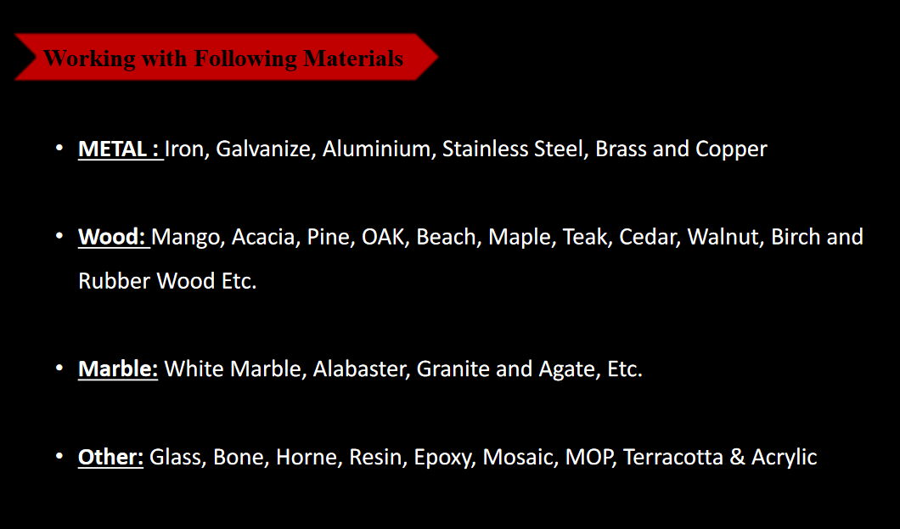

Slide 7
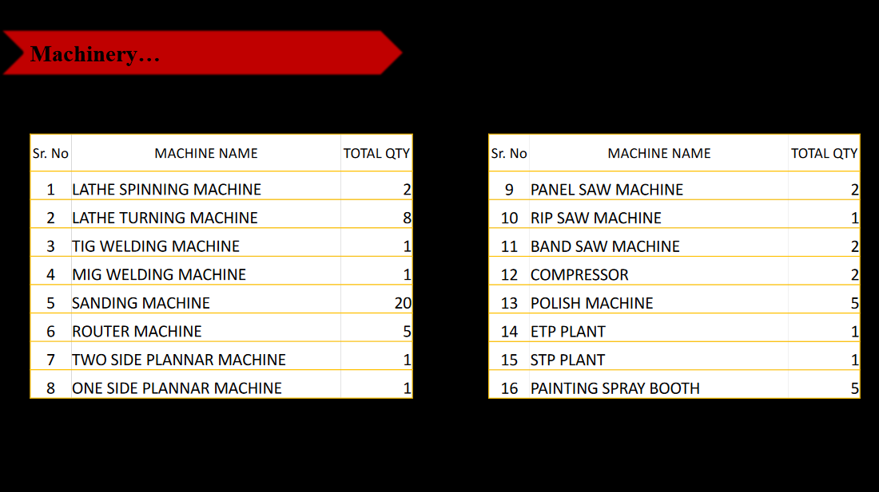

Slide 8
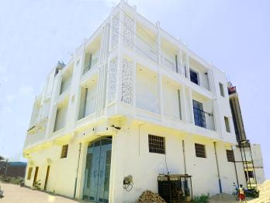
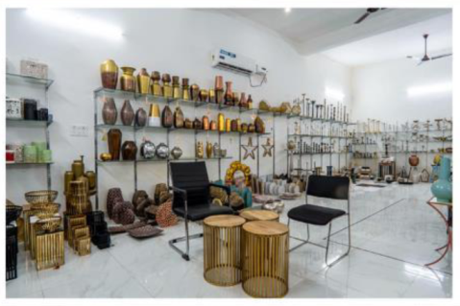
Orion Trade LLC has been exporting home décor
accessories and collectibles that blend exquisitely into
elite settings, be it home or office.
We have a passion for the craft and express it without
compromise through fines craftsmanship. Our commitment
to the highest standards of quality has set us apart from the
competition and has allows us to carve a niche market of
discerning and demanding the buyers worldwide who have
come to expect unique product lines from us.
Our highly experienced team of craftsmen pays attention to each
and every move and is dedicated to meet all your requirements
regarding products and finishes.
Our Designs & Developments division is supported by extensive market research into trends and consumer needs which is the backbone of the business. We have an experienced, sharp and hard- working personnel in the fields of sampling, merchandising, production, finishing, packaging and forwarding.
In our endeavor to understand our customers we participate in major trade shows worldwide. We are committed to relentlessly pursue innovation and develop a portfolio that is most comprehensive and unique in our industry.
Our expertise in domain has enabled us to cater to buyers from USA, Mexico, Australia, Kuwait, Saudi Arab etc.
Who are we?

Slide 9
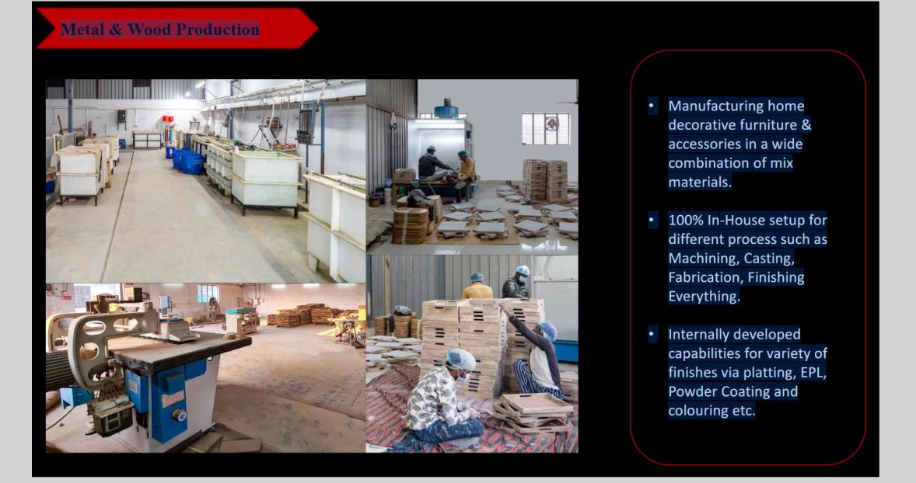

Slide 10
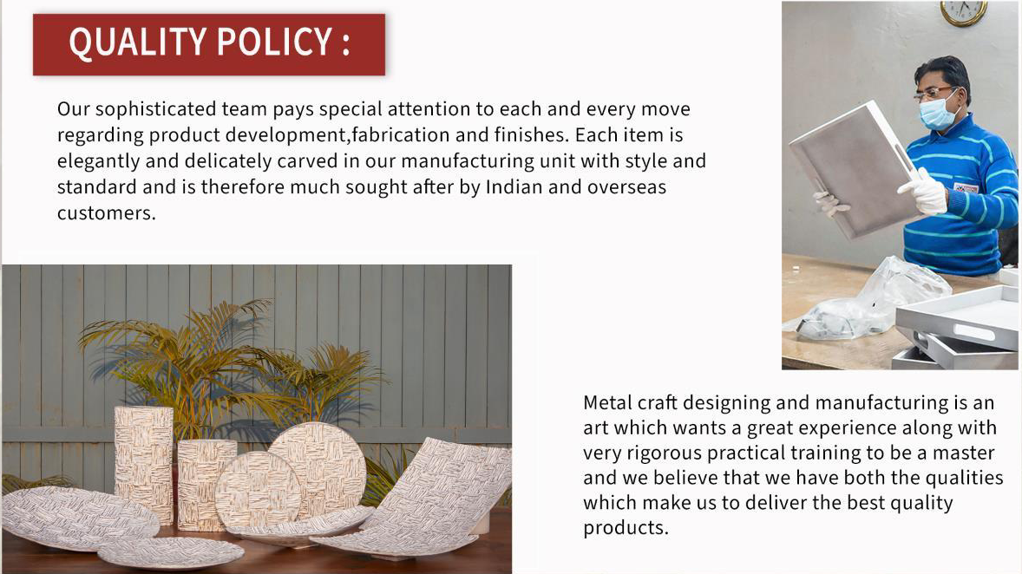

Slide 11
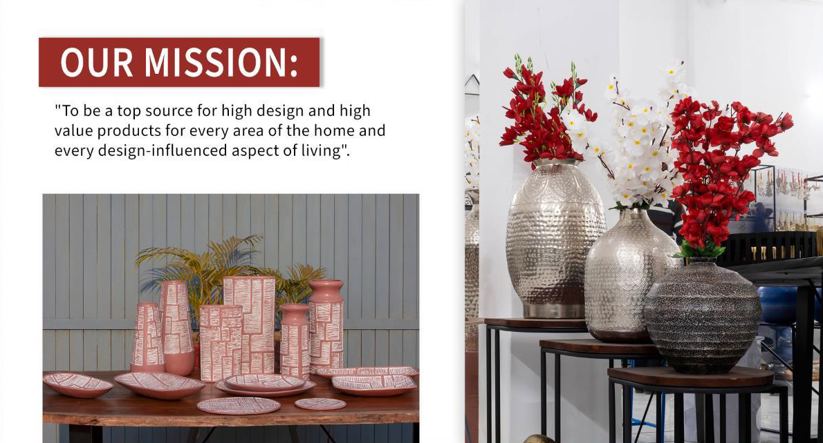

Slide 12
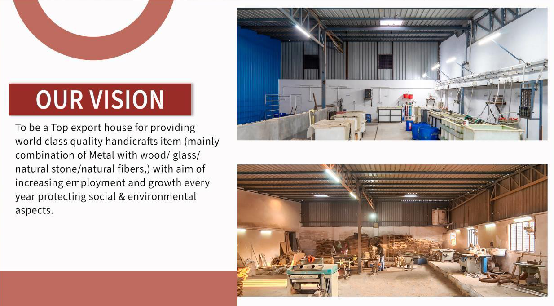

Slide 13
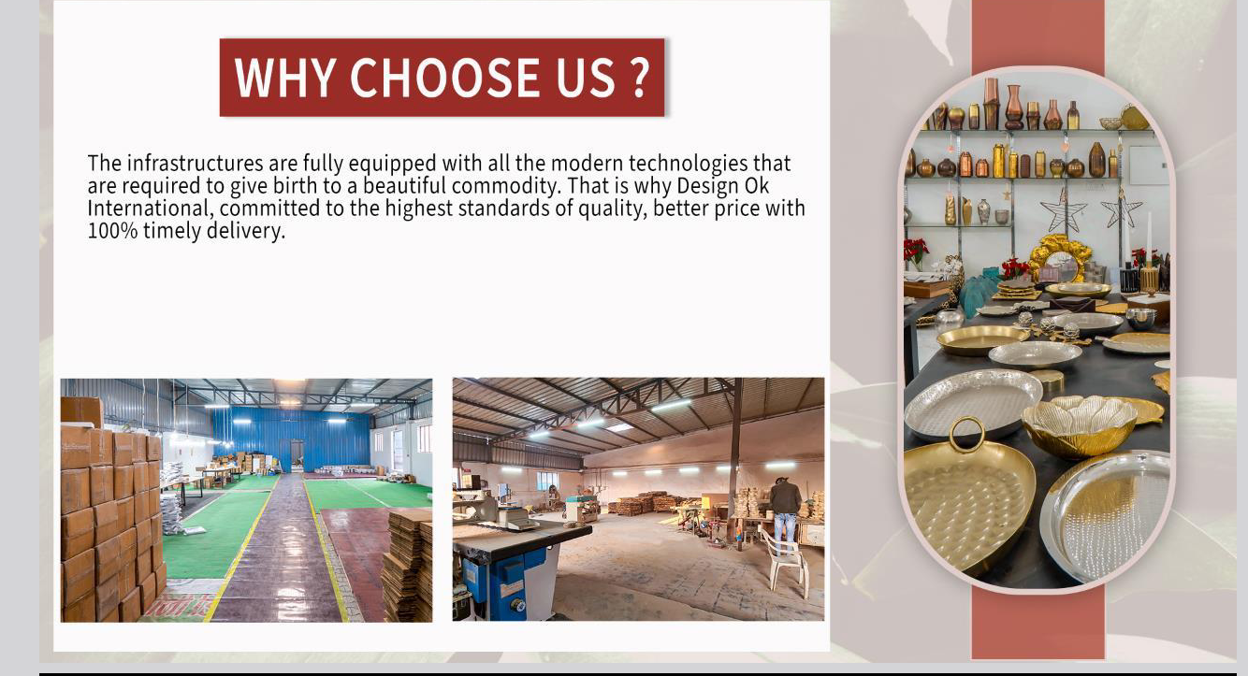
Why choose us?
The infrastructures are fully equipped with all the modern technologies that are required to give genesis to a beautiful commodity. That’s why Orion Trade LLC committed to the highest standards of quality, better price with 100% timely delivery.

Slide 14
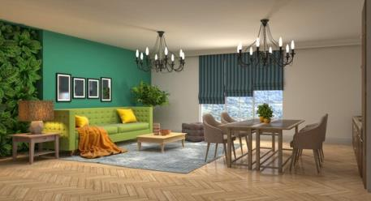
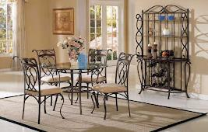

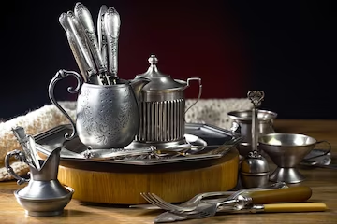
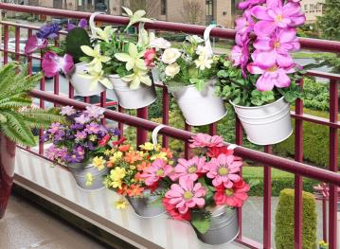
"Introducing our exquisite collection of chandeliers that redefine elegance and illuminate your space with unparalleled grace. Crafted with precision and artistic flair.
Orion Trade LLC
Range
"Discover the epitome of style, comfort, and craftsmanship with our exceptional collection of furniture.
Kitchenware encompasses a wide range of tools, utensils, and equipment used in the kitchen, like Baking Sheet, Spatula, knife, fork, Spoon
Garden planters are containers designed to hold and showcase plants, flowers, herbs, or small trees in outdoor spaces.

Slide 15
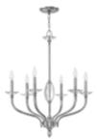

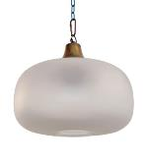
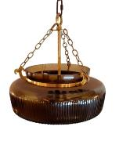
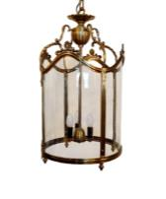
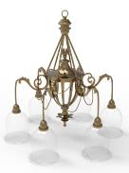
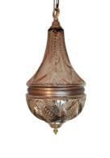
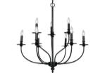
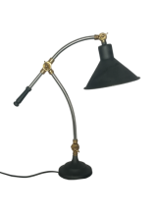
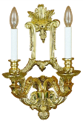
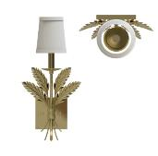
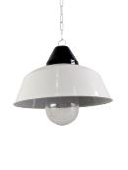

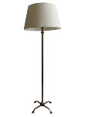
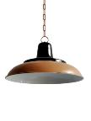
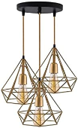
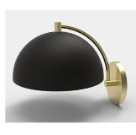
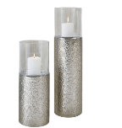
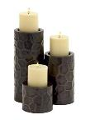
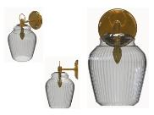
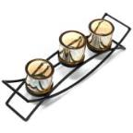
Orion Trade LLC Lighting Collection

Slide 16
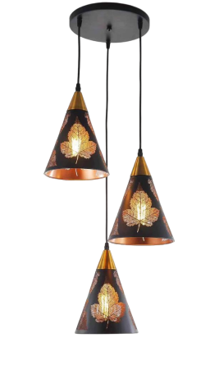
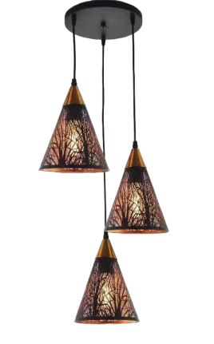
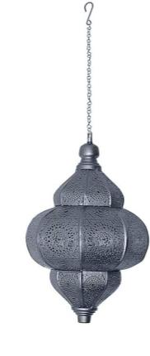
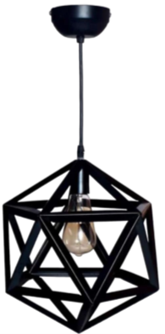
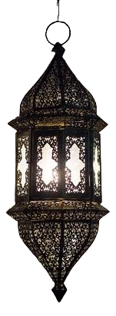
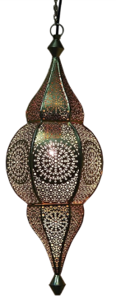
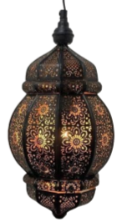
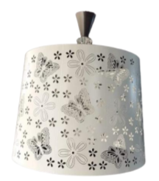

Slide 17
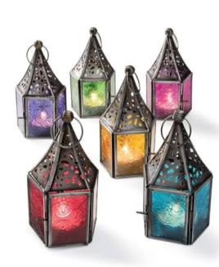
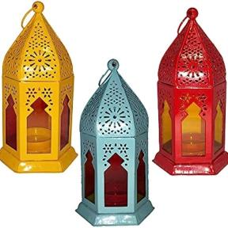
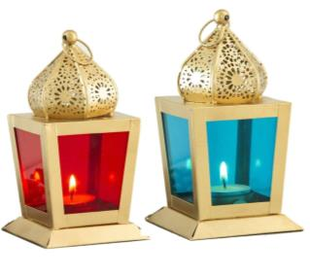
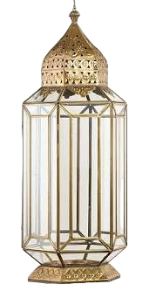
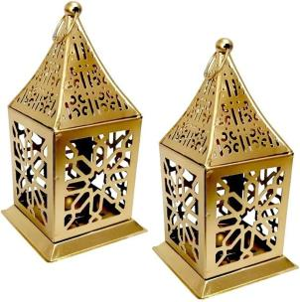
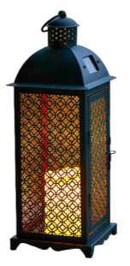
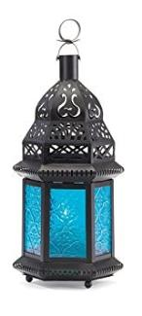
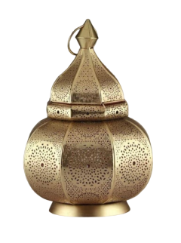

Slide 18
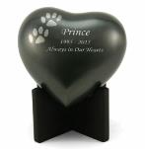



















Orion Trade LLC Cremation Urns/Jars Collection

Slide 19




















Orion Trade LLC Furniture Collection

Slide 20












Orion Trade LLC Tray, Bowl & sculptures Collection

Slide 21


















Orion Trade LLC Wood Collection

Slide 22













Orion Trade LLC Vase Collection

Slide 23



















Orion Trade LLC Garden Collection

Slide 24





Factory Overview -
MFA

Slide 25







Machinery Unit -

Slide 26


Thank you for
Connecting with us
Proprietor : Mr. Shahbaz Ahmad
Mob No.: +1 (647) 828-5111,
Merchandiser: ALI YAWAR
Mob No.: +91-827 3858617
sales@orrizen.com
www.orrizen.com
Parsavnaath Plaza -1, Delhi Road Moradabad – 244001
U.P., India.

