Slide 1



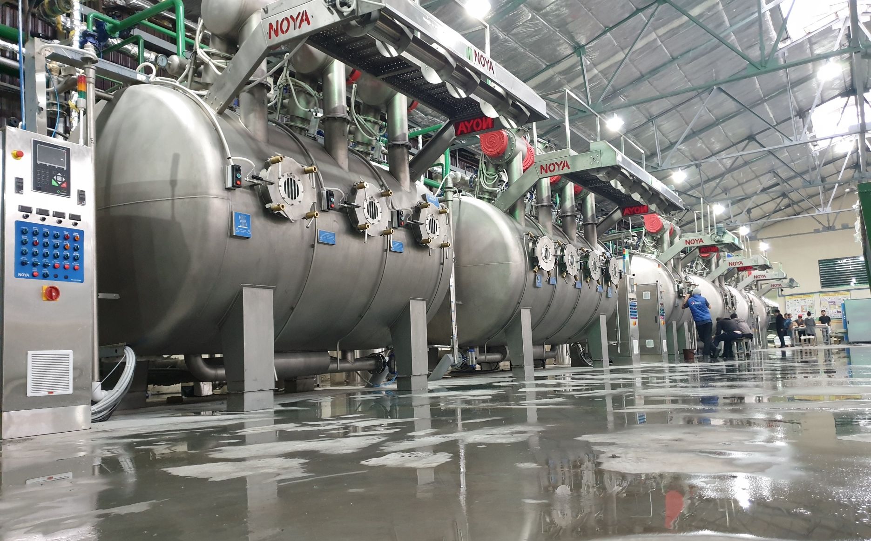
About Us Products Gallery Download Contacts
MULTIDYE FABRIC DYEING MACHINE

Slide 2
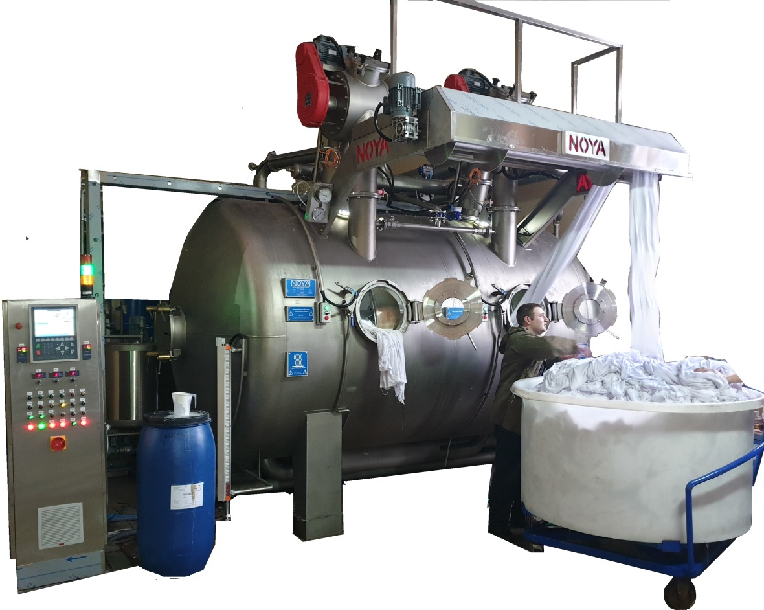
HIGHLIGHTS OF NOYA MULTIDYE
1:3
ULTRA LOW LIQOUR RATIO
DOUBLE NOZZEL
SECOND CIRCULATION PUMP
SHOWER DYEING SYSTEM
INSTULLATED BODY
QUICK DOSING
TURNING DRUMS

Slide 3
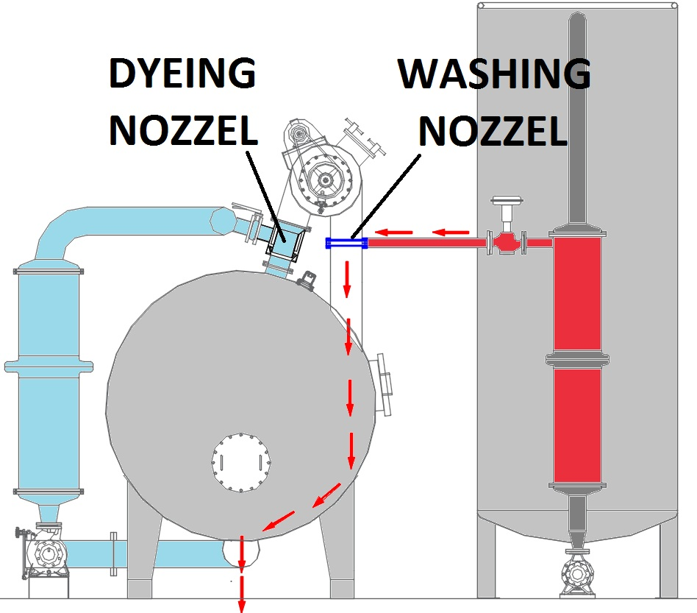
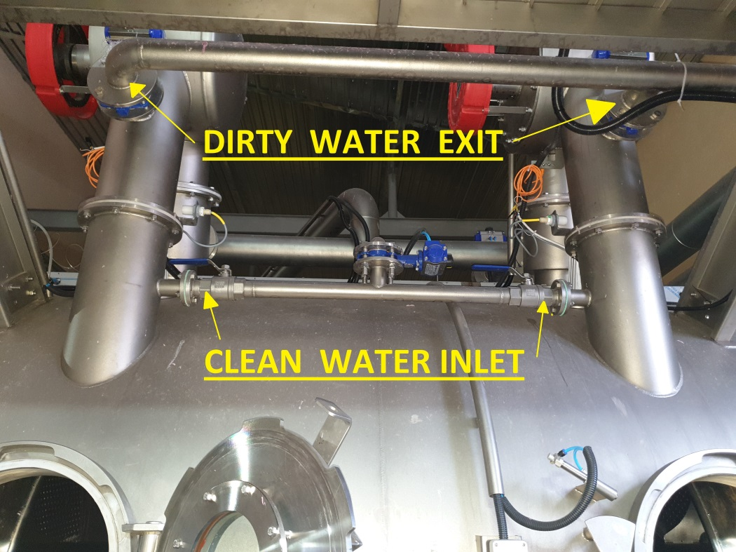
DOUBLE NOZZEL
WASHING NOZZEL +DYEING NOZZEL
Classic machines have only one nozzel for fabric dyeing & washing but our machine have second nozzel unit for support washing and dyeing process
DYEING NOZZEL working with main circulation pump water
WASHING NOZZEL working with hot water tank pump + fresh water pipe line

Slide 4
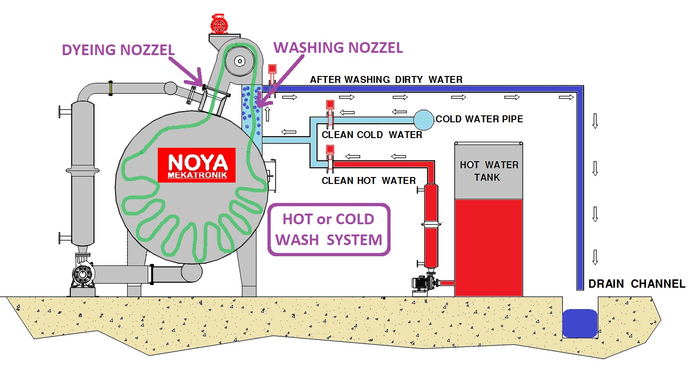
PATENT PENDING WASHING SYSTEM

Slide 5
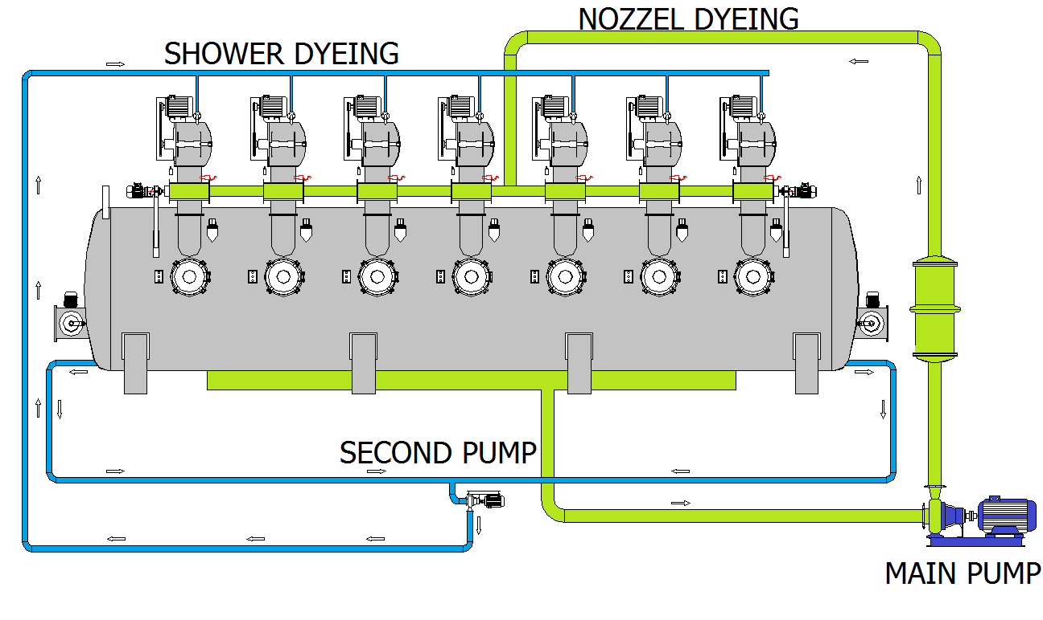
SHOWER DYEING with SECOND PUMP
We have shower dyeing system for homogenous dyeing between chambers
Thanks to second circulation pump we suction flotte from edges of the machine and make raining system to all chambers

Slide 6
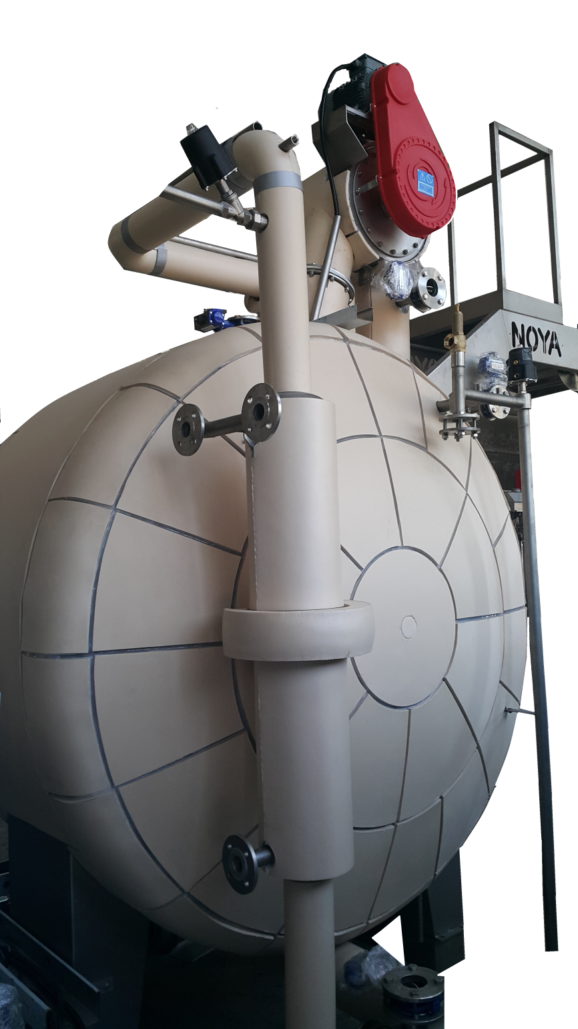
% 18 STEAM SAVING
NOYA INSTULLATION SYTEM
*Patented JAPAN instullation material
*Hydrofobic material never become wetting
*Easy cleaning with only cold water
*Long life material
*Silence machine voice
*You can touch to machine body while machine under 135 C working situation

Slide 7
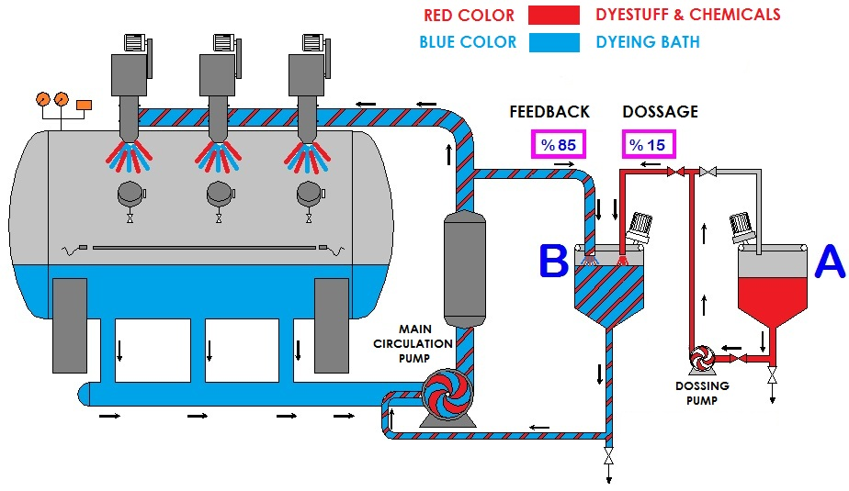
QUICK DOSING SYSTEM
Completely NEW DOSING SYSTEM at FLAPDYE®FabricDyeing Machine,
%100 problem free dosing can be possible even until today you may not dream!!!
From Tank A making dosing to Tank B and mixing with liquor from main tank and dosing inside the main tank again with huge amount of water. ALL THOSE OPERATION FINISH AT 2-5 MINUTES !!!!
For instance,
At tank A ; 50 kg soda mixed with 200 lt. water equa lto %20 solution dosing to Tank B. Liquor from main tank mixing with solution at Tank A and making solution to %2 with huge amount of liquor and again giving in front of the main pump. (Approximetely 4000-5000 lt. water suction and at the same time dosing to main tank)
DOSING TIMES
DYE STUFF….: 5 Minutes
SALT………....: 5 Minutes
SODA………...: 8 Minutes
CHEMICAL….: 2 Minutes

Slide 8
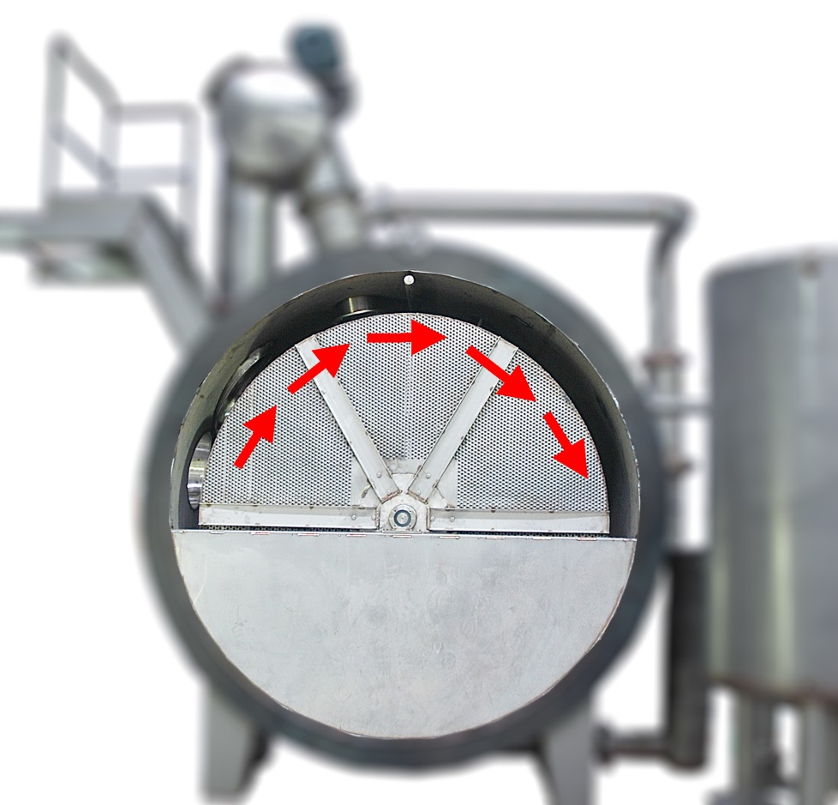
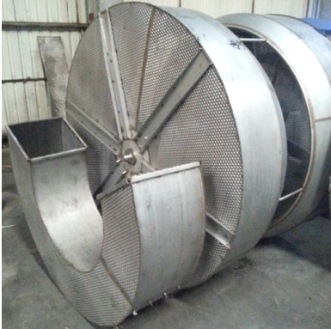
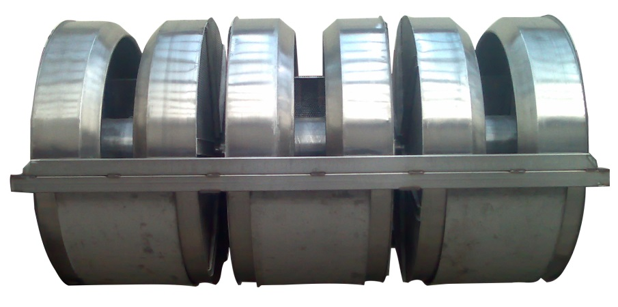
TURNING DRUMS
Instead of static J-BOX we have turning drums for tensionless fabric circulation.
With turning drums no tension ,no friction ,no lenght extension at the fabric.
Also more loading capacity than jbox sytems.

Slide 9
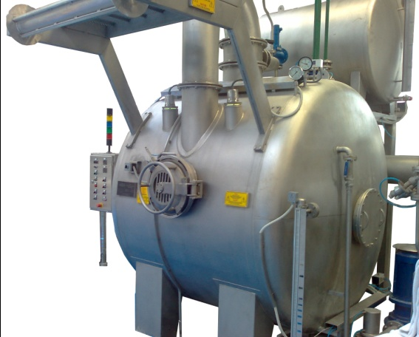
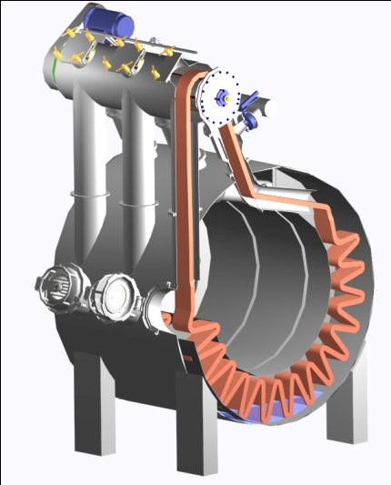
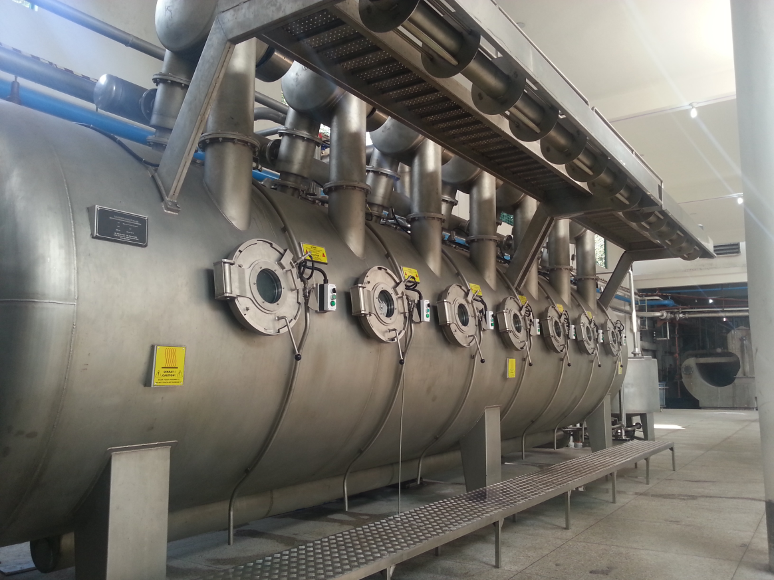
1:3 Liqour Ratio
400 m/min fabric speed
Max. Temperature 140 ℃
Max.Presuure 3,7 bar
Heating ( 25 ℃ up to 96 ℃ ) 7 ℃/min
Heating ( 96 ℃ up to 140 ℃ ) 3 ℃/min
Cooling ( 25 ℃ 3 bar water ) 3 ℃/min
150 kg fabric loading capacity / Each Chamber
4 Different pressure safety system
Water-Fabric Quick Seperator
Body & Tower Washing System
Automatic Seam Dedector
Fabric speed adjustment with Inverter control
Cycle time measuring
Dynamic Reserve Tank
Second exchanger & pump for reserve tank
Second chemical preparing tank
∆P Controlled level sensor
Magnetic level indicator
Heavy duty seal on stainless steel pump
First quality certificated European Origin Stainless Steel
Full Automatic Panel

Slide 10
