Slide 1

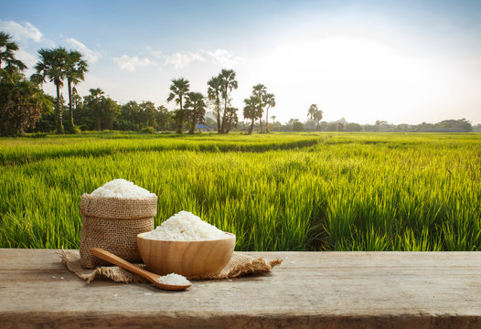
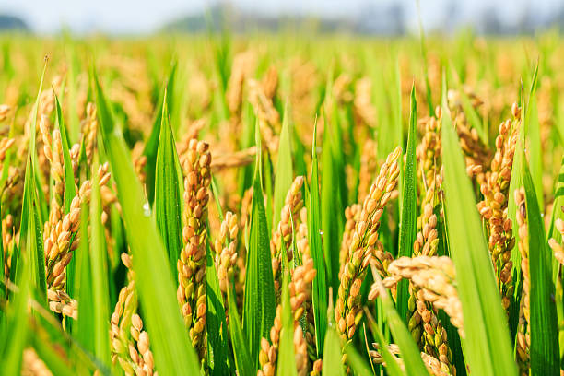
SK INTERNATIONAL IMPORT&EXPORT
ALL TYPE OF RICE SUPPLIER AND EXPORTER

Slide 2
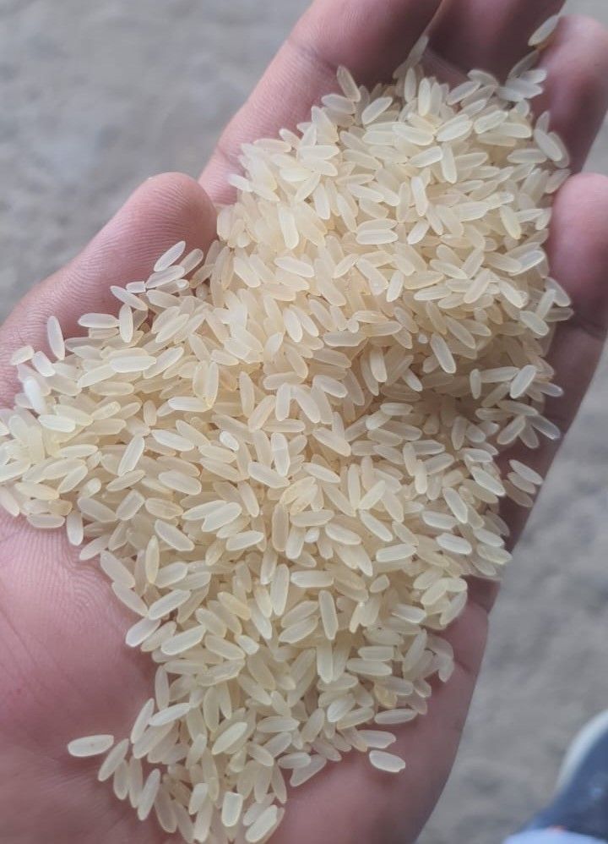
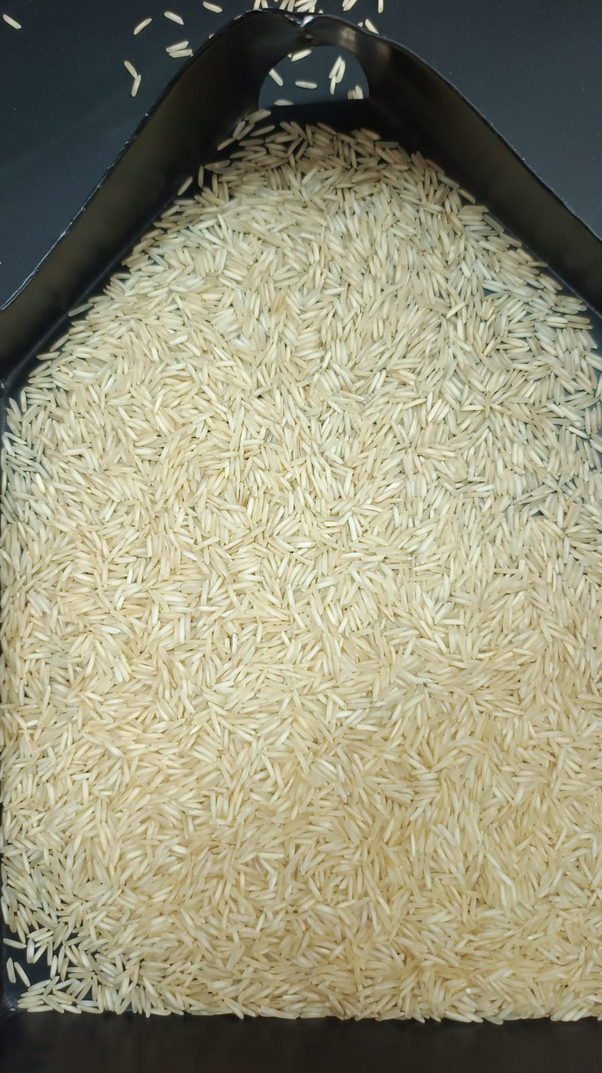
WE PROVIDE EVERY QULAITY OF RICES FOLLOWING LIKE
1121- BASMATI (STEAM/RAW/SELLA/GOLDEN)
1718- BASMATI (STEAM/RAW/SELLA/GOLDEN)
1509-BASMATI (STEAM/SELLA/GOLDEN )
PUSA BASMATI (RAW/STEAM/SELLA/GOLDEN)
SUGANDHA BASMATI (RAW/STEAM/SELLA/GOLDEN)
SARBATI BASMATI (RAW/STEAM/SELLA
IR64
PR11 (WHITE SELLA/GOLDEN SELLA)
PARMAL (WHITE SELLA/GOLDEN SELLA)
SONA MASOORI (STEAM)

Slide 3
BE STRONG BE HEALTHY YOUR HEALTH OUR PRIORITY
DILIVERING THE FINEST VARITIES OF RICES GLOBALLY WITH A COMMITMENT TO PURITY,TASTE,AND TIMELY DILIVERY EXPLORE OUR WIDE RANGE OF AROMATIC,LONG GRAINS,AND SPECIALITY RICE SOURCED FROM THE BEST FARMS,”
WE HAVE BEST DEALS AND PURE QUALITY OF RICES
CONTACT - +919737855651
EMAIL - skexport27@gmail.com, gillharshdeep25@gmail.com
LOCATION- SHOP NO 46 KUTCH GUJRAT NEAR MUNDRA PORT INDIA

