Slide 1




Slide 2
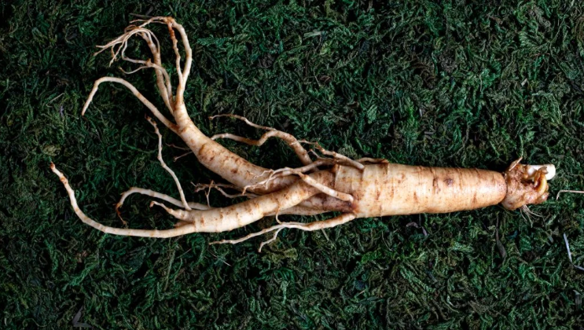



What is stealth ginseng?
FIREGIN’s unique recipe that neutralizes the unique aroma and bitterness of red ginseng
• Main features
• Use of domestic red ginseng with high saponin content
• Gently improves the unique aroma and taste of red ginseng
• Efficacy
• Boost immunity
• Antioxidant effect
• Improve blood circulation
• Feature
• High red ginseng concentrate content (200mg)

Slide 3


2. What is guarana?
A plant that grows in the Amazon primeval forest, it boasts excellent efficacy, so much so that is called the ginseng of Brazil
• Main features
• Contains high concentration of caffeine
(more than twice that of coffee beans)
• Effective as a natural energy supplement
• Efficacy
• Recovery from fatigue and boosting energy
• Stress relief
• Improves concentration and blood circulation

Slide 4

3. Point of differentiation
• Visual Impact
• Simple and clear logo
• Strong and memorable character design
• Premium Product
• Much higher red ginseng extract compared to other brands
• Contains Vitamin C and Taurine
• Natural sweetener
• Specifications added honey and pear concentrate
• Refreshing feeling
• Provides a refreshing feeling with carbonation

Slide 5
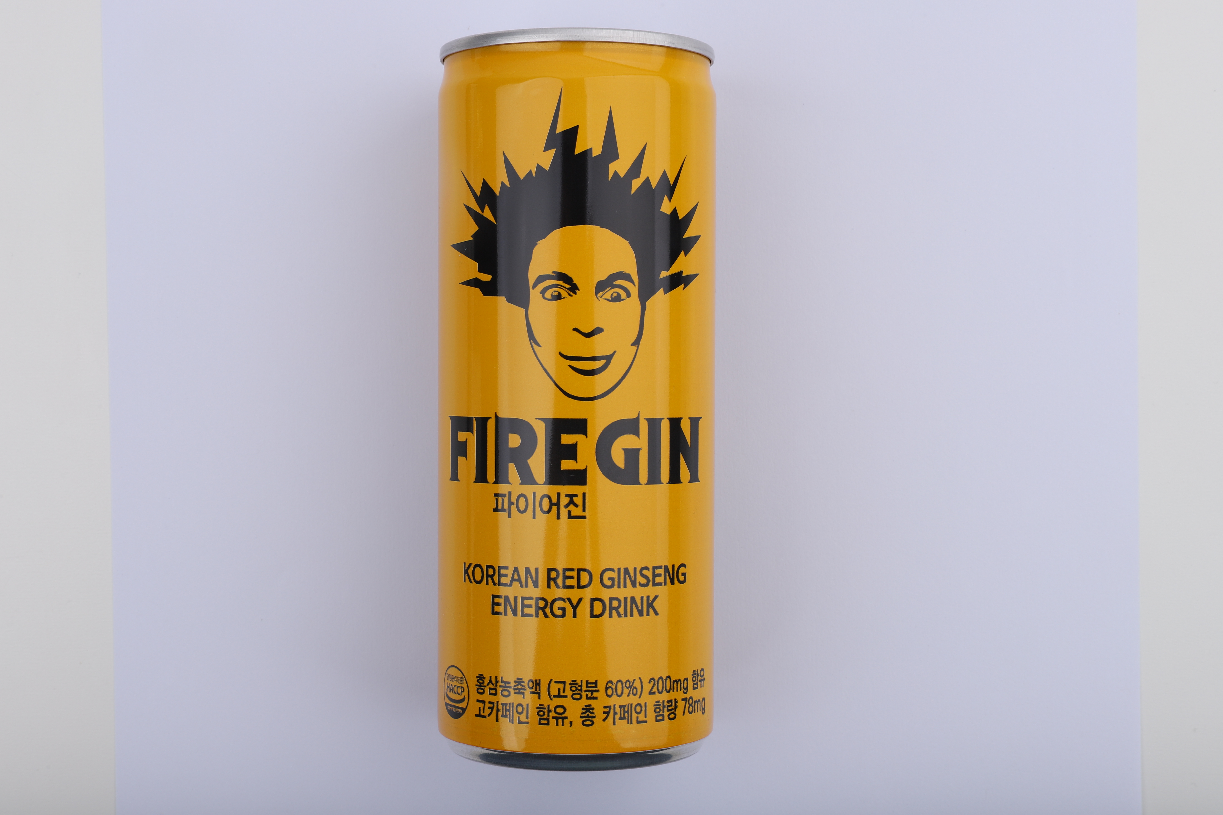
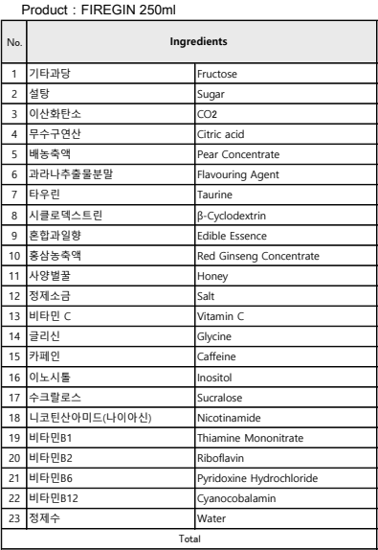
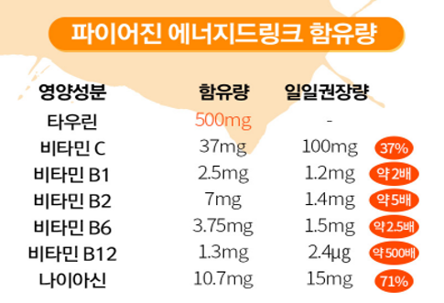
4. Ingredients

Slide 6

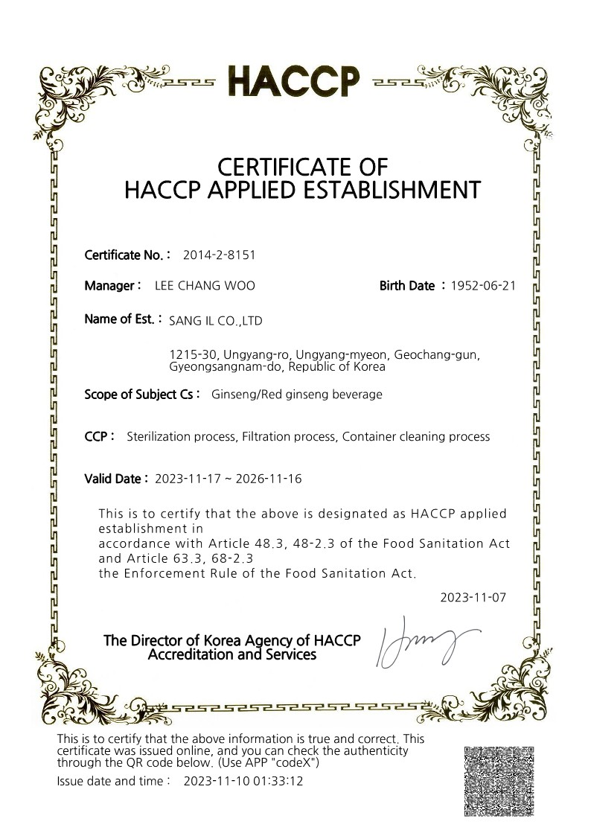
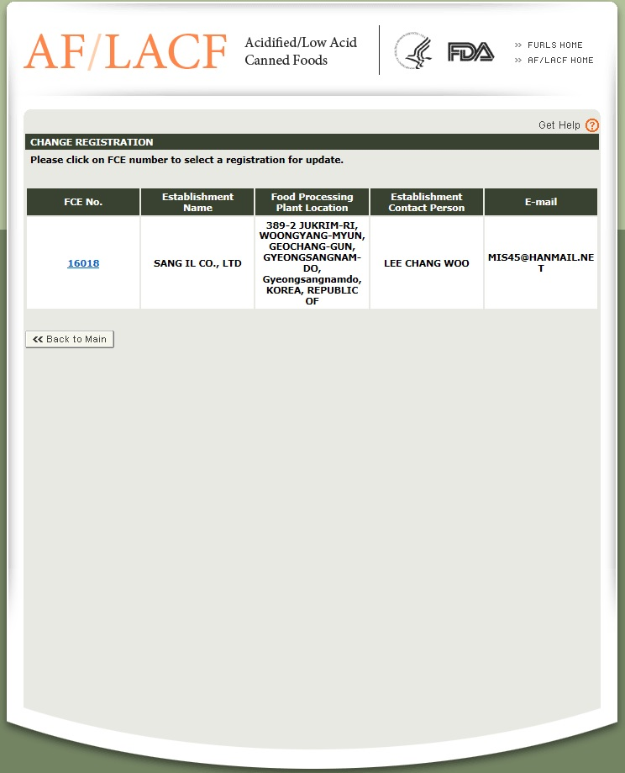
5. Stability and Certification HACCP, FDA

Slide 7
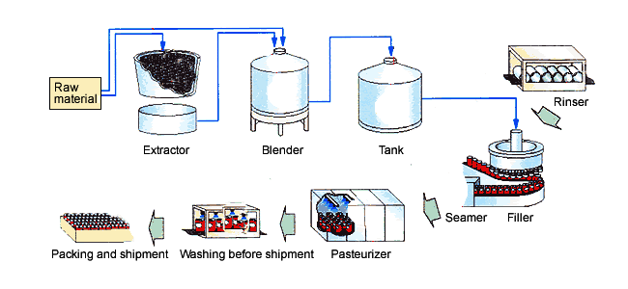
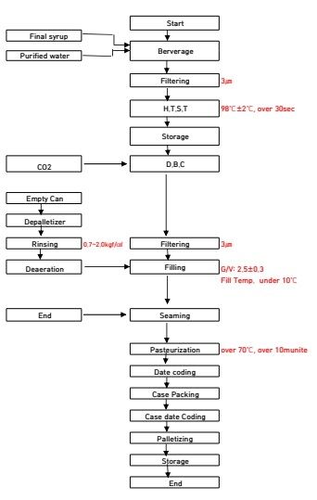
6. Manufacturing Process Sheet

Slide 8






7. Official Sponsorship

Slide 9







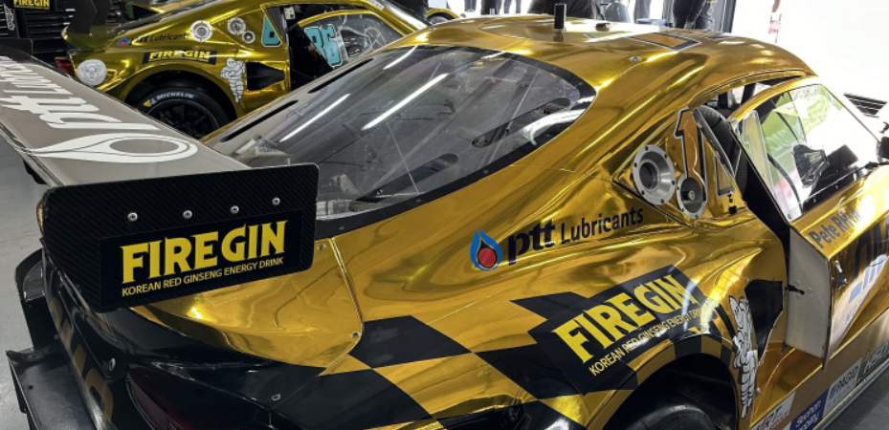
sponsorship

Slide 10
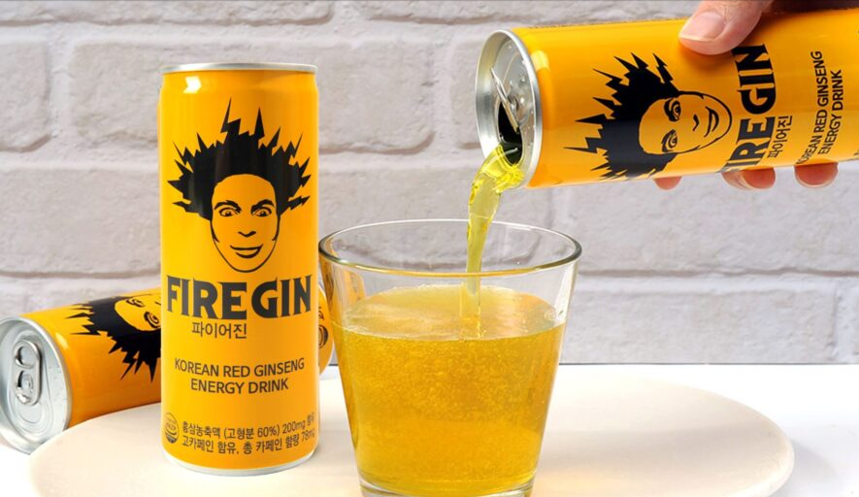

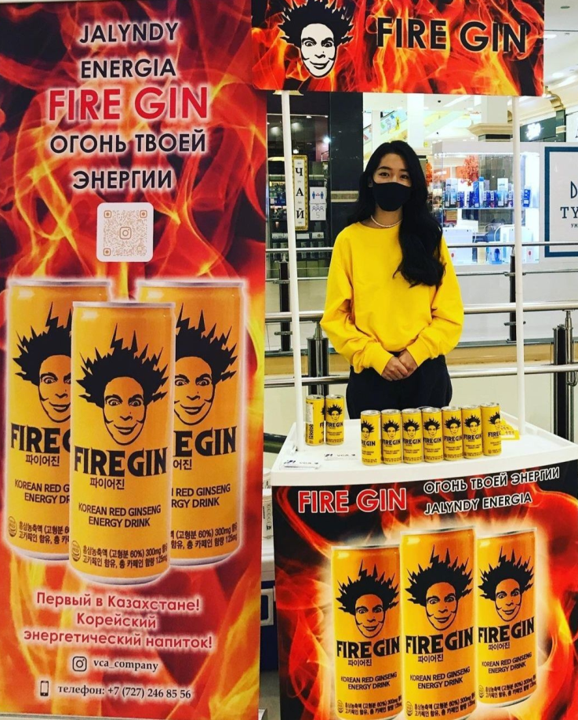



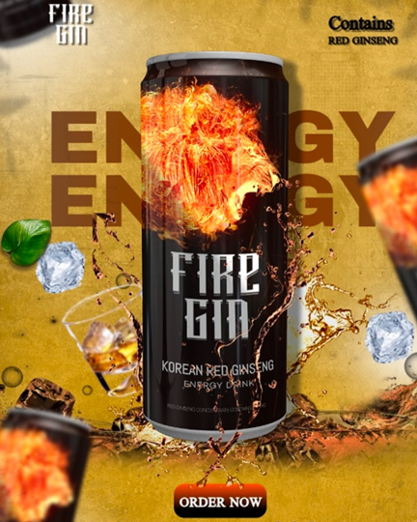


８. Export and intended export countries
Kazakhstan
Kyrgyzstan
Japan
Nigeria

Slide 11

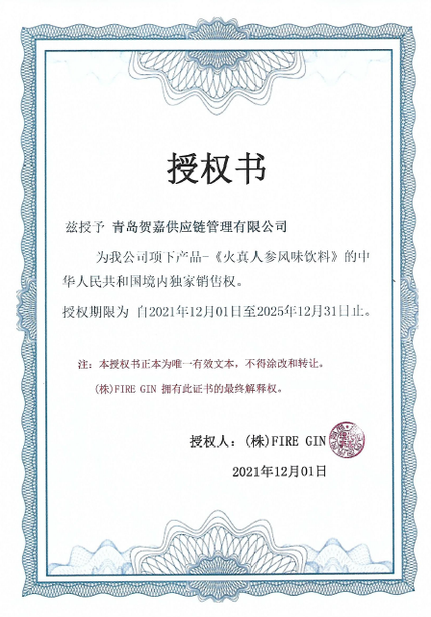
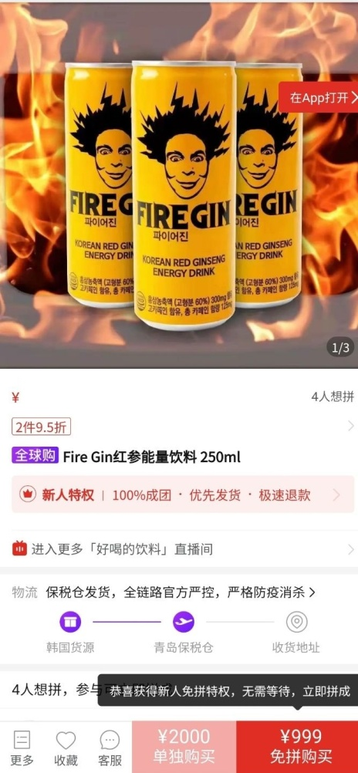

Requested for Chinese approval letter
Entering Chinese online market malls
Ingredient and design localization consultation completed

Slide 12

９. Domestic Market In KOREA
- The largest number of stores in Korea
- 14,923 stores by the end of 2022
- Released on June 14. 2023

Slide 13

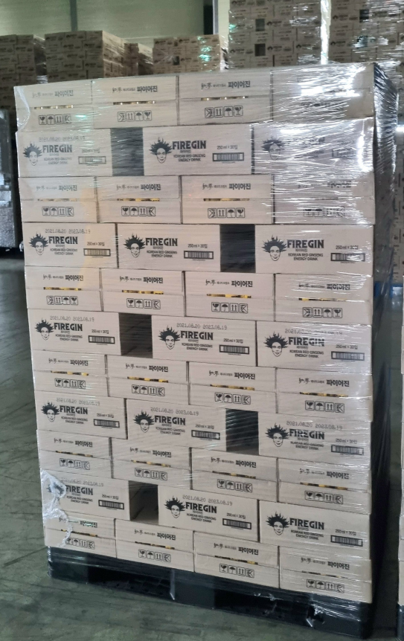
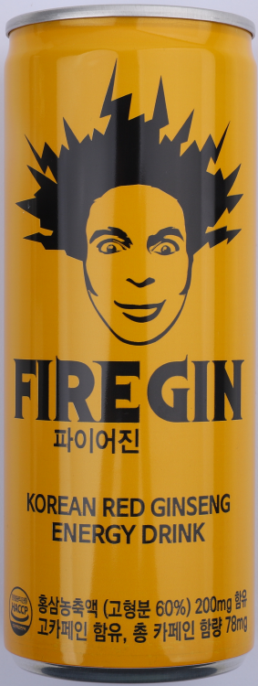
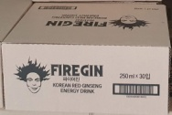
10. Product Dimension
Product dimension | Product weight | Carton dimension | Carton Weight | 1Pallet (120 Cartons)
50*133mm | 275g | (30 PCS) 325*265*135mm | 8.5 Kg | (3,600 PCS)

Slide 14
THANK YOU
Nuriearth Global USA
TEL : 714-469-0480
E-MAIL
john.son@nuriearthglobalusa.com
http://www.nuriearthglobalusa.com
http://www.fireginusa.com

