Slide 1


Semaglutide API & Intermediate
2024.03
Hanxin Pharmaceutical Technology Co., Ltd.

Slide 2

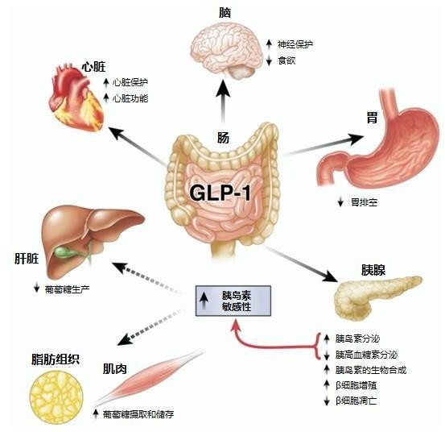

1. Basic information of Semaglutide
Semaglutide is a long-acting GLP-1 receptor agonist (GLP-1RA) administered once a week. By inhibiting the DPP-4 enzyme, it extends the half-life of GLP-1 receptors, enhances insulin secretion in a glucose-dependent manner, suppresses glucagon secretion, and slows gastric emptying, ultimately reducing blood sugar levels. Additionally, Semaglutide has effects on weight loss, glycemic control, and cardiovascular benefits. It also inhibits appetite, reducing food intake to achieve weight reduction.
In May 2021, NOVO NORDISK conducted an exploratory study, EVOKE plus, on the use of Semaglutide in early Alzheimer's disease patients. The international multicenter trial is currently recruiting participants and is intended for treating mild cognitive impairment (MCI) and mild dementia caused by Alzheimer's disease. The expected completion date for the trial is April 26, 2026.
CONFIDENTIAL
Hanxin Pharmaceutical Technology Co., Ltd.

Slide 3
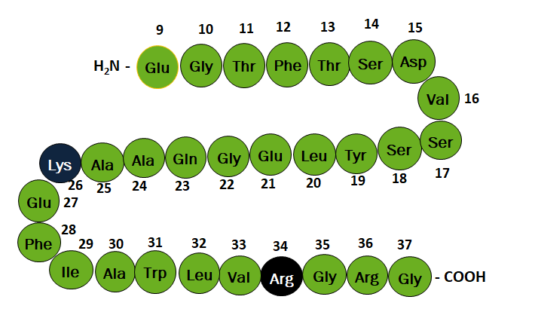
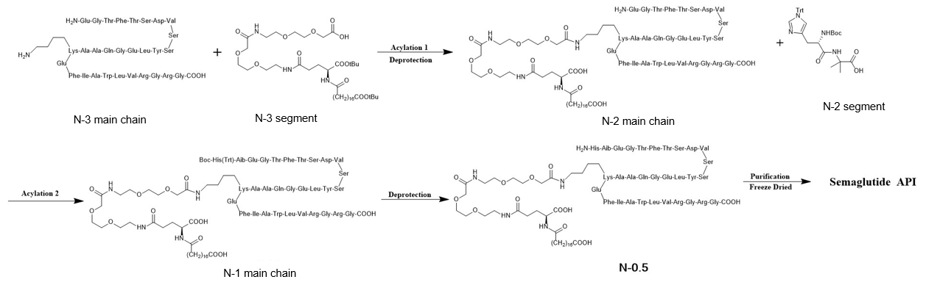
2. Conventional preparation process and compound patents
# | Country | Patent No. | Status | Expiration date
1 | China | CN10113308 2B | The authorization was nullified and has been appealed | 2026/3/20
2 | USA | US8129343B | Authorized | 2031/12/5
3 | Europe | EP1863839B | Authorized | 2031/3/20
CONFIDENTIAL
Hanxin Pharmaceutical Technology Co., Ltd.

Slide 4

4. Semaglutide API & Intermediate
4.1 Semaglutide API (for injection) 99.5%
4.2 Semaglutide API (for injection) 99%
4.3 Semaglutide API (for oral) 98%
4.4 Semaglutide API (for oral) 96%
4.5 Crude semaglutide (N-0.5) 50%
4.5.1 Second Acylated semaglutide precursor (N-1）70%
4.5.2 Acylated semaglutide precursor (N-2 main chain)80%
4.5.3 Boc-His(Trt)-Aib-oH（N-2 fragment ）99%
4.5.4 Semaglutide Main Chain P29（N-3 main chain）92%
4.5.5 High Purity Semaglutide Main Chain P29(N-3main chain）98%
4.5.6 tBuO-Ste-Glu(AEEA-AEEA-OH)-OtBu (N-3 fragment) 98%
Note: Due to the ongoing Chinese patent period for products mentioned in sections 4.1-4.4, they are solely used to support research and development. Clients are advised to conduct prior investigations into the patent status before entering the market.

Slide 5
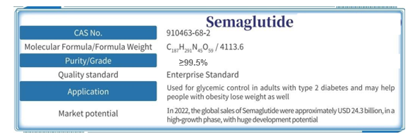
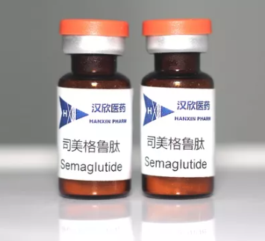
4.1 Semaglutide API (for injection) 99.5%
# | Test Items | Method Reference | Acceptance Criteria | Test Results
1 | Description | In-house | White or almost white powder | White powder
2 | Chromatographi c Identification | In-house | The retention time of the major peak of the sample solution corresponds to that of the standard solution, as obtained in the Assay | Meet requirement
3 | Peptide Mapping | In-house | The chromatographic profile of the sample solution corresponds to that of the standard solution | Meet requirement
4 | Assay | In-house | It contains 0.76 mg to 1.00 mg of semaglutide(C187H291N45O59) per mg | It contains 0.90 mg of semaglutide per mg
5 | Related Substance | In-house | Total impurities NMT 5.5% | Total impurities NMT1%, individual impurity is NMT0.2%
6 | High Molecular Weight Protein | In-house | NMT 0.3% | 0.03%
7 | Water Content | In-house | NMT 10.0% | 5.5%
8 | Bacterial Endotoxins | In-house | NMT 10 IU/mg | Meet requirement
9 | Microbial | In-house | Total aerobic bacteria NMT 100 CFU/mg | Meet requirement
10 | Host Cell Protein | In-house | NMT 100 ppm | Meet requirement
11 | Host Cell DNA | In-house | NMT 10 ng/mg | Meet requirement
12 | Bioassay | In-house | 0.7~1.3 unit/mg | 0.9 unit/mg
13 | Residual Solvents (TBD) | In-house | USP <467> | Meet USP <467> requirement
Package Specifications: 0.1g, 1g, 10g, 100g, 1kg
Packaging Format: Small quantities in bottles; Large quantities in LDPE + aluminum foil bags
Suitable for: Markets accepting API obtained through semi-synthesis with a main chain using fermentation, offering price advantages compared to total synthesis.

Slide 6
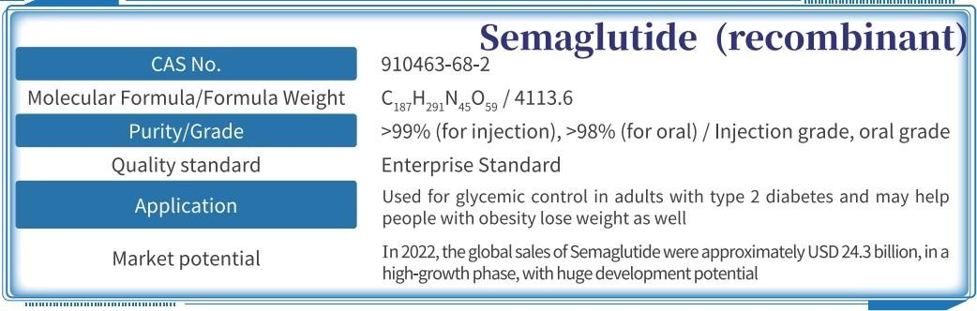
4.1 Semaglutide API (for injection) 99%
# | Test Items | Method Reference | Acceptance Criteria | Test Results
1 | Description | In-house | White or almost white powder | White powder
2 | Chromatographi c Identification | In-house | The retention time of the major peak of the sample solution corresponds to that of the standard solution, as obtained in the Assay | Meet requirement
3 | Peptide Mapping | In-house | The chromatographic profile of the sample solution corresponds to that of the standard solution | Meet requirement
4 | Assay | In-house | It contains 0.76 mg to 1.00 mg of semaglutide(C187H291N45O59) per mg | It contains 0.90 mg of semaglutide per mg
5 | Related Substance | In-house | Total impurities NMT 5.5% | Total impurities NMT1%, individual impurity is NMT0.2%
6 | High Molecular Weight Protein | In-house | NMT 0.3% | 0.03%
7 | Water Content | In-house | NMT 10.0% | 5.5%
8 | Bacterial Endotoxins | In-house | NMT 10 IU/mg | Meet requirement
9 | Microbial | In-house | Total aerobic bacteria NMT 100 CFU/mg | Meet requirement
10 | Host Cell Protein | In-house | NMT 100 ppm | Meet requirement
11 | Host Cell DNA | In-house | NMT 10 ng/mg | Meet requirement
12 | Bioassay | In-house | 0.7~1.3 unit/mg | 0.9 unit/mg
13 | Residual Solvents (TBD) | In-house | USP <467> | Meet USP <467> requirement
Package Specifications: 0.1g, 1g, 10g, 100g, 1kg
Packaging Format: Small quantities in bottles; Large quantities in LDPE + aluminum foil bags
Suitable for: Markets accepting API obtained through semi-synthesis with a main chain using fermentation, offering price advantages compared to total synthesis.

Slide 7
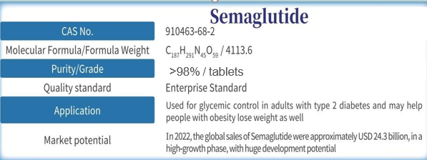
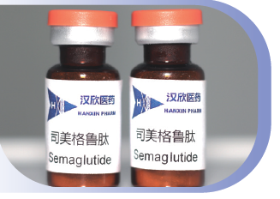
4.2 Semaglutide API (for oral) 98%
# | Test Item | Method Reference | Acceptance Criteria | Result
1 | Description | In house | White or almost white powder | White powder
2 | Chromatogra phic Identification | In house | The retention time of the major peak of the sample solution corresponds to that of the standard solution, as obtained in the Assay | Meet requirement
3 | Peptide mapping | In house | The chromatographic profile of the sample solution corresponds to that of the standard solution | Meet requirement
4 | Assay | In house | It contains 0.76 mg to 1.00 mg of semaglutide(C187H291N45O59) per mg | It contains 0.90 mg of semaglutide per mg
5 | Related substanc e | In house | Total impurities NMT 5.5% | Total impurities NMT2%, individual impurity is NMT 0.5%
6 | High Molecular Weight Protein | In house | NMT 0.3% | 0.03%
7 | Water content | In house | NMT 10.0% | 5.5%
8 | Microbial | In house | Total aerobic bacteria NMT 1000 CFU/mg | Meet requirement
9 | Bioassay | In house | 0.7~1.3 unit/mg | 0.9 unit/mg
10 | Residual Solvents(TBD ) | In house | USP <467> | Meet USP <467> requirement
11 | Particle Size | In house | Based on customer requirement | Based on customer requirement 4
Package Specifications: 0.1g, 1g, 10g, 100g, 1kg
Packaging Format: Small quantities in bottles; Large quantities in LDPE + aluminum foil bags
Suitable for: Markets with high requirements for controlling API impurities.

Slide 8
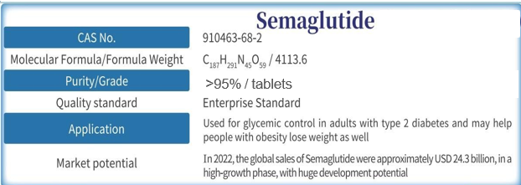
4.3 Semaglutide API (for oral) 96%
# | Test Item | Method Reference | Acceptance Criteria | Result
1 | Description | In house | White or almost white powder | White powder
2 | Chromatogra phic Identification | In house | The retention time of the major peak of the sample solution corresponds to that of the standard solution, as obtained in the Assay | Meet requirement
3 | Peptide mapping | In house | The chromatographic profile of the sample solution corresponds to that of the standard solution | Meet requirement
4 | Assay | In house | It contains 0.76 mg to 1.00 mg of semaglutide(C187H291N45O59) per mg | It contains 0.90 mg of semaglutide per mg
5 | Related substanc e | In house | Total impurities NMT 5.5% | Total impurities NMT5%, individual impurity is NMT 0.5%
6 | High Molecular Weight Protein | In house | NMT 0.3% | 0.03%
7 | Water content | In house | NMT 10.0% | 5.5%
8 | Microbial | In house | Total aerobic bacteria NMT 1000 CFU/mg | Meet requirement
9 | Bioassay | In house | 0.7~1.3 unit/mg | 0.9 unit/mg
10 | Residual Solvents(TBD ) | In house | USP <467> | Meet USP <467> requirement
11 | Particle Size | In house | Based on customer requirement | Based on customer requirement 4
Package Specifications: 0.1g, 1g, 10g, 100g, 1kg
Packaging Format: Small quantities in bottles; Large quantities in LDPE + aluminum foil bags
Suitable for: Markets where tablet compression processes do not produce new impurities and are price-sensitive

Slide 9
4.4 Crude semaglutide (N-0.5) 50%
Product：Crude Product
CAS：910463-68-2
Formula Weight：4113.57
Purity：50%
Quality Standard：Enterprise Standard
# | Test Item | Method Reference | Acceptance Criteria | Result
1 | Description | In House | White or almost white powder | White powder
2 | Chromatogra phic purity | In House | NLT 50% | 60%
3 | Assay | In House | NLT 35% | 45%
Package Specifications: 0.1g, 1g, 10g, 100g, 1kg
Packaging Format: Small quantities in bottles; Large quantities in LDPE + aluminum foil bags
Suitable for: Companies with the capacity for active pharmaceutical ingredient (API) production and a desire to hold their API registration number
Instructions: Obtain the API by purifying and drying this product through high-pressure chromatography
Equipment Requirements: High-pressure chromatography system, drying equipment (freeze dryer or spray dryer)

Slide 10
4.4.1 Second Acylated semaglutide precursor （N-1）70%
# | Test Item | Method Reference | Acceptance Criteria | Result
1 | Description | In House | Grey white | Grey white
2 | Chromatogra phic purity | In House | NLT70% | 75%
3 | Assay | In House | NLT50% | 54%
CAS：N/A
Formula Weight：4568.30
Purity：NLT 70%
Quality Standard：Enterprise Standard
Package Specifications: 0.1g, 1g, 10g, 100g, 1kg
Packaging Format: Small quantities in bottles; Large quantities in LDPE + aluminum foil bags
Suitable for: Companies with the capacity for API production and a desire to hold their API registration number
Usage Instructions: Hydrolyze to remove protective groups, obtaining N-0.5, and then purify and dry through chromatography
Equipment Requirements: Hydrolysis vessel, high-pressure chromatography system, drying equipment (freeze dryer or spray dryer)

Slide 11
4.4.2 Acylated semaglutide precursor (N-2 main chain) 80%
# | Test Item | Method Reference | Acceptance Criteria | Result
1 | Description | In House | Grey white | Grey white
2 | Chromatogra phic purity | In House | NLT 80% | 83%
3 | Assay | In House | NLT 60% | 65%
CAS：N/A
Formula Weight ：4003.61
Purity：NLT 80%
Quality Standard：Enterprise Standard
Package Specifications: 0.1g, 1g, 10g, 100g, 1kg
Packaging Format: Small quantities in bottles; Large quantities in LDPE + aluminum foil bags
Suitable for: Companies with the capacity for API production and a desire to hold their API registration number
Usage Instructions: Perform acylation and hydrolysis reactions with the N-2 fragment of 4.4.3, followed by chromatography purification and drying to obtain API
Equipment Requirements: Acylation and hydrolysis vessels, high-pressure chromatography system, drying equipment (freeze dryer or spray dryer)

Slide 12
4.4.3 Boc-His(Trt)-Aib-oH（N-2 fragment ）99%
Product：Boc-His(Trt)-Aib-OH
CAS：2061897-68-3
Formula Weight ：582.70
Purity：99%
Quality Standard: Enterprise Standard
# | Test Item | Method Reference | Acceptance Criteria | Result
1 | Description | In House | White or almost white powder | White powder
2 | Chromatogra phic purity | In House | NLT 99% | 99.6%
3 | Formula Weight | In House | Consistent with theory | 582.70Da
Package Specifications: 0.1g, 1g, 10g, 100g, 1kg
Packaging Format: Small quantities in bottles; Large quantities in LDPE + aluminum foil bags

Slide 13
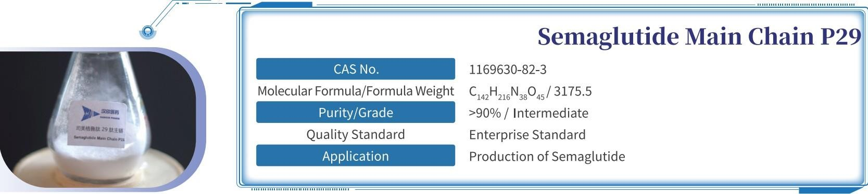
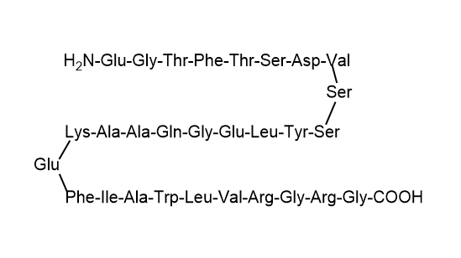
4.4.4 Semaglutide Main Chain P29（N-3 main chain）92%
Package Specifications: 0.1g, 1g, 10g, 100g, 1kg
Packaging Format: Small quantities in bottles; Large quantities in LDPE + aluminum foil bags
Suitable for: Companies with the capacity for API production and a desire to hold their API registration number
Usage Instructions: Perform acylation and hydrolysis reactions with the N-3 fragment of 4.4.6 and the N-2 fragment of 4.4.3, followed by chromatography purification and drying to obtain API
Equipment Requirements: Acylation and hydrolysis vessels, high-pressure chromatography system, drying equipment (freeze dryer or spray dryer)

Slide 14

4.4.5 High Purity Semaglutide Main Chain P29(N-3 main chain）98%
Package Specifications: 0.1g, 1g, 10g, 100g, 1kg
Packaging Format: Small quantities in bottles; Large quantities in LDPE + aluminum foil bags
Suitable for: Companies with the capacity for API production and a desire to hold their API registration number
Usage Instructions: Perform acylation and hydrolysis reactions with the N-3 fragment of 4.4.6 and the N-2 fragment of 4.4.3, followed by chromatography purification and drying to obtain API
Equipment Requirements: Acylation and hydrolysis vessels, high-pressure chromatography system, drying equipment (freeze dryer or spray dryer)

Slide 15
4.4.6 tBuO-Ste-Glu(AEEA-AEEA-OH)-OtBu (N-3segment) 98%
Product：tBuO-Ste-Glu(AEEA-AEEA-OH)-OtBu
CAS：1118767-16-0
Formula Weight ：846.11
Purity：≥98%
Quality Standard: Enterprise Standard
Application：Semaglutide Production
# | Test Item | Method Reference | Acceptance Criteria | Result
1 | Description | In House | White or almost white paste | Almost white paste
2 | Chromatogra phic purity | In House | NLT 98.5% | 99.2%
3 | Formula Weight | In House | Consistent with theory | 846.11Da
Package Specifications: 0.1g, 1g, 10g, 100g, 1kg
Packaging Format: Small quantities in bottles; Large quantities in LDPE + aluminum foil bags

Slide 16




THANKS
Create Value & Realize Win-Win Together！
14

