Slide 1

YUAN MIAO
Guizhou Yuanmiao E-Commerce Co.,Ltd.

Slide 2


Company profile
Team Style
Main Products
Contents
Product Show
Product application
Service Guarantee

Slide 3

Guizhou Yuanmiao E-Commerce Co.,Ltd.
Specializing in the sale of the world's major electrical brands
Products purchased directly from overseas, genuine stock, preferential prices
After-sales warranty, complete models, same products, different prices and services.
A large number of original imported DCS system parts, PLC system parts.
Main: ABB, GE Fanuc, Bently Bentley, Triconex, Woodward, Foxboro, Westinghouse/Emerson, Reliance, Schneider Modicon, A-B, HIMA Black Horse, Motorola, Kollmorgen, Bosch/Rexroth/Bosch, NI, YOKOGAWA, Yokogawa, and other major brands of PLC system parts, DCS system parts, robot system parts, and large servo system discontinued spare parts.
PLC system
1
2
DCS System
Systems Spare parts
Servo System
3
4
Robotic system
Notes:
Drag & drop image directly on placeholder. Press reset button from slides ribbon in case image not fit properly.

Slide 4
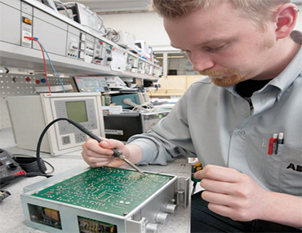
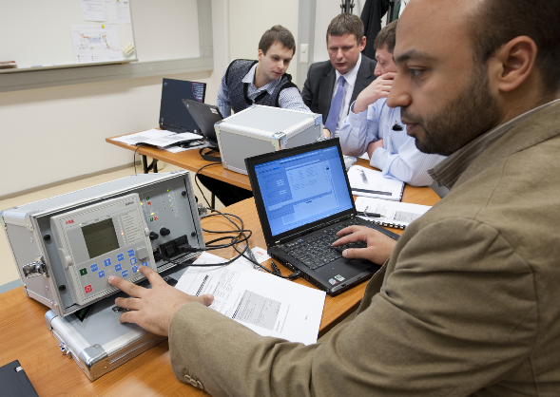
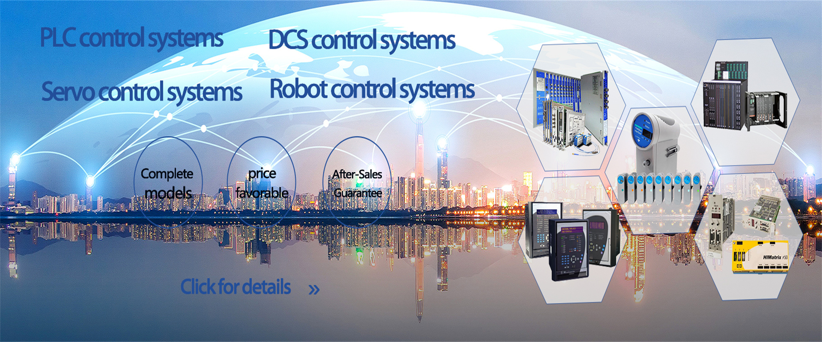
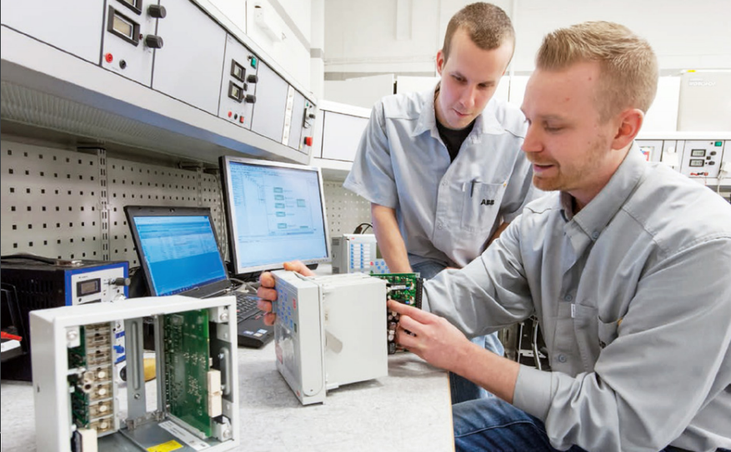
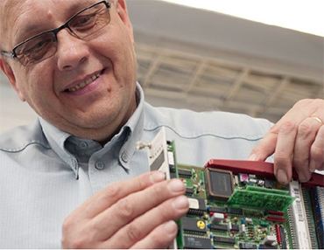

Team Style
Convenient and convenient
Specialties
Fast
Global
We create the brilliance
of the company together.
together to achieve
our ideal struggle.

Slide 5

















Main Products

Slide 6

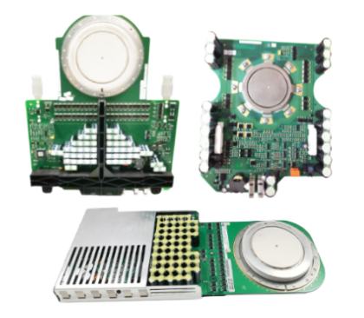
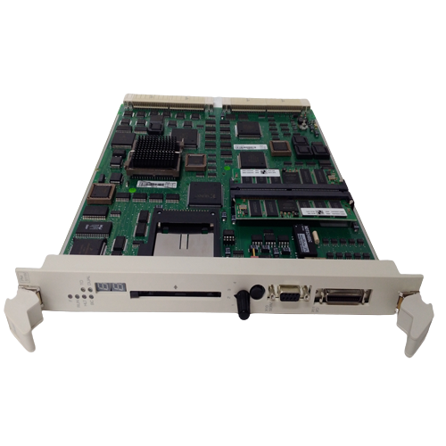
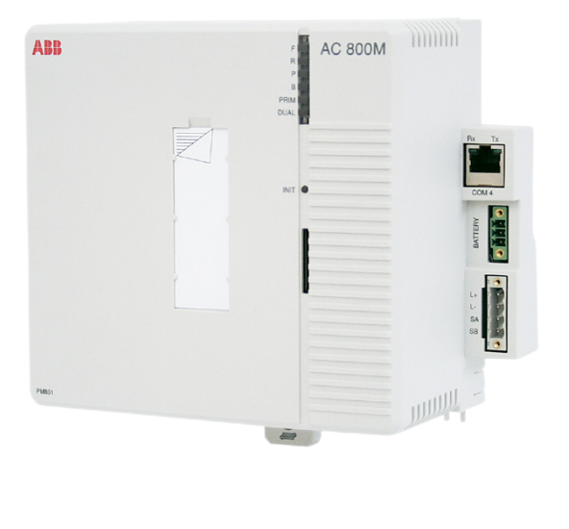
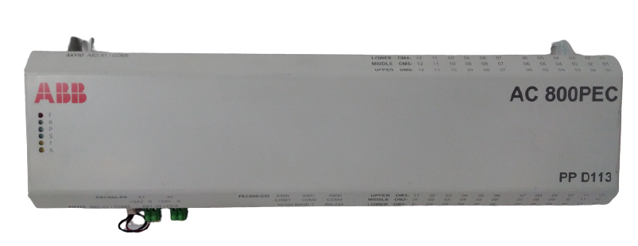
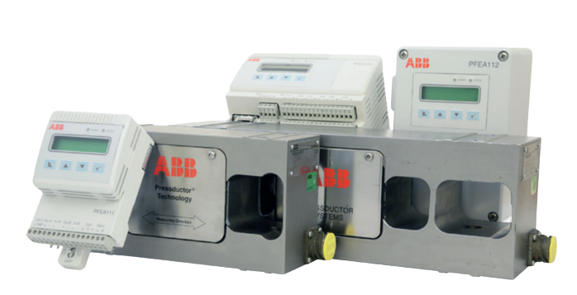
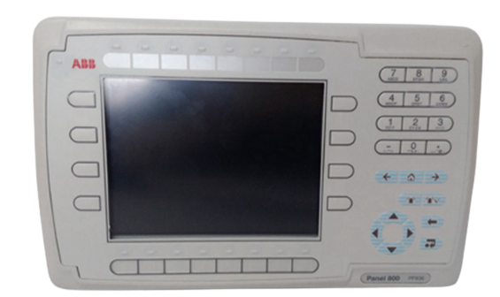
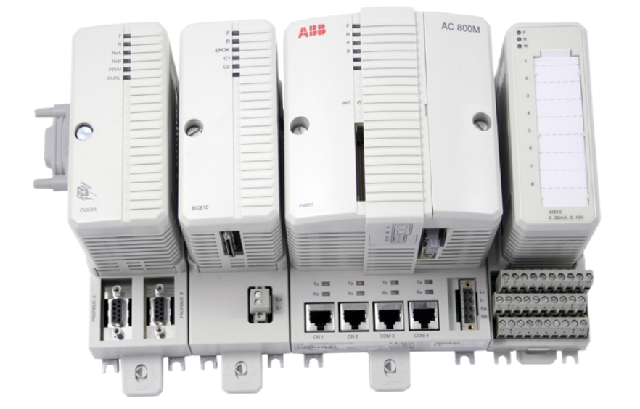
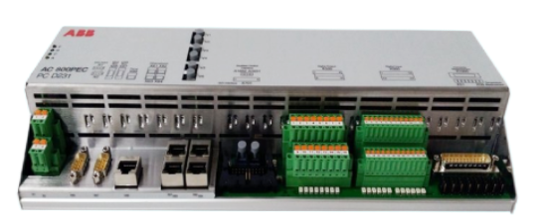
ABB main series：
5SHY、5SHX、PP/PPD、PM、PFTL、PFCL、PFEA、PFSK、PFSA、CI、KUC、RFE、etc.
5SHY series silicon
controlled modules
PM series controller
PP series controller
Tension controller
5SHY4045L0006
5SHY3545L0010
5SHX2645L0002
5SHY3545L0020
5SHY5045L0020
5SHY35L4520
PM904F
PM861AK01
PM866K01
PM864
PM864AK01
PM865K01
PM511V16
PPD113
PPD512
PP836
PP846A
PP836A
PP875
PP885
PFSK151
PFEA112-65
PFEA113-65
PFCL201C 10KN
PFTL101A 1.0KN
PFTL101B 5.0KN
PFTL301E 1.0KN

Slide 7

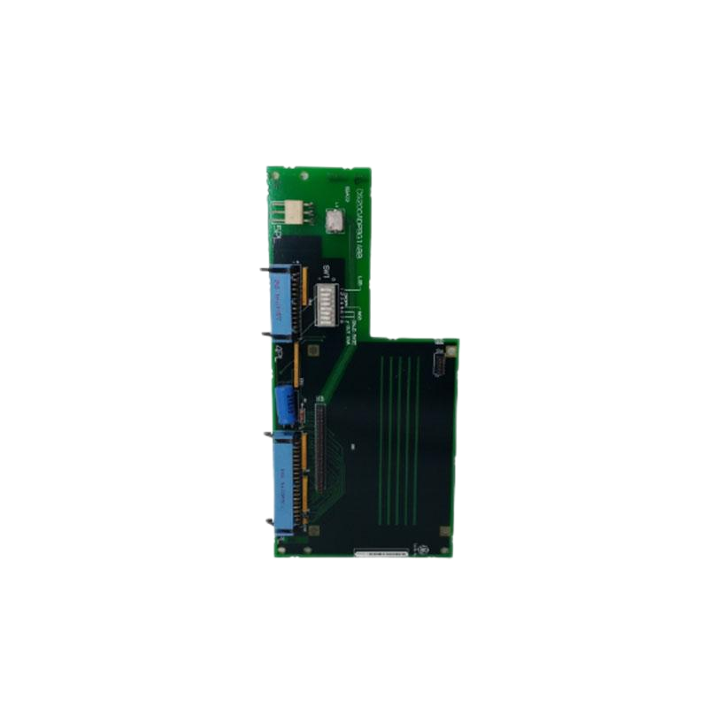
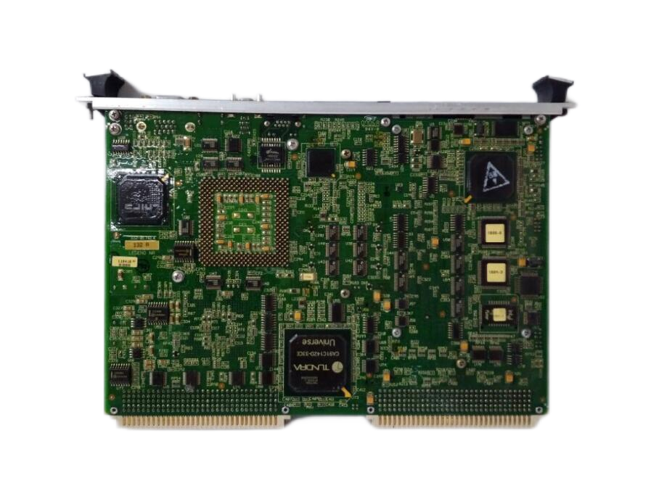
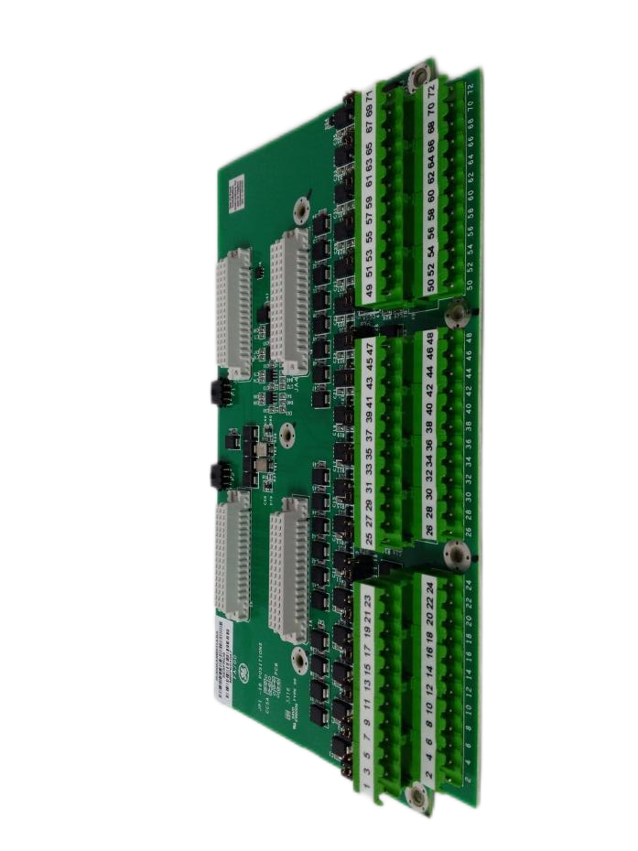
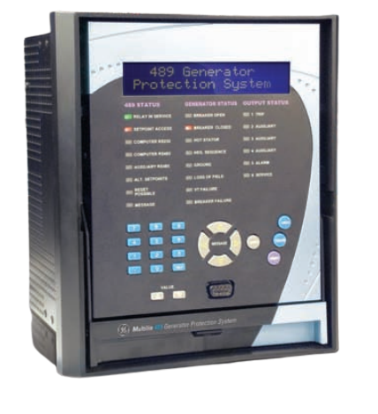
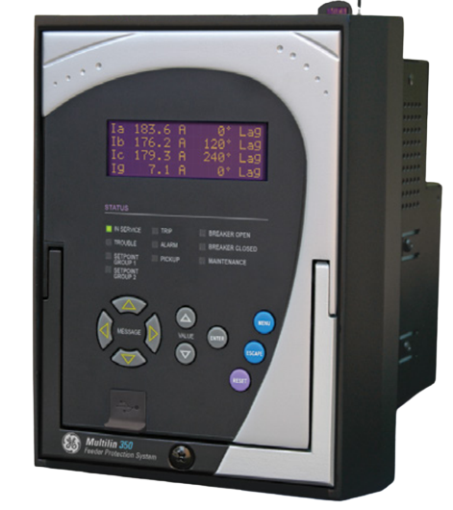
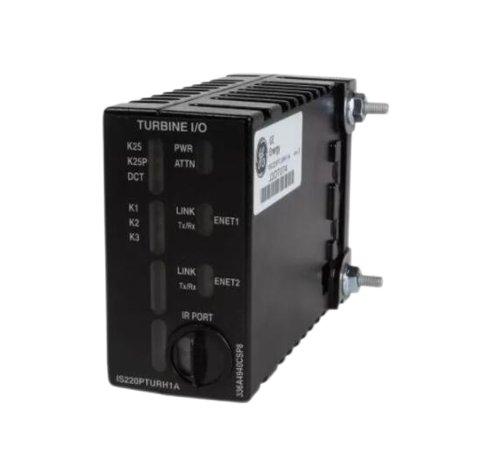
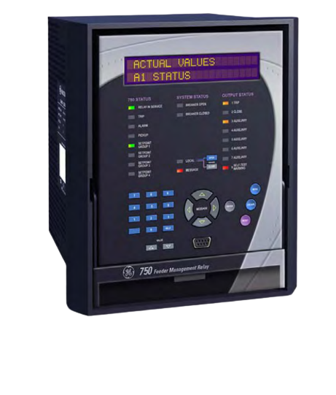
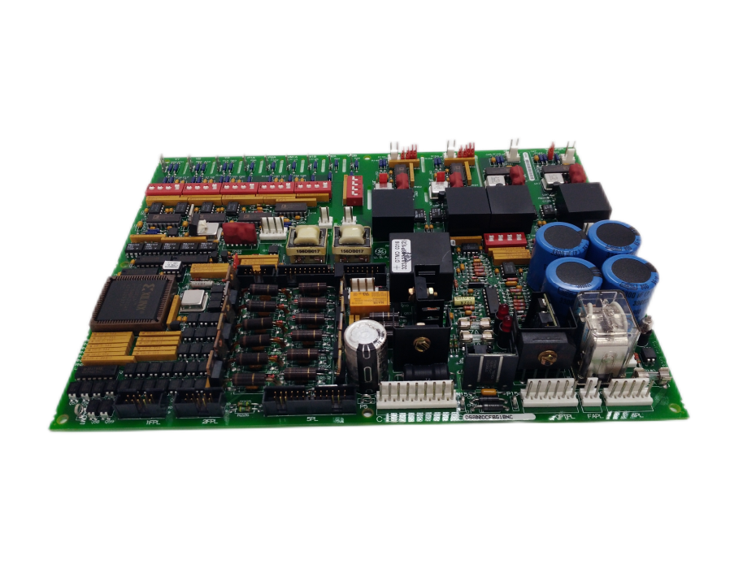
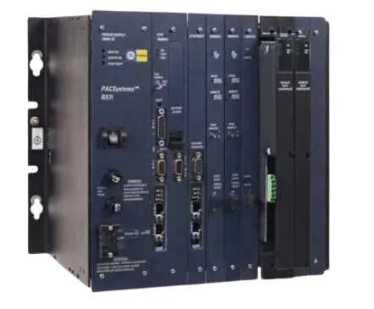
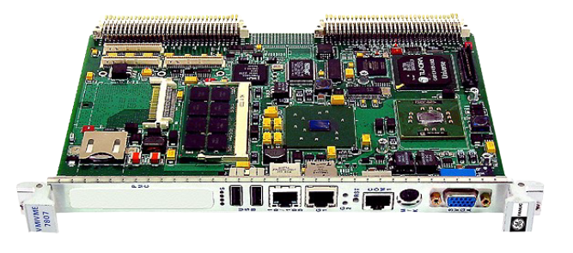
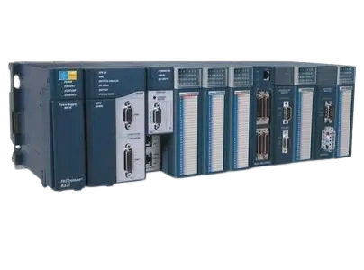
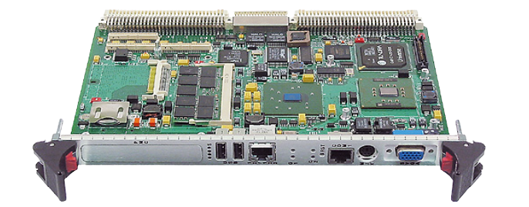
GE main series：
DS200、IS200、IS215、IS220、IS420、IS420、IC698、VMIVME、SR、etc.
Gas turbine card
Relay protection device
IS200WETBH1ABA
IS210BPPBH2BMD
IS215UCVEH2AE
IS220PDOAH1A
IS420ESWBH3A
IS230SNIDH1A
DS200DCFBG1BLC
SR465-P5-HI-A20
SR469-P5-HI-A20-E
SR469-P5-HI-A20-H
SR489-P5-LO-A20-E
SR745-W2-P5-G5-HI
SR369-HI-R-M-0-P-0-E
SR750-P5-G1-S1-HI-A20
CPU module
VMIVME series
IC693CPU350
IC693CPU331
IC693CPU363
IC695CRU320
IC697CPX772
IC698CRE030
VMIVME-7750
VMIVME-7700
VMIVME-7658
VMIVME-4140
VMICPCI-7806
VMIVME-7807RC

Slide 8

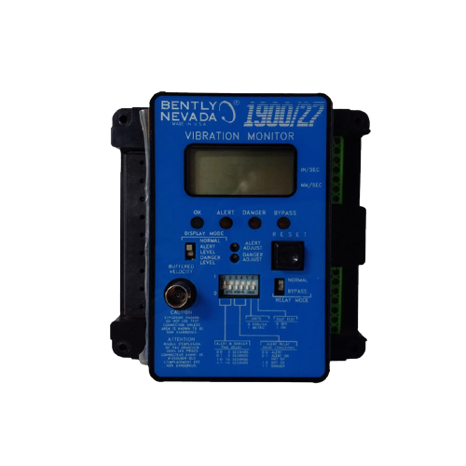
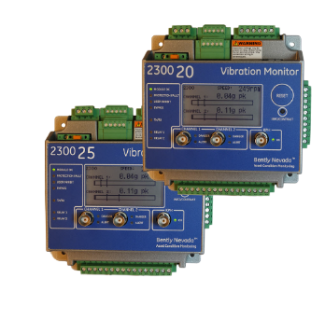
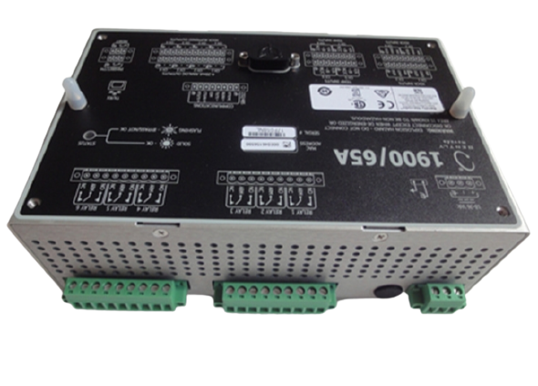
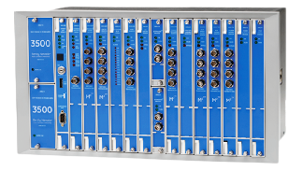
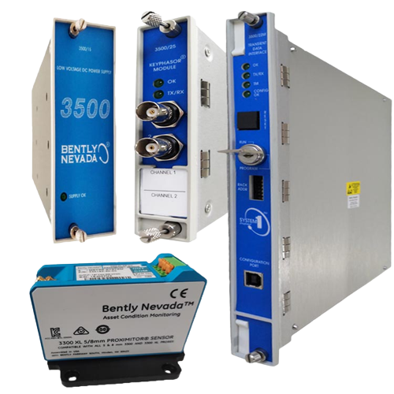
Bently Bentley 3500 mechanical protection system
3500/05 System Rack
3500/15 Power Supply Module
3500/20 Rack Interface Module
3500/22M Transient Data Interface Module
3500/25 Enhanced Keyphasor Module
3500/32 4-Channel Relay Module
3500/33 16-Channel Relay Module
3500/40M Proximitor Monitor
3500/42M Proximitor /Seismic Monitor
3500/34 4-Channel Relay Module
3500/45 Position Monitor
3500/46M Hydro Monitor
3500/50 Tachometer Module
3500/53 Electronic
Overspeed Detection System
3500/60 and 3500/61 Temperature Monitors Modules
3500/62 Process Variable Monitor
3500/72M Rod Position Monitor
3500/77M Recip Cylinder Pressure Monitor
3500/92 Communication Gateway
3500/93 System Display
3500/95 System Integrated PC Display
1900/65A General Purpose Equipment Monitor
1900/15 Vibration Monitor
1900/17 Proximitor® Monitor
1900/25 Vibration Monitor
1900/27 Vibration Monitor
1900/55 Fan Monitor
2300/20 Two Channel Vibration Monitors
2300/25 Vibration Monitor
Bently 3500 Series Mechanical protection
systems are divided into older, upgraded models.
bently3500 Vibration Monitor Module

Slide 9

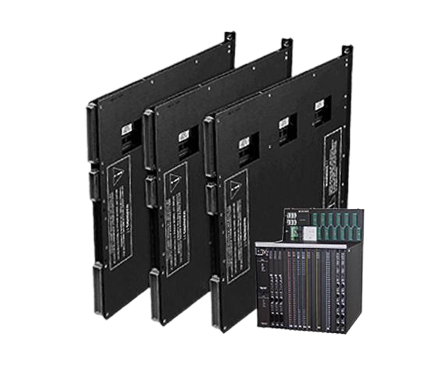
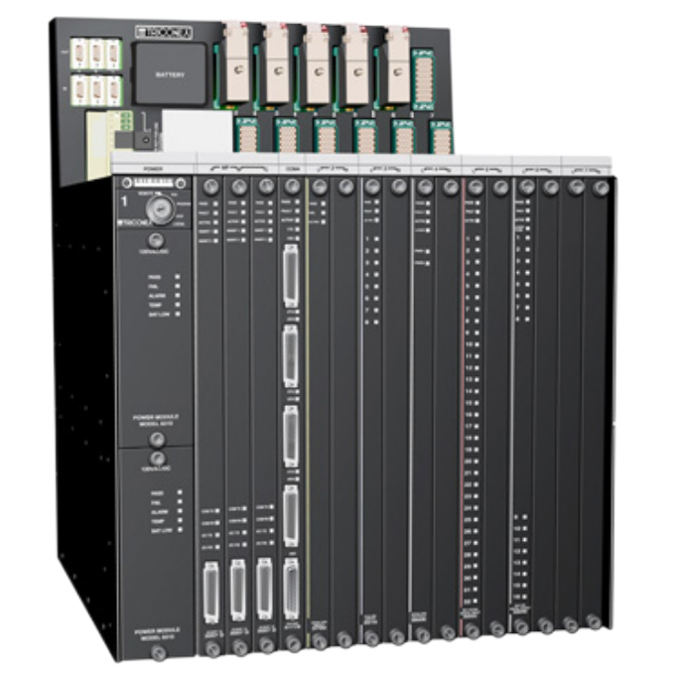
TRICONEX specialises in the manufacture of
safety instrumented SIS systems, ESD systems
8110、8111、8112
Main processor module：
3006、3007、3008、3009
Chassis
3501E、3502E
3503E、3504E
3505E、3564、3506X
8310、8311、8312
Power Module
TMR Digital input module：
3510、3511
TMR Pulse Input Module
3700、3700A、3701
3708E、3721、3720
3703E、3704E、3706E
TMR Analog Input Module：
3805E、3805H
3806E、3807
TMR Analog Output Module
3624、3625、3627
3627、3614E、3623
3664、3667、3636R
3607E、3608E、3611E
3615E、3613E、3617E
3601E/T、3603E、3604E
4351B、4119
4509、4609、4429
4329、4352A、4409
Communication Module
TMR Digital Output Module：

Slide 10

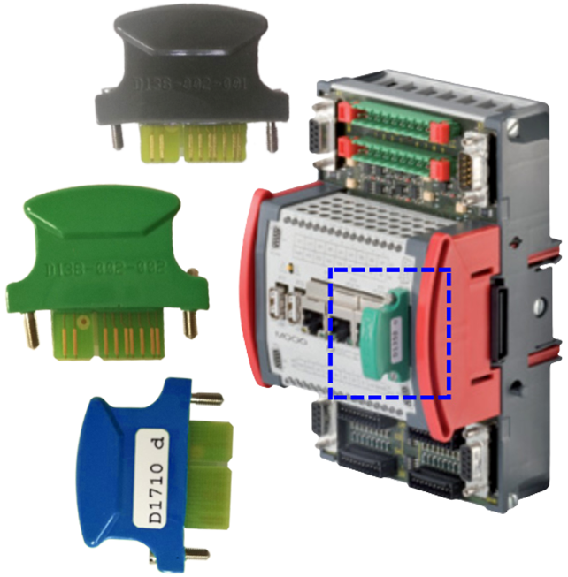
MOOG controllers, dongles
D136、D137、D138
MOOG China is widely used in the injection moulding and aerospace, steel, wind, gas and steam turbine industries, with more steel mills in northern applications
MOOG Controllers
D136-001-007
D136-001-008
D136-002-004
D136-002-005
D137-001-010
D137-002-001
The moog is a freely programmable motion controller of many types and each model has its own dedicated functions to meet the various needs of the customer MSC I and MSC II motion controllers MSC I and MSC II motion controllers are PLC machines for complex central and decentralised control applications. With task handling functions, interfaces and performance differences.
MOOG dongles
D138-002-002
D138-002-012
D138-002-001

Slide 11

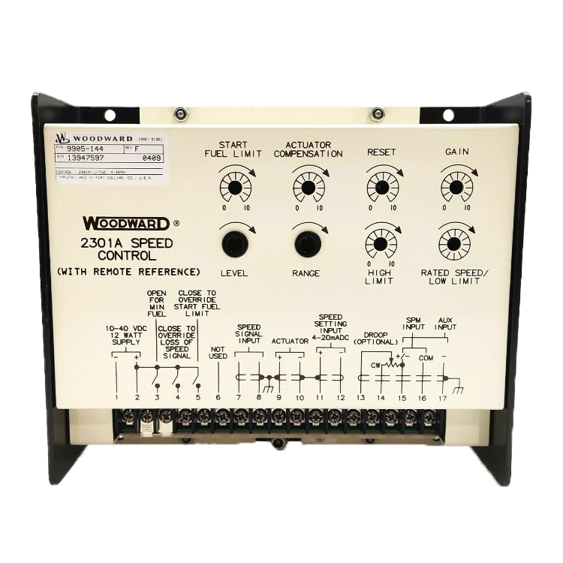
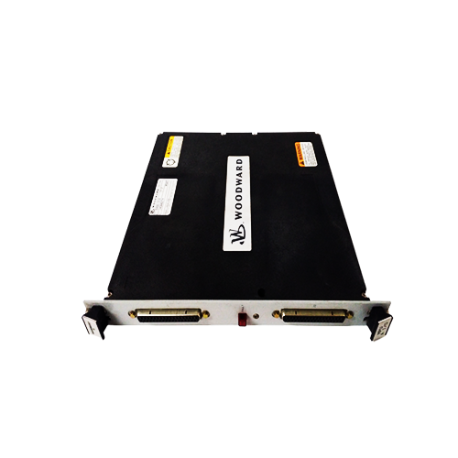
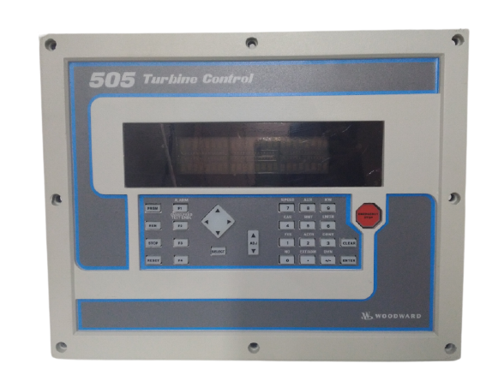
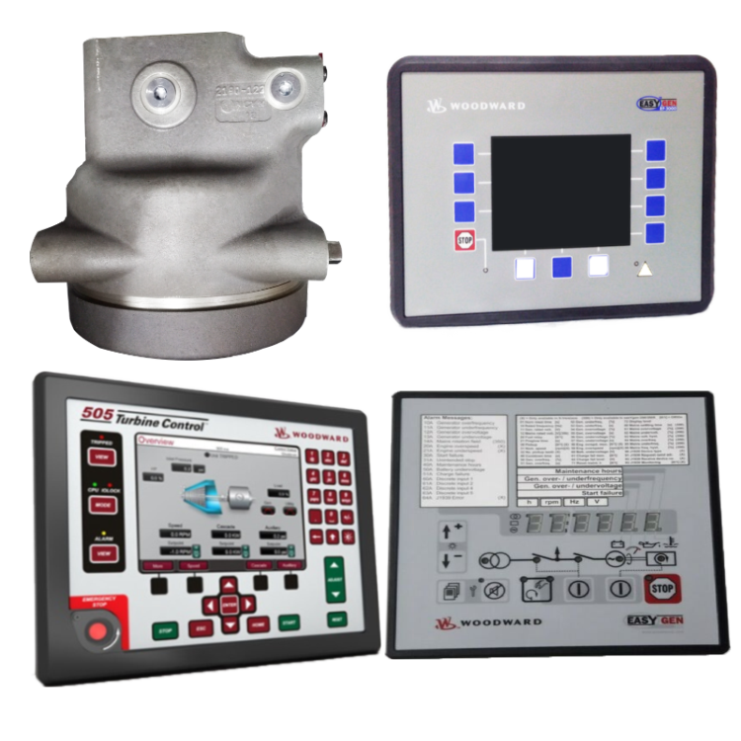
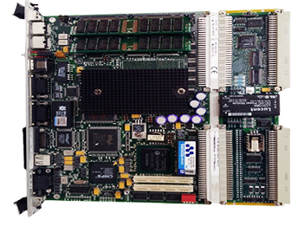
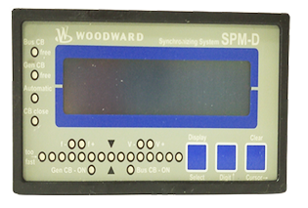
WOODWARD 505/505E digital controller, speed governor
01
02
03
9907 Series
Series beginning with 8
Series beginning with 5
9907-164
9907-162
9907-149
9905-973
9907-165
9907-167
8440-2145
8406-113
8516-038
8446-1019
8237-1600
8200-1300
5501-471
5501-470
5501-467
5466-409
5466-316
5466-258

Slide 12

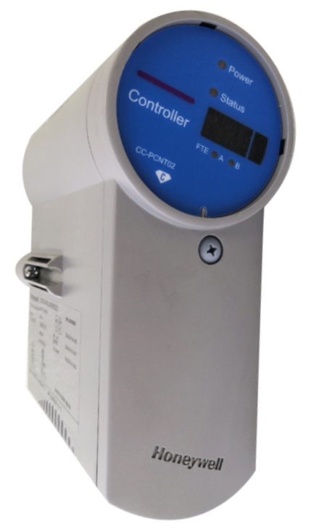
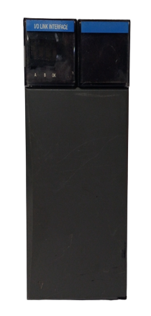
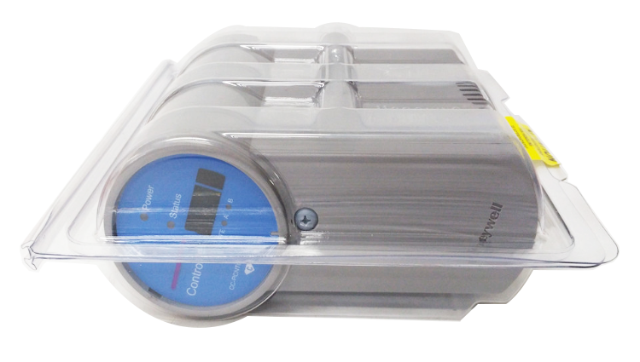
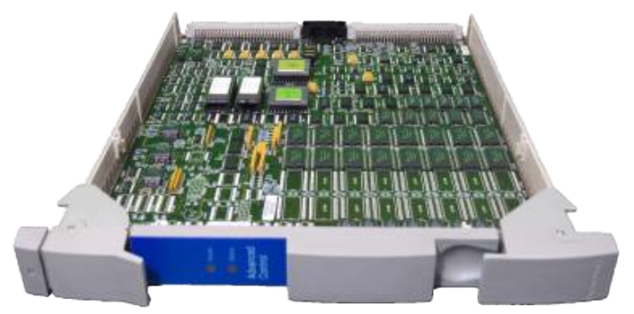
Honeywell International
TC/TK Series
TC-CCR014 TC-ODK161
TC-PRR021 TC-PRS021
TC-PPD011 TC-CCR014
TK-PRS021 TK-FTEB01
TK-IOLI01 TK-FPDXX2
TK-PRR021 TK-RPCXX1
CC Series
Other Series
51 Series
05 Series
51195156-300
51204126-915
51400700-100
51304518-150
05701-A-0301 05701-A-0302
05701-A-0325 05701-A-0326
05701-A-0330 05701-A-0351
05701-A-0361 05701-A-0511
CC-IP0101 CC-PAIH01
CC-PAIH02 CC-PAIH51
CC-PAIM01 CC-PAIN01
CC-PAIX01 CC-PAOH01
CC-PAOX01 CC-PCF901
CC-PCNT01 CC-PCNT02
8C-PCNT01
SAI-1620M
MC-PAIH03
FC-QPP-0002

Slide 13
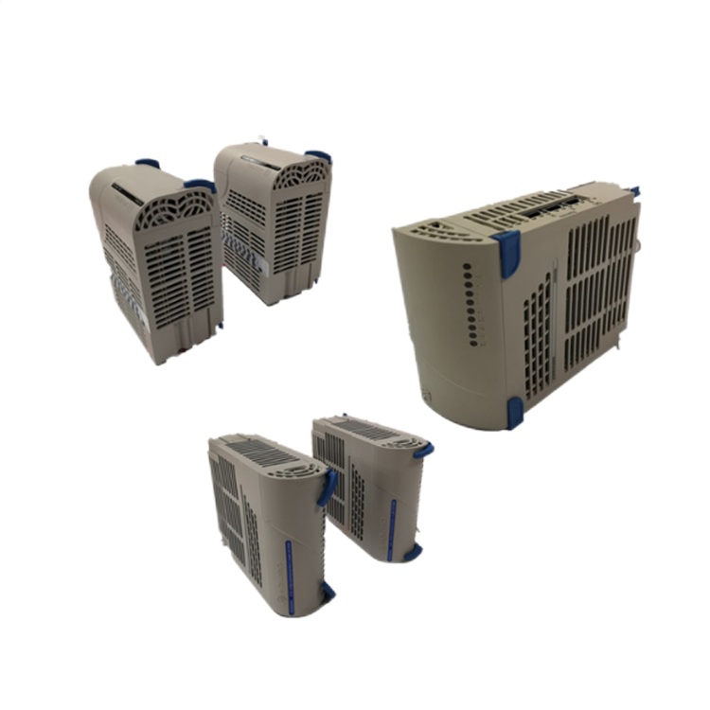
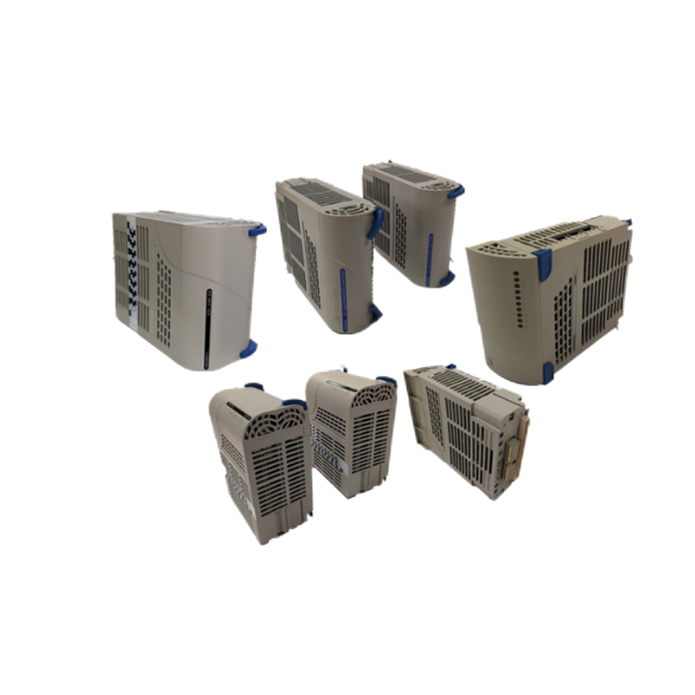
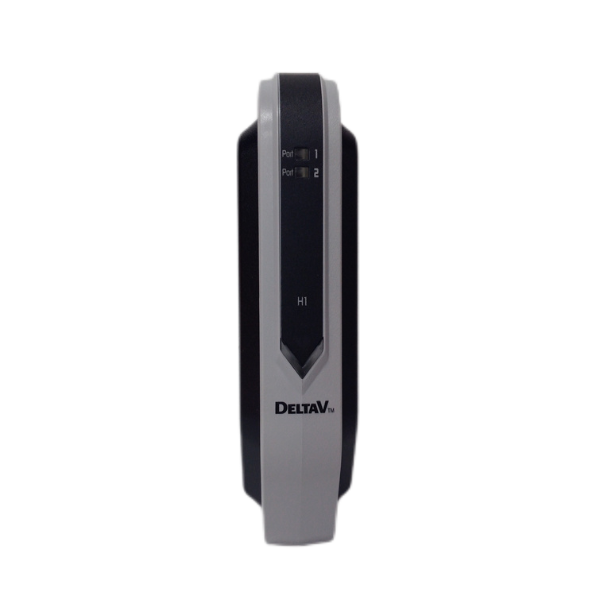
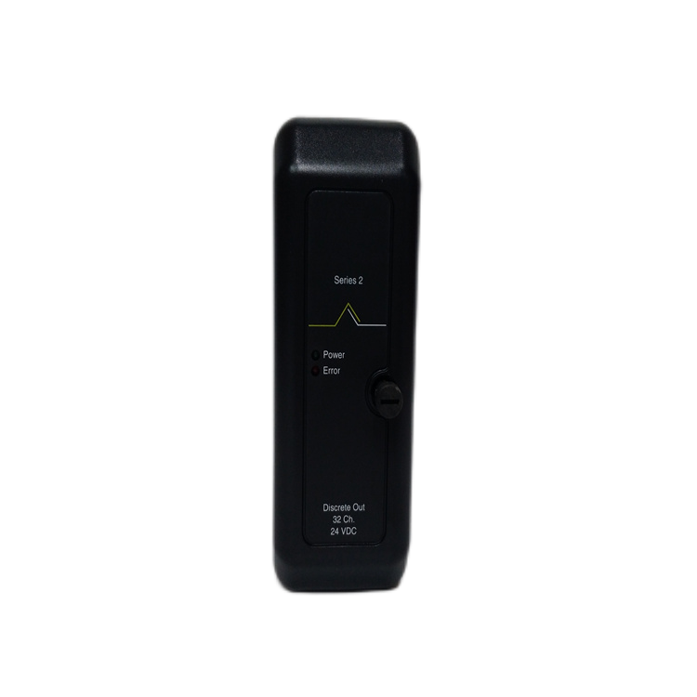
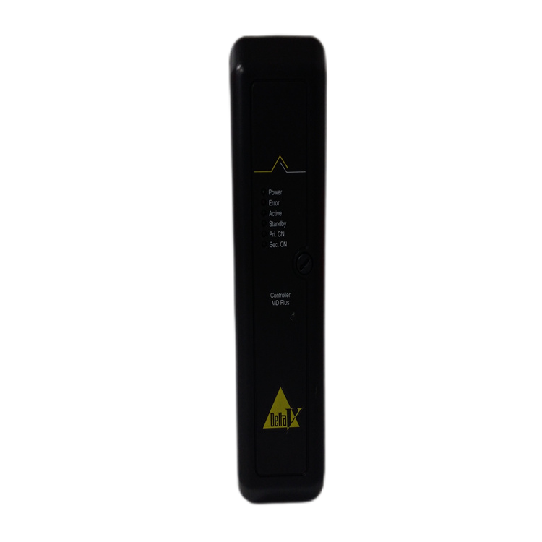
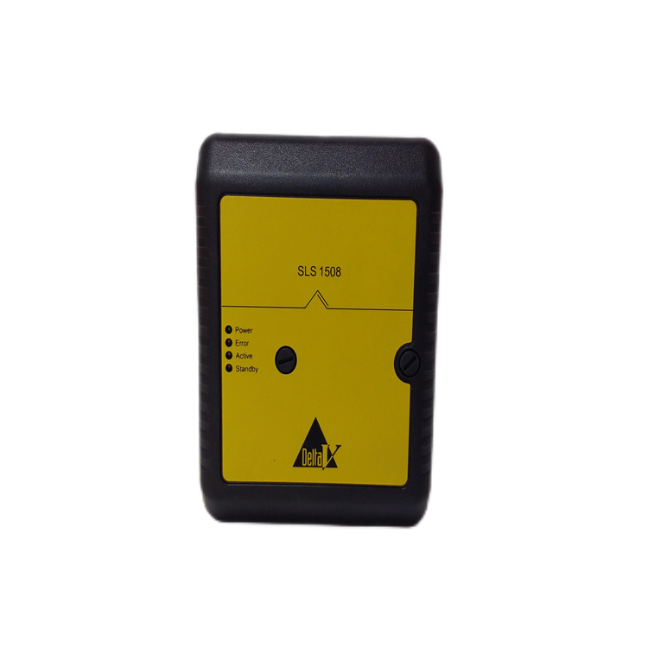
EMERSON / Ovation / WESTINGHOUSE
DeltaV™ Series
VE3007 KJ2005X1-BA1
VE3008 KJ2003X1-BB1
CE3007 KJ2005X1-BA1
CE3008 KJ2005X1-MQ1
SE3007 KJ2005X1-BK1
SE3008 KJ2005X1-MQ2
SLS1508 KJ2201X1-BA1
SE4006P2 KJ3241X1-BK1
5X Series
Other Series
1C Series
5X00622G01
5X00226G04
5X00500G01
5X00499G01
5X00481G04
5X00226G01
A6120
A6210
A6110
A6410
A6824
A6500-UM
1C31232G02 1C31181G01
1C31234G01 1C31132G01
1C31233G04 1C31227G01
1C31194G03 1C31169G02
1C31224G01 1C31169G02
1C31179G01 1C31203G01
1C31189G03 1C31166G02
1C31129G03 1C31222G01

Slide 14

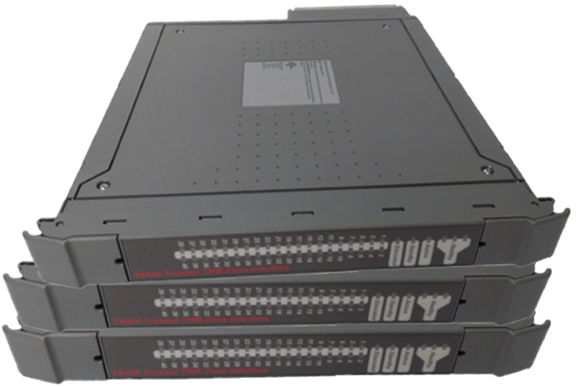




Allen-Bradley
Ics Triplex
RELIANCE
Allen-Bradley
Ics Triplex
RELIANCE
1407-CGCM
1394C-SJT22-A
Y-3023-2-H00AA
1753-L32BBBM-8A
MPM-B1652F-MJ74AA
T8403
T8311
T9451
T9481
T9431
45C224
57C554
0-60002-6
UAZ3222-A
WR-D4004

Slide 15




National Instruments Series：
SCXI、PXIE、PXI、PCI、USB、etc.
SCXI-1000
SCXI-1001
SCXI-1100
SCXI-1102B
SCXI-1104C
SCXI-1193
SCXI-1124
SCXI-1126
SCXI-1140
SCXI-1141
SCXI-1160
PXI-1031
PXI-4071
PXI-4351
PXI-4461
PXI-4462
PXI-6527
PXI-6608
PXI-7340
PXI-8186
PXI-8423
PXI-8461
SCXI
PXI
Other Series
NI-9234、PCI-8517、USB-6363、PXIE-8840、PCIE-1427

Slide 16







Some of the other brands on show
MOTOROLA
FOXBORO
HIMA
F35
F8627X
F8650X
F3330
F8628X
X-CPU 01
MVME5500
MVME5100
MVME162-031
FCP270
FCP280
P0973LN
SCHNEIDER
KOLLMORGEN
REXROTH
140CPU67160
140CPU65260
140CPU67260
CB06551
S21260-SRS
S72402-NANANA
DKC02.3-100-7-FW
MHD041B-144-PG1-UN
VT-HNC100-1-23/W-08-P-0

Slide 17






Product application
Chemical
Automotive
Thermal power
Steel
Plastics
Wind power
Power plant, paper making, steel, mine, rubber, water supply, cement, chemical, glass, printing
Textile, machinery, plastic, paint, medicine, hospital, food, hotel, scientific research institute

Slide 18
Parts (wide selection of components)
Older systems
We offer a wide range of branded quality parts
1
6
We offer you a competent and cost-efficient all-round spare parts service
Warehouse spares
Quality Assurance
Keeping tens of thousands of different discontinued spare parts for you
7
Warranty regardless of price
2
Fast order processing (save time)
Invoice
Rapid turnaround of urgent orders within 24 hours
3
8
Invoicing available
Service Guarantee
Products imported directly
from abroad
Daily growth in stock
Discontinued for many years, we have all the hard-to-find parts
4
9
Cut out the middleman and you get a lower
price for the same product
Special distribution
Offer direct anonymous forwarding
shipments to your customers
Offering unique price advantages and win-win cooperation
5
10
Over a decade of experience successfully delivering anonymously directly to customers

Slide 19


Sincere service
Work hand in hand to win
Notes:
Drag & drop image directly on placeholder. Press reset button from slides ribbon in case image not fit properly.

