Slide 1
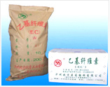
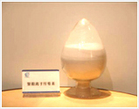
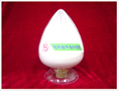
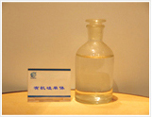

Products List

Slide 2
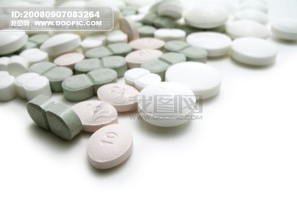

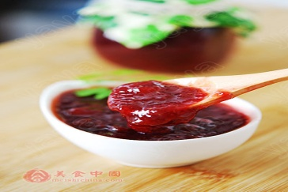
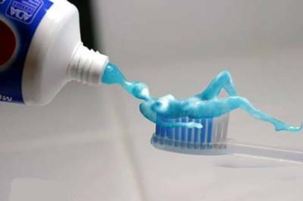
CMC
Sodium Carboxymethyl Cellulose
CMC
Sodium Carboxymethylcellulose (CMC) has good water solubility. It has functions of thickening, binding, water-maintaining, emulsifying, and suspending, etc. in its water solution, so it can be widely used as thickener, water-maintainer, dispersing agent, emulsifier, stabilizer, and adhesive.
The main application fields of CMC are in industries of food, toothpaste, petroleum, medicine, ceramics, welding rod, coating, paper making, construction, etc.

Slide 3

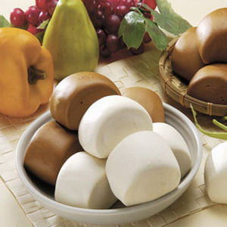
CMC For Food Industries
can be widely used in liquid drinks, lactic acid drinks, dairy products, flouring products, seasoning, etc. with the functions of thickening, emulsifying, stabilizing, water maintaining, mouthfeel improving, toughness reinforcing, and so on.
Liquid drinks and Lactic acid drinks
Dairy products
Flour products
Biscuits, thin pancakes
Instant pastes

Slide 4


CMC For Pharmaceutical Industry
When added into medicine tablet or grain as adhesive and disintegrant, the medicine will be easily processed into some shape and it is helpful to the medicines’ dissolution, digestion and absorption.
CMC can also be used in ointment as dispersant and humectant, and in some liquid medicine, syrup, etc. as suspending agent, emulsifier, stabilizer and so on.

Slide 5
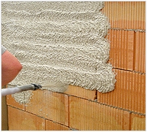
CMC For Coating and Painting
  As a protective colloid, CMC can raise stability of the emulsion-polymer system in a wide PH range.
  It can cause additives like pigments fillings, etc dispersed into coatings.
  It can impart coatings excellent effects of adhesion by coloring matter.
  It can increase the emulsion coatings’ viscosity evidently.
  It can raise the coatings’ leveling property.
  It can improve coatings’ construction properties of spattering resistance and hanging resistance.
Application properties

Slide 6
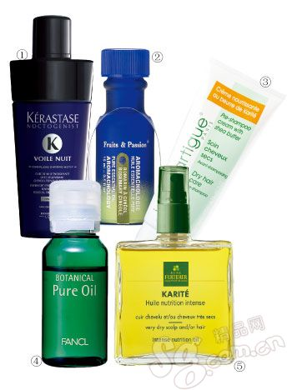

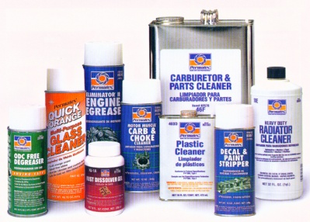

CMC For Cosmetics and
Personal Care
Tooth paste: as the most important matrix, CMC has the properties of paste fine, smooth and uniform, foam plentiful, and high stability. It can impart toothpaste good shape-maintaining and unusual comfortable mouthfeel.
Detergent
Cosmetics

Slide 7

CMC / PAC For Oil Drilling
CMC can be used in Oil drilling industry with the following characteristics：
* It has high power for controlling water loss, and PAC is an especially high effective filtrate volume controller.
* Good and tough mud cake will be formed.
* Having strong salt- and temperature-resistant properties, especially with PAC.
* As a good non-Newtonian fluid, it will effectively control the mud’s rheological property.

Slide 8



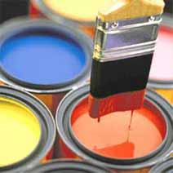
HEC
Hydroxyethyl cellulose
  HEC has functions of:
  thickening,
  binding,
  emulsifying,
  dispersing,
  stabilizing
  water-maintaining.
  It is easily dissolved in cold and hot water to provide a wide range of solution viscosity, It has a good flow regulation. Can be videly used in construction,painting and personal care industries.

Slide 9
HEC For Painting
Functions: In addition thickening to the Latex paint, it has the functions of emulsifying, dispersing, stabilizing and water-retaining. Its properties are significant effect of thickening, and good show clour, film forming and storage stability.
Benefits: HEC is nonionic cellulose ether which can be used in a wide range of pH. It has good compatability with other material, such as pigment, auxiliaries, fillers and salts, good workability and levelling. It is not easy to dripping, sagging and spattering.

Slide 10
HEC for Construction industry
HEC can be used in construction products like concrete mixture, the new mix of mortar, plaster or other cement, etc. playing a role of water retaining during construction process before their condensating and hardening.
HEC can extend mortar or cement’s correction and opening time, reduce crusting, slipping and sagging so as to improving workability and efficiency and saving time, raise the mortar’s compatibilization rate to save raw materials.

Slide 11


HEC for Detergents and Cosmetics
  In shampoo, hair spray, nutralizer, conditioner and cosmetics, HEC is an effective film former, binder, thickener, stabilizer and disperser.
  In powder detergent, it is a dirt redeposition agent. The detergent containing HEC has the evident characteristcs of improving smoothness and silkness of the fabrics.

Slide 12
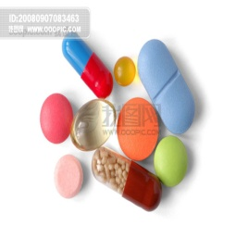

Ethyl Cellulose
EC For Pharmaceutical
In pharmaceutical
mainly used as tablet binder and film coating material, etc.
It is also used as retarder of framework material for preparing various types of matrix sustained-release tablets.
used in hybrid material for preparing coating sustained-release preparation and piller.
used in vitamin and mineral tablets as binder, retarder and moisture proof agent.

Slide 13
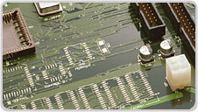

Ethyl Cellulose
EC For Industry
EC can be widely used in various painting, such as metal surface coating, paper product painting, rubber coating, heat-melt coating, and coating for integrated circuit (IC), etc., used in inks like magnetic ink, gravure ink and aniline ink as cold-resistant material, used in special plastics and deposits, for instance coated tape for rocket propellant, used in insulation material and cable coating, used as polymer suspension polymerization dispersant, binder for hard alloy and ceramics, and used in textile Industry as printing paste.

Slide 14

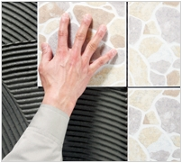
Methyl Cellulose/Hydroxypropyl
Methyl Cellulose For Construction
In Construction:
MC and HPMC are widely used as thickener, emulsifier, film-former, binder, dispersing agent, protective colloids, etc in construction materials, paints, paper making industry, printing, synthetic resins, ceramics, textiles, agriculture, etc.

Slide 15
Hydroxy ethyl methyl cellulose High temperature cellulose ether
For Construction
In Construction:
MHEC main properties compared to ordinary used cellulose ether chemistry:
High temperature stability
Slower cement setting, minor influence on gypsum plaster (Cost saving: dosage of retarders might be lowered, if used)
Sufficient water retention (viscosity dependent)
Overall good workability

Slide 16

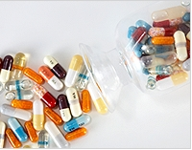
Methyl Cellulose/Hydroxypropyl
Methyl Cellulose For Pharmaceutical
In Pharmaceutical:
MC/HPMC,a multipurpose additive for pharmaceutical, can be functioned as thickener, dispersant, emulsifier, film forming agent, etc. It is used in tablets for dressing and binding to improve solubility of the drugs and reinforce tablets’ water prevention function. It can also be utilized as mixed suspending agent, additive for eye drops, sustained-release agent, and so on. HPMC can be widely used in the fields of detergent and cosmetics industries as thickener and emulsion stabilizer to improve rheologic property.

Slide 17

Methyl Cellulose/Hydroxypropyl
Methyl Cellulose For Food
In Food:
Benefits
Reduces greasiness in fried foods
Prevents fillings from leaking
Provides gel texture to hot foods
Stabilizes whipped desserts
Reduces breading loss
Extends life of frying oil
Applications
Bakery--frostings, icings, breads
Dairy--ice cream, whipping toppings, frostings
Meat and Meat Analogues--veggie patties
Prepared Foods--onion rings, structured potato products, deep-frying batter

Slide 18

Methyl Cellulose/Hydroxypropyl
Methyl Cellulose For Personal care
In Personal care:
MC and HPMC are compatible with most personal care surfactant systems. In particular, HPMC is chosen for its foam enhancing properties in surfactant systems. When used in a shampoo or body wash, the HPMC polymer helps with formation of bubble structure, leading to richer, longer lasting lather.
【Applications】
MC and HPMC are used in a variety of applications in personal care and cosmetics.
Shampoo
Hair styling products
Liquid bubble bath concentrate
Lotions and creams
Liquid soap and body wash

Slide 19
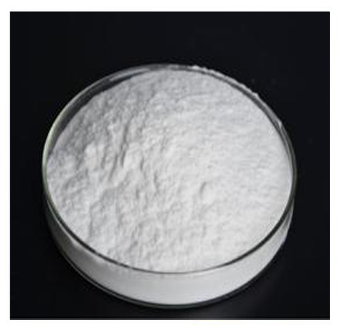
Cellulose Ether For paint stripper
MRP series been developed to paint stripper. MRP series are is not only soluble in cold water, but also some polar organic solvents(Methanol/some organic solvents, IPA, Methylene chloride, etc). It could build viscosity and offer ideal rheology properties in organic solvent.

Slide 20
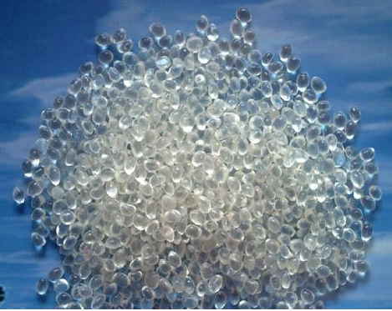
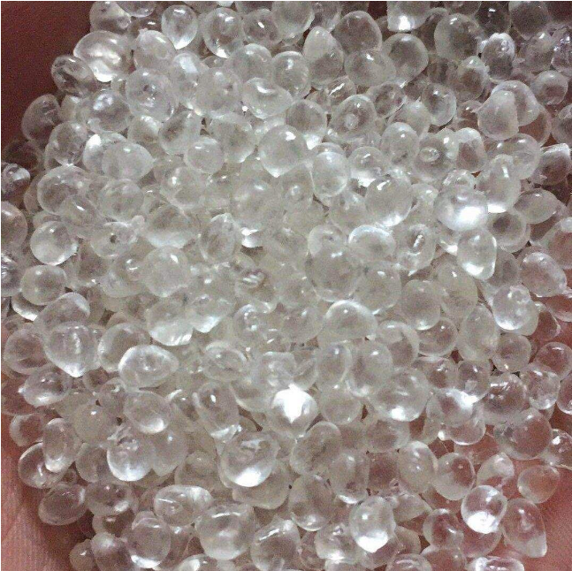
Polyurethane Resin
Strong adhesion to BOPP, PET, NYLO and PE, excellent coating adaptability, perfect transferring to shallow plate, resistance to anti-adhesion of ink, excellent wettability and dispersion of pigments, and excellent dry lamination.

Slide 21
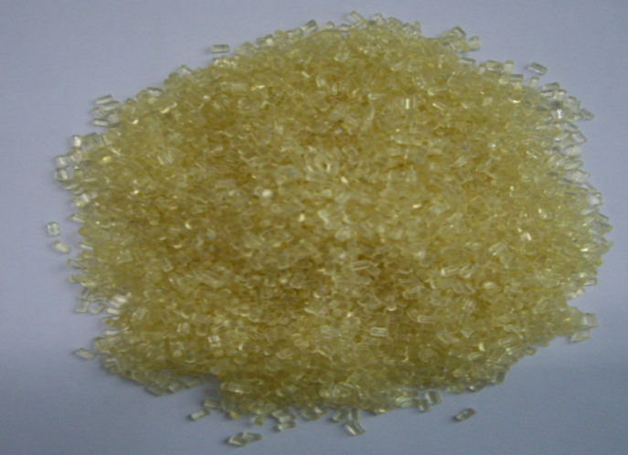
Chlorinated PP
CPP belongs to thermoplastic resin. It has good adhesive force for kinds of base material, such as PP / BOPP.also has good compatibility with polyurethane.

Slide 22
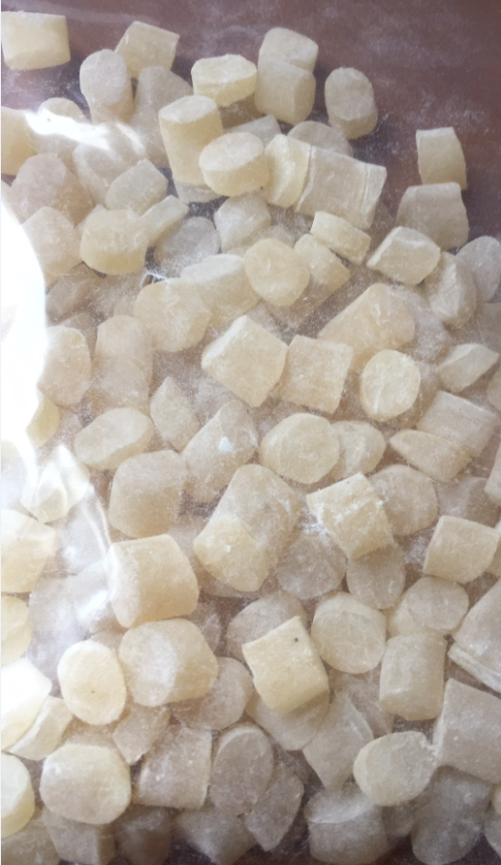
Chlorinated EVA
CEVA is a good binder for plastic products. It is applicable to high grade ink, additives for treatment of fibers, paint for biaxial tension polypropylene film and laminating agent for polyethylene / polypropylene films. It has been widely used in composite ink for high grade plastics in order for improving the ink’s adhesive strength, ink property, glossiness and the pigment’s dispersilbility, wettability and cold resistance, etc.

