Slide 1


Fountain Technologies Co., Ltd
One-stop Electronics Manufacturing Services
PCB Manufacturing丨Component Sourcing丨PCB Assembly丨Testing
Presentation

Slide 2
Contents
01
About us
02
Company development
03
03
Application
04
Production Capacity
05
Product show
06
System Management

Slide 3



About us
Fountain technologies is a national high-tech enterprise established in 2016, which is committed to provide one-stop services for samples & small-big volume orders and specializing in PCB manufacturing, component sourcing, PCB assembly and testing.
FT has 3,000m² work area, 7 SMT lines and 2 DIP lines for production. Meanwhile, FT has experienced and skilled R&D team, excellent and professional sales, effective and efficient customer service team, productive and technical procurement team, as well as qualified and trusted assembly testing team. All of these make a guarantee for our quality and delivery time.
Our services includes: 1-40 layers all kinds of PCB manufacturing, professional, components sourcing, PCB assembly and testing. We have advantage in quick quotation, manufacturing and delivery, especially for samples and small-big volume orders.

Slide 4
Company milestones
80%
66%
40%
20%
2022-2023
Pass the certification IATF16949, Passed GJB 9001C-2017 cert, and got 2 new SMT lines, then total have 7 SMT lines and provide the large Qty ODM service.
2020-2021
2018-2019
Build a new SMT factory, Enlarge the factory to 2000㎡. Have ISO14001 certification.
Passed ISO14001 and IATF16949 cert. Monthly output exceeded 20,000 sq.m, set 5 automatic SMT lines.
2016-2017
PCB factory established and passed ISO9001 cert. Set a new quick turn line for rush orders.

Slide 5
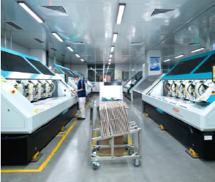
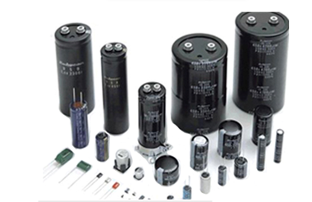
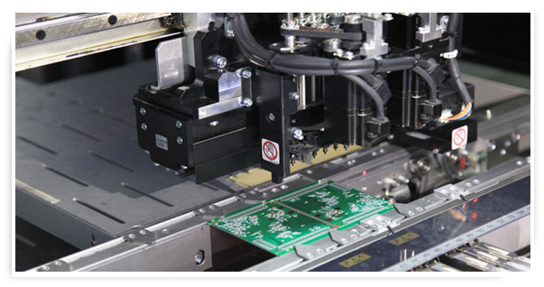
  One-stop Services
PCB Manufacturing
Components Sourcing
PCB Assembly
Manufacture 1-40 layer PCB including rigid, flex-rigid, HDI, FPC, MCPCB.
Professional purchasing team, own international purchasing channel and high quality standard.
Advanced equipments and experienced engineers make a guarantee for assembly.

Slide 6
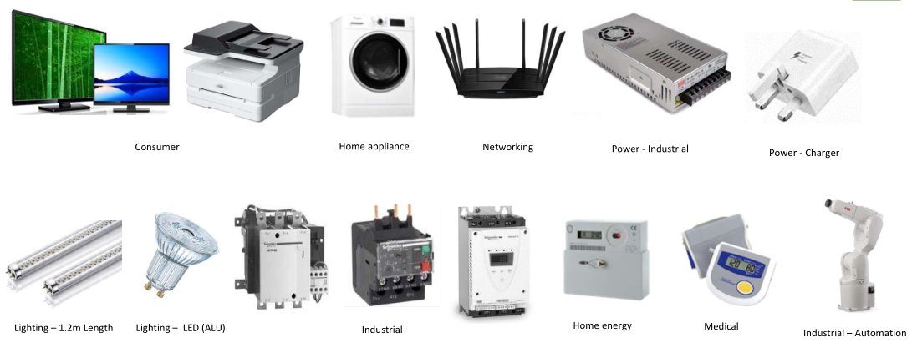
  Application

Slide 7
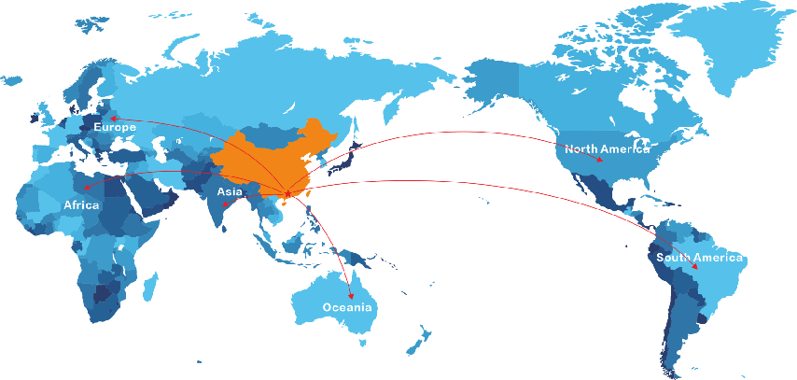
Customer distribute

Slide 8
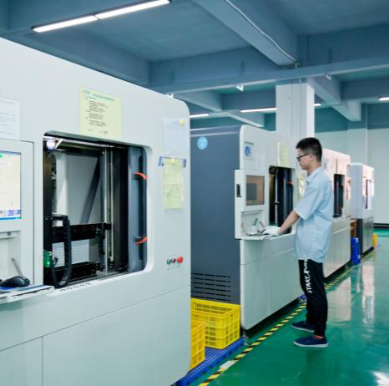
PCB Capability
Item | Capability
Layers | 1-40 L
Material | FR4,High-Tg，Halogen Free，TU, Rogers，Isola，Taconic，Arlon，Teflon，AL, Coppe core. PI
Max. Panel Dimension | 646mm*1500mm
Outline Tolerance | ±0.10mm
Board Thickness | 0.2mm-8.0mm
Board Thickness Tolerance | ±10%
Min. Track Width | 3mil
External Cu Thickness | 18um-350um（HOZ-10OZ）
Drilling Bit Size(CNC) | 0.15mm-6.50mm
Finished Hole Dimension | 0.1mm-6.0mm
Hole Tolerance | ±0.05mm
Hole Position Tolerance | ±0.05mm
Plugged Hole Diameter | 0.20mm-0.50mm
Solder Mask | Green，Blue，White，Black，Red，Yellow，Purple, etc.
Surface Finishing | HASL，HASL(Lead Free)，Immersion Gold，Immersion Tin，Immersion Silver，OSP，Hard Gold( up to 100u”)
基本情况简介
加入你的标题

Slide 9
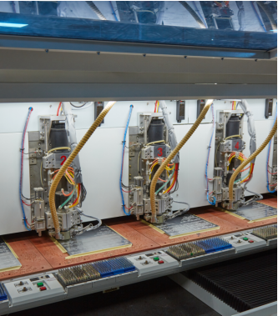
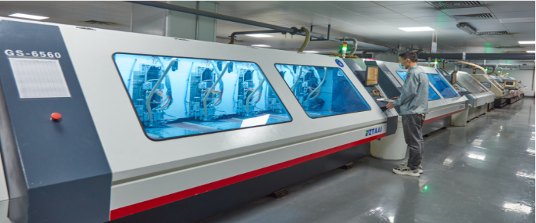
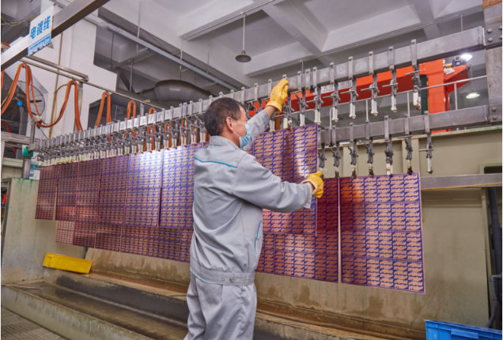
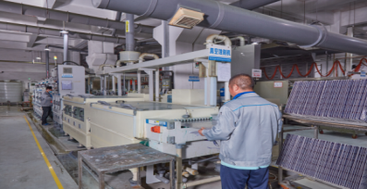



Production workshop

Slide 10

TEAM STRENGTH

Slide 11
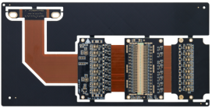
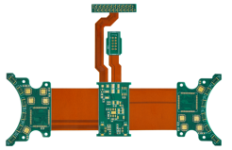
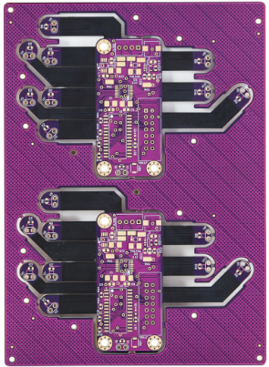
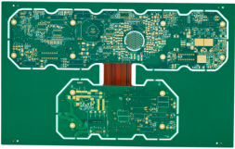
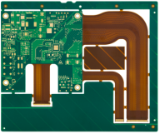

FLEX-RIGID PCB
Material：FR-4+PI
Thickness：2.0mm
Layer：8
Min. trace：4.0mil
Min. spacing：3.0mil
Min. hole：0.25mm
Surface finish：ENIG, gold：2U″
Product feature：laser blind&buried hole, resin plug-hole，pyralux material
Material：FR-4+PI
Thickness：1.6mm
layer：4
Min. trace：5.0mil
min. spacing：5.0mil
Min. hole：0.20mm
Surface finish：ENIG, gold：2U″
Material：FR-4+PI
Thickness：1.6mm
Layer：4
Min. trace：4.0mil
min. spacing：4.0mil
Min. hole：0.20mm
Surface finish：ENIG, gold：2U″
Product feature：Purple solder mask
Material：FR-4+PI
Thickness：2.4mm
Layer：8
Min. trace：5.0mil
Min. spacing：5.0mil
Min. hole：0.25mm
Surface finish：ENIG
Product feature：resin plug-hole
Material：FR-4+PI
Thickness：1.6mm
Layer：6
Min. trace：3.0mil
Min. spacing：3.0mil
Min. hole：0.20mm
Surface finish：ENIG+Plated gold
Product feature：golder finger with 50U" gold

Slide 12

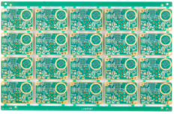
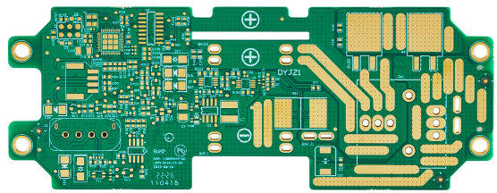
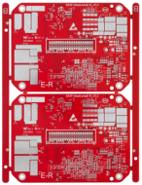
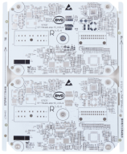

AUTOMOTIVE ELECTRONICS
Material：FR-4，Tg170
Thickness：1.6mm
Layer：4
Min. trace：3.0mil
Min spacing：2.8mil
Min. hole：0.2mm
Product feature：resin plug hole
Material：FR-4，Tg150
Thickness：2.0mm
Layer：6
Min. trace：3.0mil
Min spacing：3.0mil
Min. hole：0.25mm
Surface finish：ENIG
Product name：Car 360-view board
Material：FR-4，Tg180
Thickness：2.0mm
Layer：6
Min. trace：6.0mil
Min. spacing：6.0mil
Min. hole：0.25mm
Surface finish：ENIG, gold：2U″
Product name：Blade battery control board
Material：FR-4，Tg140
Thickness：1.6mm
Layer：4
Min. trace：5.0mil
Min. spacing：5.0mil
Min. hole：0.25mm
Surface finish：HASL
Product name：New energy lamp board
Material：FR-4，Tg140
Thickness：1.6mm
Layer：4
Min. trace：6.0mil
Min spacing：5.0mil
Min. hole：0.25mm
Surface finish：HASL

Slide 13
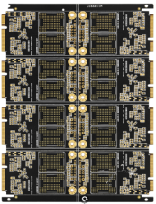
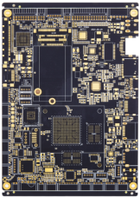
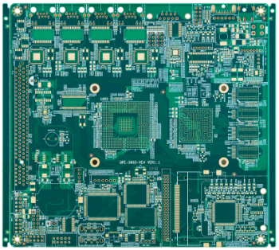
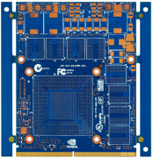


INDUSTRY CONTROL
Material：FR-4 Tg150
Thicness：1.0mm
Layer：8
Min. trace：4mil
Min spacing：4mil
Min. hole：0.2mm
Surface finish：Plated gold+ENIG
Product feature：Traceless gold finiger
Material：FR-4 Tg150
Thickness：1.6mm
Layer：8
Min. trace：3.0mil
Min. spacing：3.0mil
Min. hole：0.2mm
Surface finish：ENIG
Product feature：resin plug-hole
Material：FR-4，Tg180
Thickness：2.0mm
Layer：6
Min. trace：6.0mil
Min. spacing：6.0mil
Min. hole：0.25mm
Surface finish：ENIG, gold：2U″
Product festure：resin plug-hole
Material：FR-4 Tg180
Thickness：2.0mm
Layer：10
Min. trace：3.5mil
Min spacing：3.5mil
Min hole：0.2mm
Surface finish：plated gold+osp
Product feature：gold finiger+OSP
Material：FR-4 Tg180
Thickness：6.0mm
Layer：12
Min. trace：4.0mil
Min. spacing：4.0mil
Min. hole：0.25mm
Surface finish：plated gold 120u"
Product feature：high-layer+partly plated gold

Slide 14
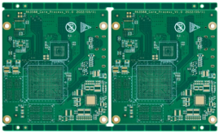
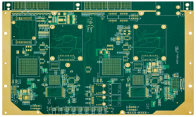
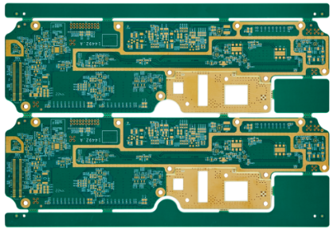
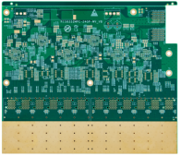
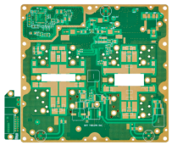

MILITARY ELECTRONICS
Material：FR-4，Tg150
Thickness：1.6mm
Layer：8
Min. trace：3.5mil
Min. spacing：3.5mil
Min. hole：0.20mm
Surface finish：ENIG, gold：2U″
Product feature：HDI with sequential lamination(two lamination cycles)
Material：FR-4，Tg180
Thickness：2.0mm
Layer：16
Min. trace：3.5mil
Min. spacing：3.5mil
Min. hole：0.20mm
Surface finish：ENIG, gold：2U″
Product feature：Impedance controlled
Material：FR-4+ceramic
Thickness：2.0mm
Layer：6
Min. trace：4.0mil
Min. spacing：4.0mil
Min. hole：0.20mm
Surface finish：ENIG, gold：2U″
Product feature：shoulder hole+grout hole
Material：FR-4，Tg180
Thickness：1.6mm
Layer：14
Min. trace：4.0mil
Min. spacing：4.0mil
Min. hole：0.20mm
Surface finish：ENIG
Product feature：HDI with sequential
Material：Ceramic（Rogers4350B）
Thickness：1.6mm
Layer：6
Min. trace：4mil
Min. spacing：4mil
Min. hole：0.20mm
Surface finish：ENIG

Slide 15
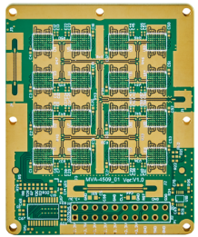
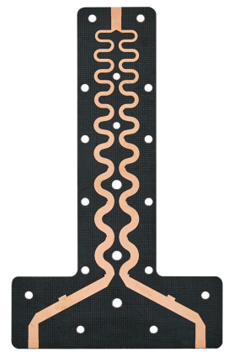
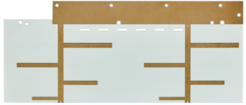

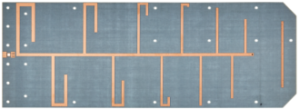

COMUN & NAV
Material：FR-4+ceramic
Thickness：2.0mm
Layer：16
Min. trace：8mil
Min. spacing：8mil
Min. hole：0.2mm
Surface finish：ENIG
Product feature：HDI with sequential lamination+back drill
5G base station signal board
Material：Ceramic(Rogers4350B)
Thickness：0.5mm
Layer：2
Layer finish：ENIG
Product feature：Rogers4350B
Material：PTFE
Thickness：0.5mm
Layer：2
Min. hole：3.0mm
Surface finish：OSP
Product feature: microwave-dielectric
Material：PTFE
Thickness：2.0mm
Layer：2
Min. trace：2.0mm
Min. spacing：OSP
Product feature：High-frequency material
Material：PTFE
Thickness：0.5mm
Layer：2
Surface finish：Immersion Tin
Product feature：Rogers5880

Slide 16
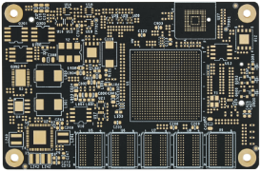
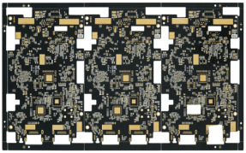
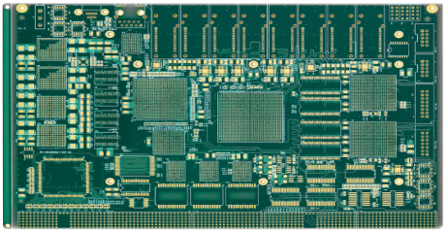
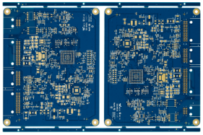
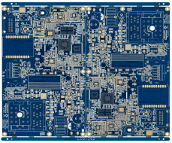

MEDICAL EQUIPMENT
Material：FR-4，Tg150
Thickness：1.6mm
Layer：6
Min. trace：4mil
Min. spacing：4mil
min. hole：0.25mm
Surface finish：ENIG, gold：2U″
Product feature：matt black, 4mil solder mask dam
Material：FR-4，Tg180
Thickness：1.6mm
Layer：10
Min. trace ：4mil
Min. spacing：4mil
min. hole：0.12mm
Surface finish：ENIG, gold：2U″
Product feature：HDI with sequential lamination
Material：FR-4，Tg150
Thickness：2.0mm
Layer：6
Min. trace：6.0mil
Min. trace：6.0mil
Min. spacing：0.25mm
Surface finish：ENIG, gold：2U″
Product feature：resin plug-hole
Material：FR-4，Tg150
Thickness：1.6mm
Layer：8
Min. trace：4mil
min. spacing：4mil
Min. hole：0.25mm
Surface finish：ENIG, gold：2U″
Product feature：ENIG
Material：FR-4，Tg150
Thickness：1.6mm
Layer：12
Min. trace：3.5mil
Min. spacing：4mil
Min. hole：0.2mm
Surface finish：ENIG, gold：2U″
Product feature：high-layer board

Slide 17
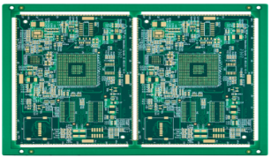
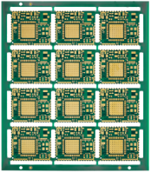
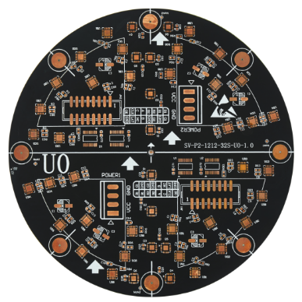
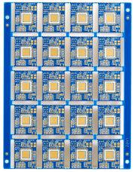
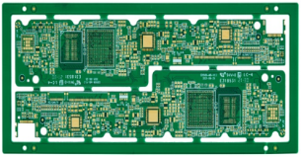

CONSUMER ELECTRONICS
Material：FR-4，Tg180
Thickness：2.0mm
Layer：6
Min. trace：4.0mil
Min. spacing：4.0mil
Min. hole：0.25mm
Surface finish：ENIG, gold：2U″
Product feature：HDI with sequential lamination(two lamination cycles)
Material：FR-4，Tg150
Thickness：0.8mm
Layer：4
Min. trace：4.0mil
Min. spacing：4.0mil
Min. hole：0.15mm
Surface finish：ENIG, gold：2U″
Product feature：half-hole
Material：FR-4
Thickness：2.0mm
Layer：6
Min. trace：4.0mil
Min. spacing：4.0mil
Min. hole：0.20mm
Surface finish：OSP
Product feature：resin plug hole
Material：FR-4，Tg150
Thickness：1.0mm
Layer：10
Min. trace：3.0mil
Min. spacing：3.0mil
Min. hole：0.1mm
Surface finish：ENIG, gold：2U″
Product feature：HDI with sequential
Material：FR-4，Tg150
Thickness：0.8mm
Layer：8
Min. trace：3.0mil
Min. spacing：3.0mil
Min. hole：0.1mm
Surface finish：ENIG, gold：2U″
Product feature：HDI with sequential lamination

Slide 18
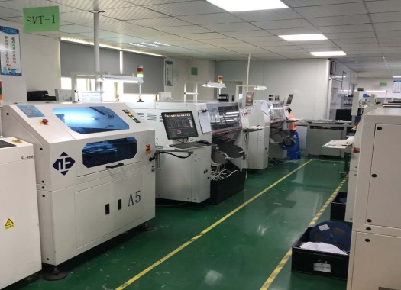
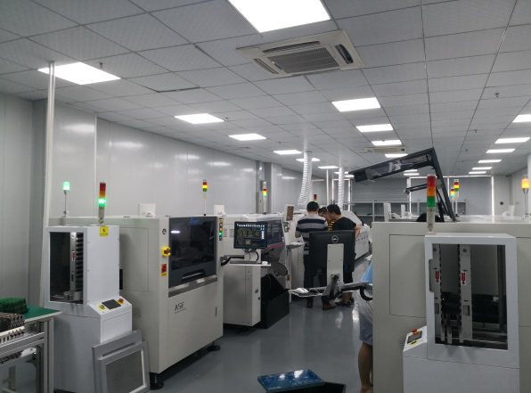
SMT Capability
Material Type | Item | Min | Max
PCB | Dimension（length, width, height mm） | 50*50*0.38 | 600*400*4.2
 | Weight |  | 1.8KG
 | Special dimension(mm) |  | 1200*400*4.2
Components | Chip and IC | 0201（0.5*0.25） | 55mm
 | BGA Pitch | 0.3mm
 | QFP Pitch | 0.3mm
Type | Solder Points | SMT Points | Qty | Lead time | Expedited delivery
SMT |  | ＜70,000 | 5-200 | 2 WD | 8 H
SMT |  | ＜150,000 | 201-2000 | 3-4 WD | 2 WD
SMT |  | ＜300,000 | ≥2000 | 5 WD | 3 WD
SMT+DIP | ＜10 | ＜70,000 | 5-200 | 3-4 WD | 2-3 WD
SMT+DIP | ＞10 | ＜70,000 | 5-200 | 4-5 WD
SMT+DIP | ＜10 | ＜150,000 | 201-2000 | 4-8 WD
SMT+DIP | ＞10 | ＜150,000 | 201-2000 | 5-10 WD
SMT+DIP |  |  | ≥2000 | More than 8 WD

Slide 19
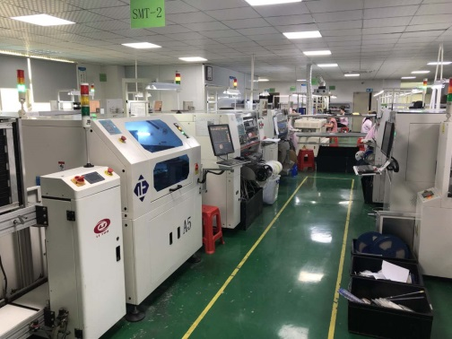
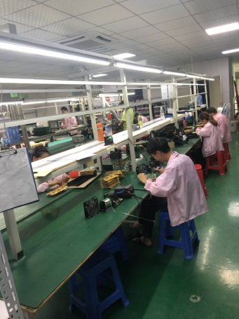
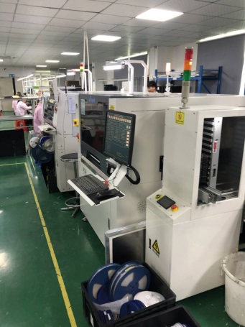
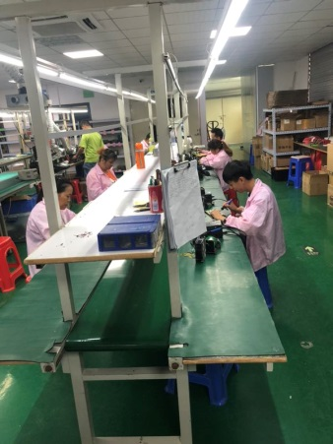
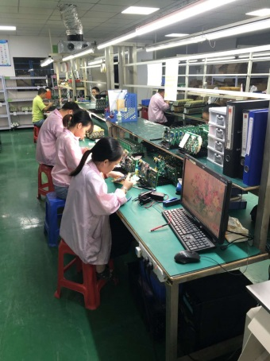
PCBA Factory 1

Slide 20
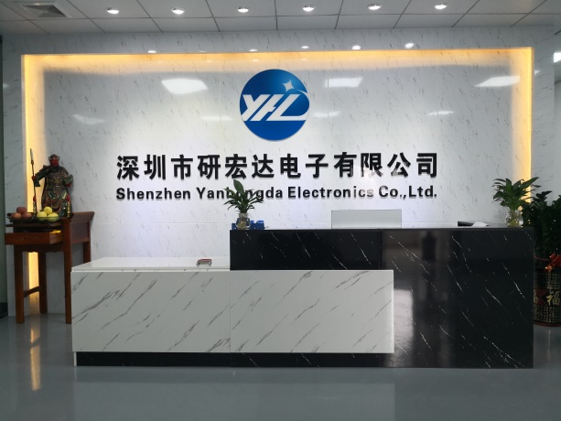



PCBA Factory
PCBA Factory

Slide 21








PCBA Products
PCBA for Communication
PCBA for Electric Machinery
Medical equipment PCBA
Internet PCBA
网络云拼接处理器板
工业控制板
PCBA for LED
PCBA for Security Equipment
行车记录仪板
PCBA for Industry Control
LED灯板
Driving Recorder PCBA

Slide 22
Why choose us?
Quick Delivery
Reasonable Price
Special samples deliver with 48 hours. Prototype deliver within 3 days. Small lot deliver within 4-6 days.
Reasonable price with high quality products
Standardized Process
Closed Cooperation
New assembly and Testing equipment. 7 Inspection process, according strictly to IPC-A-610F standard
We want to be a partner of clients. Always feed back quickly. Win-Win

Slide 23


STRATEGIC PARTNERS
Main cutomers for PCB
Main suppliers

Slide 24




















Our Customers for PCBA

Slide 25

Thank you!
YHD Electronics Limited

