Slide 1

Welcome Brightz Interconnection system Pvt.Ltd
Is Manufacturer, Supplier & Exporter Of Wire Harnessing, Enclosure Wiring & Integration, Power Cables, Cable Assemblies, Cabinet Integration, Aerospace, Defense, E V Wire Harness, Automotive Cable & wire Assemblies, Ethernet Cable Harness, RF network Cable Harness.

Slide 2
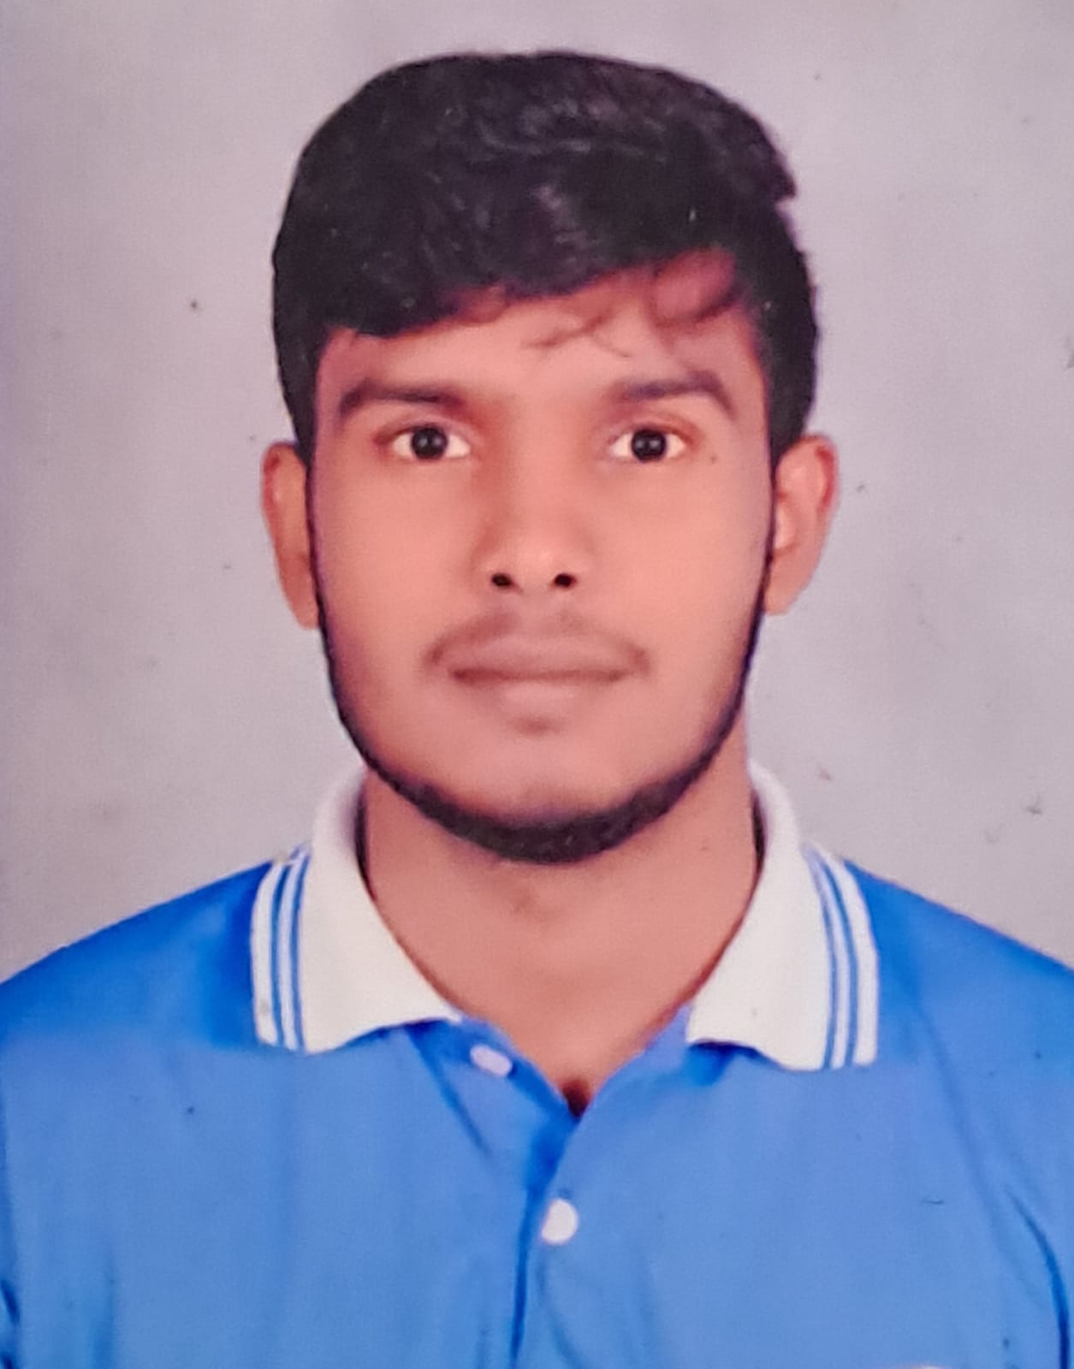
I am Jagadeesha S., founder of Brightz Interconnection System Pvt. Ltd.
We have with 10+ years experience in the cable & wire harness manufacturing field. Per-wisely, worked with Aerospace, Defense, EV, Medical, automotive wire harnesses & cabinets customers. In Trasccon, Centum, Amphenol, Nysha Mobility.
I formally launched this company on May 27, 2024.

Slide 3
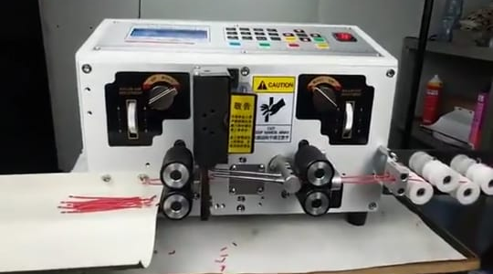
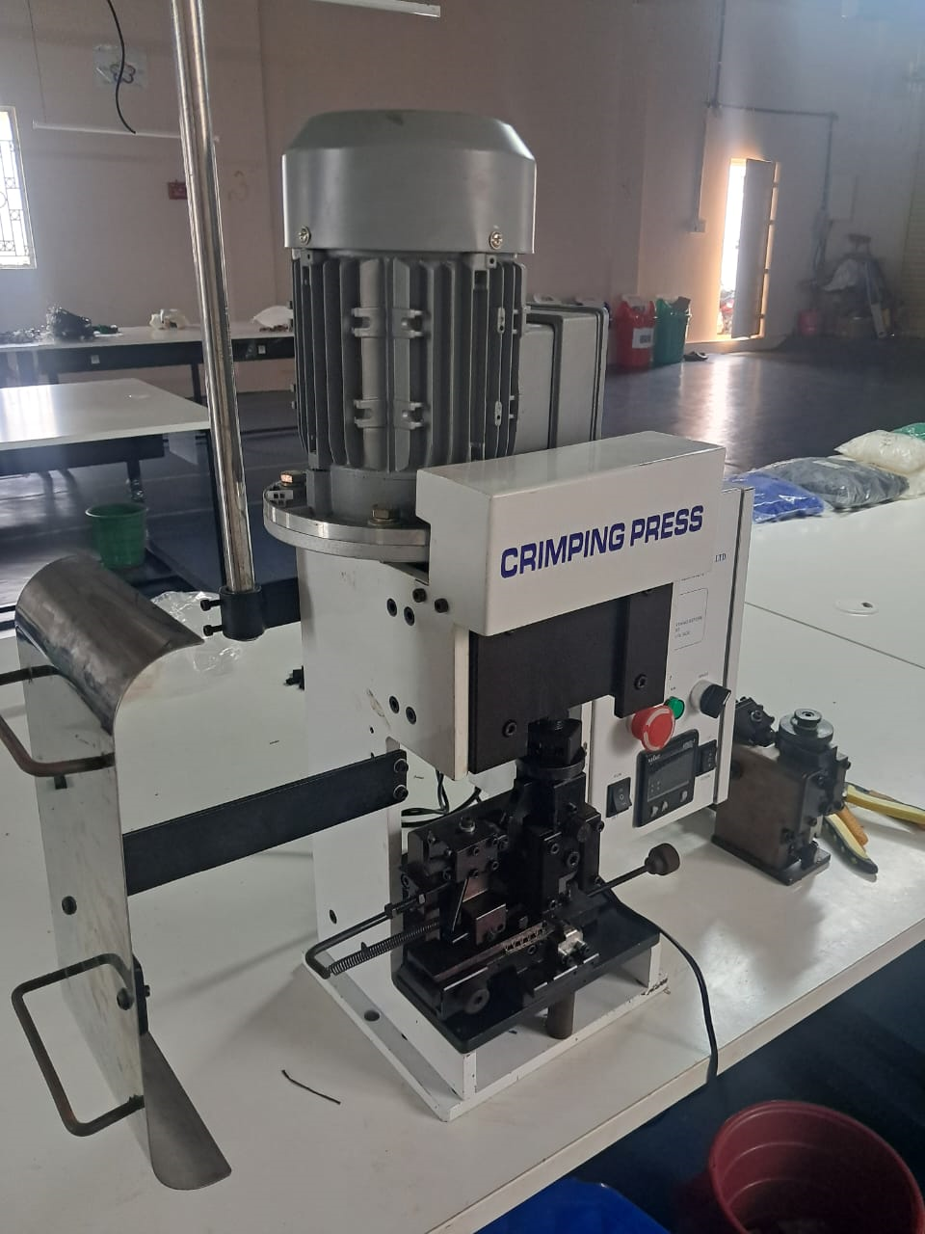
We have automatic cable & wire cutting & stripping machine , wire crimping machine, dedicated applicator, crimping tools, toggle press, soldering stations, Hot air Gun, & etc..
We have 5 members more the 3~4 years experience & 7 no’s Operators
purchase dept.: 1
Engineer dept. 1
Stores & Accounts: 1

Slide 4

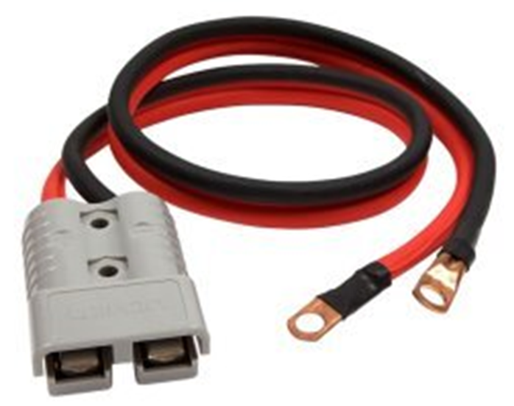
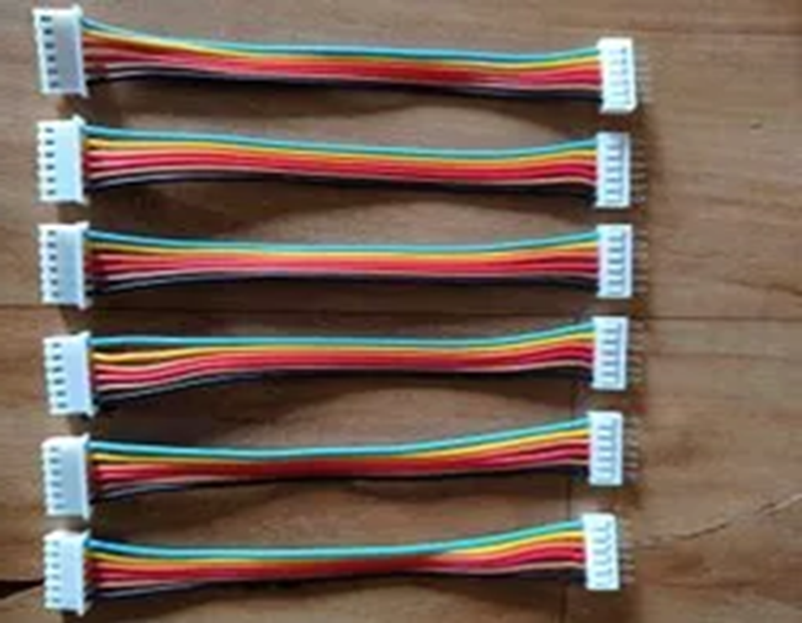
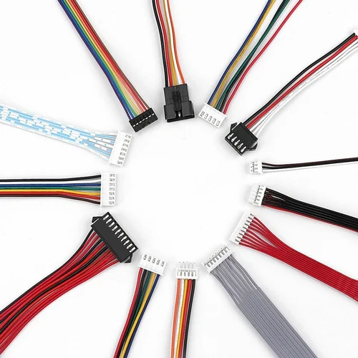
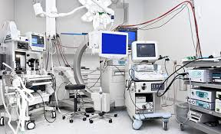
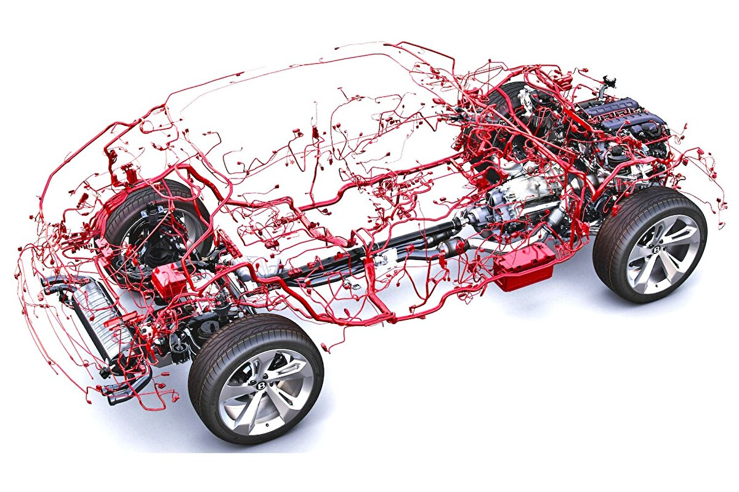
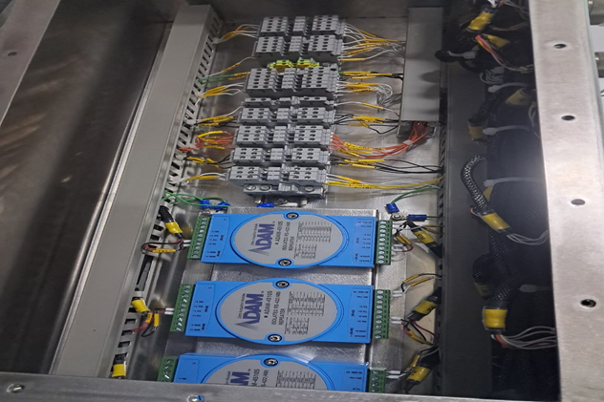

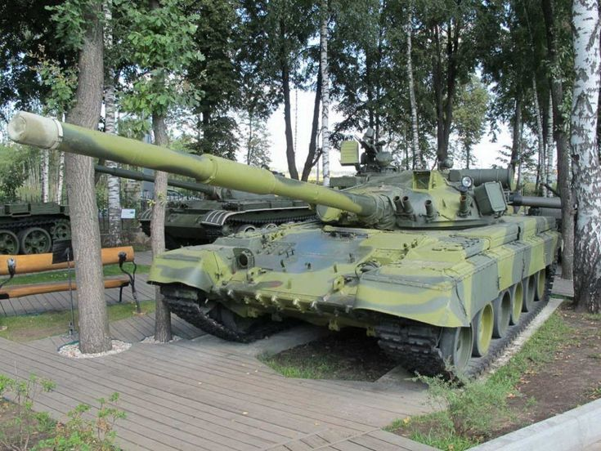
Relimate Harness For PCB
Relimate Harness For PCB
Medical equipment’s cable Harness
EV Battery Cable
Defense Cabinets wiring
Aerospace wiring Harness
Military equipment’s wiring Harness
Automotive wiring Harness

Slide 5
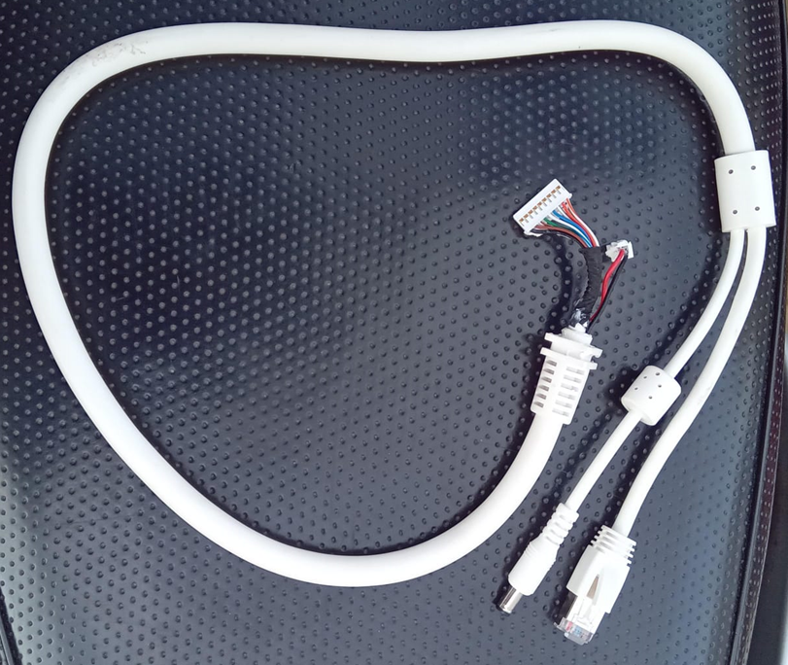
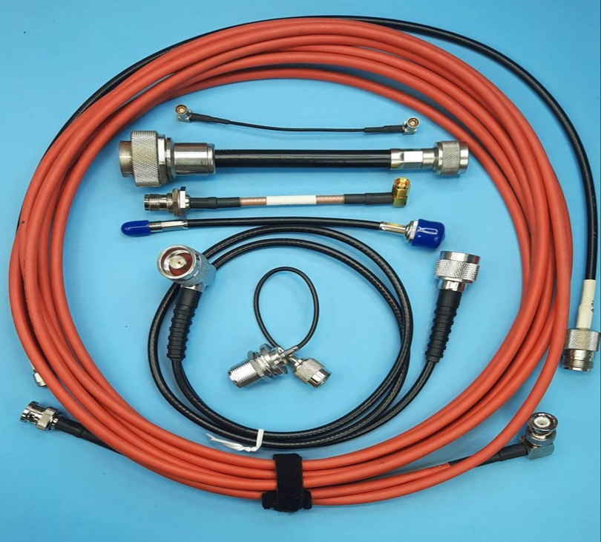
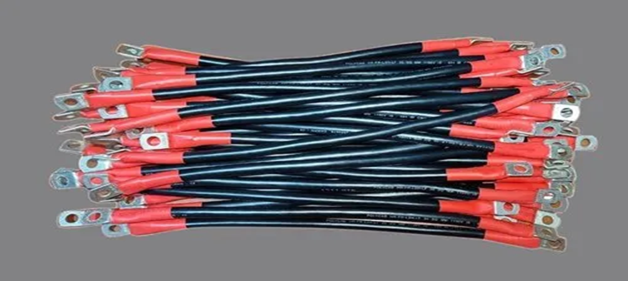
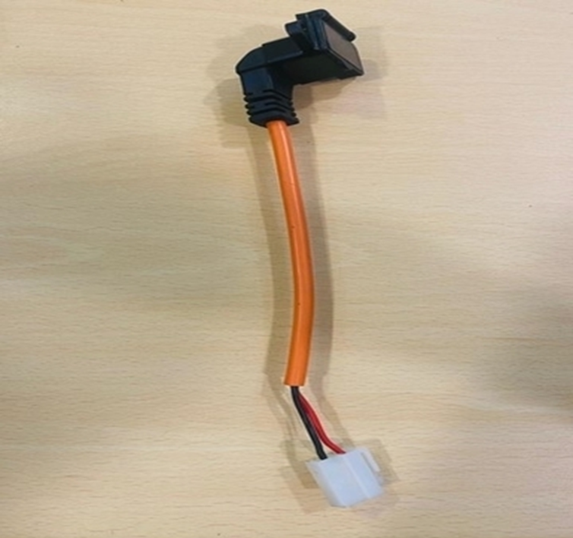
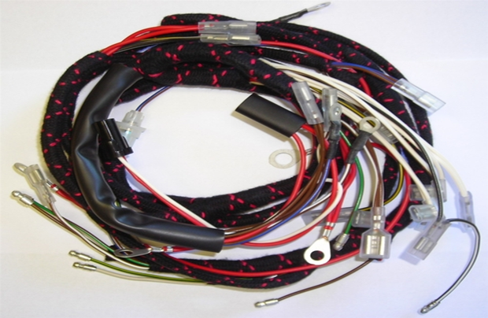
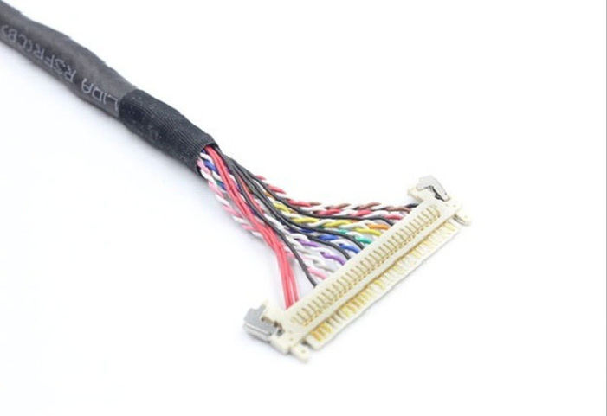
CCTV Cable Harness
RF Network Cable Harness
Phase Cable
EV Cable Harness
LVDS Cable Harness
EV Charger Ex Cable Harness

Slide 6
Inventory & Quality
Will keep inventory on PO release_ Lead time 7~10 days.
RM availability we will make FIFO (First In First Out) based on purchases date.
Supplier base with Chennai & Delhi
On open PO will hold material
We have motorized pullout tester for Quality part production and assurance
Dedicated customized applicators (Locally mfg)
Semiautomatic Wire cutting, Stripping operation
Semiautomatic Crimping machine with 2ton capacity

Slide 7







Clients who we have presently
VAIDEHEE INDUSTRIES
Vetech Electronic

Slide 8
Thank You
Email: - brightzinterconnectionsystem@gmail.com
Mobile: - +918553099116
Website: - brightzsystem.com
Address: - 74/7 Pemmanahalli Village Sompura Hobli Nelamangala Taluk Dabaspet Bangalore Rural - 562111

