Slide 1
Metal Napkin Rings/Napkin holders
By – MAHY Handicrafts
Note- All sizes and designs are customizable as per buyer needs.

Slide 2
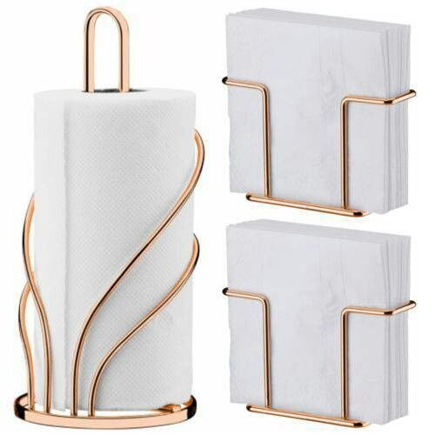
ITEM NO. – MH9982
ITEM NAME – IRON ROSE GOLD NAPKIN HOLDER
SIZE – TISSUE HOLDER-H23 X W10CM X L10CM
NAPKIN HOLDER – H11CM X L11CM X W4.5CM
MATERIAL - IRON
FINISH – ROSE GOLD PLATING (EPL)

Slide 3
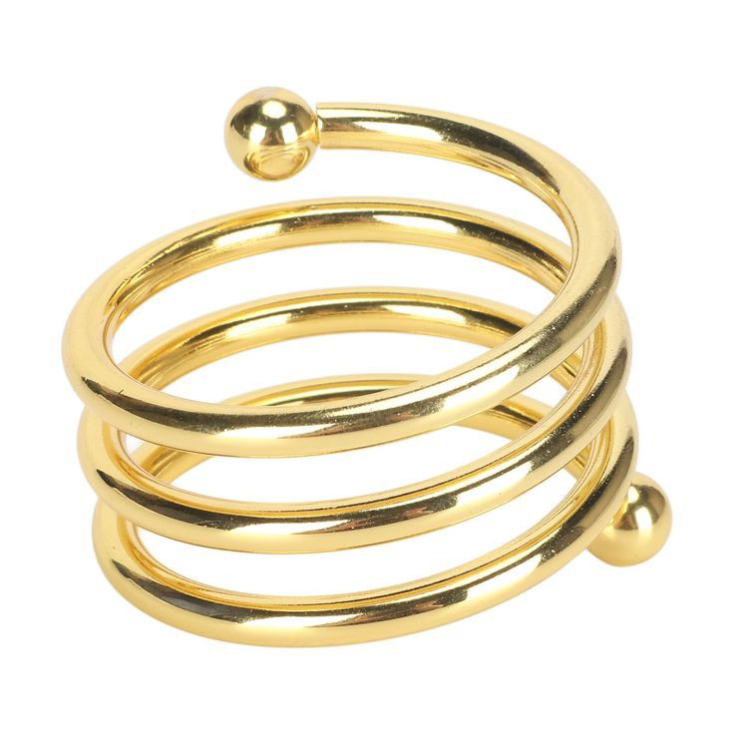
ITEM NO. – MH9986
ITEM NAME – IRON GOLDEN NAPKIN
SIZE – H4CM X L5CM X W5CM
MATERIAL – IRON
FINISH – GOLDEN PLATING (EPL)

Slide 4
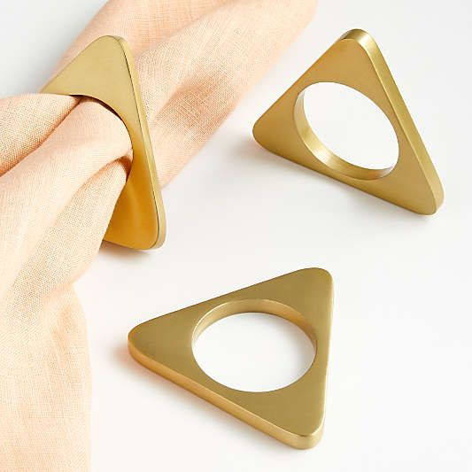
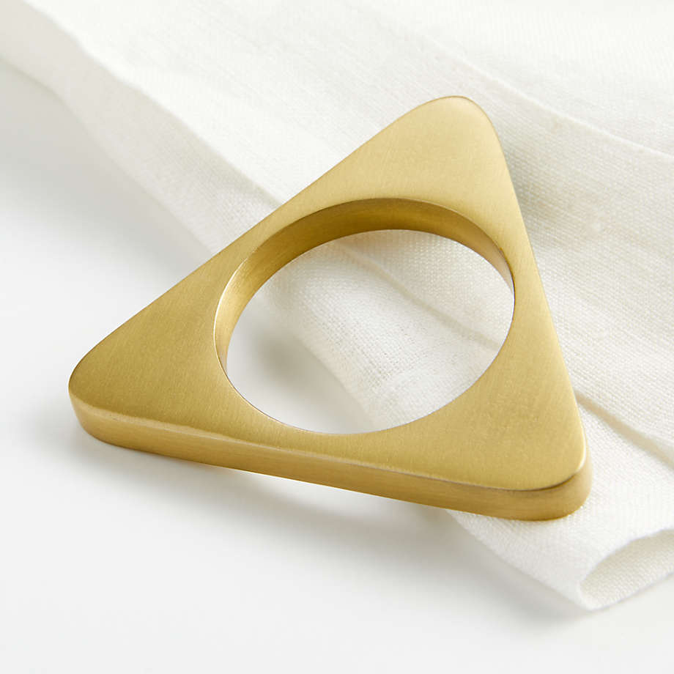
ITEM NO. – MH9988
ITEM NAME – BRASS TRIANGLE NAPKIN RING
SIZE – TRIANGLE – 5CM
INSIDE HOLE – 4CM
MATERIAL – BRASS
FINISH – GOLD PLATING (EPL)

Slide 5
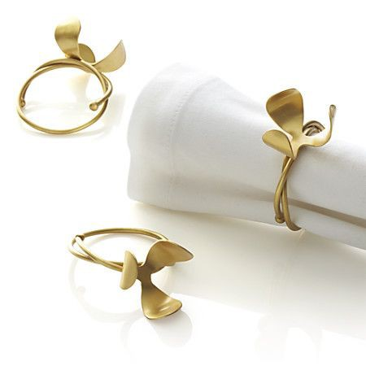
ITEM NO. – MH9989
ITEM NAME – BRASS LEAVES NAPKIN RING
SIZE – FLOWER 4CM
RING 5CM
MATERIAL – BRASS
FINISH – BRASS PLATING

Slide 6
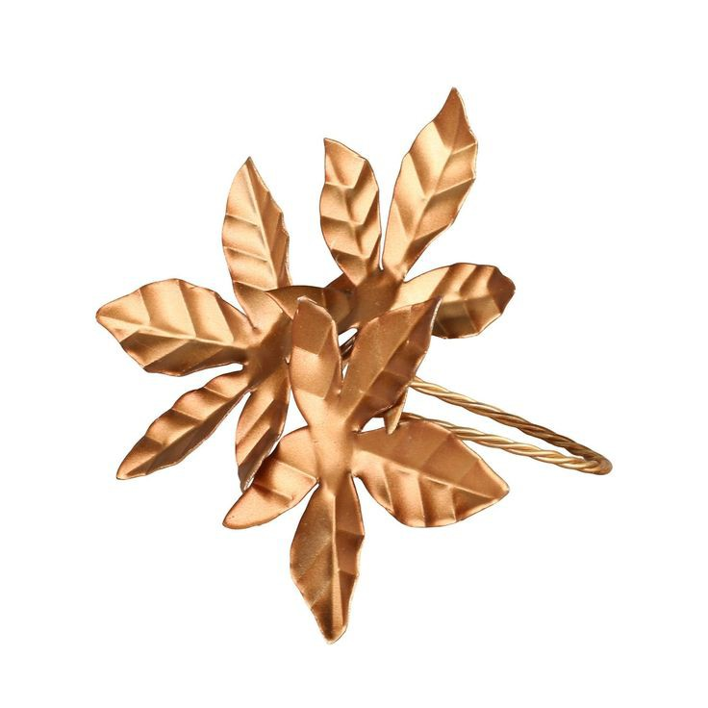
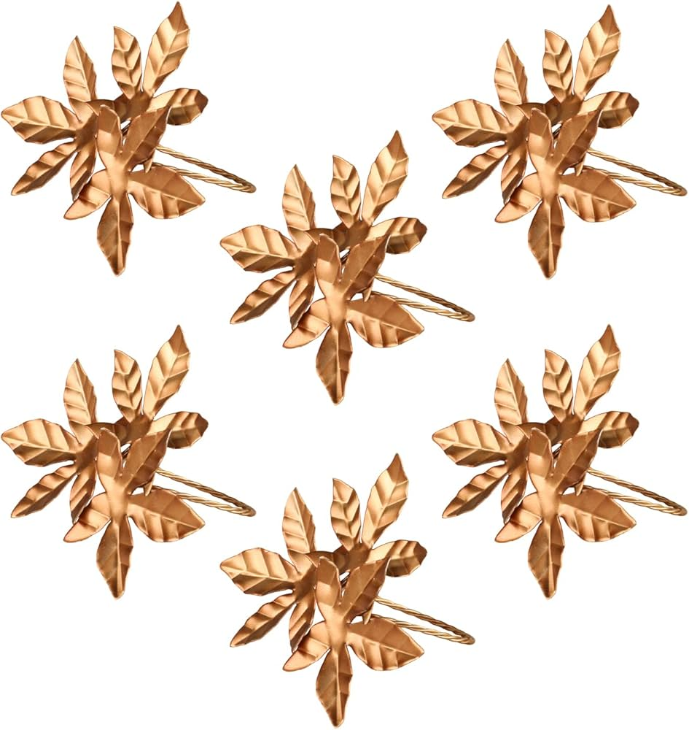
ITEM NO. – MH9990
ITEM NAME – IRON FLORAL NAPKIN RING
SIZE – LEAFE 6CM
RING 4.5CM
MATERIAL – IRON
FINISH – ROSE GOLD PLATING (EPL)

Slide 7
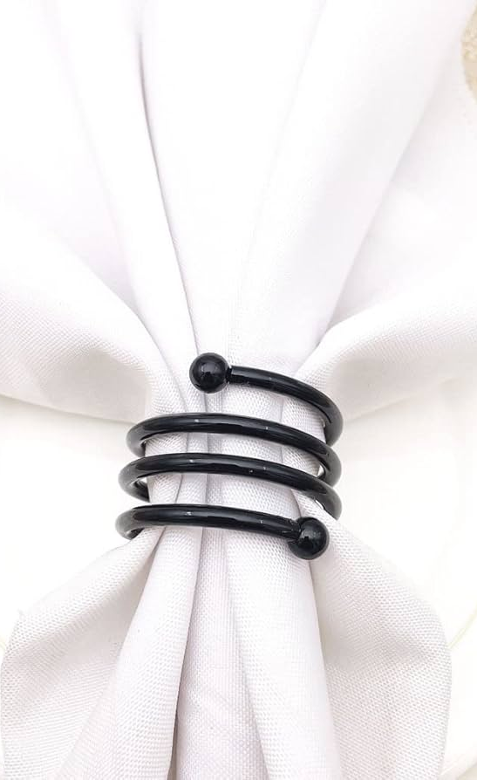
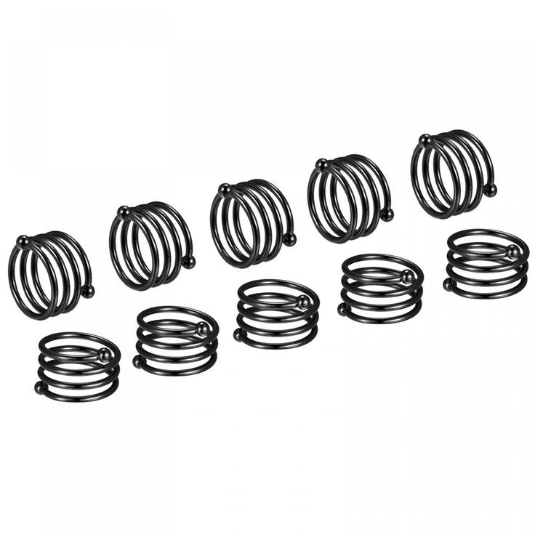
ITEM NO. – MH9991
ITEM NAME – IRON ROLL ONN NAPKIN RINGS
SIZE – H-4CM X W5CM X L5CM
MATERIAL – IRON
FINISH – BLACK POWDER COATING

Slide 8
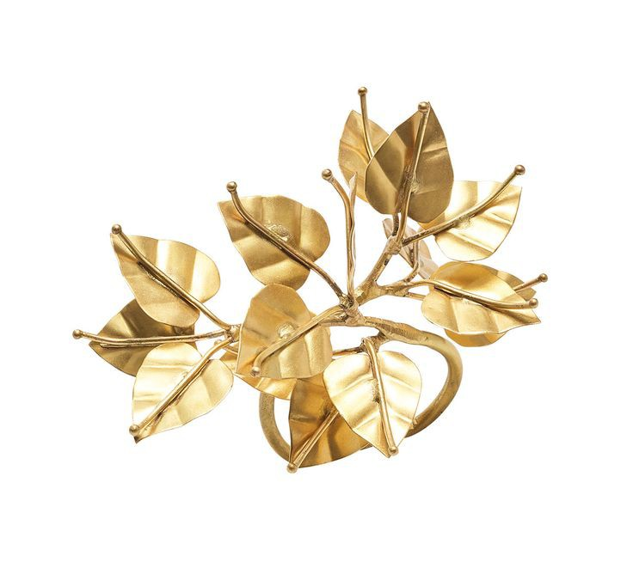
ITEM NO. – MH9993
ITEM NAME – IRON GOLD LEAVES NAPKIN RING
SIZE – LEAFES – 6CM
RING – 4.5CM
MATERIAL – IRON
FINISH – GOLDEN COLOUR COATING

Slide 9
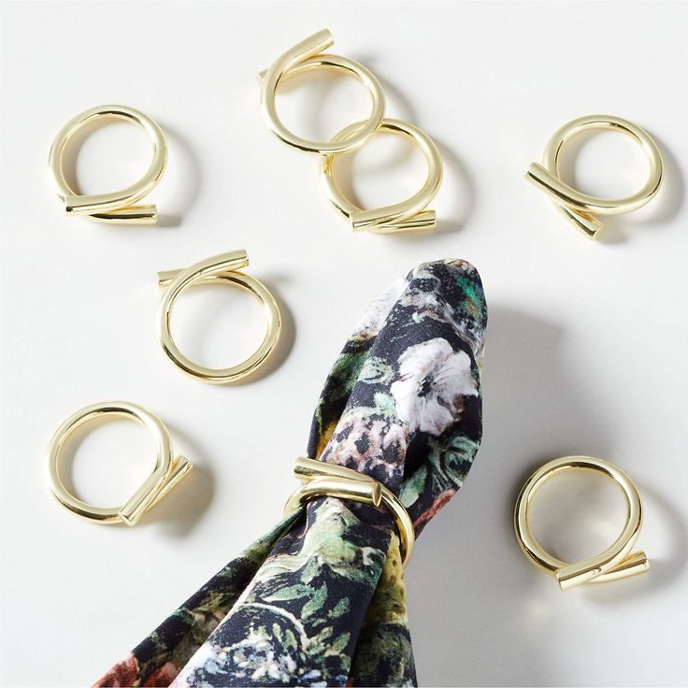
ITEM NO. – MH9995
ITEM NAME – BRASS NAPKIN RING
SIZE – OUT SIDE DIA 5.5CM
INSIDE DIA 4.5CM
MATERIAL – BRASS ROD
FINISH – POLISH WITH GOLD PLATING (EPL)

Slide 10
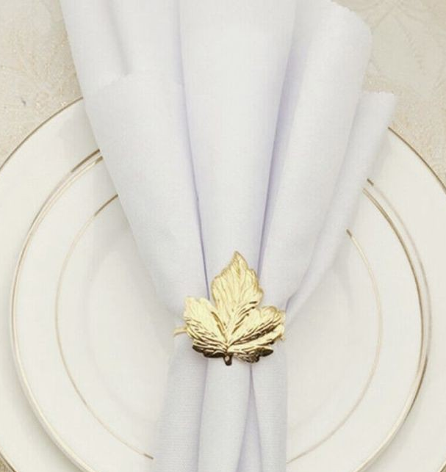
ITEM NO. – MH9996
ITEM NAME – IRON EMBOSSED NAPKIN RING
SIZE – LEAFE – 5.5CM
RING – 4.5CM
MATERIAL – IRON
FINISH – GOLD PLATING (EPL)

Slide 11
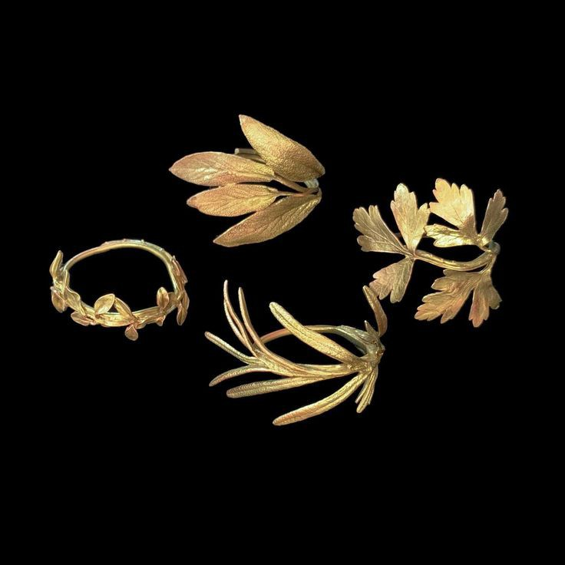
ITEM NO. – MH99997
ITEM NAME – BRASS LEAVES NAPKIN RINGS
SIZE – W5CM X LCM X H6CM
MATERIAL - BRASS
FINISH – BRASS PLATING (EPL)

Slide 12
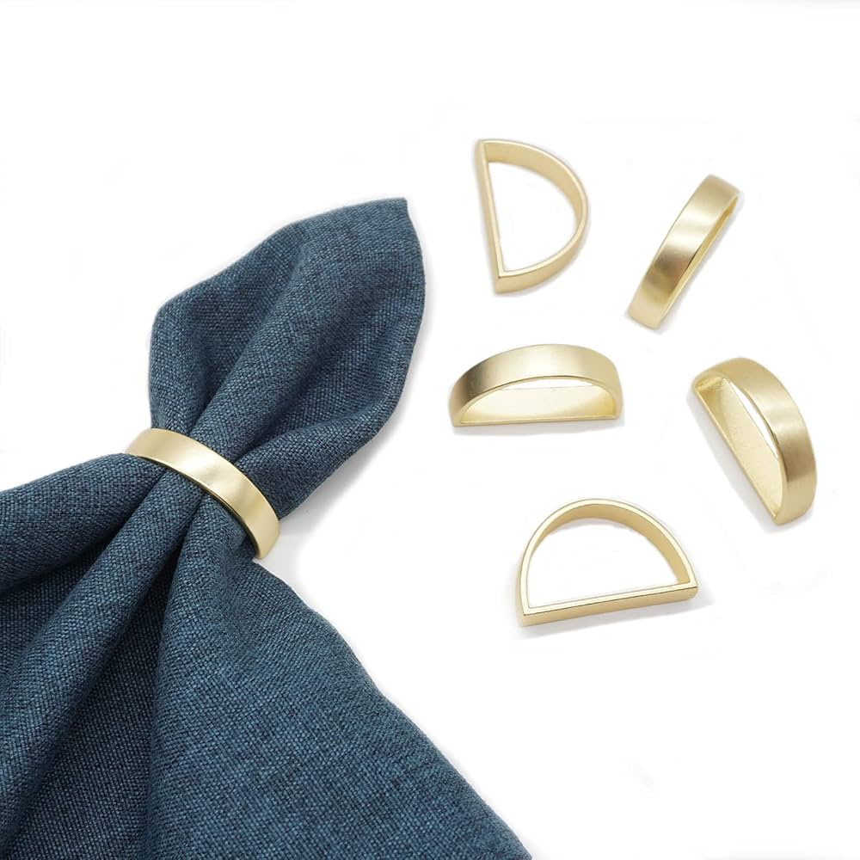
ITEM NO. – MH9998
ITEM NAME – BRASS NAPKIN RINGS
SIZE – H-3.5CM X L-4.5CM
MATERIAL – BRASS
FINISH – BRASS PLATING (EPL)

Slide 13
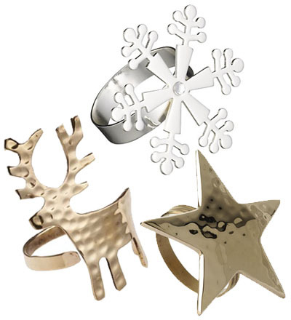
ITEM NO. – MH9993A
ITEM NAME – IRON HAMMERED NAPKIN RING SET OF 3
SIZE – SNOW FLAKE – 6CM
REINDEER – 5CM
STAR- 5CM
RING SIZE – 4.5CM
MATERIAL – IRON
FINISH – GOLD , ROSE GOLD , NICKLE (SILVER) (EPL)

Slide 14
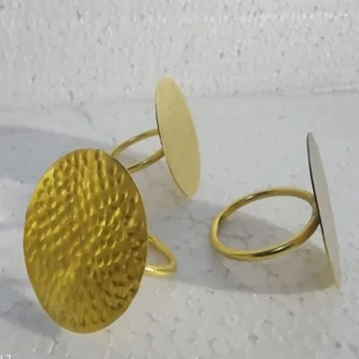
ITEM NO. – MH9999
ITEM NAME – BRASS HAMMERED NAPKIN RING
SIZE – HAMMERED CIRCLE – 5CM
RING SIZE – 4.5CM
MATERIAL – BRASS
FINISH – GOLD PLATING (EPL)

Slide 15
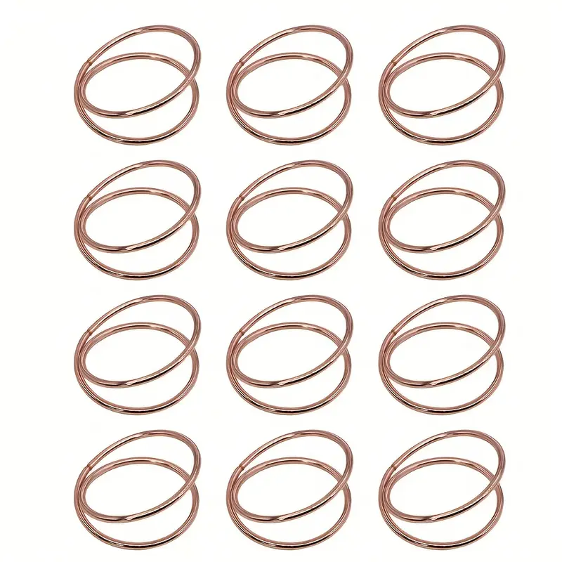
ITEM NO. – MH10002
ITEM NAME – IRON ROSE GOLD NAPKIN RINGS
SIZE – Out side dia – 5.5cm
Inside hole - 4.5cm
MATERIAL – IRON
FINISH – GOLD ROSE PLATING (EPL)

Slide 16
Thank you for your attention,
We hope you like our designs.
Looking forward for your positive response.
Designs by - MAHY Handicrafts
Contact no. - +918954520617
E-mail – merchant.mahyhandicrafts@gmail.com
Add. – Tobacco street , near sadar – e – ala gate , Moradabad 244001

