Slide 1
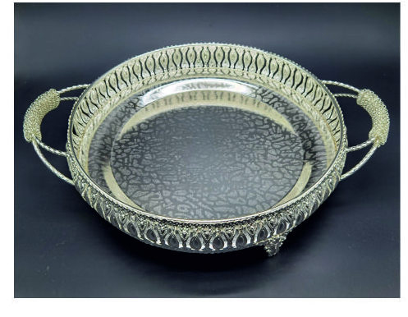
ITEM NO. - MH - 06170128
SIZE – L20 X W20 X H7 CM
FINISH – SHAMPAIGN GOLD

Slide 2
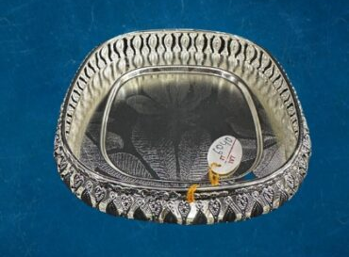
ITEM NO. – MH061738
SIZE – L20 X W20 X H7 CM
Finish – Silver Nickel

Slide 3
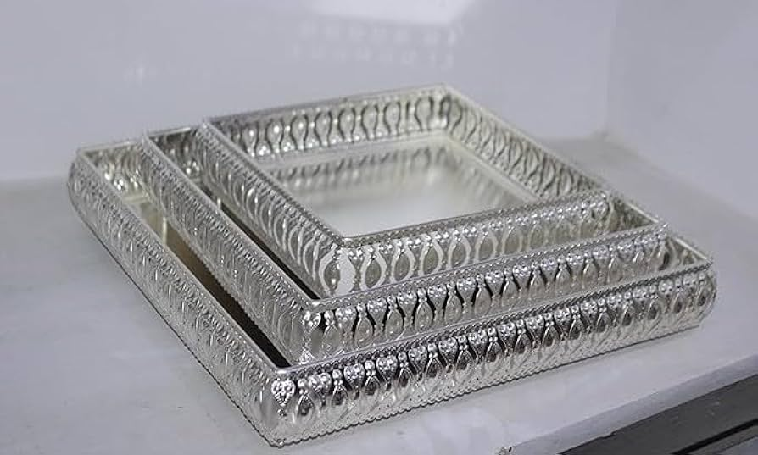
Item No. – MH061734
SIZE – LARGE TRAY – L31 X W31 X H9 CM
MEDIUM TRAY – L25 X W27 X H8 CM
SMALL TRAY – L20 X W20 X H7 CM
FINISH – SILVER NICKEL

Slide 4
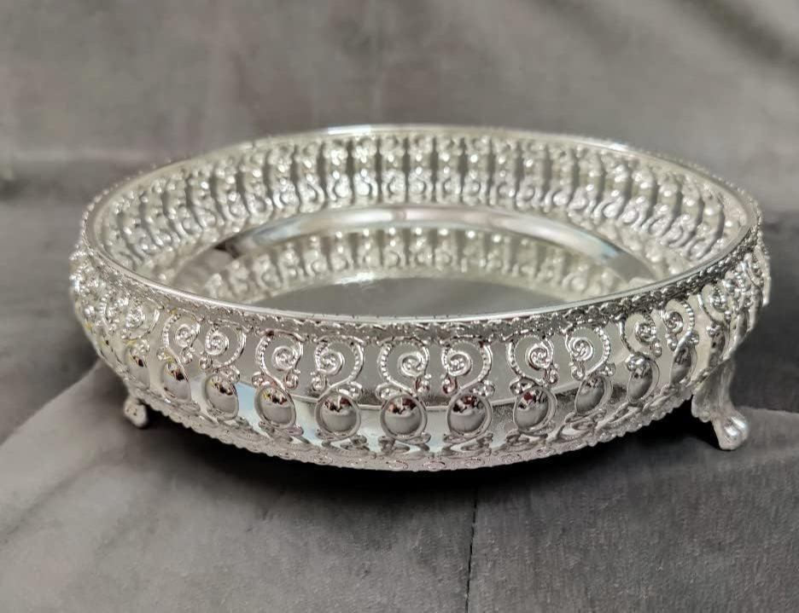
ITEM NO. – MH03967
SIZE– L23 X W23 X H8 CM
FINISH – SILVER COATING

Slide 5
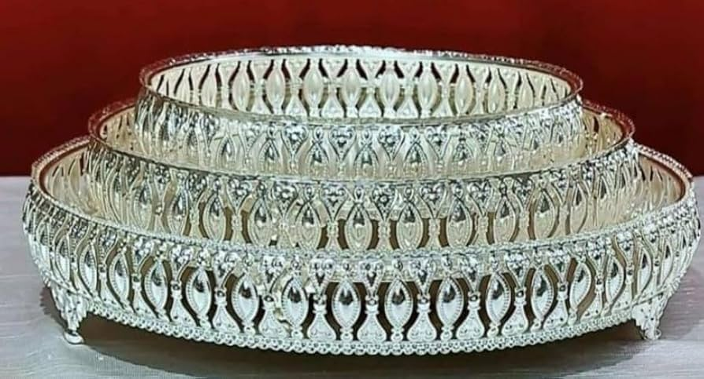
ITEM NO. – MH02989A
SIZE – LARGE TRAY – L31 X W31 X H7 CM
MEDIUM TRAY – L25 X W25 X H7 CM
SMALL – L20 X W20 X H7 CM
FINISH – SILVER COATING

Slide 6
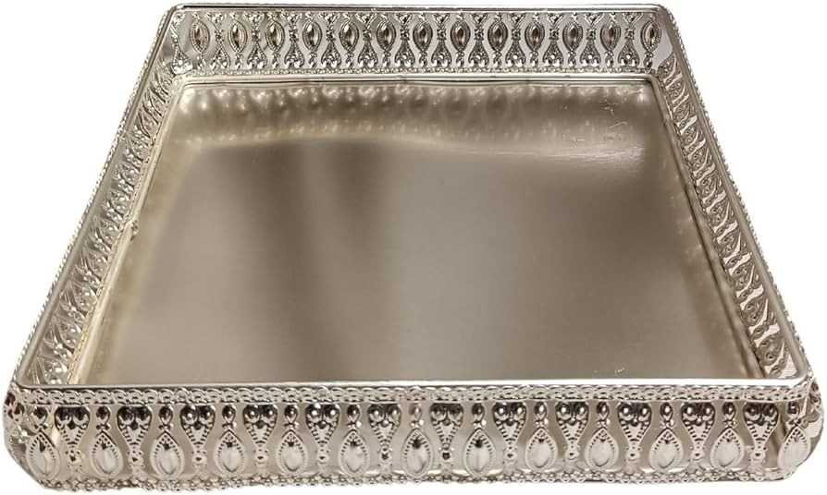
ITEM NO. – MH03165
SIZE – L31 X W26 X H7 CM
FINISH – SHAMPAIGN GOLD

Slide 7
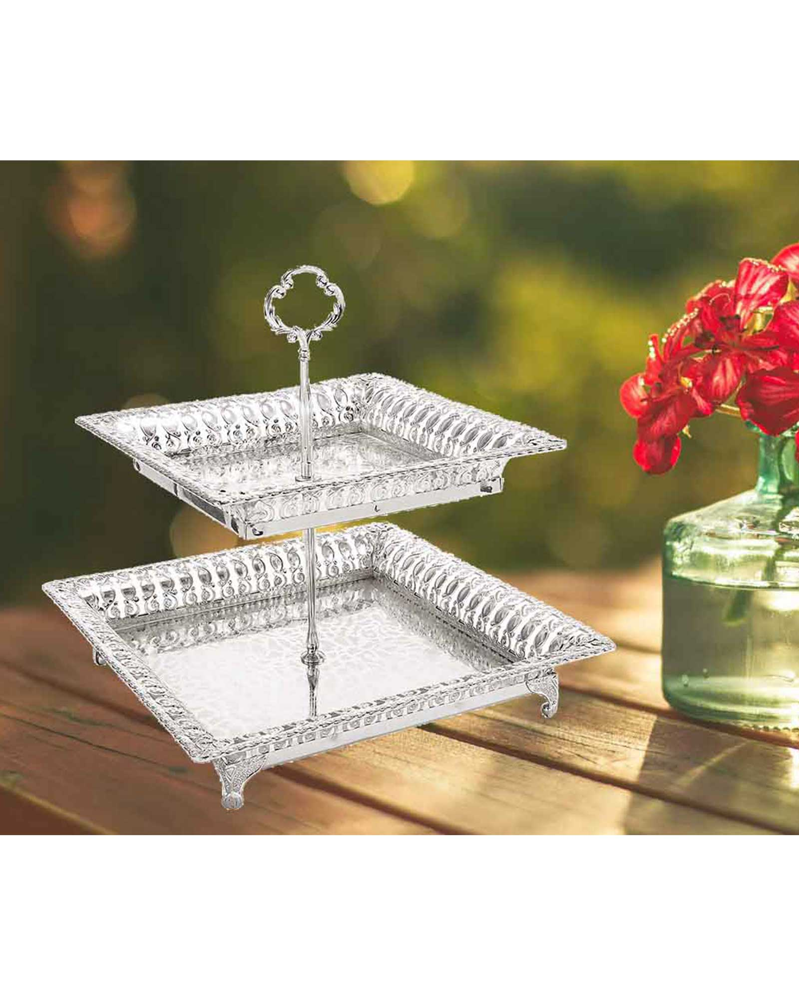
ITEM NO. – MH03168
SIZE – LARGE TRAY L35 X W31 X H7 CM
SMALL TRAY L25 X W20 X H6 CM
STAND HEIGHT – 33 CM
FINISH – SILVER COATING

Slide 8
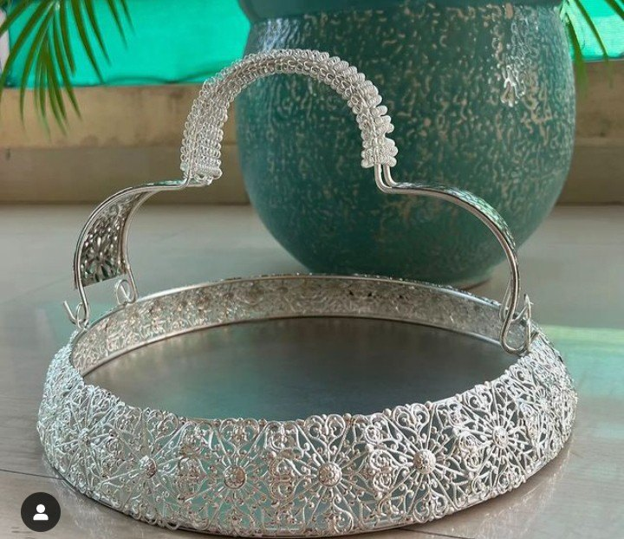
MH - 98970
SIZE – L31 X W31 X H9 CM
FINISH – SILVER NICKEL

Slide 9
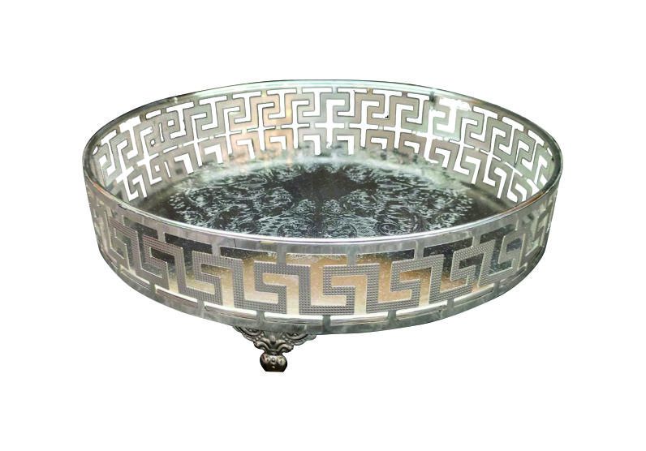
ITEM NO. – MH03596
SIZE – L31 X W31 X H7 CM
FINISH – SHAMPAIGN GOLD

Slide 10
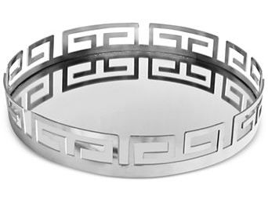
ITEM NO. – MH05086
SIZE – L35 X W35 X H6 CM
FINISH – SILVER NICKEL

