Slide 1
TRENDY AND CLASSIC Collection OF SCARVES FOR AW 25-26
gd trendz GDTRENDZ@GMAIL.COM
Noida , up ( india ) WWW,GDTRENDZ.COM

Slide 2
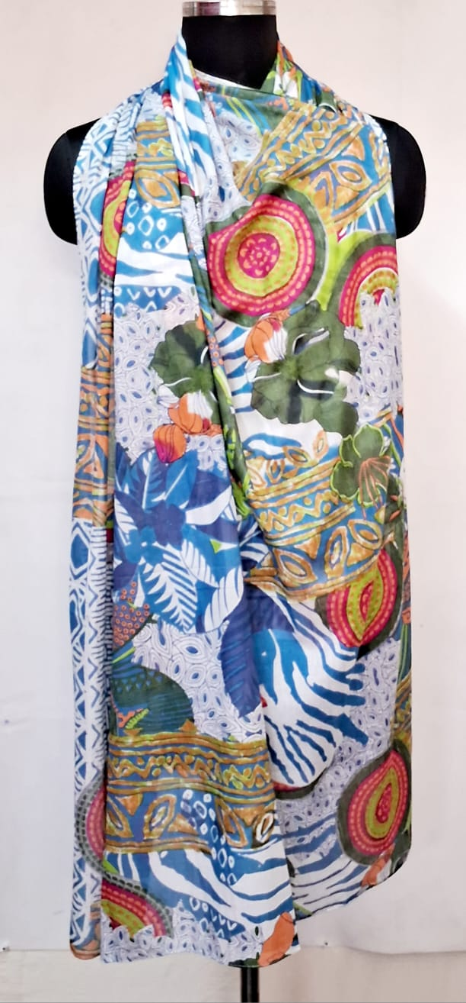
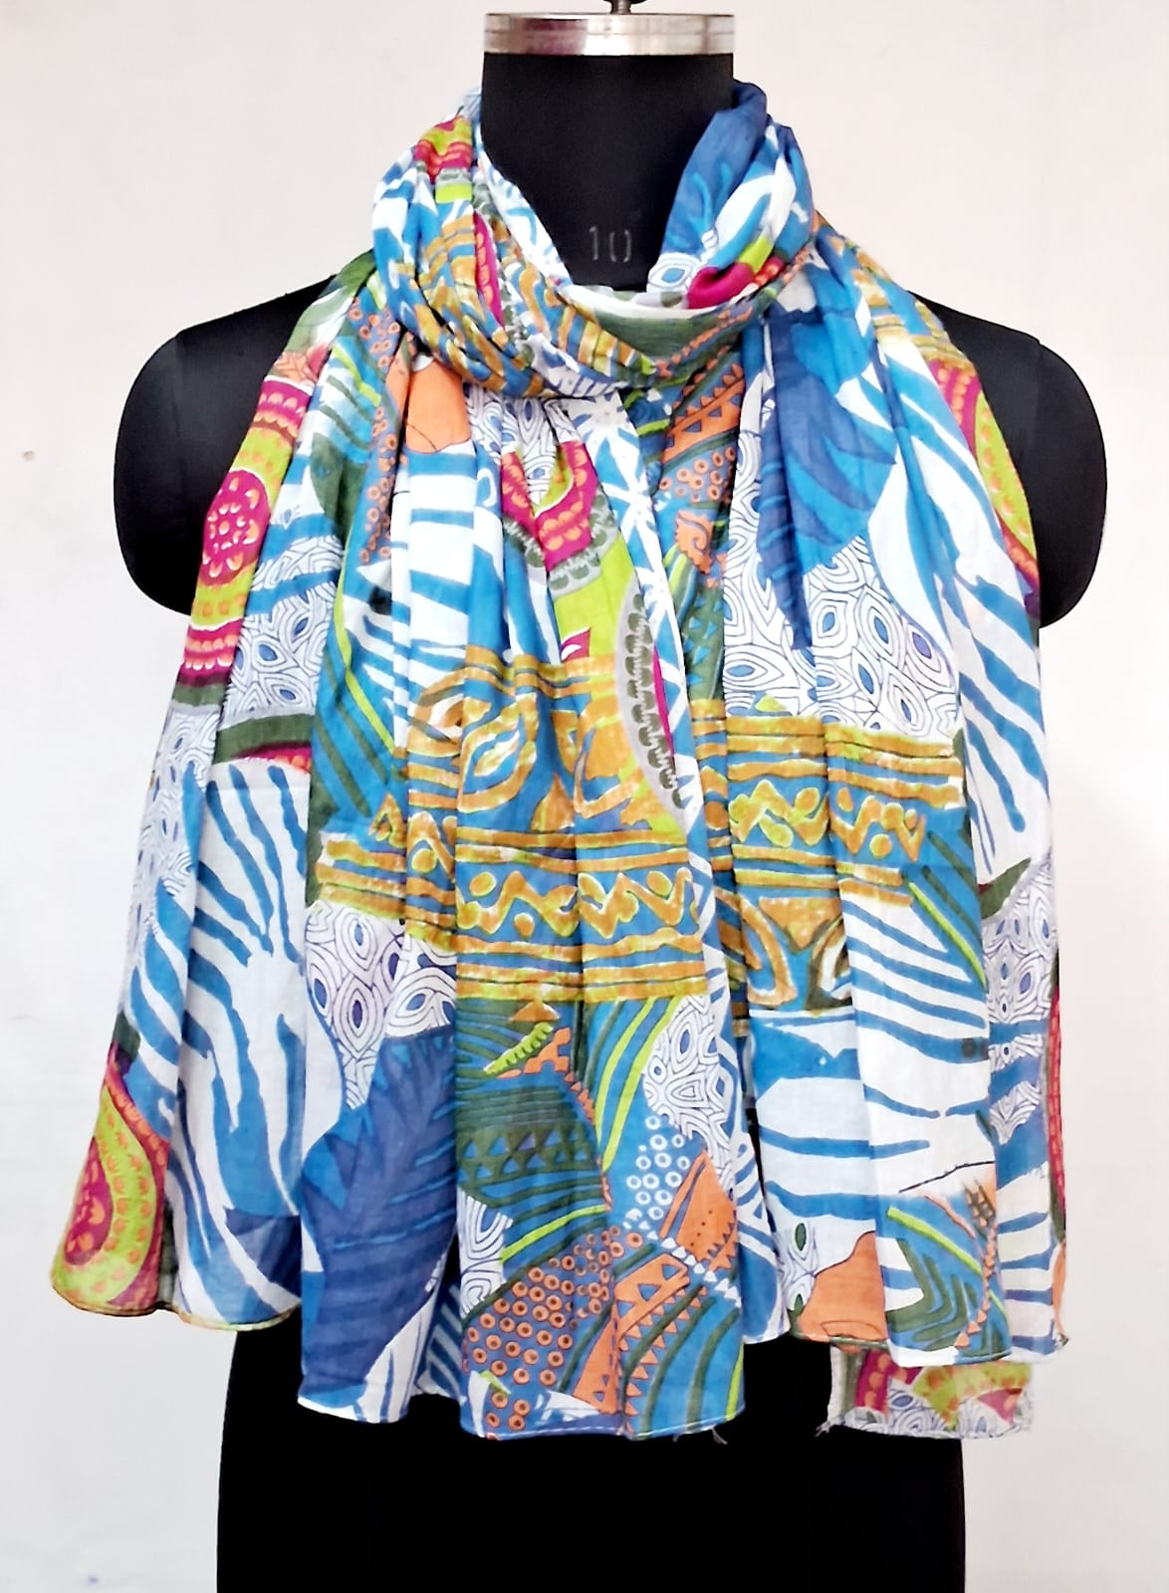
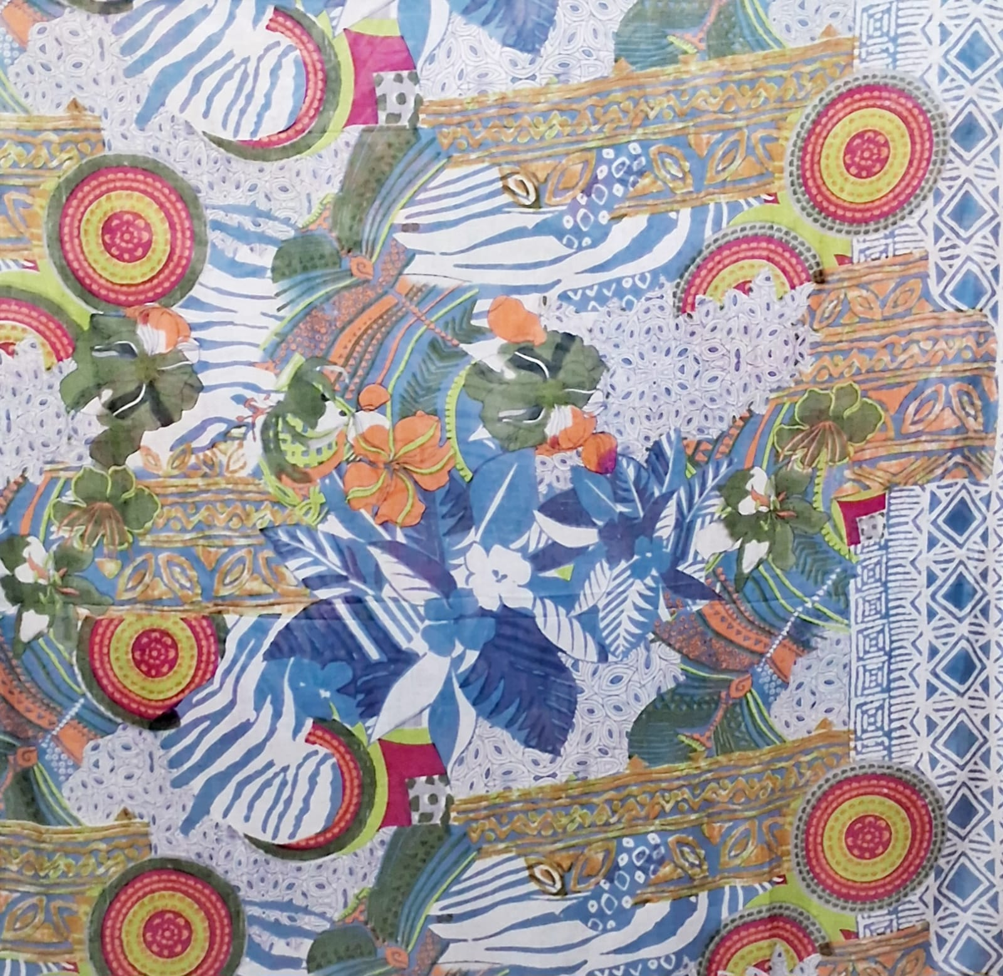
GS 104
SZ- 110 X 180 CMS
100% COTTON
Price- USD 2.55

Slide 3
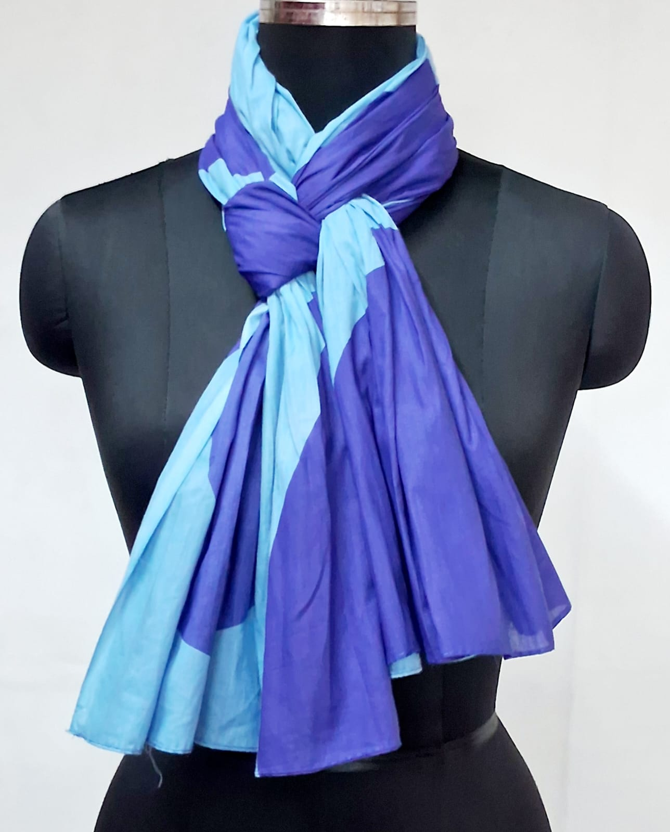
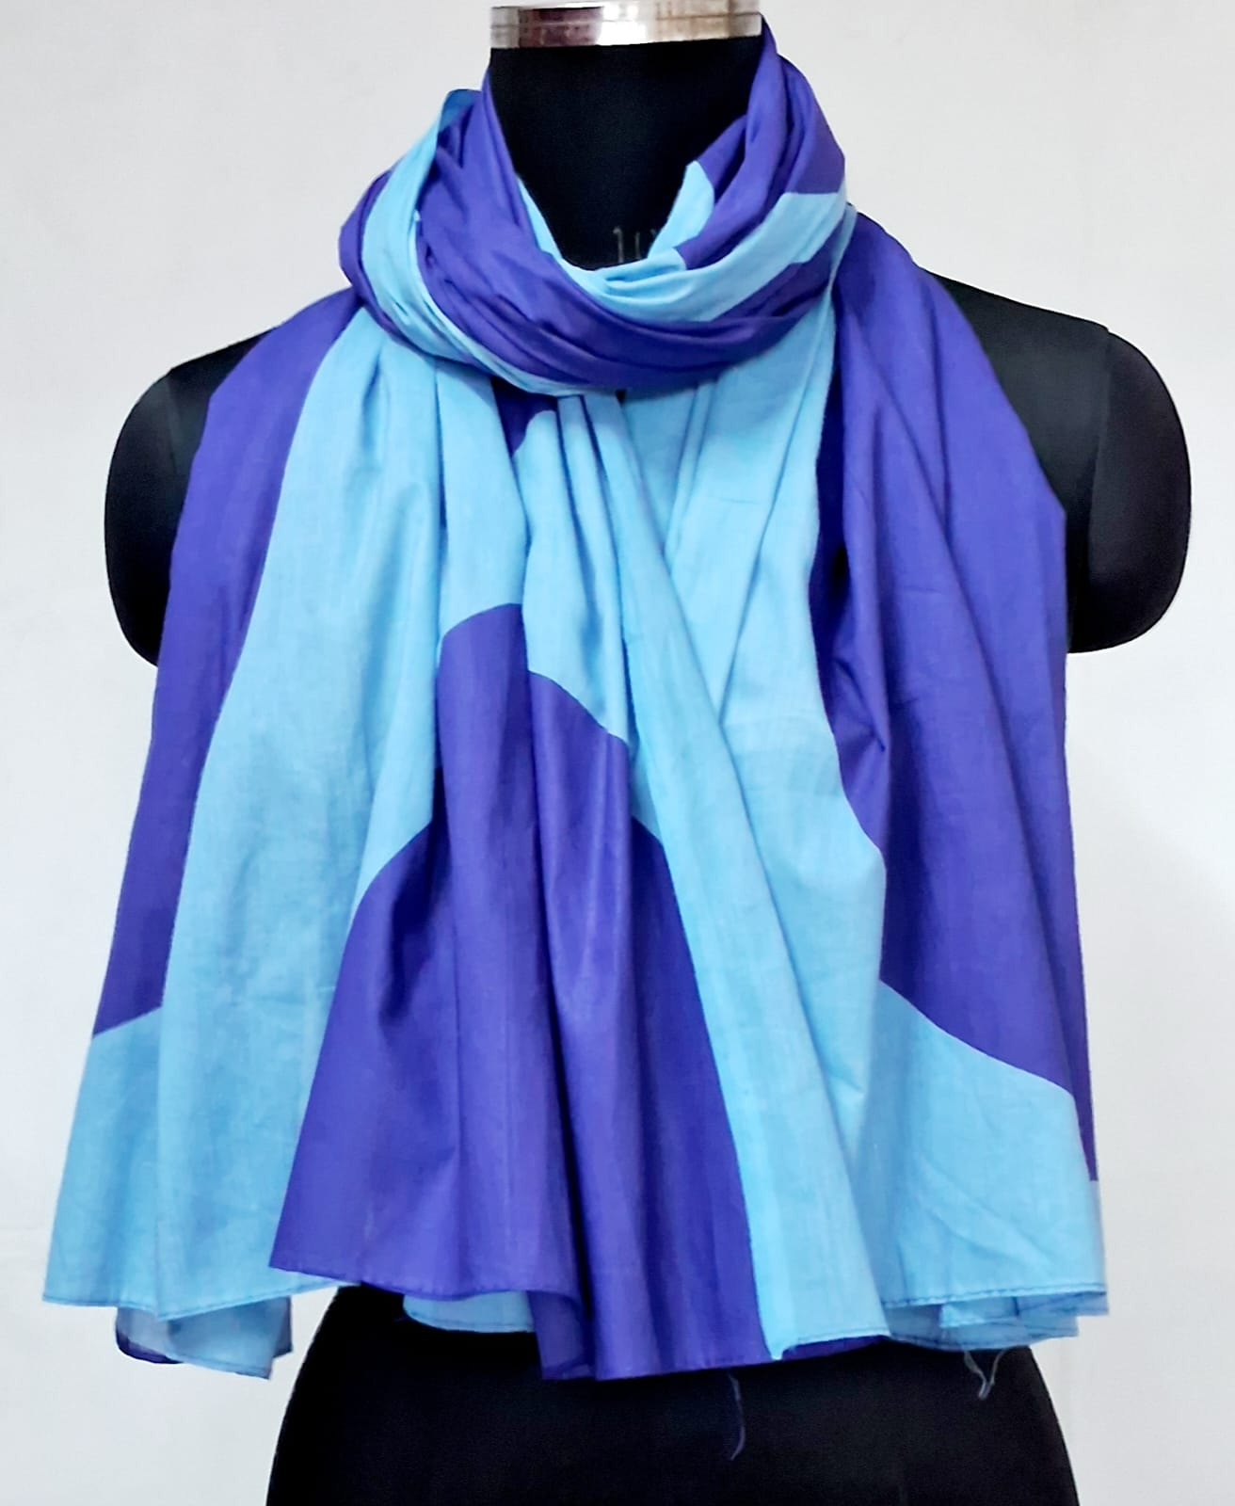
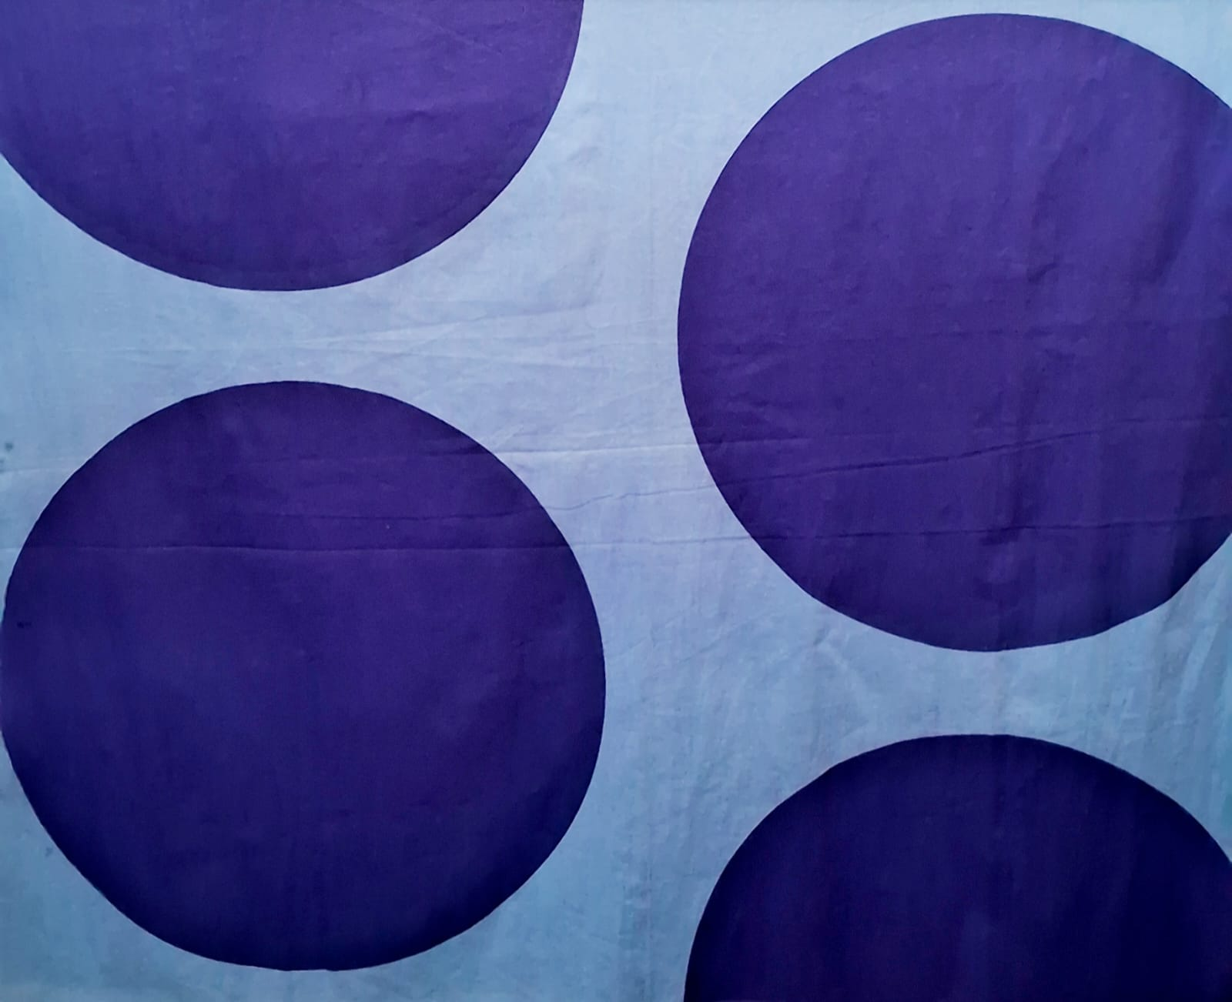
GS 105
SZ- 110 X 180 CMS
100% COTTON
Price- USD 2.55

Slide 4
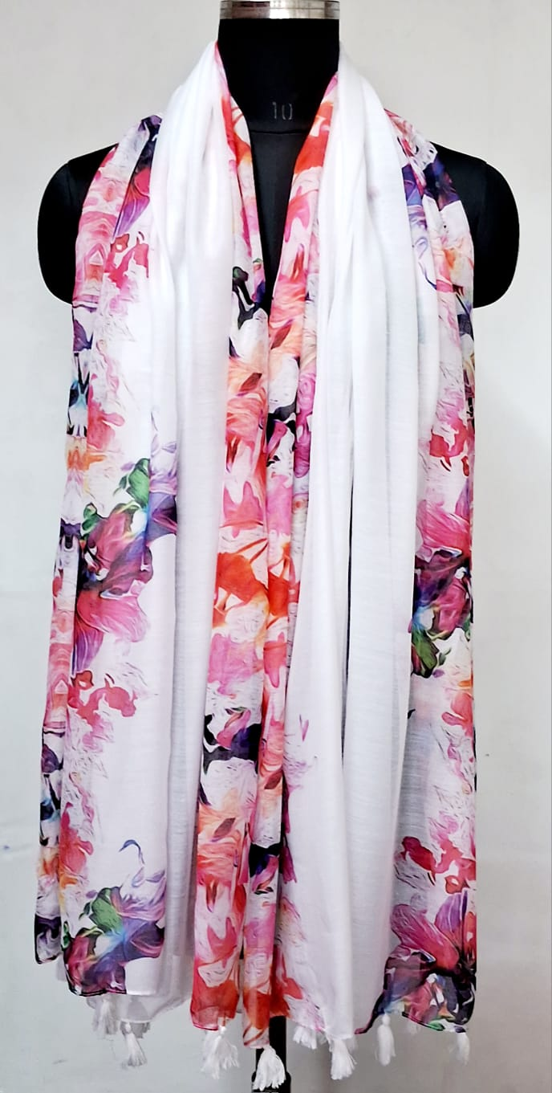
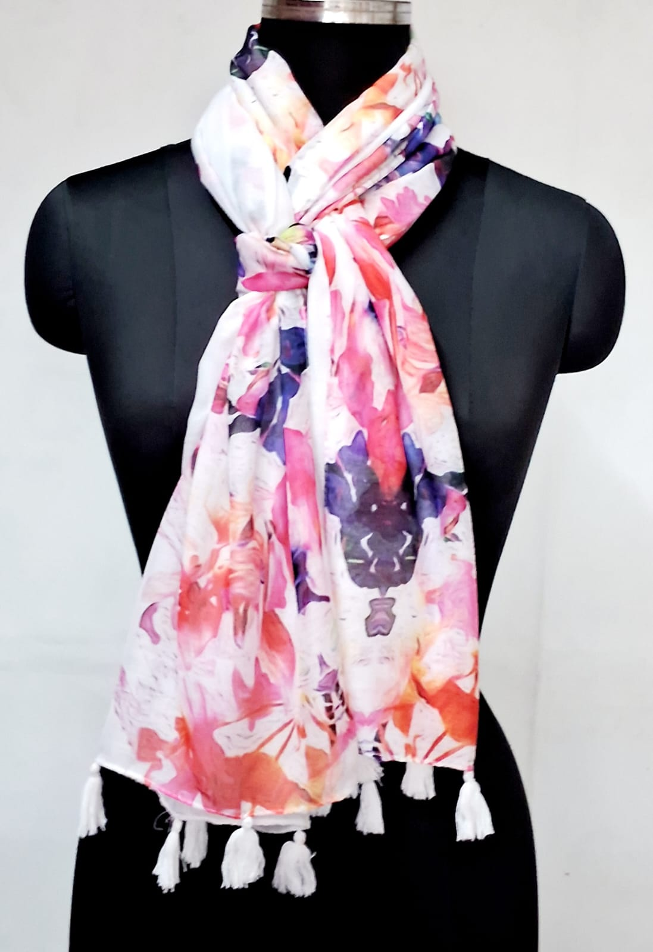
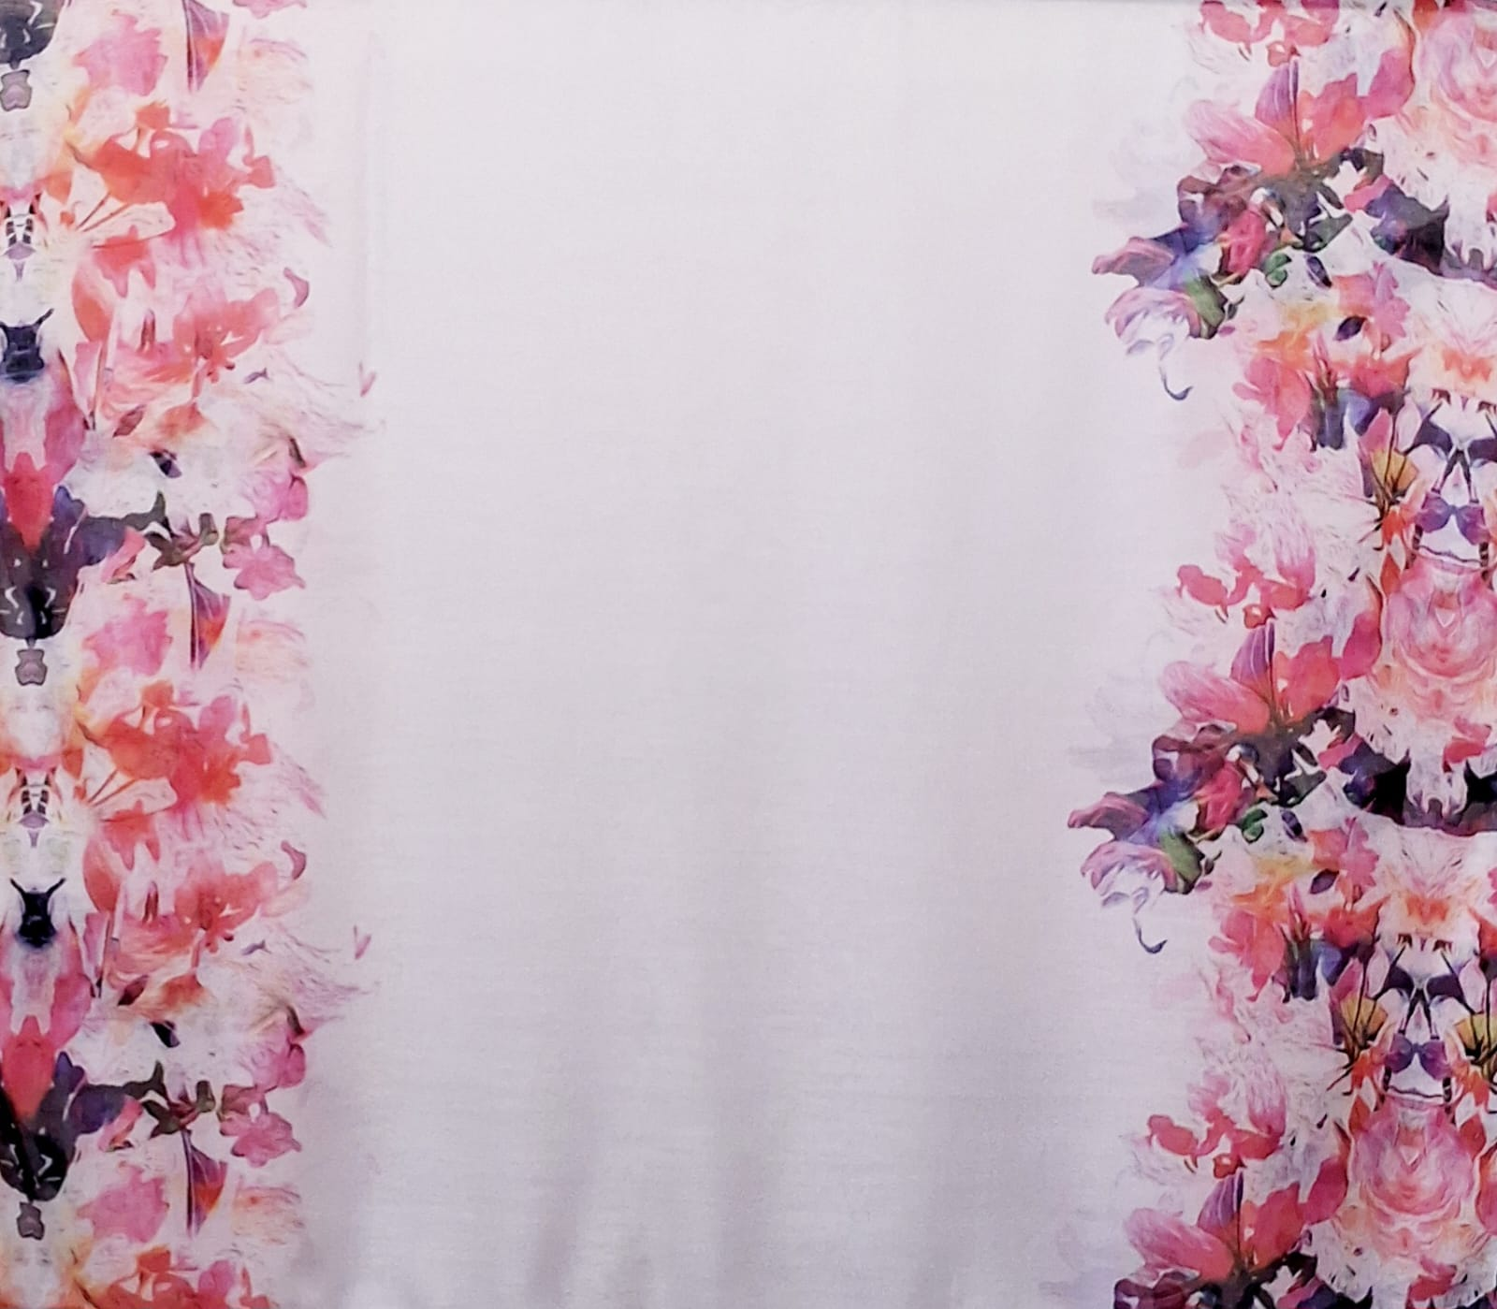
GS 111
SZ- 105 X 200 CMS
65 % COTTON + 35 % POLYESTER
Price- USD 3.25

Slide 5
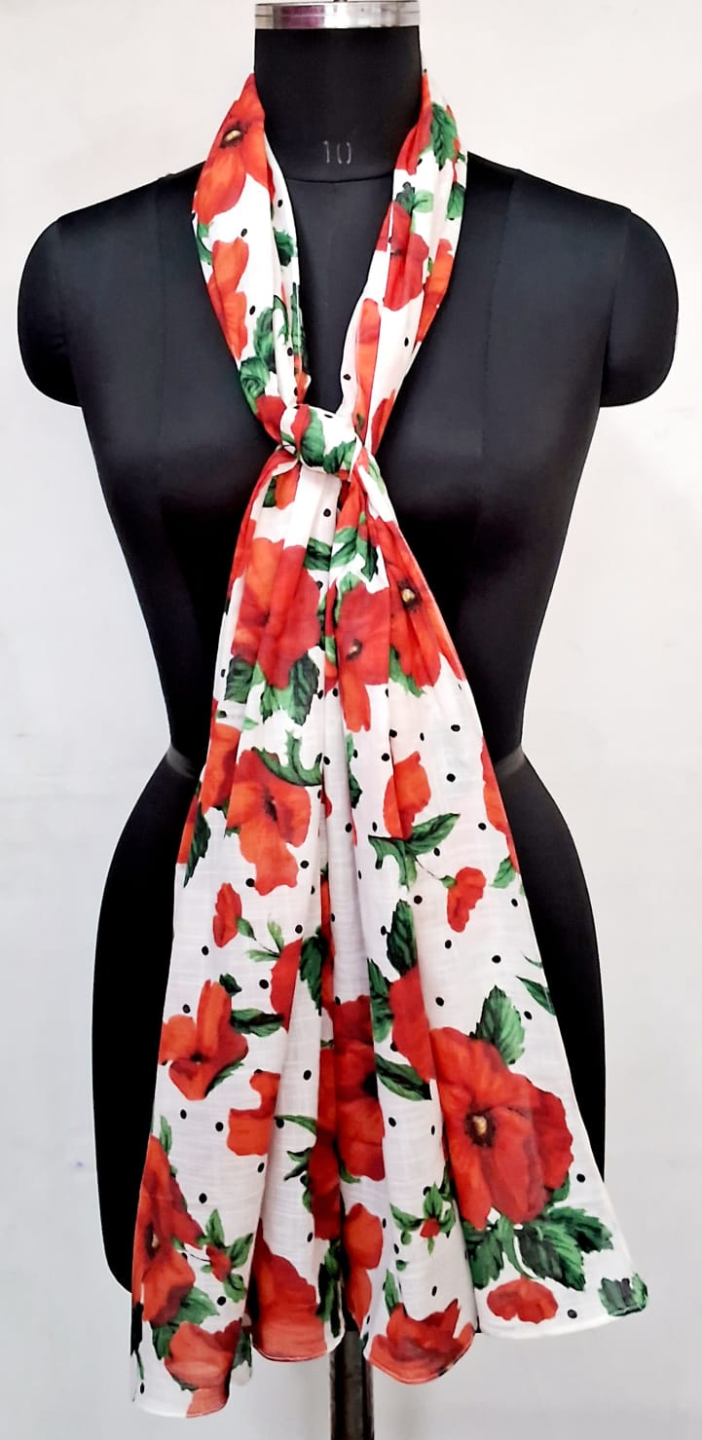
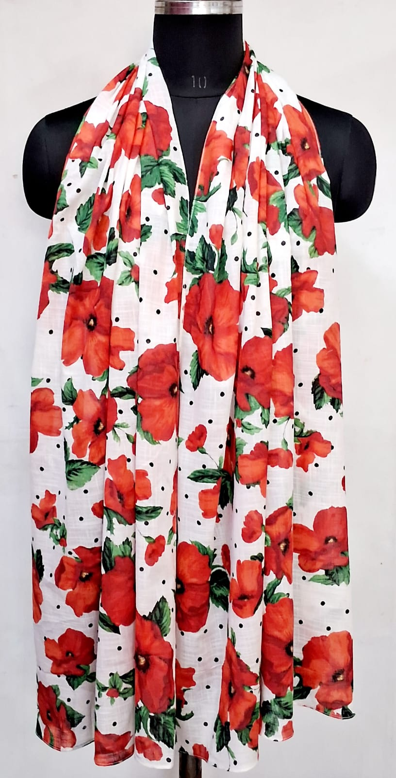
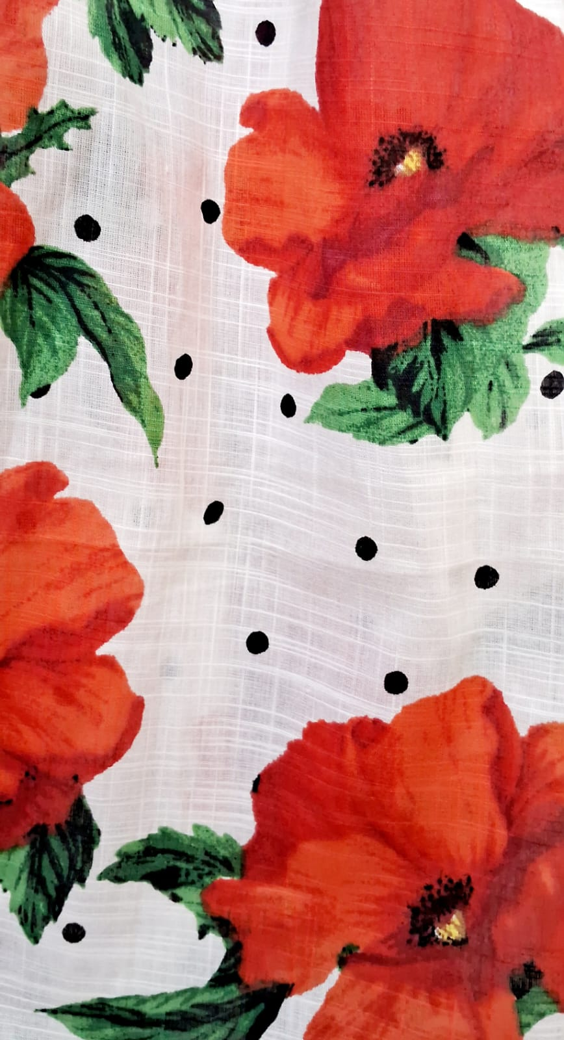
GS 75
SZ- 70 X 180 CMS
100% RAYON
Price- USD 2.45

Slide 6
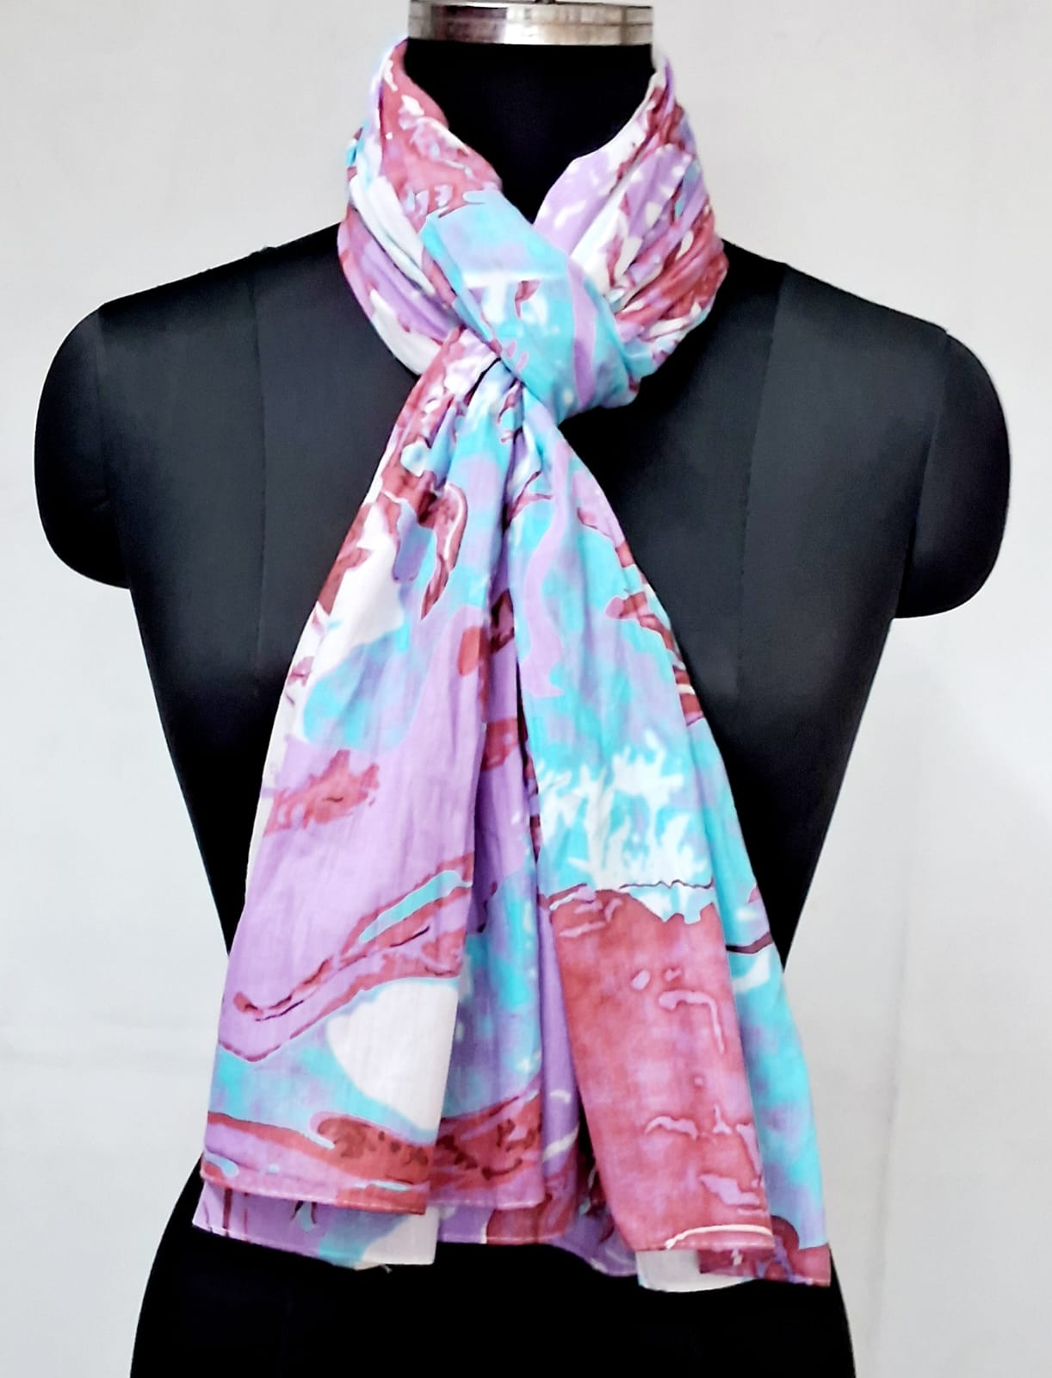
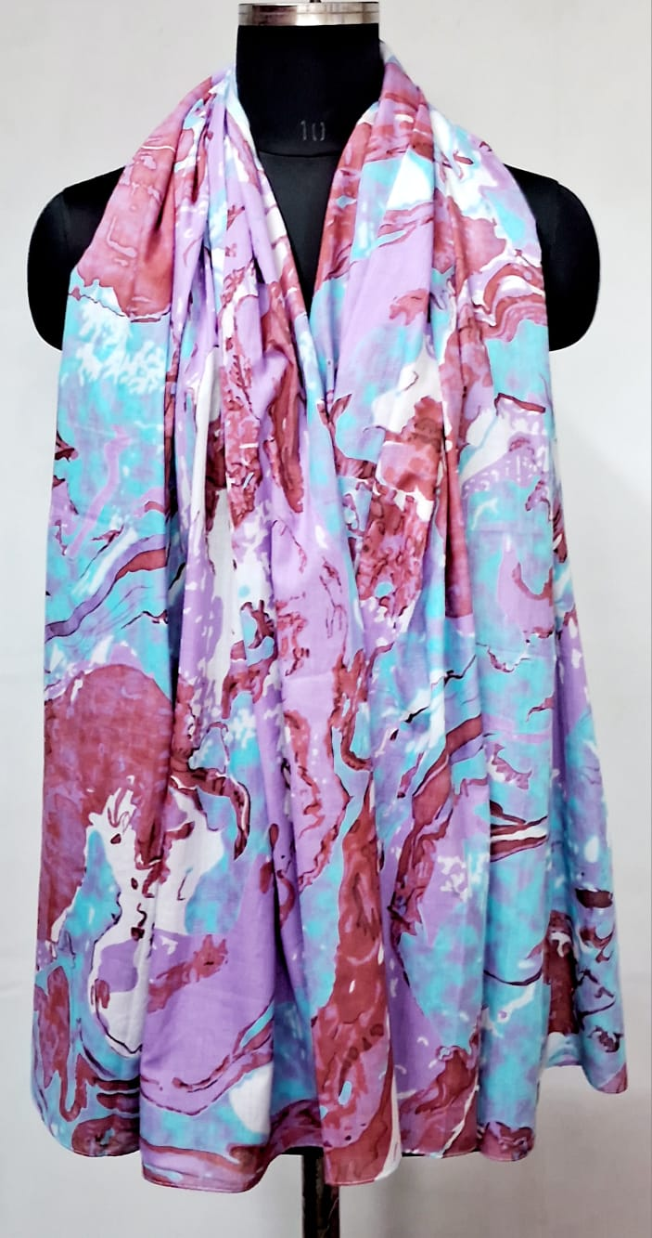
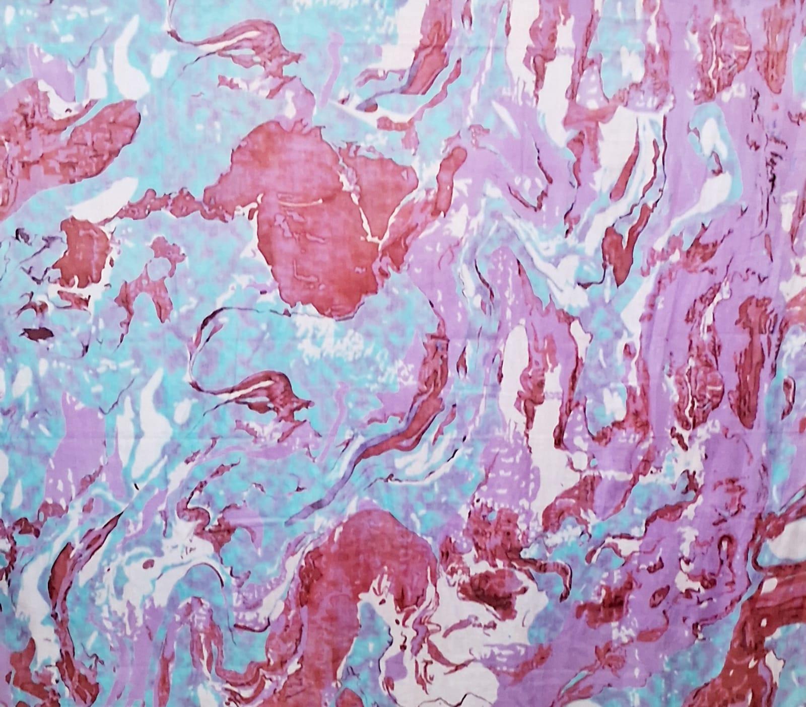
GS 116
SZ- 110 X 180 CMS
100% COTTON
Price- USD 2.55

Slide 7
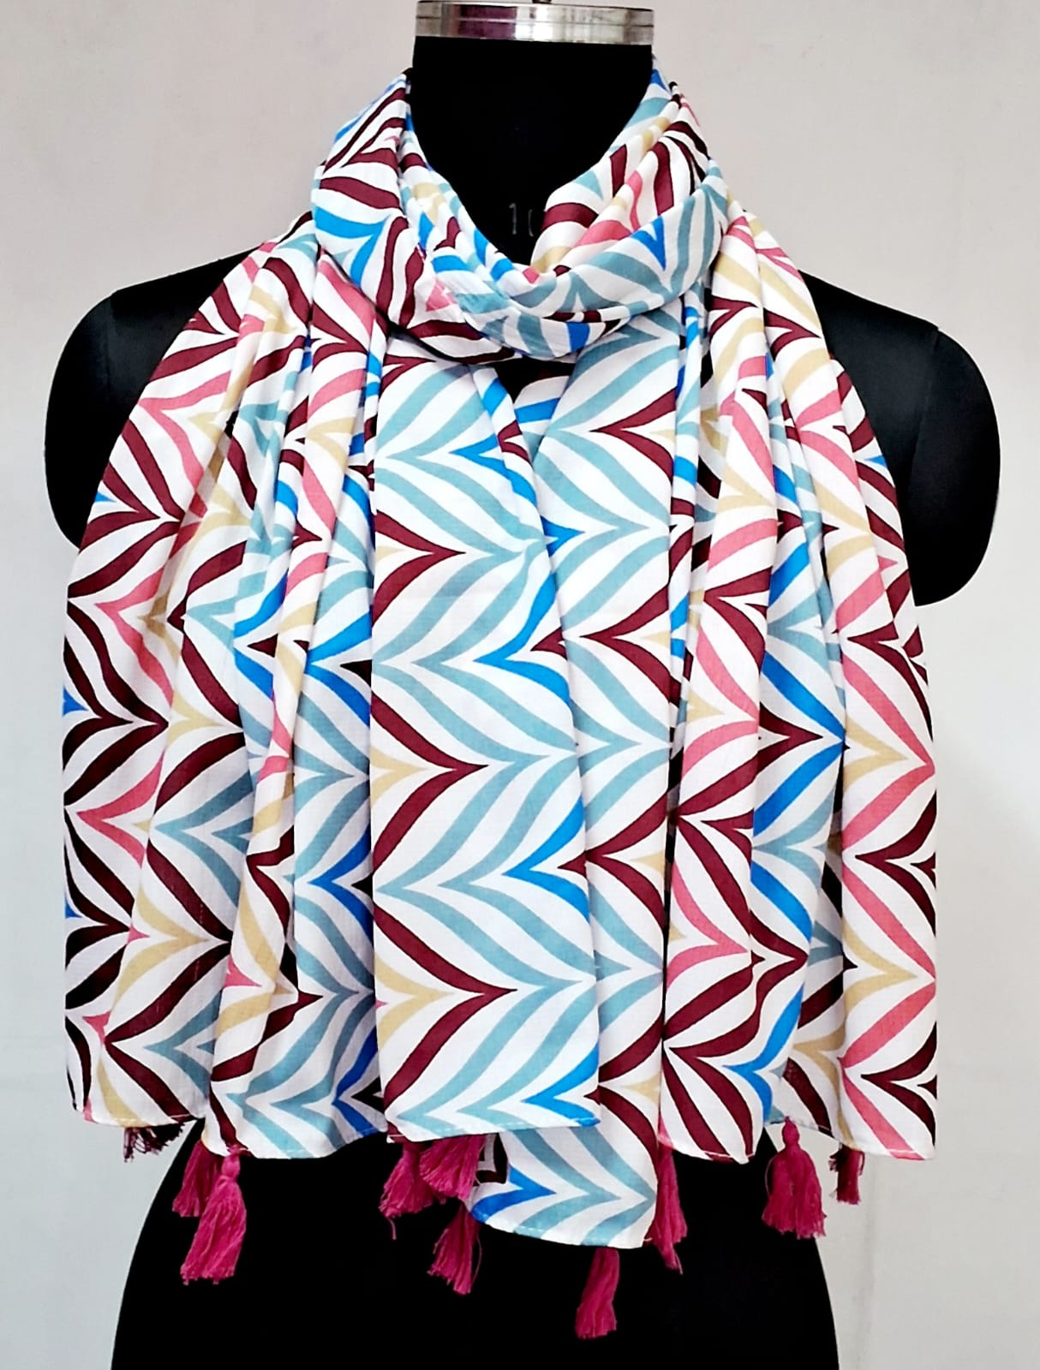
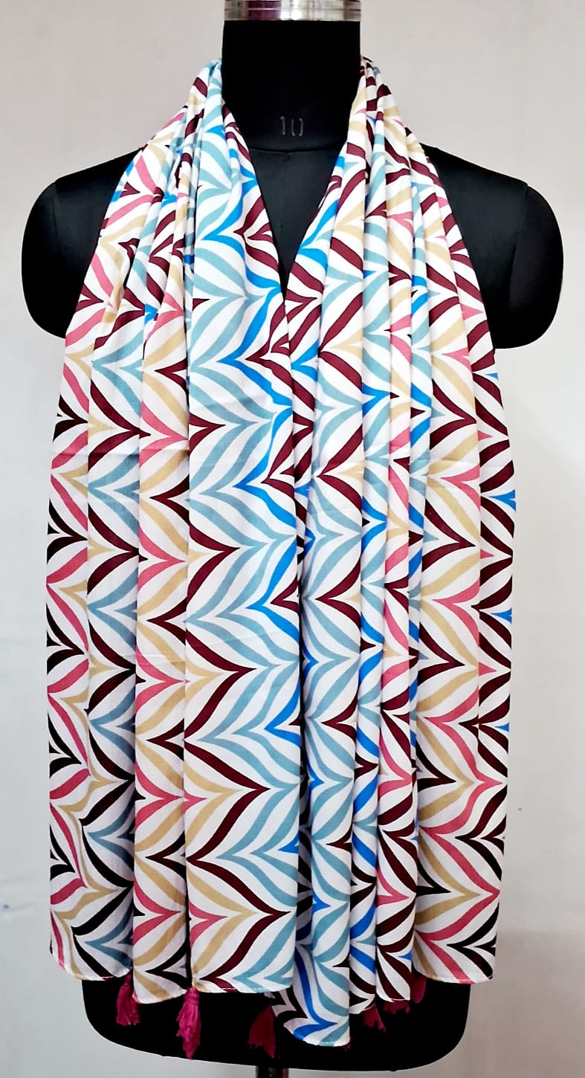
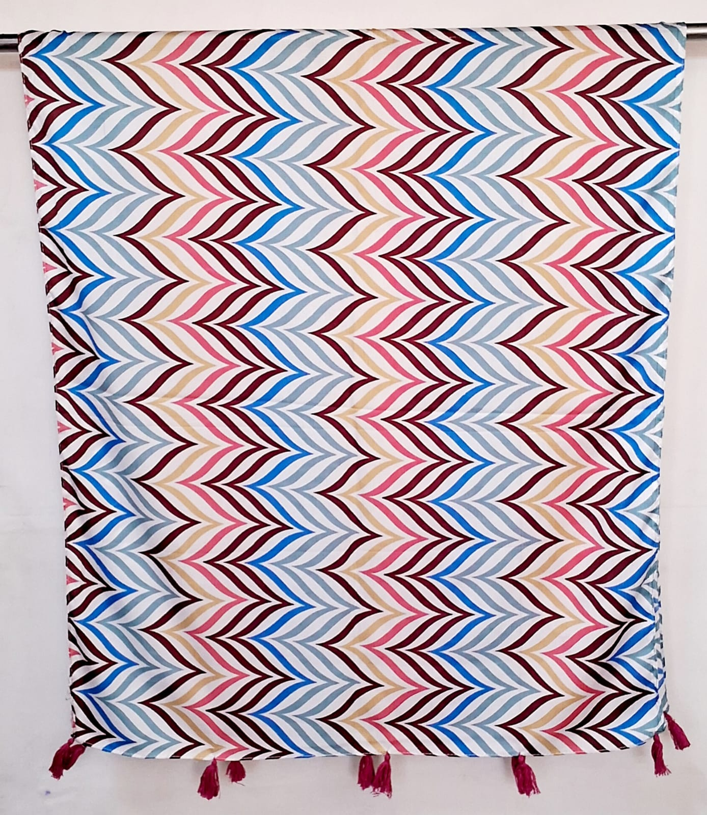
GS 114
SZ- 75 X 180 CMS
100% POLYESTER
Price- USD 1.95

Slide 8
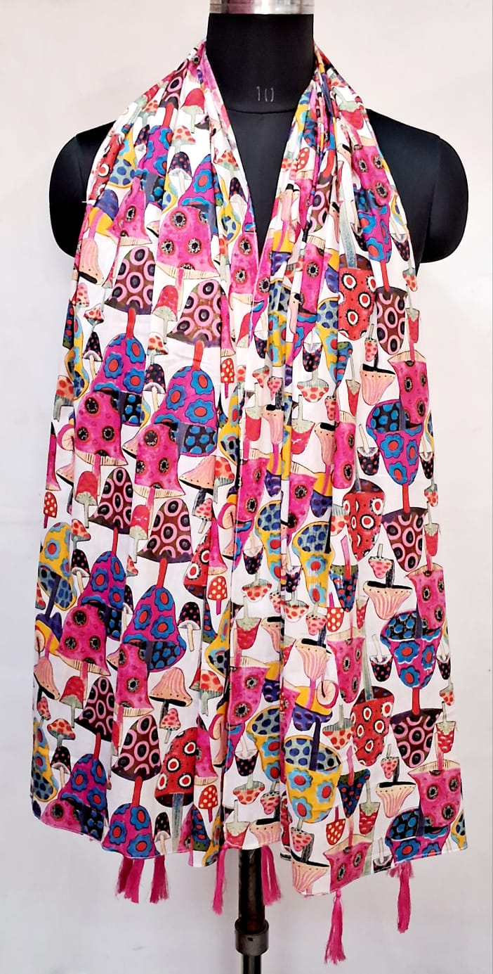
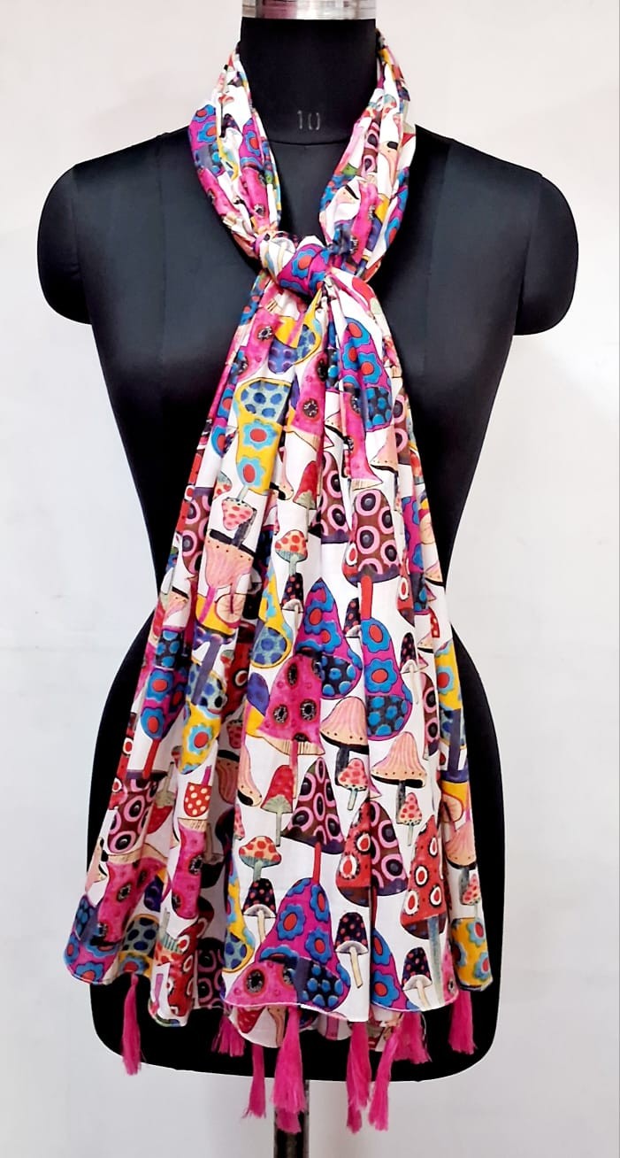
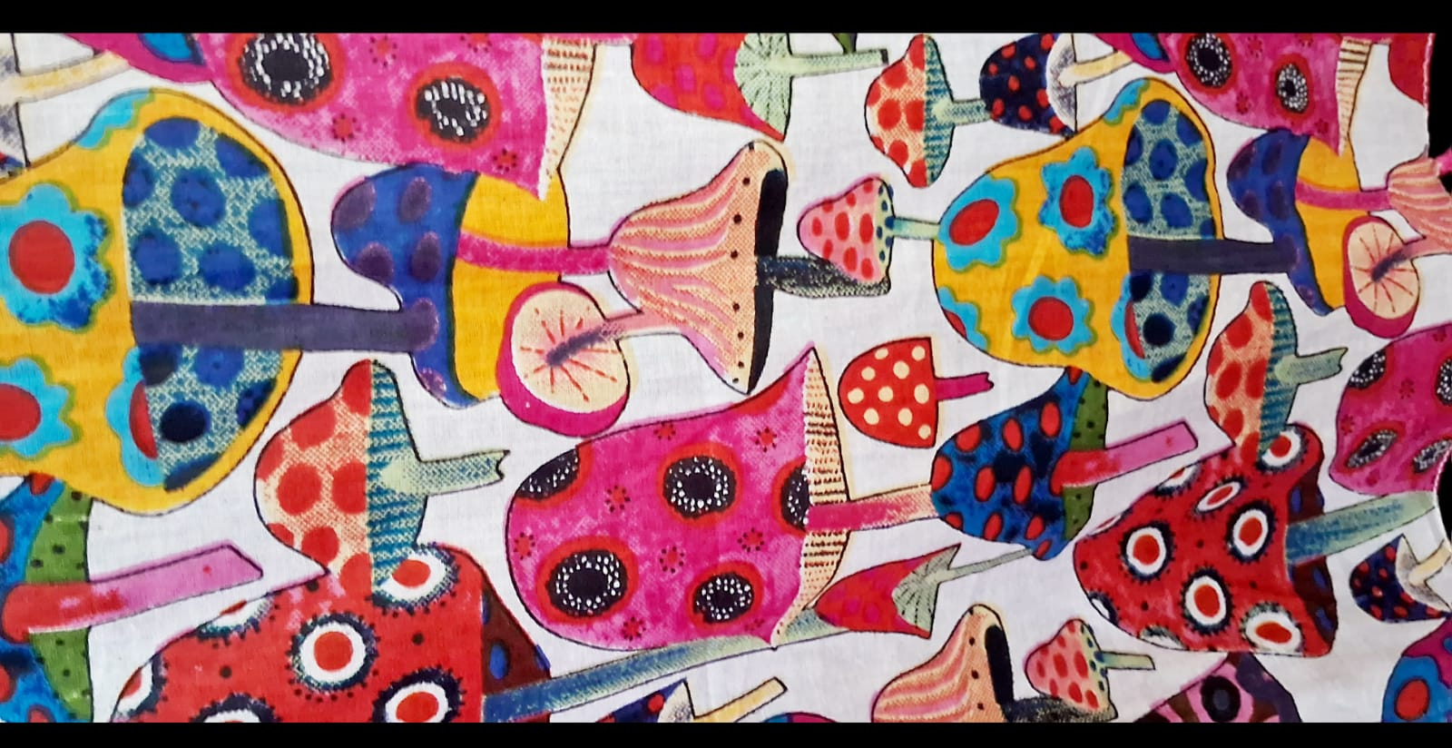
GS 77
SZ- 105 x 180 CMS
100% COTTON
Price- USD 2.55

Slide 9
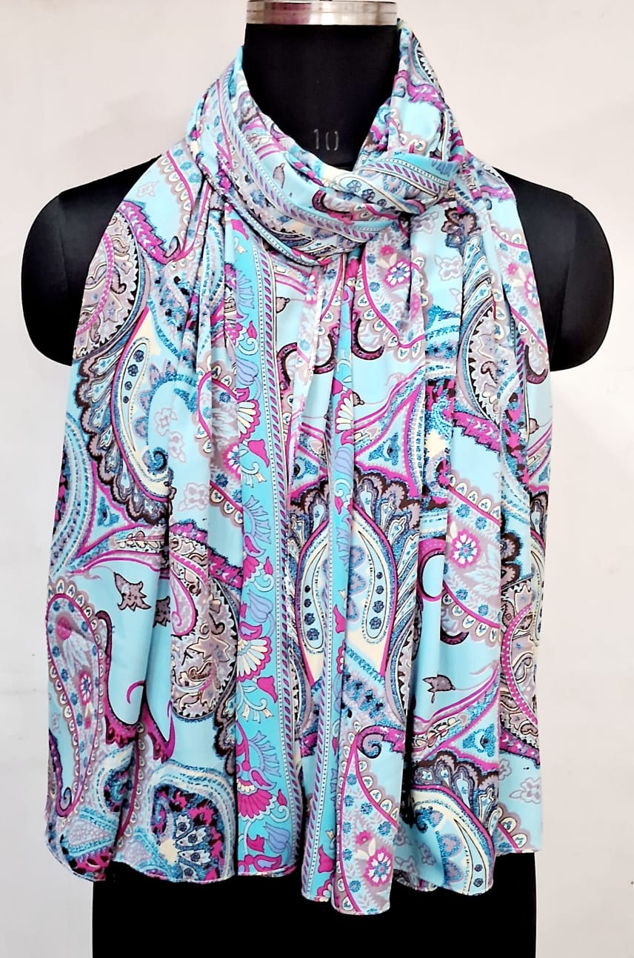
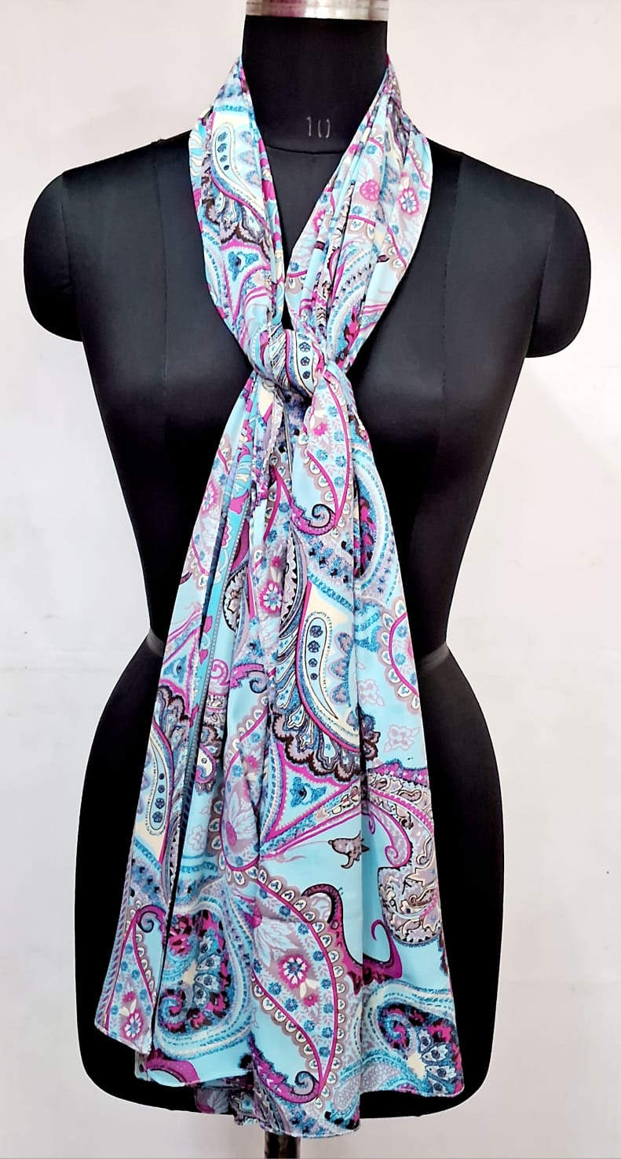
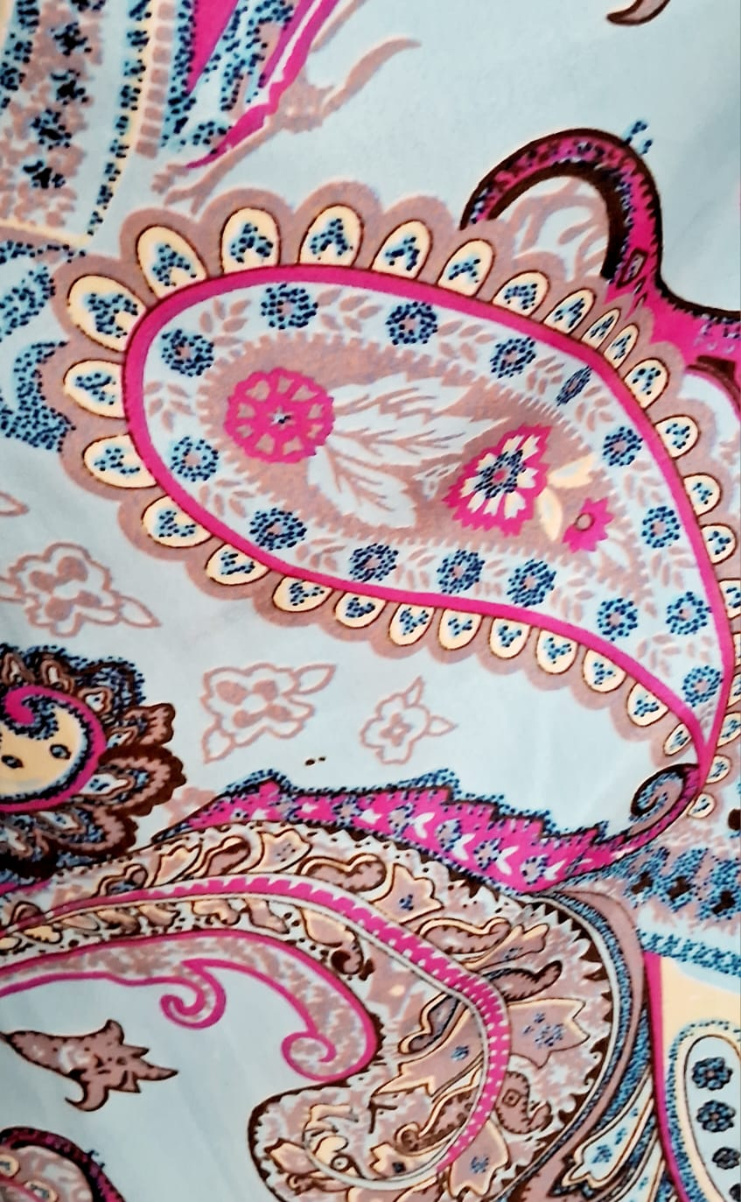
GS 78
SZ- 1100 X 180 CMS
100% POLYESTER
Price- USD 2.25

Slide 10
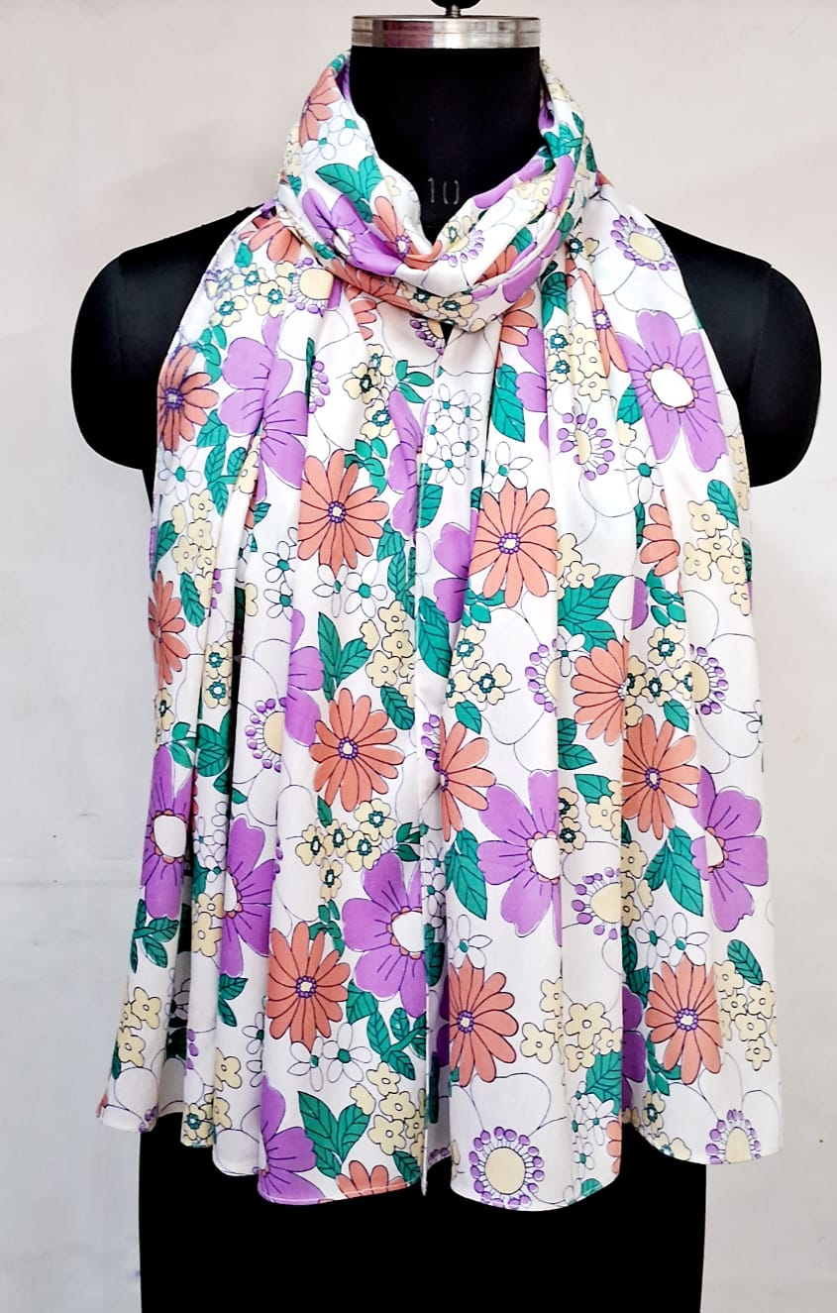
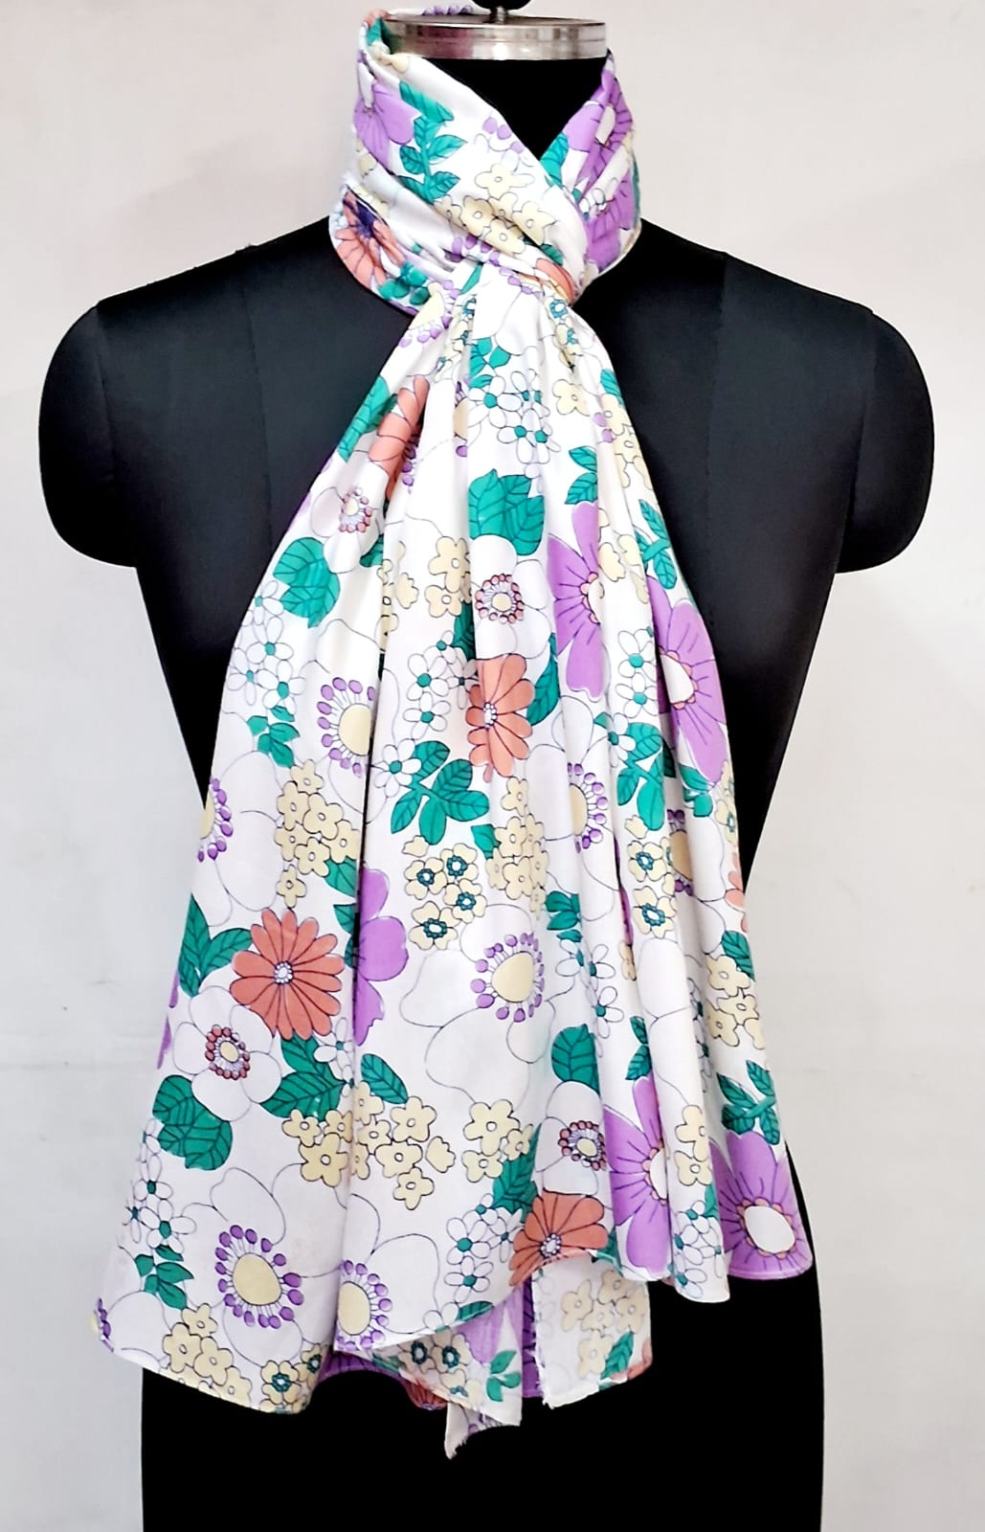
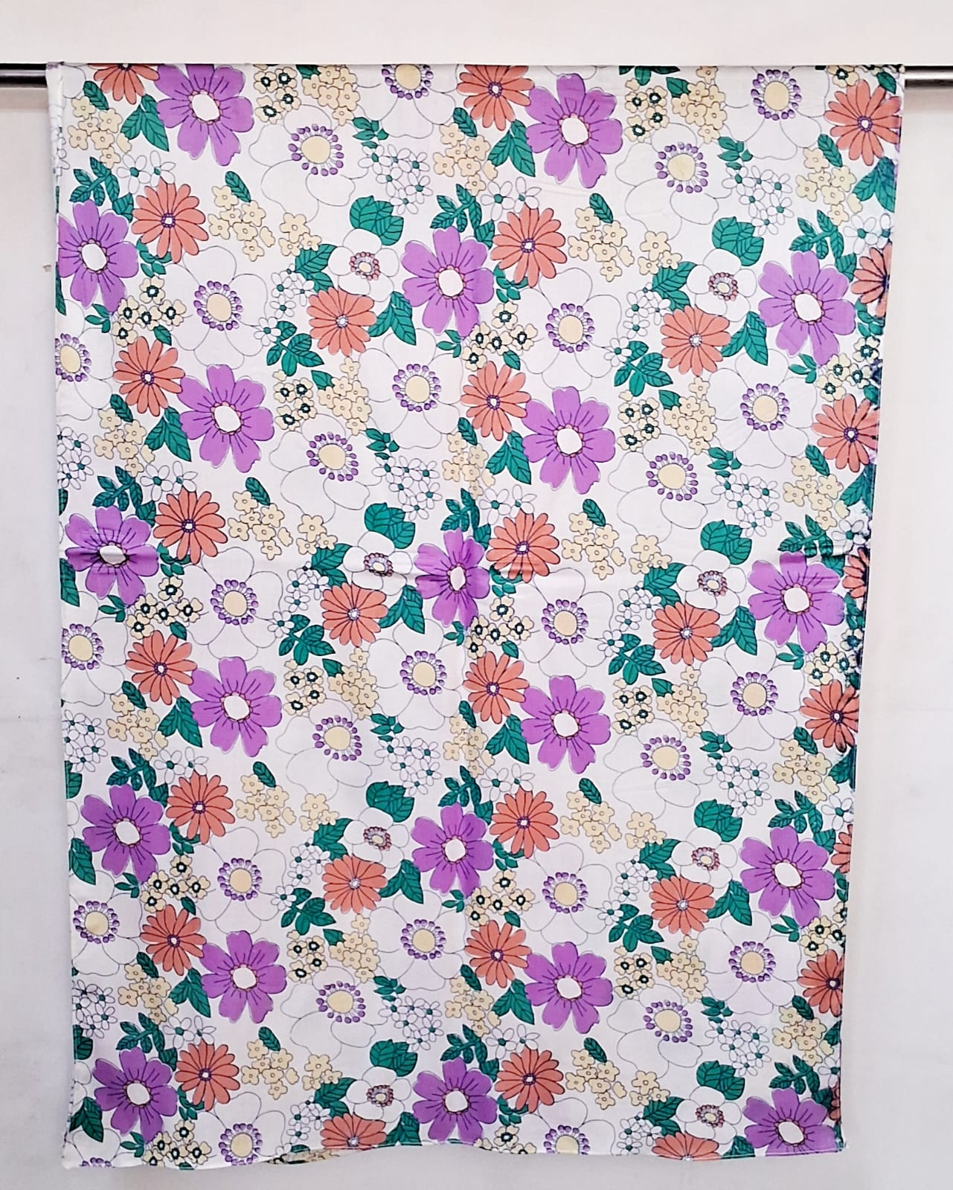
GS 76
SZ- 105 x 180 CMS
100% RAYON
Price- USD 2.45

Slide 11
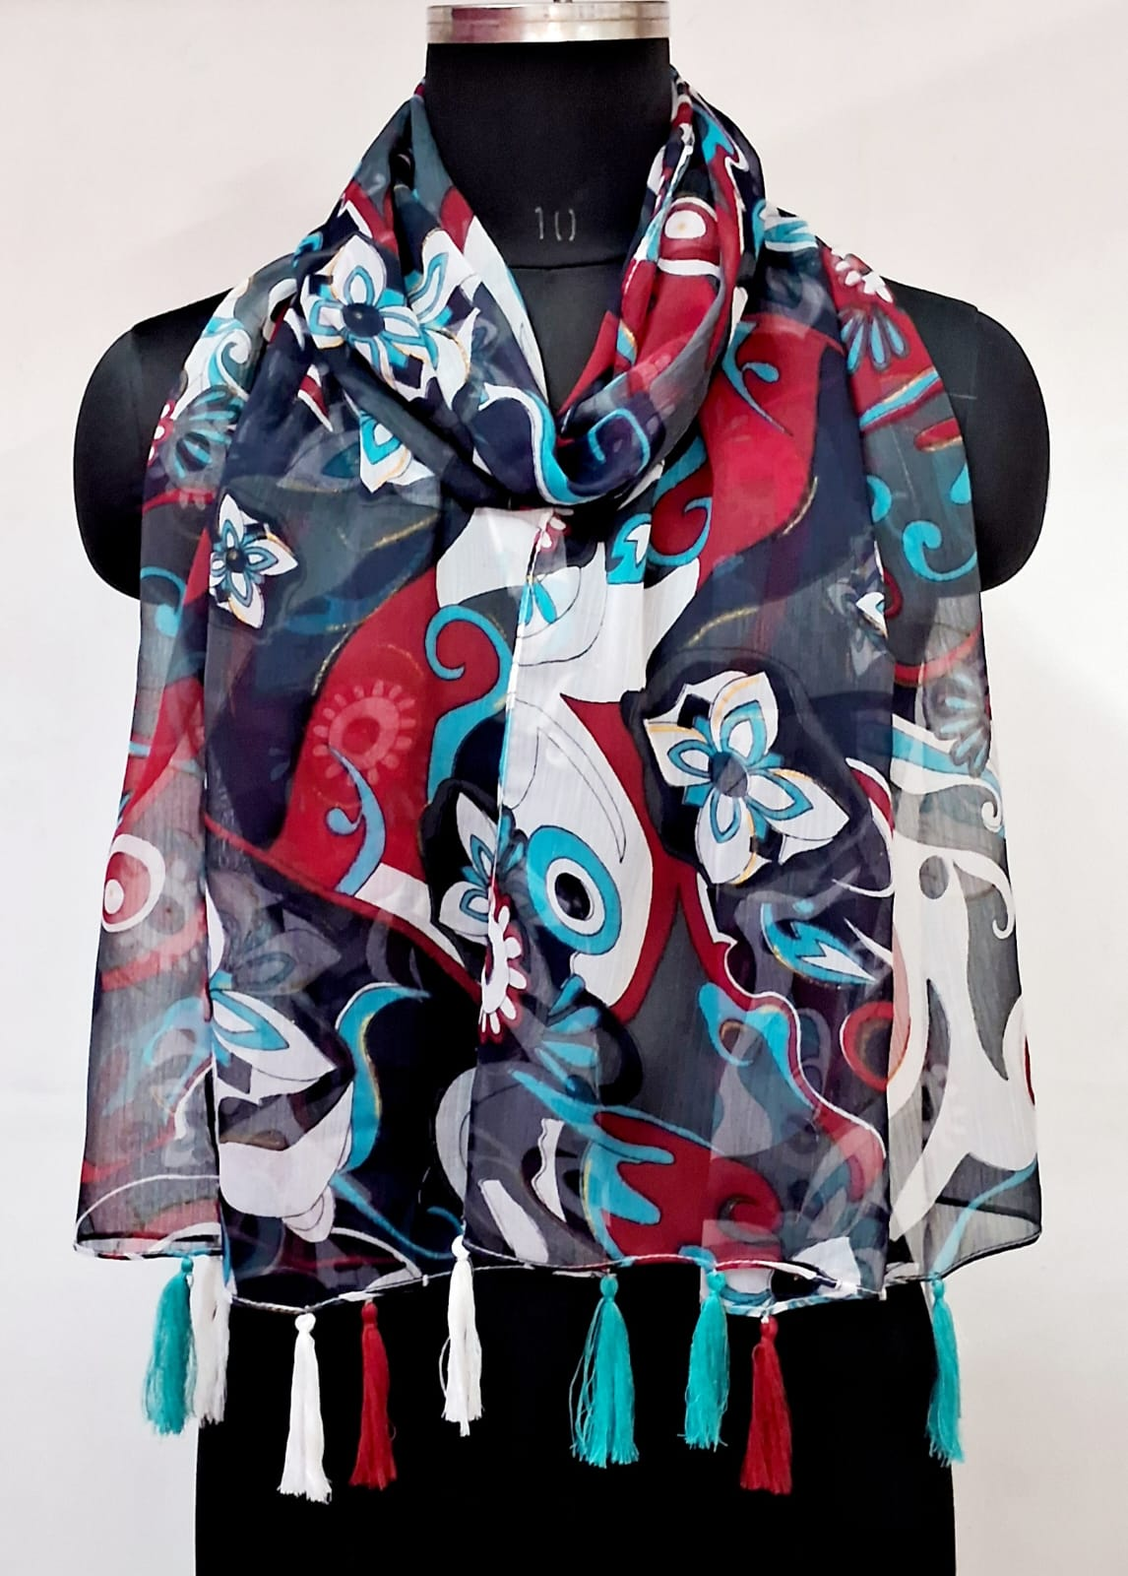
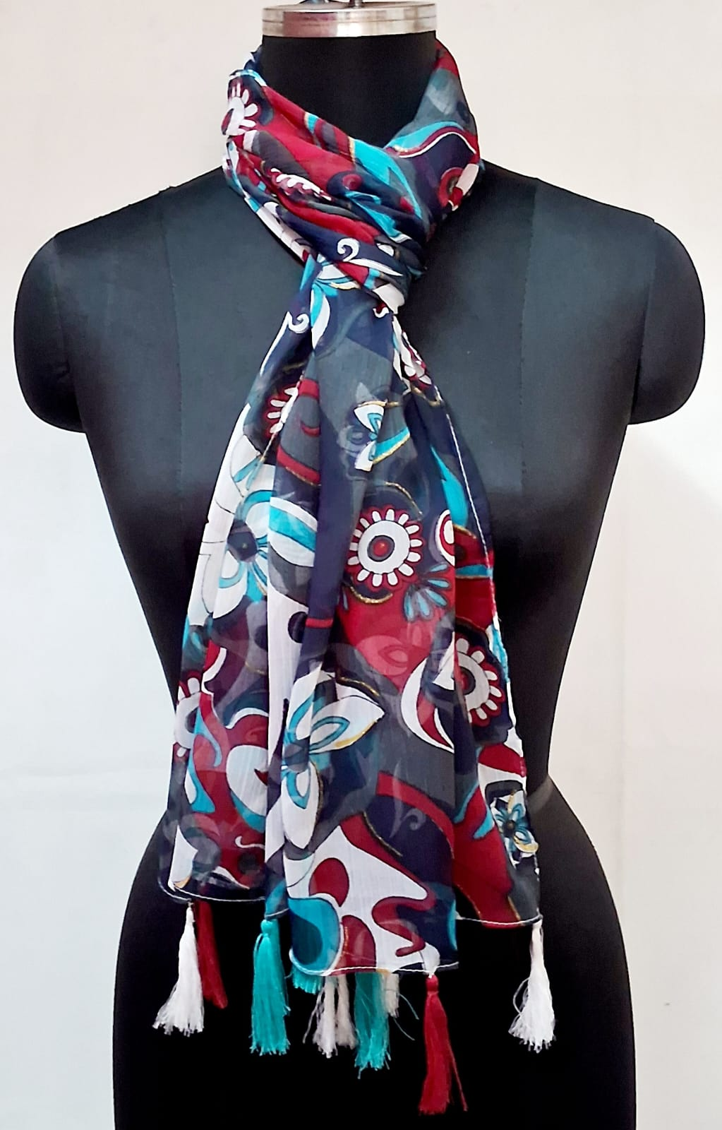
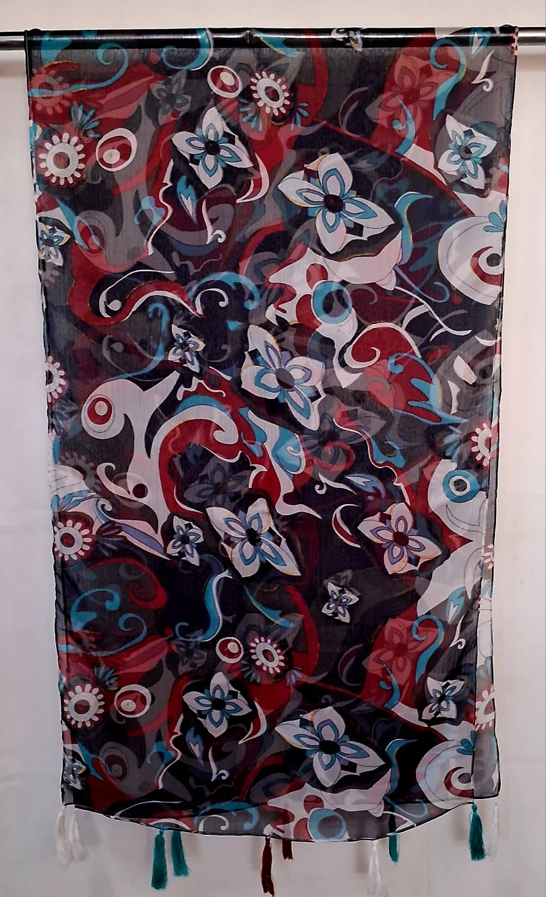
GS 20
SZ- 70 x 180 CMS
100% POLYESTER
Price- USD 1.95

