Slide 1
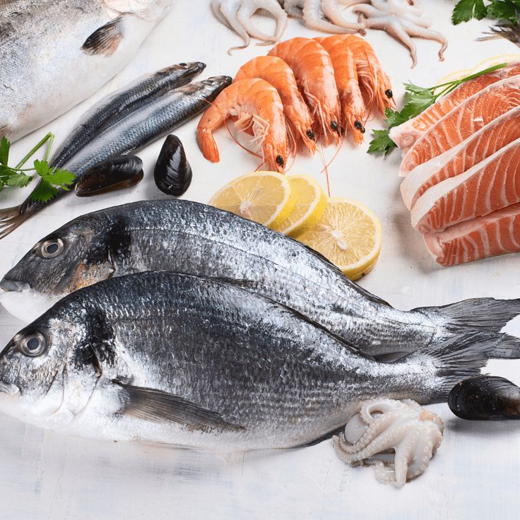
FROZEN SEAFOOD
SUPPLIER
Product Presentation

Slide 2
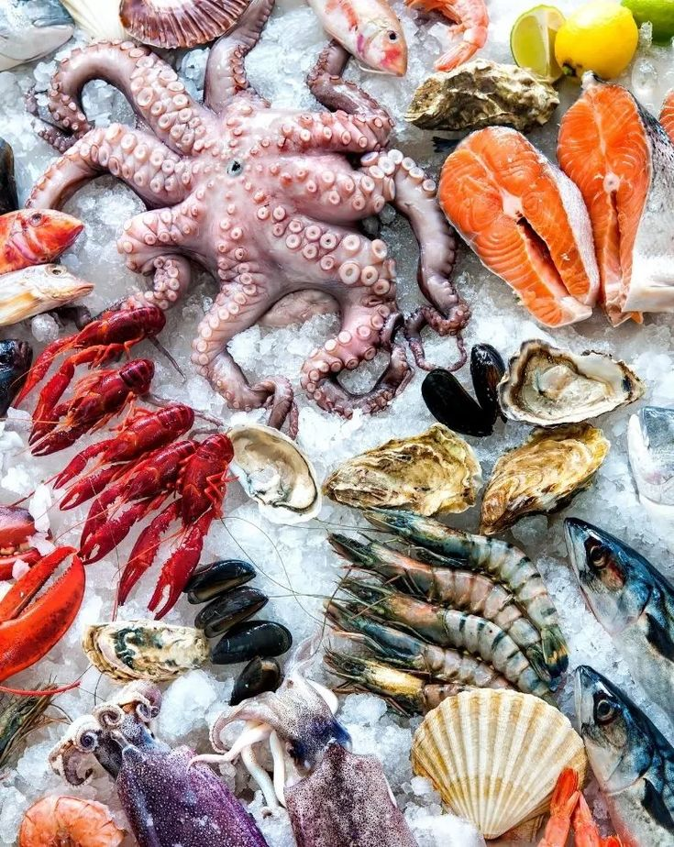
INTRODUCING
FROZEN SEAFOOD
Yellowfin Tuna
Skipjack Tuna
Squid
Octopus
Indian Mackerel
Yellow Tail Mackerel
Short Mackerel
.

Slide 3
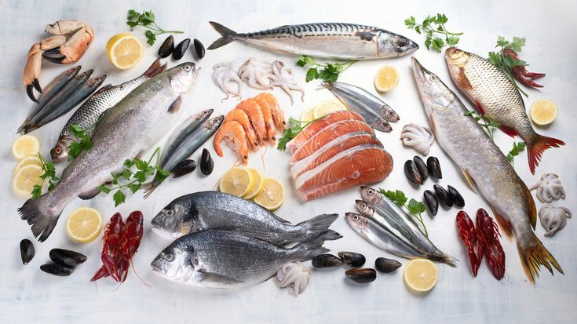
ABOUT OUR FROZEN SEAFOOD
Our seafood is sourced directly from the bountiful seas, ensuring each item is of the highest quality, guaranteeing satisfaction for your discerning customers
.

Slide 4
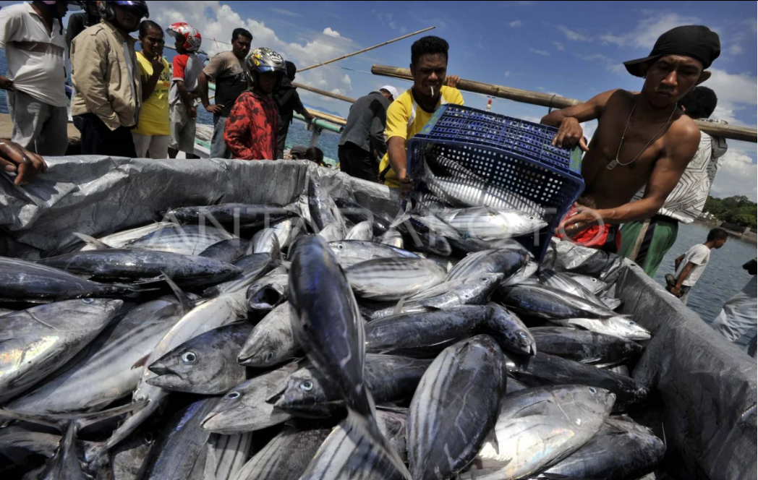
#1
SKIPJACK TUNA
Has darker flesh compared to Yellowfin Tuna and is known for its strong flavor and tender texture
Commonly processed into various products such as canned tuna, smoked tuna, and other seafood delicacies

Slide 5
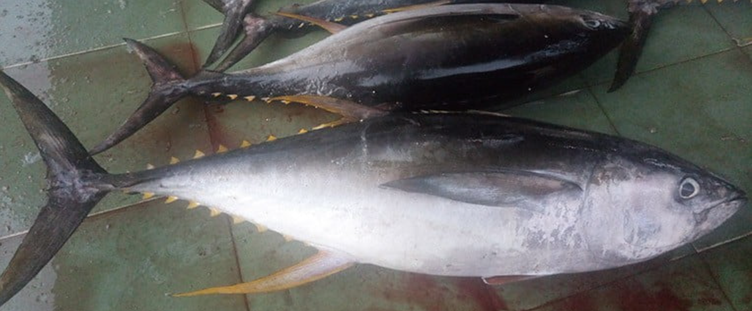
#3
YELLWOFIN TUNA
Known for its pink to deep red flesh and high nutritional content
A staple in various cuisines, including sashimi, sushi, and tuna steaks
Primary advantages: high-quality protein, omega-3 fatty acids, and essential vitamins and minerals

Slide 6
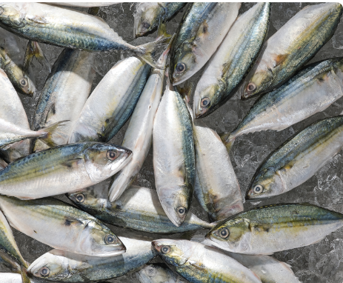
#4
INDIAN MACKEREL
Rich in omega-3 fatty acids, our Indian Mackerel is a healthy and delicious choice. It is flash-frozen to preserve its freshness and nutritional value, suitable for frying, grilling, or baking..
I

Slide 7
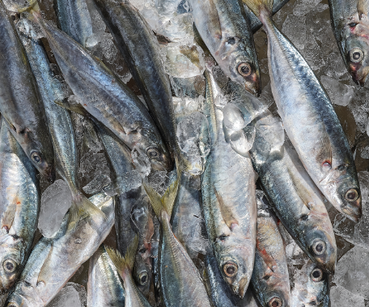
#5
ROUND SCAD
Our round scad is a versatile fish with a mild flavor and firm texture. It is perfect for frying, grilling, or incorporating into traditional recipes.

Slide 8
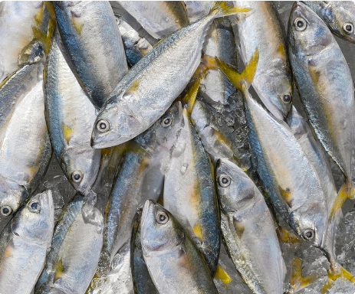
#6
SHORT MACKEREL
Short Mackerel is a flavorful fish that is easy to prepare. Our freezing method maintains its freshness and taste, making it suitable for steaming, frying, or using in fish curries..

Slide 9
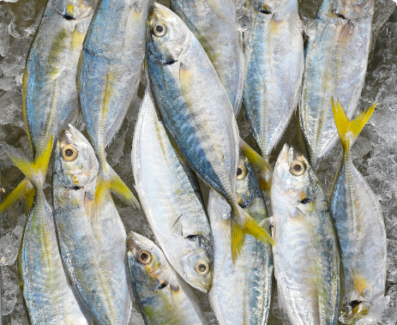
#7
YELLOW TAIL MACKEREL
This mackerel variety is prized for its succulent flesh and high nutritional content. Our freezing process ensures that it retains its taste and quality, making it ideal for a range of culinary.

Slide 10
ARE YOU LOOKING FOR A YELLOWFIN AND SKIPJACK TUNA FROZEN SUPPLIES?
OUR COMPANY IS THE ANSWER!

Slide 11
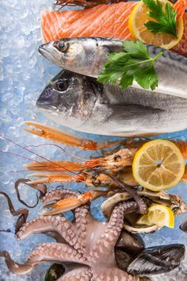
HOW TO REACH US
FURTHER INFORMATION TO
ADDRESS
Sarotari,Larantuka,Flores Timur (NTT)
EMAIL ADDRESS
ferdy@ebbantel.com
WEBSITE
Ebbantel.com
PHONE
085142891513

