Slide 1
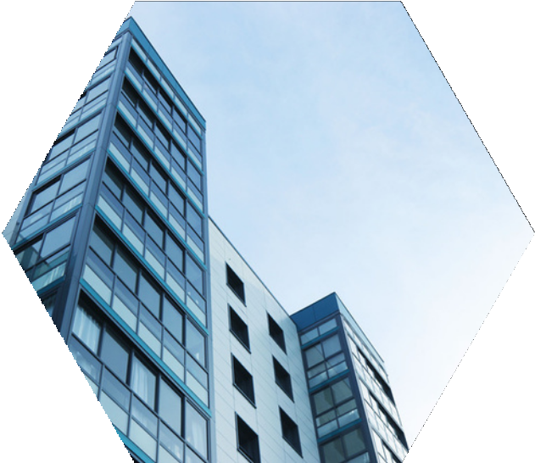

COMPANY
PROFILE
PT . EDHO BAHY BANTEL
Contact : Sarotari-Larantuka-Flores Timur
Phone: (+62)85142891513
Contact : ferdinandusbahy3003@gmail.com

Slide 2

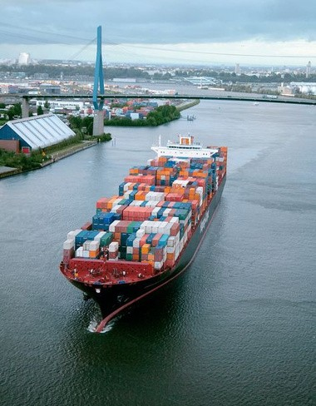

COMPANY
INTRODUCTION
PT EDHO BAHY BANTEL
customers worldwide.
PT EDHO BAHY BANTEL is a premium coffee producer and exporter based in Indonesia. We are dedicated to introducing the authentic flavors of Nusantara coffee to the international market. One of our flagship products is East Flores Coffee, renowned for its exceptional quality and taste
"Drive Profitability through International Trade."
WHAT IS OUR GOAL
Our goal is to be a reliable and trusted business partner, upholding values of honesty, integrity, and customer satisfaction.

Slide 3



Vision and Mission
Vission
To be the leading coffee producer that brings the unique flavors of Nusantara to the world
Mission
Using selected coffee beans from local farmers.
Maintaining product quality and freshness through hygienic processes
Providing the best coffee experience to consumers

Slide 4

Our Services
Our Service
PT EDHO BAHY BANTEL, we offer a range of services to support our customers in their export endeavors. Our services include:
Expand Market Reach : To establish a strong presence in international markets by introducing East Flores Coffee to coffee enthusiasts around the world.
2. Promote Unique Flavors : To highlight the unique and rich flavor profile of East Flores Coffee, showcasing the distinct characteristics that set it apart from other coffees
3. Support Local Farmers : To provide sustainable income opportunities for local farmers by promoting and exporting their high-quality coffee beans to global markets.
4. Ensure Quality and Freshness : To maintain the highest standards of quality and freshness in every batch of coffee, ensuring a premium product for our customers
5. Business Networking: We facilitate business networking opportunities for our clients, connecting them with potential buyers, distributors, and other business partners. This helps them expand their network and establish valuable collaborations.
Our services are designed to streamline the export process, minimize risks, and maximize the success of our clients' export ventures. We are committed to delivering excellent service and ensuring the satisfaction of our customers.

Slide 5
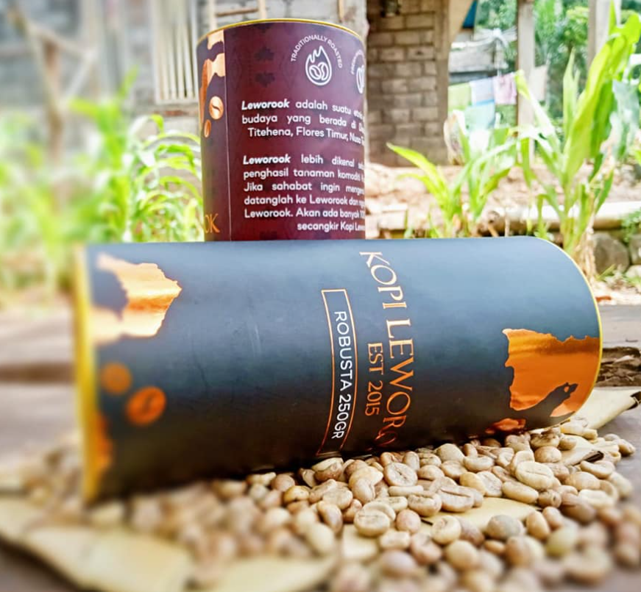
Our Product
Our Product
East Flores Coffe Bean
Our East Flores Coffee beans are selectively sourced from experienced local farmers. The natural processing methods we employ preserve the authentic taste and aroma of the coffee, resulting in a coffee with genuine and delightful flavors. We are committed to maintaining the highest quality at every stage of production

Slide 6
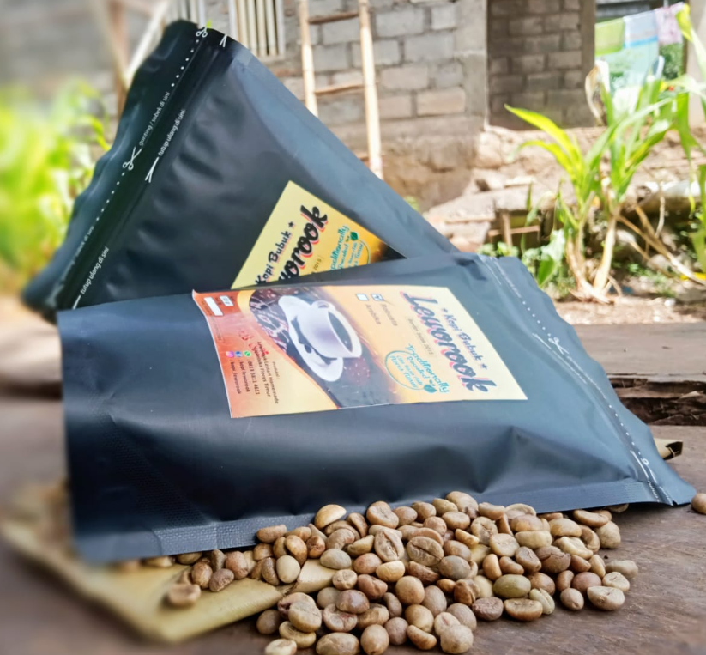
Our Product
Our Product
East Flores Coffee Beans
This coffee boasts a rich flavor profile with hints of tropical fruits, chocolate, and a touch of spice. Its balanced acidity and strong aroma make East Flores Coffee a favorite among true coffee aficionados.

Slide 7

Our Product
Our Product
East Flores Coffee uses selected Arabica coffee beans handpicked from plantations at an altitude of 1,200 meters above sea level. These conditions produce the best quality coffee beans with a distinctive flavor. The coffee beans are processed using natural methods that preserve the authentic taste and aroma. Sun-drying the beans naturally ensures the quality of the coffee beans is maintained through to roasting

