Slide 1


COMPANY
PROFILE
PT . EDHO BAHY BANTEL
Contact Sarotari Larantuka Flores Timur Phone:(+62)85142891513
Contact ferdinandubahy3003@gmail.com

Slide 2

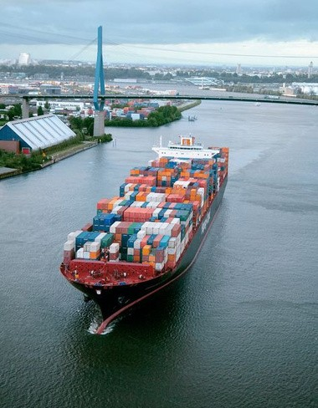

COMPANY
INTRODUCTION
PT EDHO BAHY BANTEL
customers worldwide.
We specialize in exporting Frozen Seafood to international markets. With extensive experience and a commitment to quality, we ensure to deliver high-quality products to customers worldwide
"Drive Profitability through International Trade."
WHAT IS OUR GOAL
Our goal is to be a reliable and trusted business partner, upholding values of honesty, integrity, and customer satisfaction.

Slide 3



Vision and Mission
Vission
To become a global leader in the export of frozen seafood, committed to quality and sustainability
Mission
To provide high-quality frozen seafood products that meet international standards
To build an efficient global distribution network to reach international markets
To implement sustainable and environmentally friendly business practices throughout the production and distribution process

Slide 4

Our Services
Our Service
PT EDHO BAHY BANTEL, we offer a range of services to support our customers in their export endeavors. Our services include:
We are dedicated to meeting the highest standards in food safety, sustainability, and customer satisfaction. Our support extends beyond our products to providing exceptional customer service, ensuring strong and sustainable partnerships with our international clients
If you are seeking a reliable supplier for Frozen Seafood, PT EDHO BAHY BANTEL is ready to be your best solution for export needs. Please contact us for further information or to initiate a mutually beneficial partnership

Slide 5
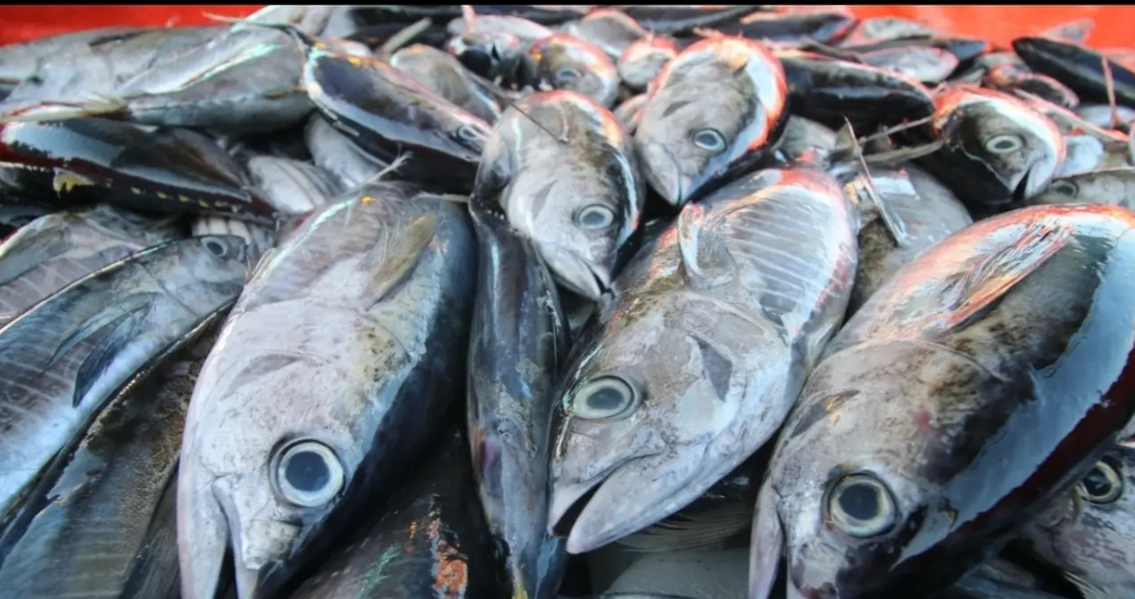
Our Product
Our Product
SKIPJACK TUNA FROZEN
Discover our premium frozen skipjack tuna at PT EDHO BAHY BANTEL.Sourced from the pristine waters, our frozen skipjack tuna is renowned for its freshness and quality. Ideal for a variety of culinary applications, our product is meticulously processed and frozen to preserve its natural flavor and nutritional value. Whether for sashimi, grilling, or canning, our frozen skipjack tuna meets the highest standards of taste and sustainability.

Slide 6
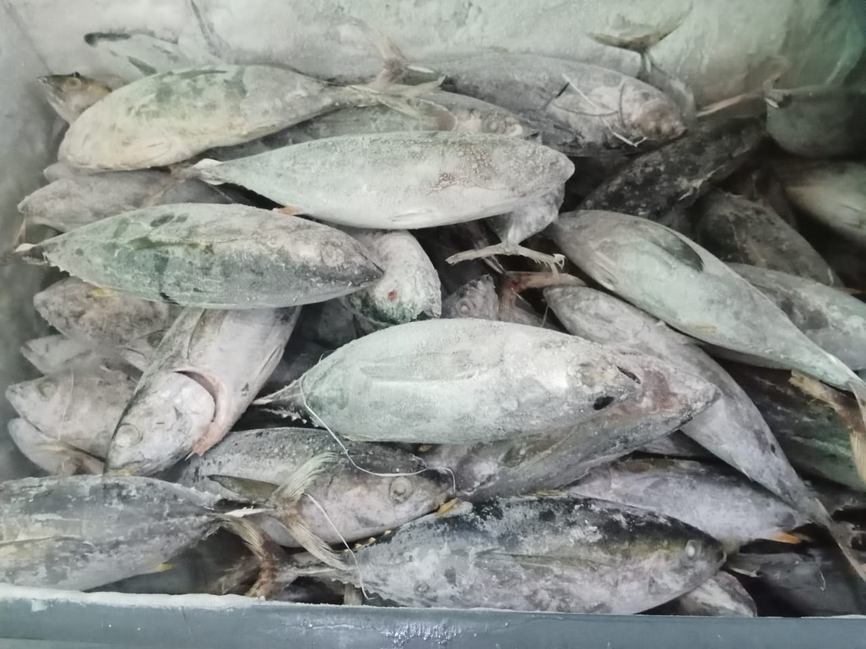
Our Product
Our Product
YELLOWFIN TUNA FROZEN
Introducing our premium frozen yellowfin tuna at PT EDHO BAHY BANTEL. Sourced from pristine waters, our frozen yellowfin tuna is celebrated for its superior quality and freshness. Perfect for various culinary uses, our product is carefully processed and frozen to retain its natural taste and nutritional benefits. Whether for sushi, grilling, or gourmet dishes, our frozen yellowfin tuna consistently meets the highest standards of flavor and sustainability.

Slide 7
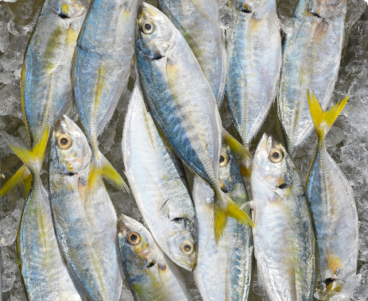
Our Product
Our Product
YELLOW TAIL MACKEREL
Introducing our premium frozen yellow tail mackerel at PT EDHO BAHY BANTEL. This mackerel variety is prized for its succulent flesh and high nutritional content. Our freezing process ensures that it retains its taste and quality, making it ideal for a range of culinary.

Slide 8
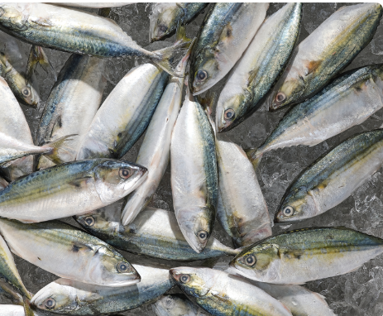
Our Product
Our Product
INDIAN MACKEREL
Introducing our premium frozen Indian Mackerel at PT EDHO BAHY BANTEL. Rich in omega-3 fatty acids, our Indian Mackerel is a healthy and delicious choice. It is flash-frozen to preserve its freshness and nutritional value, suitable for frying, grilling, or baking.

Slide 9
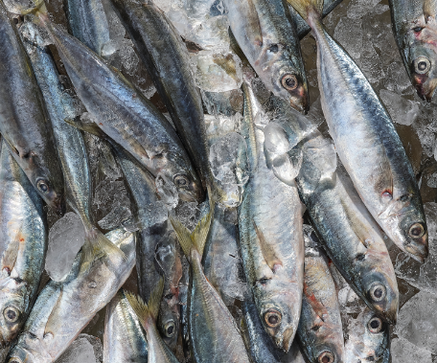
Our Product
Our Product
ROUND SCAD FROZEN
Introducing our premium Round Scad Frozen at PT EDHO BAHY BANTEL. Our round scad is a versatile fish with a mild flavor and firm texture. It is perfect for frying, grilling, or incorporating into traditional recipes.

Slide 10
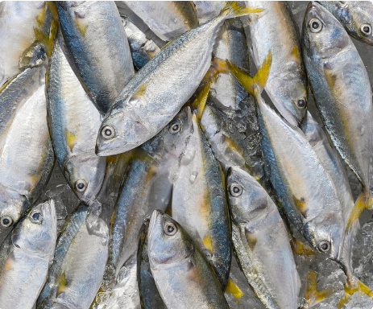
Our Product
Our Product
SHORT MACKEREL
Introducing our premium Short Mackerrel at PT EDHO BAHY BANTEL. Short Mackerel is a flavorful fish that is easy to prepare. Our freezing method maintains its freshness and taste, making it suitable for steaming, frying, or using in fish curries.

