Slide 1
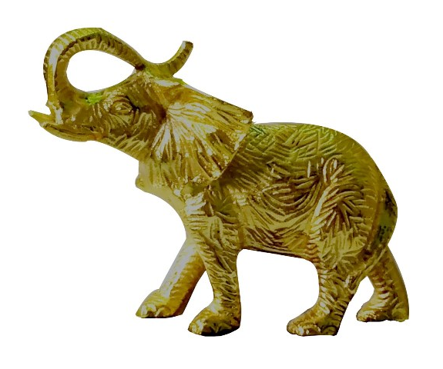
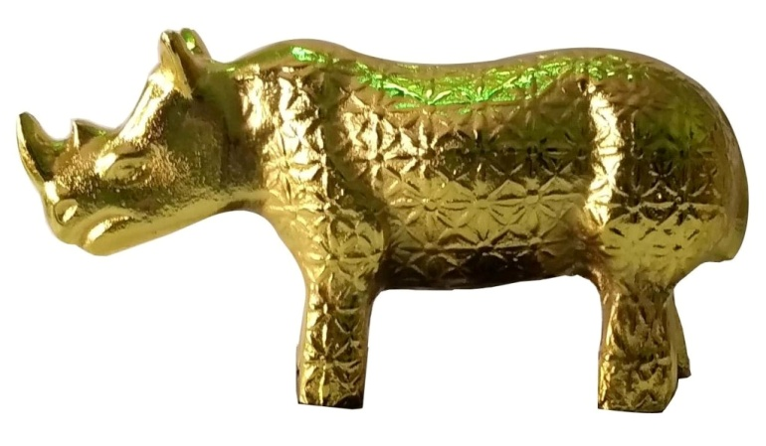
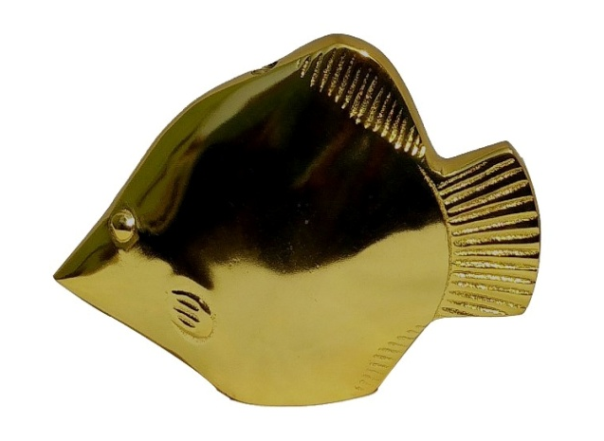
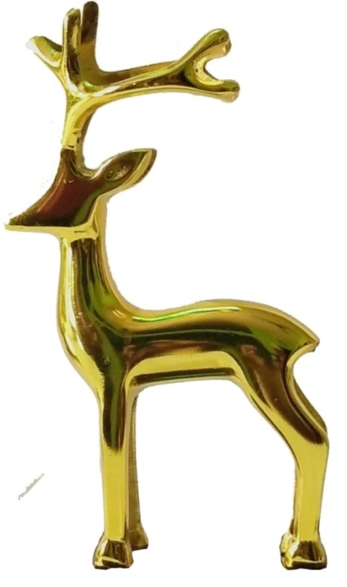
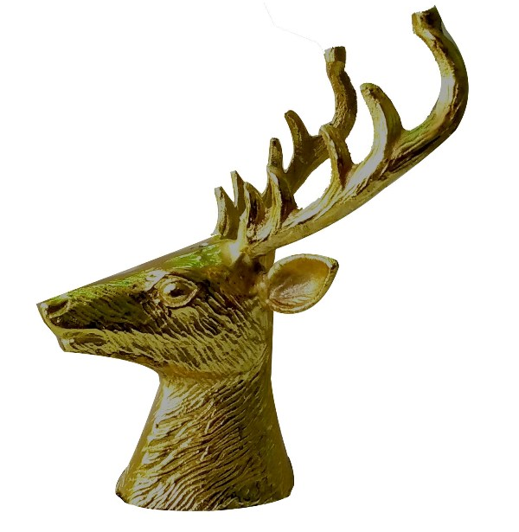
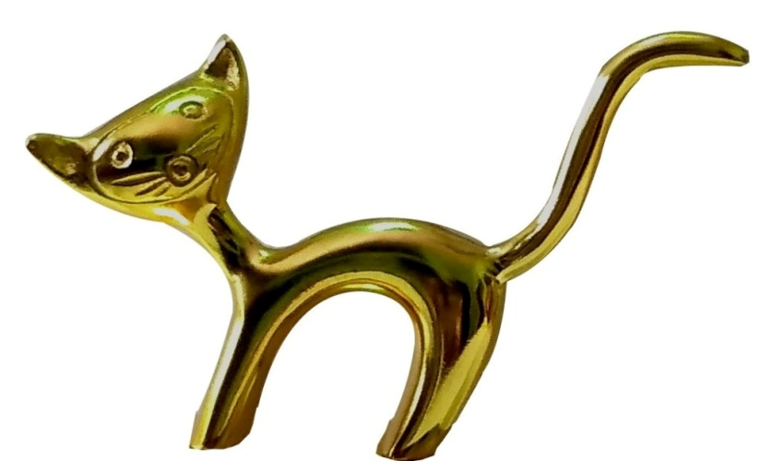
ALUMINUM DECORATIVE ANIMALS GOLD PLATED
TM-1045
TM-1044
TM-1048
TM-1053
TM-1050
TM-1056

Slide 2
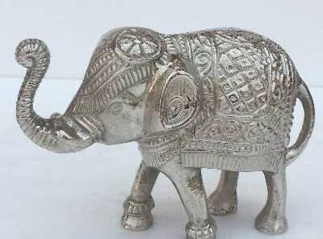
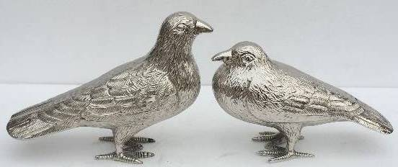
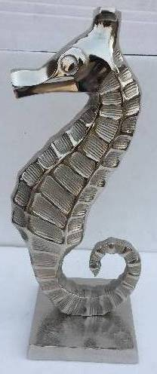
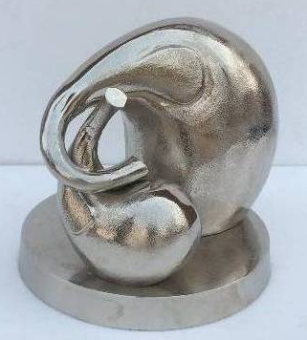
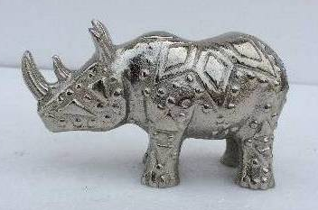
ALUMINUM DECORATIVE ANIMALS NICKEL PLATED
TM-41008 (Pair)
TM-41007
TM-411556
TM411560
TM-41003

Slide 3
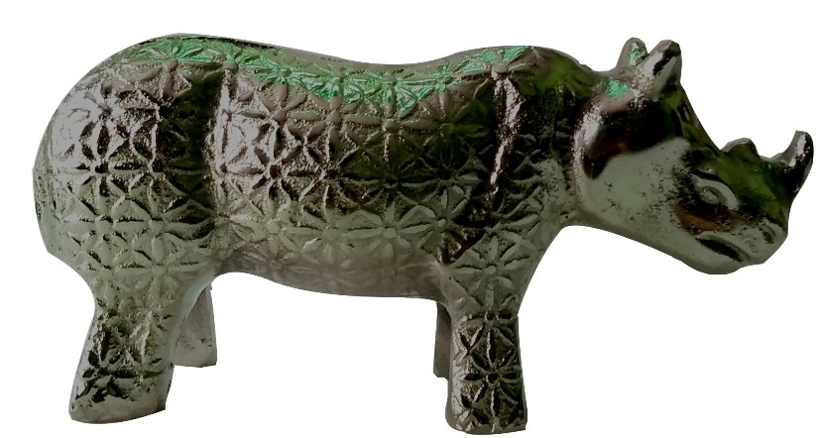
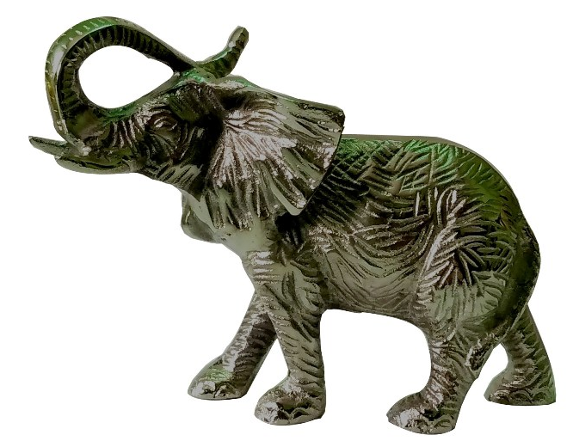
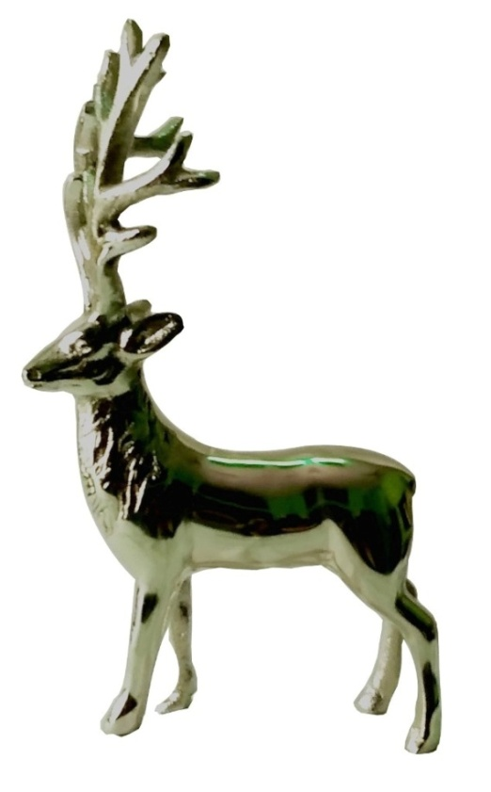
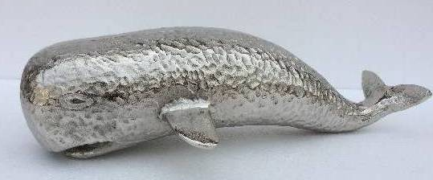
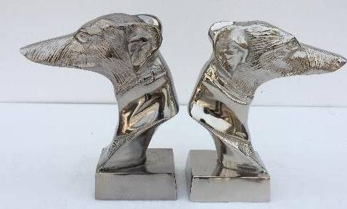
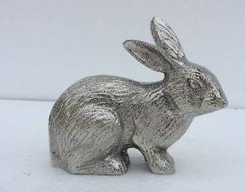
ALUMINUM DECORATIVE ANIMALS NICKEL PLATED
TM-1056
TM-1058
TM-1060
TM-1061
TM-1059
TM-1046

Slide 4
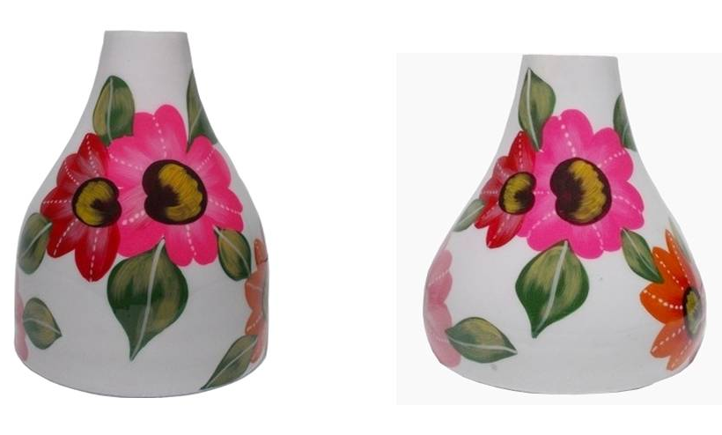
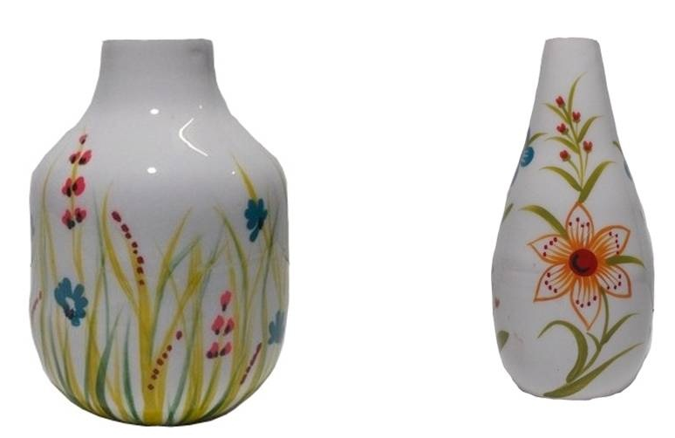
ALUMINUM FLOWER VASE ENAMELED PAINTED
ITEM-1002
SIZE-16x16x20 cm
PRICE FOB US$ 4.10
ITEM-1001
SIZE-15x15x16 cm
PRICE FOB US$ 3.60
ITEM-1009
SIZE-8x8x15 cm
PRICE FOB US$ 2.00
ITEM-1005
SIZE-9x9x13 cm
PRICE FOB US$ 1.90

Slide 5
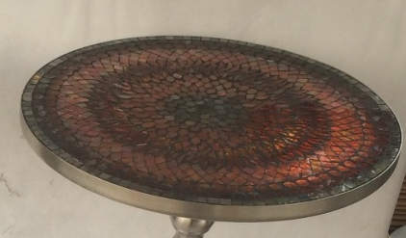
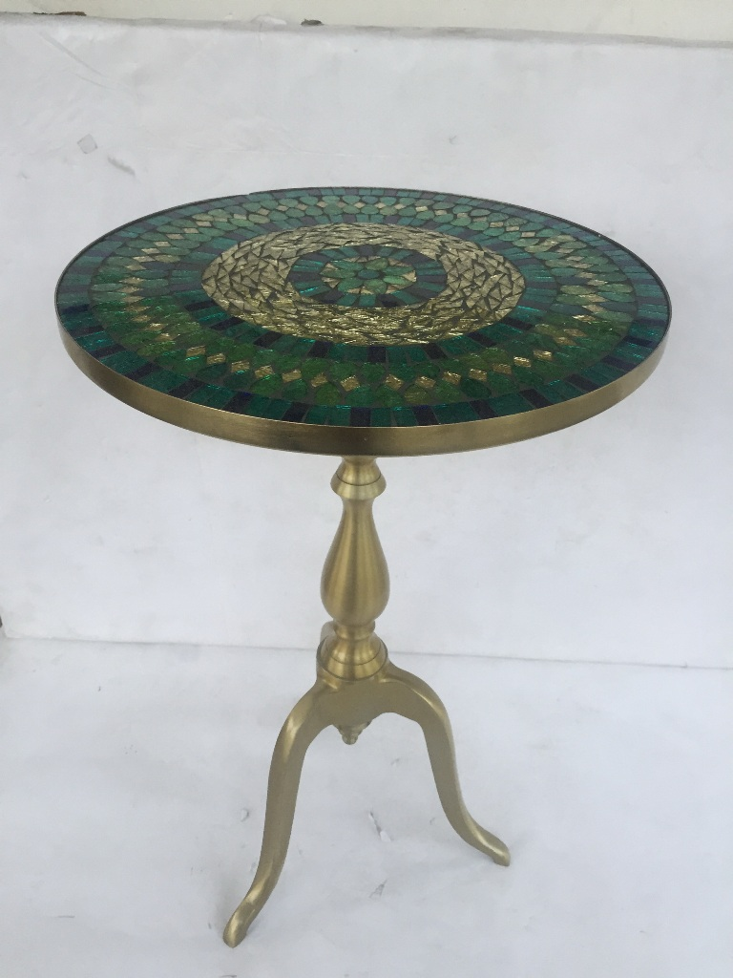
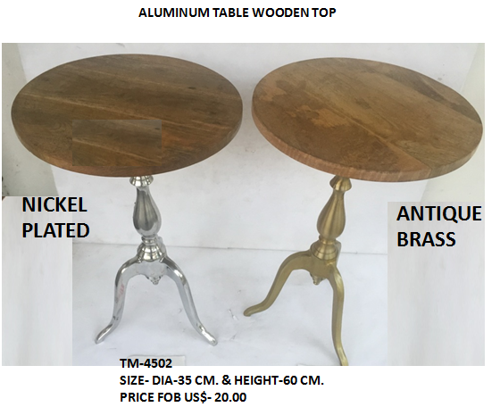
ALUMINUM TABLE MOSAIC & WOODEN TOP
RED MOSAIC TOP
GREEN MOSAIC TOP
TM-4501
SIZE- DIA-35 CM. & HEIGHT-60 CM.
PRICE FOB US$- 20.00

Slide 6
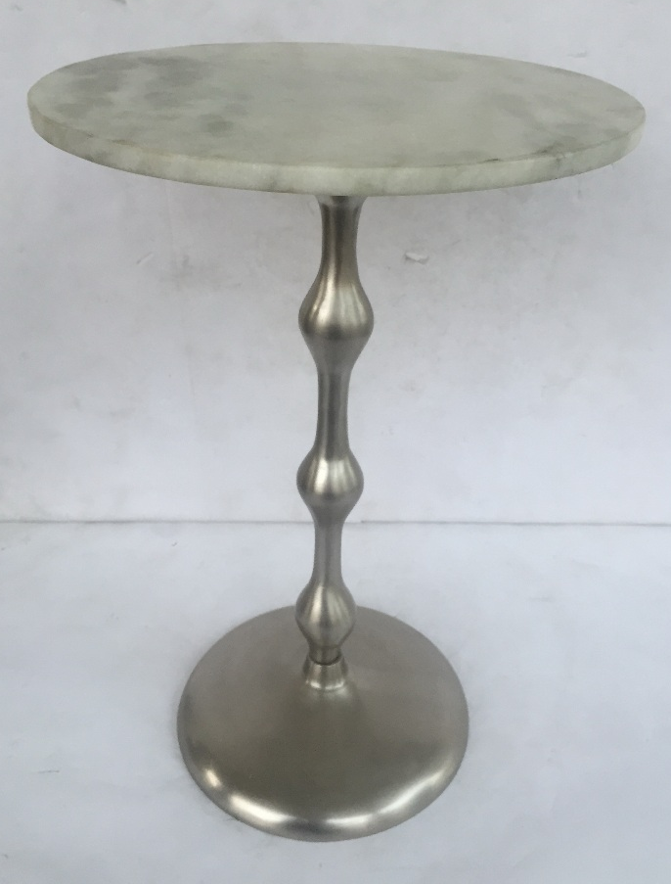
ALUMINUM TABLE MARBLE TOP
TM-4503
SIZE- DIA-35 CM. & HEIGHT-60 CM.
PRICE FOB US$- 27.00

Slide 7
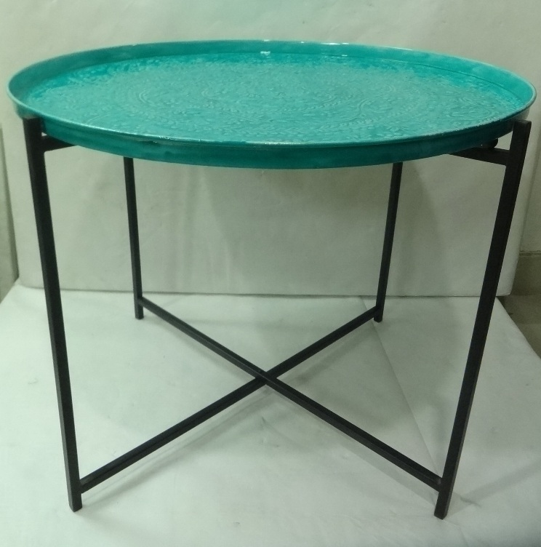
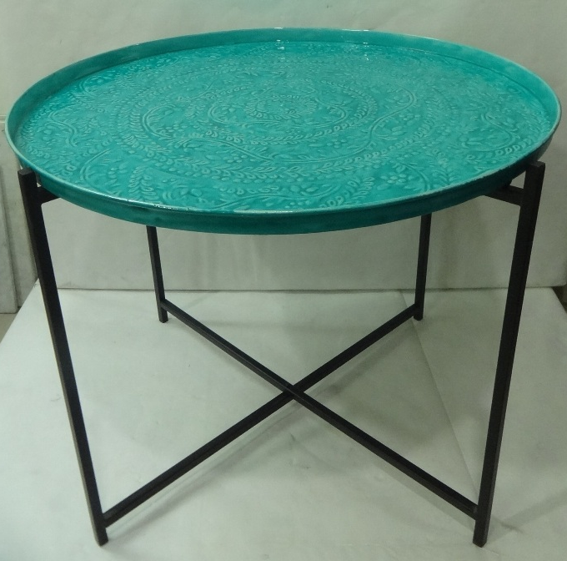
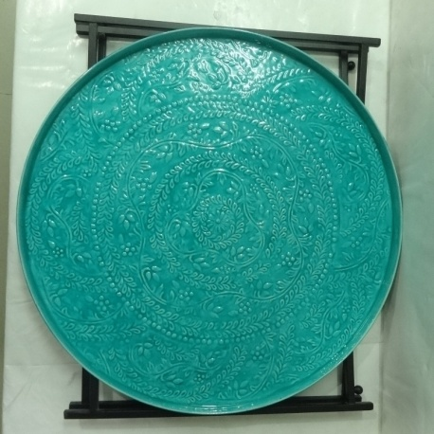
IRON TABLE (FOLDING STAND)
TM-4504 SML & LRG
PRICE SMALL FOB US$ 12.00 ( DIA-36 CM. & HEIGHT-46 CM.
PRICE LARGE FOB US$ 17.00 ( DIA-50 CM & HEIGHT-58 CM)

