Slide 1
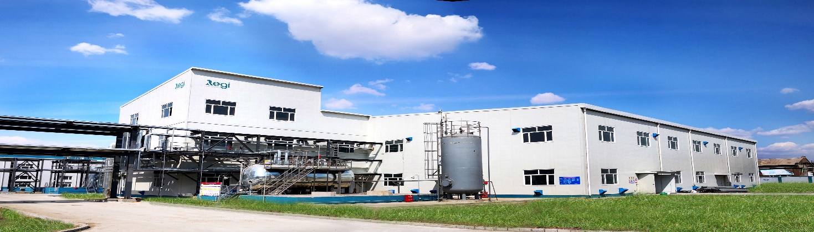

REGI CHEMICAL BUSINESS OVERVIEW
Jilin Regi Performance Chemicals Co., ltd.

Slide 2

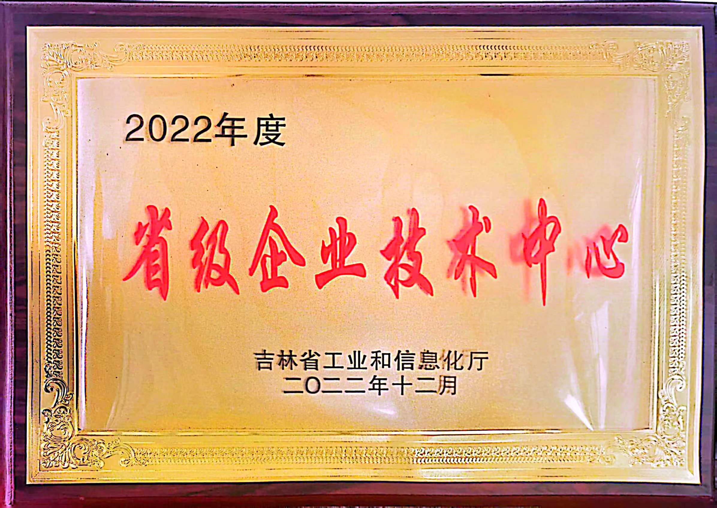
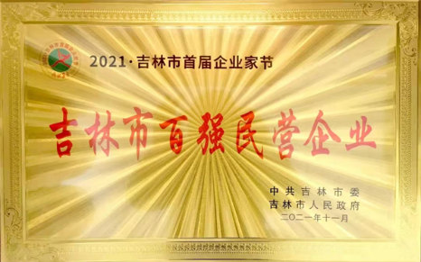
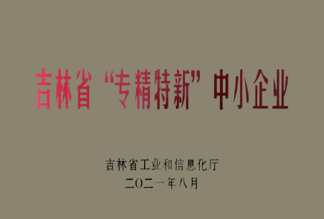



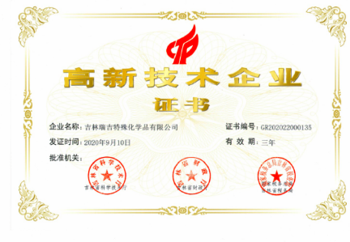
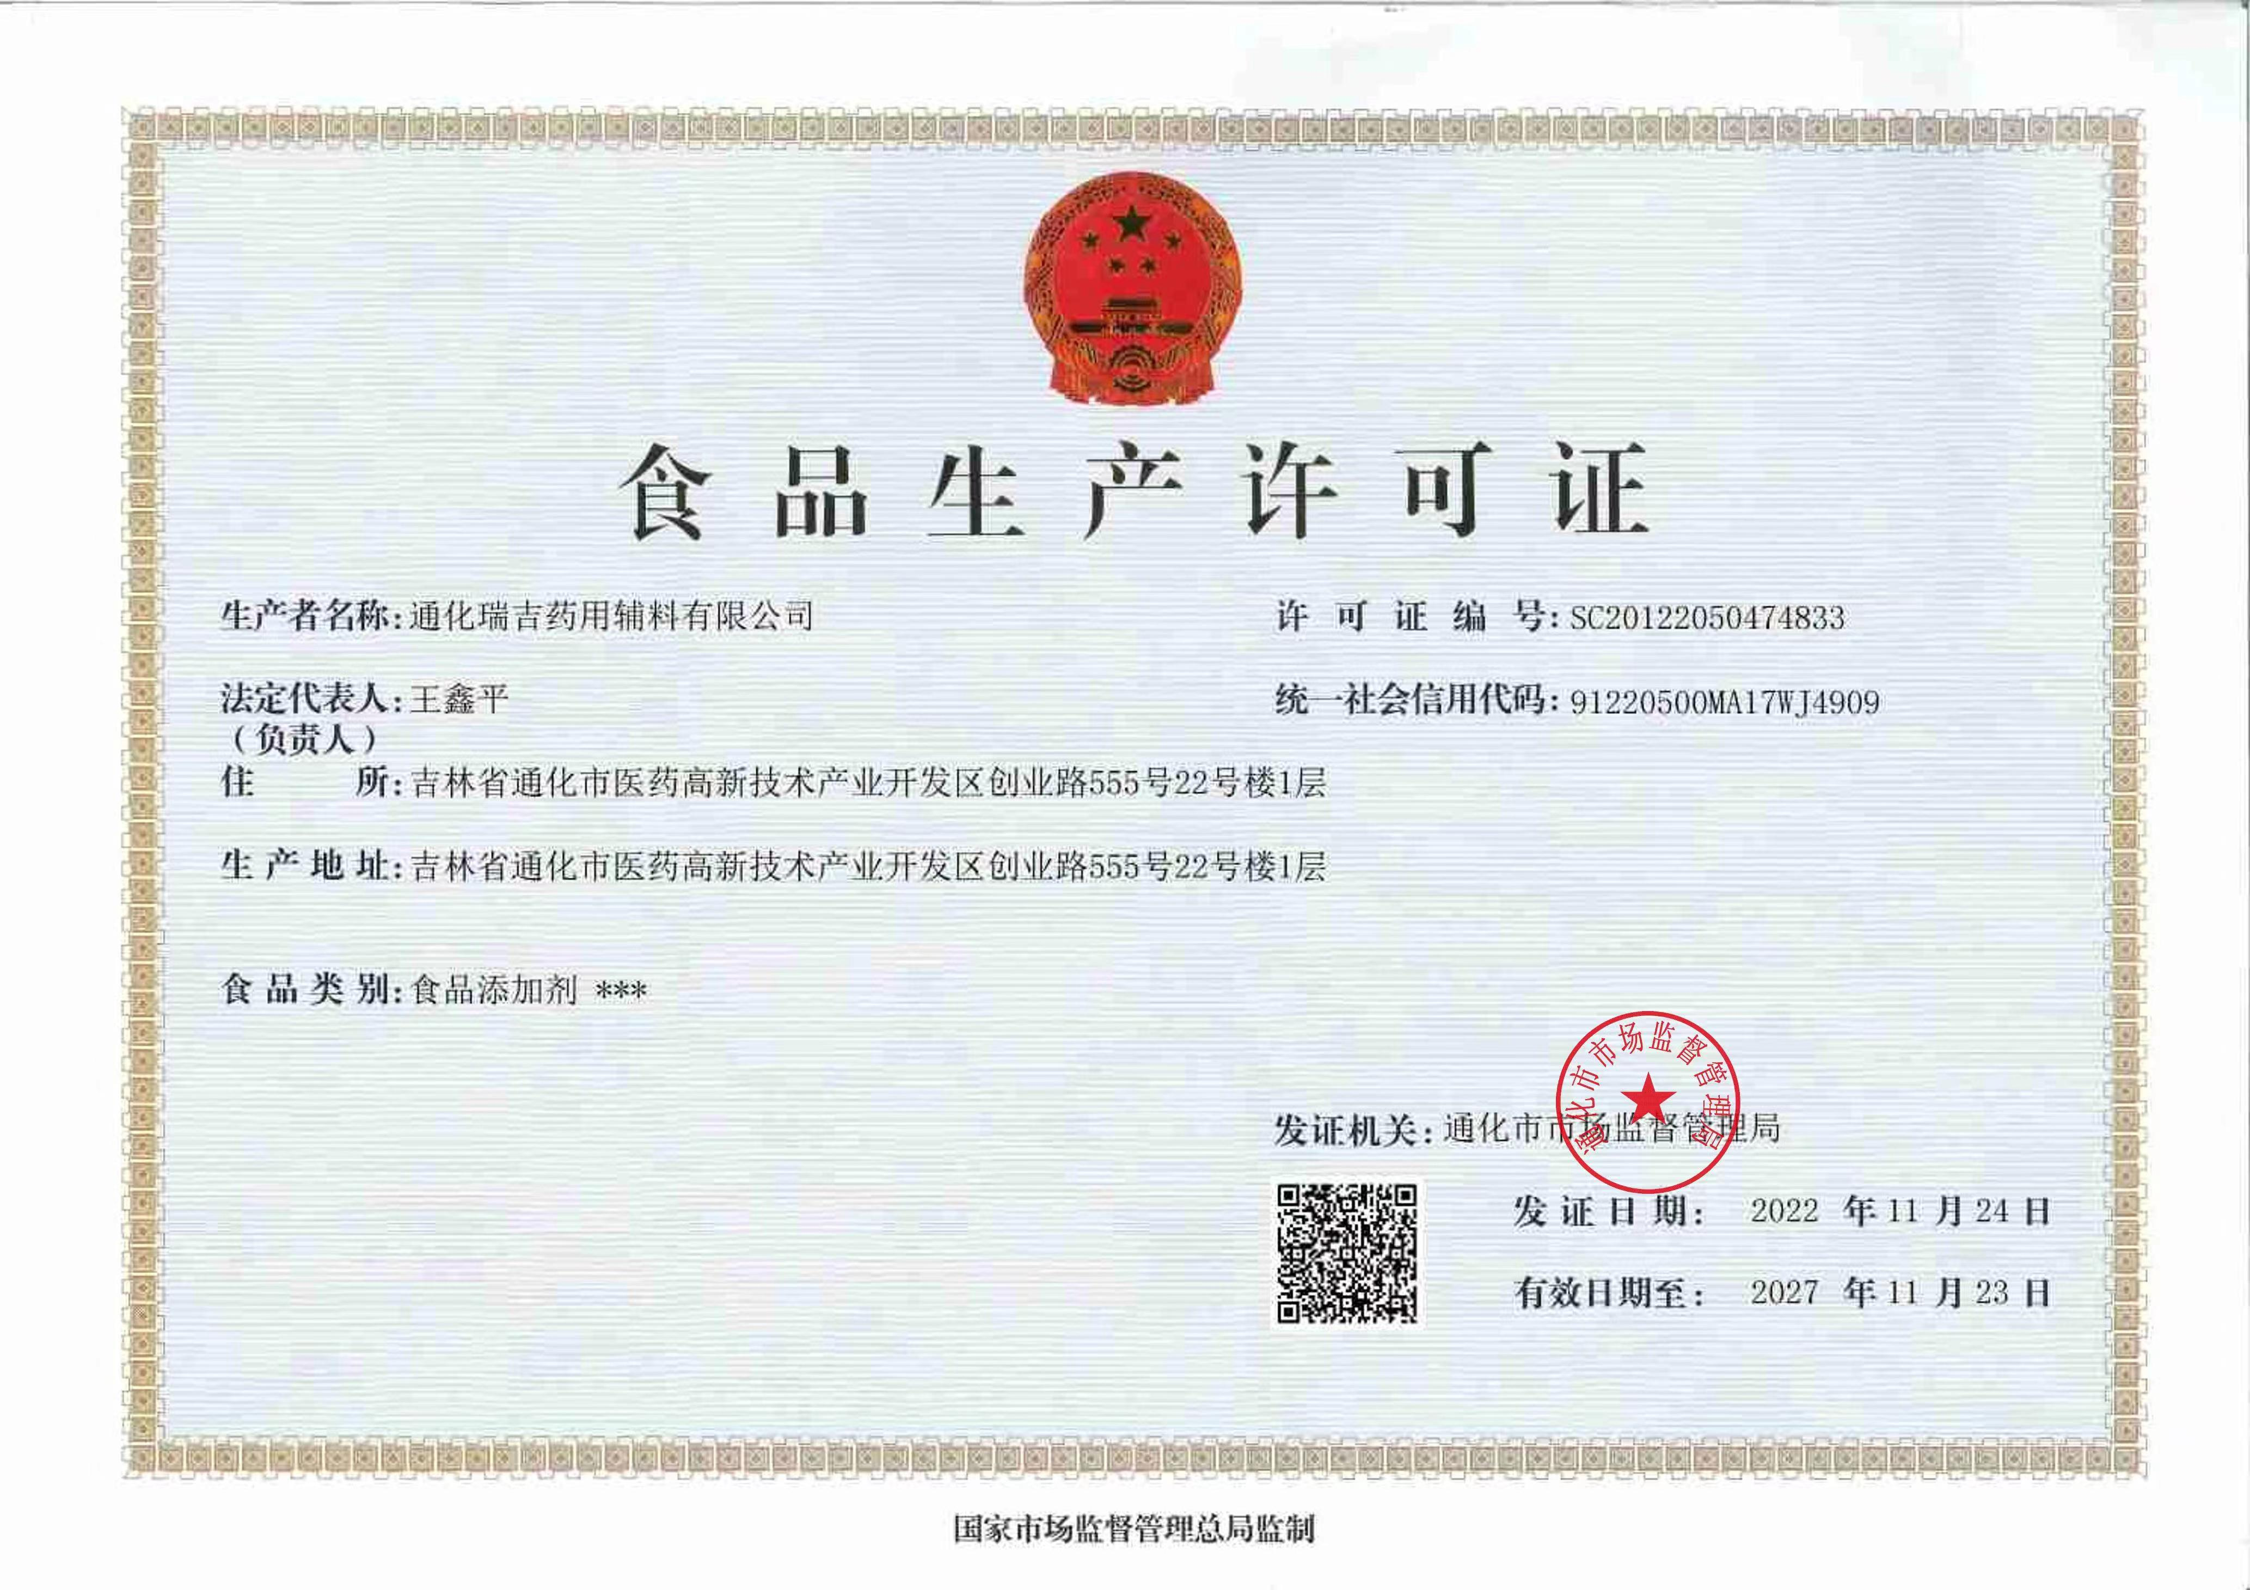
01
Honors & Certificates
关于瑞吉
National High-tech Enterprise
Jilin Province Small and Medium-Sized Enterprise Specializing in Specilty and New
Jilin Province Fine Chemicals Jointed Laboratories
Jilin City Technique Center for Enterprises
Jilin City Top-100 Private Enterprise
Pass the Quality System Certification of ISO 9001/ISO14001 and ISO 14001
QUALIFICAION CERTIFICATES

Slide 3
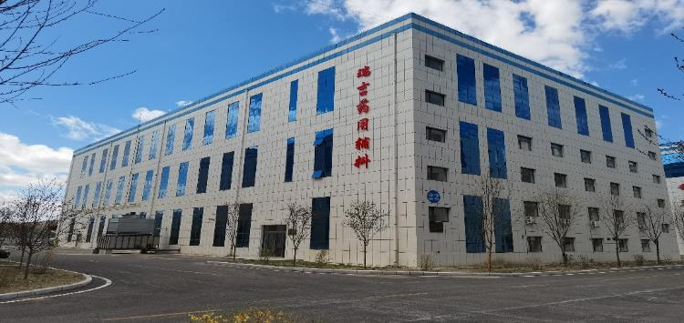
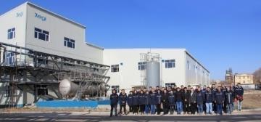
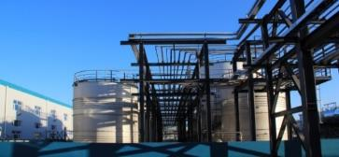
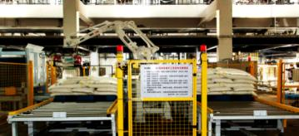
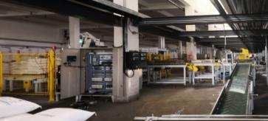
02
Company Profile
公司特色
Supply base for Key Raw Materials of Functional Products
GMP Manufacturing Base for Food, Cosmetics and Pharmaceutical Adjuvants
Manufacturing Base-Jilin: Adjacent to PetroChina Jilin Petrochemical, Regi makes use of Ethylene Oxide as the main raw materials with Propylene Oxide mainly coming from Jilin Shenhua Group, 5 km radius away, owning 13 units of ethoxylation and propoxylation, Esterification plants, adopts DCS fully automatic Production and Control System with branch enterprises in Nanjing, Guangzhou and off-site storage rooms.
Supply power per year：120kta ethoxylated and proproxylated products. Meanwhile, obtaining pilot and pilot scale test plants, Regi can promptly respond to the clients, developing functional monomers and new products of surfactants flexibly.
Tonghua GMP Phamaceutical Adjuvants Manufacturing Base: Located in Pharmaceutical High-tec Zone of state level in Tonghua City, Regi has newly built dust-proof workshops of D and C level, owning the production plants of Polyethylene Glycol products of phamaceutical level of whole serials, established product quality control system of dual systems, food and pharmaceutical adjuvants as well as complete EHS management system.

Slide 4
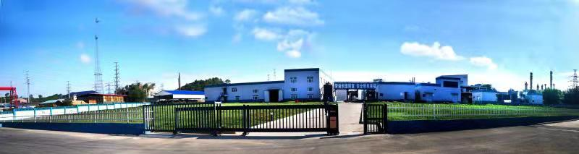
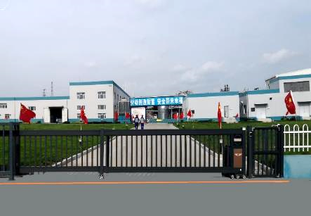
03
Company Profile
关于瑞吉
Jilin Regi Performance Chemicals Co.,ltd.
Non-ionic surfactants and technical solutions provider
Business Orientation
Application Field
Main Products
Fields in Coating, Textile, Leather, Papermaking, Polyster, Agricultural chemicals, Oil Fields, Architecture, Metal processing, Water treatment, Polyurathane and etc.
New Energy Battery Materials
Construction Engineering, Oil Well Engineering, Geotechnical Engineering, Fire-proofing Materials
Food Addictives, Pharmaceutic Adjuvants, Daily-use Chemicals, Raw Materials for Cosmetics
Non-ionic surfactants of technical grade
Non-ionic surfactants of refined grade
Polyethylene Glycol serials products of food and pharmaceutical grade
Clad materials of Lithium iron carbon phosphate
Other downstream derivatives of propylene oxide and ethylene oxide
Raw materials for daily-use chemicals and surfactants
Provider of Dispersants, emulgators, anti-forming agents, penetrating agents, solubilizers, detergents and etc.
Provide surfactants of technical grade and technical solutions
Provide surfactants of refined grade, food and pharmaceutical grade, battery grade as well as applied technical solutions
R&D, Production and Sales of Ethoxylated and Propoxylated special chemicals

Slide 5
04
Product Overview
公司特色
Polycarboxylic High-performance Superplasticizers
Raw materials for Concrete Superplasticizer
Engineering Paster
Reactive Polymer Monomers
Solid Superplasticizers
Cement-based Materials and Products
Ethylene Oxide
Propylene Oxide
Polyethylene Glycol
Hyperdispersants
Paper-making,Pesticide, Oil Field, Water Treatment
Pharmaceutical Adjuvants
Fatty Acid Ether
Surfactants
Daily Chmical Products
Food Additives
Fatty Alcohol Ether
Rheological regulator
Pharmaceutical Adjuvants
Industrial paste
Coatings, Leather, Texttile
Alkyl phenol ether
Phamarceutical Addictive
Allyl alcohol polyether
Materials for Surface Care
Lithium battery, Solor Energy
Personal Care Function Additive
Lithium iron phosphate carburant agent
Industrial Cleaning
Fatty amine polyether
Industrial Additive
Surface Treating Agents
Key Raw Materials
Functional
Products
Product
Category
Product Application
Application Field

Slide 6
05
Product Recommendation
产品推荐
PEG Serials
【Performance and Application】
Chemical Name | Ethylene Oxide Condensation Compound
Molecular Formula | H（OC₂H₄)_{n}OH
Type | Non-ionic
1. PEG serials products can be used as pharmaceutical adjuvants. PEG 4000 and PEG 6000 are appropriate coating materials,hydrophilic polishing materials, membrane materials and capsule wall materials, plasticizers, lubricants, pill base substances.
2. PEG4000 and PEG6000 can be used as excipients, preparation of suppository and medicinal extracts; coating agents in paper-making industry; lubricants and in rubber and coolants in metal processing industry; dispersants and emulgators in Agricultural Chemicals and Pigment Industry; antistastic agents, lubricants in Textile industry.
3. Polyethylene Glycol serials products can be used as the raw materials of surfactants of Ester type.
4. PEG-200 can be used as humectants, inorganic salt solubilizers, viscosity modifiers in daily-use chemicals industry; softening agents, antistastic agents in Textile industry; wetting agents in paper-making and farm
5. PEG-400, PEG-600 and PEG-800 are used as base materials in phamarceuticals and cosmetics, lubricants and wetting agents of Rubber and Textile Industry.
6. PEG-1000 and PEG-5000 are used as base materials or lubricants, softening agents in Phamarceuticals, Textile, Cosmetics Industry; Dispersants in Coating industry; Dispersants in Rubber industry, also dispersants as carbon black fillings.
7. PEG-2000 and PEG-3000 are used as moulding agents of metal processing, lubricants and cutting fluid of brushed metal, pressing or moulding; Polishing agents, solders and etc of Grinding, Cooling and Lubricating; Lubricants in Paper-making industry and also used as melt adhesives.
8. PEg 8000 are used as base materials in phamarceuticals and cosmetics industrial production, fuctioning as adjusting viscosity, melting points; wetting agents, cooling agents in Rubber, Metal Processing Industry, dispersants and emulgators in Pharmaceuticals, Painting Industry; Antistatic agents, lubricants in Textile Industry.
【Technical Specification】
SPEC. | Appearance （25℃） | Average Relative Molecular Weight | Water Content （%）
PEG-200 | Transparent Liquid | 190~210 | ≤0.50
PEG-400 | Transparent Liquid | 380~420 | ≤0.50
PEG-600 | Transparent Liquid or White Paste | 570~630 | ≤0.50
PEG-800 | Transparent Liquid or White Paste | 770~830 | ≤0.50
PEG-1000 | White Waxy Solids | 950~1050 | ≤0.50
PEG-1500 | White Waxy Solids | 1400~1600 | ≤0.50
PEG-2000 | White Waxy Solids | 1800~2200 | ≤0.50
PEG-3000 | White Waxy Solids | 2800~3200 | ≤0.50
PEG-4000 | White Waxy Solids | 3600~4200 | ≤0.50
PEG-6000 | White Waxy Solids | 5500~7000 | ≤0.50
PEG-8000 | White Waxy Solids | 7200~8800 | ≤0.50

Slide 7
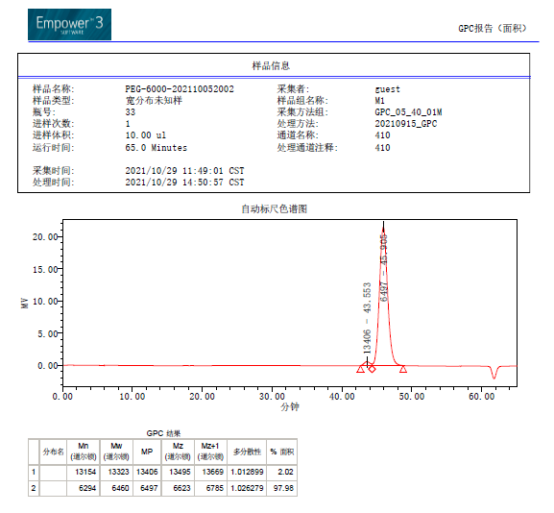
06
Product Recommendation
产品推荐
PEG Serials for Food&Pharm Daily Chemicals Grade
【Techinique Index】
Distribution Diagram of GPC Molecular Weight of PEG Serials
Product No. | Appearance（25℃） | Water solubility | Melting point | Viscosity | Common form
RJ-PEG200 | Colorless transparent liquid |  |  |  | Liquid
RJ-PEG400 | Colorless transparent liquid |  |  |  | Liquid
RJ-PEG600 | Colorless transparent liquid |  |  |  | Liquid
RJ-PEG800 | White Paste |  |  |  | Paste（soft solid）
RJ-PEG1000 | White Paste |  |  |  | Paste（soft solid）
RJ-PEG1500 | White solid, paste |  |  |  | Paste（soft solid）
RJ-PEG2000 | White solid |  |  |  | Solid（slice）
RJ-PEG3350 | White solid |  |  |  | Solid（flake, particle, powder)
RJ-PEG4000 | White solid |  |  |  | Solid（flake, particle, powder)
RJ-PEG6000 | White solid |  |  |  | Solid（flake, particle, powder)
RJ-PEG8000 | White solid |  |  |  | Solid（flake, particle, powder)
*The above data comes from Sunrise Enterprise-Shanghai Technology Center

Slide 8
07
Product Recommendation
产品推荐
High Carbon Fatty Alcohol Polyoxyethylene Ether
【Performance and Application】
Chemical Name | High Carbon Fatty Alcohol Polyoxyethylene Ether
Type | Non-ionic
1. MOA-3 and MOA-5 are easy to be dissolved in oil and solar solvents and shown in diffusion in the water with favorable emulsification as w/o emulgators for the emulsification of mineral oil and aliphatic series solvents, viscosity reducer of plastisol of PVCs. Widely used in preparation agents, MOA 3 is the mainly raw materials of makeing AES.
2. MOA-8, MOA-9, MOA-10 are easy to be dissolved in water and shown favorable emulsification, detergent washing and wetting, also used as detergents and degreasants for woolen materials and scouring agents, detergents of textiles; an important part of liquid detergents; emulgators in cosmetics and pastes; favorable emulsification, dispersion, wetting function towards mineral oil, animal and vegetable oil; emulgators of laddering oil agents of glass fiber.
3. MOA-15, MOA-20, MOA-25, MOA-30 are used as woolen degreasants, detergents of fibric, liquid detergents, solvents for hydro carbon and general industrial emulgators, essential oil solubilizers, wetting agents of anti-static agents, brighteners in electroplating industry. MOA-20 is used as levelling agents in printing and dyeing industry with remarkable effects, meanwhile, it is great in scouring and not only achieves the aim of slow dyeing, level dyeing with the auxiliary in dyeing industry, but increase the fastness of dyeing with bright and charming colors.
【Technical Specification】
Specification | Appearance （25℃） | Hydroxyl Value (mgKOH/g) | Water content （%）
MOA-3 | Colorless transparent liquid | 141~149 | ≤0.4
MOA-5 | Colorless transparent liquid | 111~149 | ≤0.4
MOA-8 | Colorless transparent liquid | 130～140 | ≤0.4
MOA-9 | Milk white paste | 83~89 | ≤0.4
MOA-10 | Milk white paste | 77~85 | ≤0.4
MOA-15 | Milk white paste | 80~85 | ≤0.4
MOA-20 | Milk white solid | 43~49 | ≤0.4
MOA-25 | Milk white solid | 35~45 | ≤0.4
MOA-30 | Milk white solid | 34~38 | ≤0.4
MOA-40 | Milk white solid | 26~30 | ≤0.4
MOA-62 | Milk white solid | 17~31 | ≤0.4

Slide 9
08
Product Recommendation
Product Recommendation
AEO Serials of Emulgators
Chemical Name | AEO Serials of Emulgators Lauryl-Myristyle Alcohol
Type | Non-ionic
【Performance and Application】
The product is oleophylic emulsifier, which can enhance the solubility of some substances in organic solvents, also can be used as emulsifier of W/O type emulsion. In addition, it can also be applied as the effective components in the oiling agents used in synthetic fiber industry. In other industries, it can be used as solubilizer, water deformer. Basic materials of making surfactants AES, oleophylic emulsifier, it is also one of the most important monomers of Synthetic fiber.
【Technical Specification】
SPEC. | Appearance（25℃） | Hydroxyl value（mgKOH/g） | Water content（%）
AEO-3 | Colorless liquid | 162~172 | ≤0.5
AEO-5 | Colorless or white liquid or pasty fluid | 132~140 | ≤0.5
AEO-7 | Colorless or white liquid or pasty fluid | 110~114 | ≤0.5
AEO-9 | Colorless or white liquid or pasty fluid | 91~99 | ≤0.5
AEO-15 | Colorless or white liquid or pasty fluid | 60~70 | ≤0.5
AEO-20 | Colorless or white liquid or pasty fluid | 47~57 | ≤0.5
AEO-30 | Colorless or white liquid or pasty fluid | 35~39 | ≤0.5

Slide 10
09
Product Recommendation
Product Recommendation
Isomeryl alcohol ether serials（ISO1000）
Chemical Name | Isomeryl alcohol ether serials ISO1000
Chemical Formula | C₁₀H₂₂O（C₂H₄O)_{n}H
Type | Non-ionic
【Performance and Application】
1. Can be used as cleaning agents of solvent type with a better emulsibility, wettability than TX serials, compounded with negative ions, positive ions and other non-ionic surfactants. Also can be used to clean the engines, metal components, machinery parts.
2. Used as dispersants
3. Used as wetting agents, penetrating agents, which are used to purify, refine, penetrate and do surface treatment.
4. Used as leather degreasants when compounded with other penetrating agents.
5. Multiple uses in paper-making, coating, construction and etc..
【Technical Specification】
SPEC. | Appearance（25℃） | Water content（%） | Hydroxyl value(mgKOH/g) | Cloud point (1%water solution)
ISO-1003 | Colorless to light yellow liquid | ≤0.5 | 175-215 | --
ISO-1004 | Colorless to light yellow liquid | ≤0.5 | 160-180 | --
ISO-1005 | Colorless to light yellow liquid | ≤0.5 | 135-165 | --
ISO-1006 | Colorless to light yellow liquid | ≤0.5 | 126-140 | 40-50
ISO-1007 | Colorless to light yellow liquid | ≤0.5 | 115-127 | 50-60
ISO-1009 | White pasty fluid | ≤0.5 | 97-107 | 70-80
ISO-1010 | White pasty fluid | ≤0.5 | 85-90 | --

Slide 11
10
Product Recommendation
Product Recommendation
Isomeryl alcohol ether serials（ISO1300）
Chemical name | Isomeryl alcohol ether serials ISO1300
Chemical Formula | C₁₃H₂₈O（C₂H₄O)_{n}H
Type | Non-ionic
【Performance and Application】
1. The serials are easy to be dispersed or dissolved in the water with an excellent wettability, penetrability and emulsibility. A small amount of the products to be put into the pre-treatment formulas, excellent refining performance.
2. In Textile and Leather processing industry, used as the components of degreasants, detergents, emulsifiers and scouring agents. Used as metal processing accessory ingredients, multi-functional detergents, decontamination solubilizers, detergents of home care, detergents of vehicles, public facilities, ultrasonic wave.
3. Special emulsifying effects to amino-silicon oil and simethicone, increase the effects after use, less emulsifiers than normal silicon oil with stable performance of solution, which can penetrate to the inside of the fiber to gain a more satisfying softness.
【Technical Specification】
SPEC. | Appearance（25℃） | Water content（%） | Hydroxyl value(mgKOH/g)
ISO-1303 | Colorless to light yellow liquid | ≤0.5 | 170±5
ISO-1305 | Colorless to light yellow liquid | ≤0.5 | 133±5
ISO-1307 | Colorless to light yellow liquid | ≤0.5 | 110±5
ISO-1309 | Colorless to light yellow liquid | ≤0.5 | 95±5
ISO-1310 | Colorless to white pasty fluid | ≤0.5 | 88±5
ISO-1340 | White flakes | ≤0.5 | 24-34

Slide 12
11
Product Recommendation
Product Recommendation
octylphenoleol（OP）
Chemical Name | 2-(2-[4-(1,1,3,3-Tetramethylbutyl)phenoxy]ethoxy)ethanol
Chemical Formula | C₁₄H₂₁O（C₂H₄O)_{n}H
type | Non-ionic
【Performance and Application】
Octaphenyl polyoxyethyiene serials are a kind of multifunctional non-ionic special surfactants with an extraordinary emusifying performance. Reconized publicly as industrial standard products in the aspect of pigment wettability and stability of the coatings. In the balanced range of hydrophile-lipophile, specific requirements of wettability and dispersibility should be fulfilled as well as the stability of water-based paints.
enyl polyoxyethyien
【Technical Specification 】
SPEC. | Appearance（25℃） | Cloud point (1%water solution) | Hydroxyl value(mgKOH/g) | pH value (1%water solution) | HLB value
OP-4 | Colorless to light yellow grease | -- | 147±5 | 5.0-7.0 | 13～14
OP-6 | Colorless to light yellow grease | -- | 119±3 | 5.0-7.0 | 11-12
OP-8.5 | Colorless to light yellow grease | 58～62 | 97±3 | 5.0-7.0 | 8～8.6
OP-10 | Colorless to light yellow grease | 68～78 | 87±5 | 5.0-7.0 | 13～14

Slide 13
12
Product Recommendation
Product Recommendation
Fatty Amine Polyoxyethylene Ether
Chemical Name | AC-1200 Serials
Type | Non-ionic
【Performance and Application】
1. AC-1203 is used as dispersants, anti-static agents, softening finishing agents, stabilizer of latex, acid corrosion preventer in Textile industry.
2. AC-1205, AC-1210 and AC-1215 are used as preparing for pesticides, herbicide, anti-static agents, emulsifiers if lubricants in Textile industry. Also it can be used as grease addictives, finally applied in water-based ink and cosmetics.
3. AC-1210 especially is adapted to addictives of electrostatic spraying for ships, which can decrease resistance. Take place of process high pressure painting and improve the working conditions. In tackspun fabric, it is used as dispersants of inorganic salts, emulsifier of fat and grease in industrial lubricancy.
4. When AC-1215 is used in man-made fiber, the product is put into the spinning bath to prevent the sludge deposited on the sprayers, meanwhile, it can improve the transparency level of Alkaline fibre.
【Technical Specification】
SPEC. | Appearance（25℃） | water content（%） | Total Amine amount （mgKOH/g）
AC-1203 | Yellow viscous liquid | ≤0.5 | 168～178
AC-1205 | Yellow viscous liquid | ≤0.5 | 130～141
AC-1210 | Yellow viscous liquid | ≤0.5 | 82～92
AC-1215 | Yellow viscous liquid | ≤0.5 | 60～70

Slide 14
13
Product Recommendation
产品推荐
Fatty amine polyoxyethylene ether
【Performance and Application】
1. AC-1802 is not soluble in water but in organic solvents. It can be used as anti-static agents in the plastics, addicitives in Textile industry.
2. AC-1810 is soluble in water and organic solvents. It can be used as levelling agents in dyestaff of reducing acidity. Used as corrosion inhibitors of petroleum cracking plants; lubricants, emulsifiers, dispersants in farm chemicals, textile, paper-making, leather industry.
3. AC-1812 and AC-1815 are soluble in water, non-ionic type in alkali or neutral medium but positive ion type in acid medium, a good levelling and diffusing function. Mainly applied as levelling agents of complex dyes of acid metal, decrease the amount of stained base sulfuric acid, also the strength damage of the fabrics, meanwhile as levelling agents of neutral dyes, reduced dyes, which can effectively control strike test rates and migration of the dyes and good for abrumpt dying under high temperature. Levelling agents in wool, jute, silk and synthetic fiber, increasing the content and make it to be the ideal stripping agents, used as stripping agents of woolen and Polyamide fabric, stripping and levelling dyes of wool, which can improve the appearance of the fabrics. Finally it can improve the fastness to rubbing of dying and printing of azoic dyes. Addictives in cord threads of jubilan, increasing the strength of the azoic dyes, improving the fitrability and processing of the jubilan, increasing the strength of the single silk of the jubilian to make the self-regulating rates of the spinning nozzles decrease by 20-40%. Used as emulsifiers, anti-static agents and dispersants in textile industry.
4. AC-1820, AC-1830 are used as detergents, emulsifiers, dispersants, desizing agents, anti-static agents, softening agents in textile and printing industry; also used as raw stock of viscose, increasing the fitrability and silk-proof of the raw stock. During alkalization, remarkably decrease the power load, increase the loosening of alkali fiber.
Chemical Name | AC-1800 Serials
Type | Non-ionic
【Technical Specification】
Spec. | Appearance（25℃） | water content（%） | Total Amine amount（mgKOH/g）
AC-1802 | Colorless to light yellow wax | ≤0.5 | 150～165
AC-1810 | Yellow oil phase | ≤0.5 | 75～85
AC-1812 | Yellow oil phase | ≤0.5 | 65～75
AC-1815 | Yellow oil to paste phase | ≤0.5 | 55～65
AC-1820 | Light brown paste phase | ≤0.5 | 44～54
AC-1830 | Yellow paste phase | ≤0.5 | 32～38
AC-1860 | Yellow paste phase | ≤0.5 | 14～24
【技术指标】

Slide 15
14
Product
产品推荐
Cator Oil / Hydrogenated castor oil polyoxyethylene ether
Chemical Name | Cator Oil / Hydrogenated castor oil polyoxyethylene ether
Type | Non-ionic
【Performance and Application】
1. Main components of textile, synthetic fiber spinning with emulsifying and anti-static function.
2. In pharmaceutical industry, used as emulsifiers, making linimentum, cream, emulsion and etc..
3. Used as emulsifiers in farm chemicals.
4. Prepare for aqueous metal machining liquid in metal processing industry.
5. Dehydrators in oil fields.
6. Emulsifier, superfatting agents, emollient agents in cosmetics and pharmaceutical industry.
7. Creaming and dispersants agents in printer ink.
【Technical Index】
Spec. | Appearance（25℃） | Soapification number mgKOH/g | water content（%） | HLB
EL-10 | Light yellow transparent oil phase | 110～130 | ≤1.0 | 6～7
EL-12 | Light yellow transparent oil phase | 110～120 | ≤1.0 | 6.5～7.5
EL-20 | Light yellow transparent oil phase | 90～100 | ≤1.0 | 9～10
EL-30 | Light yellow transparent oil to paste phase | 70～80 | ≤1.0 | 11.5～12.5
EL-40 | Light yellow transparent oil to paste phase | 57～67 | ≤1.0 | 13～14
EL-60 | Light yellow paste or solid | 42～52 | ≤1.0 | 14～15.5
EL-80 | Light yellow to yellowish solid | 33～43 | ≤1.0 | 15.5～16.5
EL-90 | Light yellow solid | 30～40 | ≤1.0 | 17
HEL-20 | Light yellow transparent oil | 90～100 | ≤1.0 | 9～10
HEL-40 | Light yellow transparent oil to paste phase | 57～67 | ≤1.0 | 13～14

Slide 16
15
Product
产品推荐
PHE
【Performance and Application】
1. PHE is used as fixing agents in perfume, also as vermifuge, disinfectants for external use, solvents of cellulose acetate, dyes, prints and ink, resins, corrosion removers and other medical uses. In addition, also be used in anesthetic for fishes in aquaculture industry. Meanwhile, listed as one of the parts of the vaccines in the U.S.A.
2. PHE is soluble with mixture solubility, often used as diluents of perfume, excellent solvents and auxiliary penetrating agents of hair dye staff and nail polishing dye staff, solvents and ameliorants of oil and ink, ballpoint pen oil as well as penetrating agents of pad ink and etc..
3. PHE has specific antibacterial activity to Pseudomonas aeruginosa, also to positive and negative bacterias of Gram. Due to its considerable solubility in water, white mineral oil, cosmetics like isopropyl vinegar palmitate, in addition, with its highly effective broad-spectrum, low toxicity, no irritability and irritation (2.2% aqueous solvents has no irritation to skin), therefore, it is widely used in the creams of cosmetics and shampoo.
Chemical Name | PHE
Molecular formula | C₈H₁₀O₂
Type | Non-ionic
【Technical Index】
Spec. | Appearance（25℃） | PHE content （%） | reside amount of phenol（mg/kg）
PHE | Colorless transparent liquid | ≥99.0 | ≤10

Slide 17
Product
16
产品推荐
Cashew phenol polyoxyethylene ether
【Performance and Application】
1. Natural anacardol used as raw natural materials with the outcome excluding APEO or NPEO after ecological degradation, which is an environmentally-friendly non-ionic surfactants of high ecological degration.
2. As a ideal alternative of NPE(nonylphenol polyoxyethylene ether), fatty alcohol polyoxyethylene glycol, its oil solubility and also can be soluble in many organic solvents, matching functions with many negative ions and non-ionic surfacts.
Technical Index
Spec. | Appearance （25℃） | pH (1%水溶液) | Cloud point（℃） | Hydroxyl value(mgKOH/g) | Vicosity（MPa·s）
CPE-7 | Light yellow liquid | 5.0~8.0 | 45~51 | 78 | 120~220
CPE-9 | Light yellow liquid | 5.0~8.0 | 73~79 | 67 | 150~350
CPE-10 | Light yellow liquid | 5.0~8.0 | 82~88 | 62 | 120~220
Bisphenol A polyoxyethylene ether
【Performance and Application】
【Technical Index】
1. Mainly used as cathode electrophoretic paints, water-proof and special coatings of polyurethane serials, polyurethan foams, which can improve flexibility, anti-corrosion of cathode electrophoretic paints and adhesive force between layers; improve the mechanic strength, strengthen the aging function, a good anti-chemical corrosion and electricity property.
2. BPE-06 is also used in coatings and foams of making polyurethan and the coatings prepared by BPE-06 have great flexibility.
Spec. | Appearance（25℃） | chromaticity（Pt-Co） | pH (1%aqueous solution) | Hydroxyl value(mgKOH/g) | Acid value(mgKOH/g)
BPE-6 | Colorless to light yellow transparent liquid | ≤80 | 5.0~7.0 | 220~230 | ≤0.3
BPE-10 | Colorless to light yellow transparent liquid | ≤50 | 5.0~8.0 | 170~178 | ≤0.3

Slide 18
17
Product
产品推荐
Agricultural Pesticide Emulsifier 600#
【Technical Index】
【Performance and Application】
Spec. | Appearance（25℃） | water content （%） | cloud point（℃）
Agricultural Pesticide Emulsifier600# | White paste | ≤0.5% | 60~65
A kind of non-ionic surfactants, with property same with emulsifiers, main components of agricultural pesticide emulsifiers of organic phosphorus, one of the most important monomers in farm chemical preparation, featuring on wide application, less usage, complete specifications. Mainly used in solution polymerization, farm chemicals, coatings and etc..
Stearine polyoxyethylene ether
【Technical Index】
Spec. | appearance（25℃） | water content （%） | pH | Total amine value（mgKOH/g）
NE-1805 | Light yellow wax | ≤0.5 | 9.0~12.0 | 105~115
NE-1808 | Yelow oil phase | ≤0.5 | 9.0~12.0 | 81~91
NE-1815 | Colorless to light yellow wax | ≤0.5 | 9.0~12.0 | 52~62
【Performance and Application】
Widely used in emulsifiers, wetting agents, dispersants. The features of weak positive ions make it widely used in creams of farm chemicals and formulas of suspending agents. Also used as wetting agents to improve the absorption, penetration and adherence of water-soluble components with separate use or compound with other monomers in the production of farm chemicals emulsifiers. Additionally, it can be used as synergistic agents of gyphosate solution.

Slide 19
18
Product
产品推荐
Propylene Ethylene Glycol Block Polyether
【Technical Index】
【Performance and Application】
Spec. | Appearance（25℃） | Mean molecular weight | Cloud point （℃） | HLB
L31 | Colorless transparent liquid | 1100 | 37 | 3.5
L35 | Colorless transparent liquid | 1900 | 70~85 | 18.5
F38 | White solid | 5000 | ＞100 | 30
L42 | Colorless transparent liquid | 1630 | 37 | 8
L43 | Colorless transparent liquid | 1850 | 42 | 10
L44 | Colorless transparent liquid | 2200 | 61~68 | 12
L45 | Colorless liquid to paste | 2400 | 75~85 | 15
L61 | Colorless transparent liquid | 2000 | 17~26 | 3
L62 | Colorless transparent liquid | 2500 | 18~26 | 7
L63 | Colorless transparent liquid | 2650 | 34 | 11
L64 | Colorless transparent liquid | 2900 | 54~64 | 13
P65 | Milk white paste | 3500 | 75~85 | 15
F68 | White flake solid | 8650 | ＞100 | 29
1. Used as low foam detergents or defoamers. L61,L64 and F68 are used to prepare low foam, synthetic detergents of high detengency; L61 is used as defoamers in paper-making or fermentation industry; F68 is used as defoamers in blood circulation of artificial heart-lung machines to keep away the air from coming in.
2. Polyether is always used as excipients and emulsifiers of medicine with a low toxicity; often used in oral cavity, eyes, ear drops and hair lotion.
3. Polyether is effective wetting agents, which can be used for dyeing of fibric, acid bath of photographic development and electroplates. F68 is used in sugar houses, because of the increasing of penetrating of the water, it can gain more sugars.
4. Polyether is effective anti-static agents and L44 can provide everlasting electrostatic protection to synthetic fiber.
5. Polyethers are used as dispersants in milky coatings. F68 is used as emulsifiers when polymerizing in Vinyl acetate emulsion. L62 and L64 can be used as pesticides emulsifiers, cooling agents and lubricants in metal cutting and grinding.
6. Polyether can be used as demulsifiers of crude oil and L64, F68 can effectively prevent the formation of hard scales inside the oil pipelines as well as the recycling of secondary oil.
7. Polyethers can be used as auxiliaries of papermaking. F68 can effectively improve the quality of coated paper.
8. F38 can be used as emulsifiers, wetting agents, defoamers, demulsifiers, dispersants, anti-static agents,dedusting agents, regulatory agents of viscosity, foam control agents, levelling agents, gelatinizers and etc. Can also be used to produce agricultural chemicals, cosmetics, phamarceuticals; also detergents of metal processing, paper pulp and paper-making industry, textile processing, treatment of water quality; Also used as rinsing auxiliaries.

Slide 20
19
Product
产品推荐
Random Polyether Polyether Serials
【Technical Index】
【Performance and Application】
1. Macromolecule surfactants with distinctive performances. Normally not moisture absorption, low toxicity and foaming power but good dispersion effects. Strong emulsibility and good low temperature fluidity.
2. Used as low foaming detergents, emulsifiers, defoamers and levelling agents of fabric, anti-static agents, cooling solution of metal cutting, high speed spinning agents, lubricants and adhesives.
3. Used as smoothing agents in oiling agents of chemical fiber.
Spec. | Appearance（25℃） | Molecular weight | acid amount（mgKOH/g）
Random Polyether of Propylene Glycol PPE-1500 | Colorless liquid | 1500±100 | ≤0.5
Glycerol Random Polyether GPE-3000 | Colorless thick liquid | 3000±300 | ≤0.5
Butanol Random Polyether BPE-1000 | Colorless liquid | 1000±100 | ≤0.5
Butanol Random Polyether BPE-1500 | Colorless liquid | 1500±100 | ≤0.5
Butanol Random Polyether BPE-2500 | Colorless liquid | 2500±150 | ≤0.5
lauric acid random polyether LPE-1200 | Colorless liquid | 1200±100 | ≤0.5
lauric acid random polyether CPE-1500 | Colorless liquid | 1500±100 | ≤0.5

Slide 21
20
Product
产品推荐
Alkylphenol Polyoxyethylene Polyoxypropylene Ether
【Technical Index】
【Functions and Application】
Spec. | Appearance（25℃） | Color Pt-Co | Cloud point （1%aqueous solution，℃） | pH （1%aqueous solution）
NPE-108 | Colorless to light yellow oily substances | ≤50 | 30~35 | 5.0~7.0
NPE-105 | Colorless to light yellow oily substances | ≤50 | 38~44 | 5.0~7.0
1. Easy to be dissolved in the water with no swelling. A good emulsification, detergency, penetrating.
2. One of the components of synthetic fiber oil agents, apart from emulsification, anti-static, good fluidity under low temperature. In printing and dyeing industry, it is used as auxiliaries in levelling, disfussion, wetting, detergency and etc.
【Functions and Application】
Trans Polyether RPE Serials
【Technical Index】
1. RPE serials are easy to be dissolved in organic solvents like ethanol, isopropanol, methylbenzene and etc..
2. RPE serials can be used as detergents of dairy industry, wine-making industry, softdrink industry, metal processing and other industrial detergents.
3. RPE serials can be used as lubricants in synthetic metal processing liquid, releasing agents and synthetic spinning coating. No tarry residues are to be formed under high temperature.
4. PRE serials are applied in the printed curcuit boards in electronic industry, good thermal liquid and hydraulic fluid.
规 格 | Appearance（25℃） | Cloud point (solvent method) | water content （%） | pH (1%aqueous solution)
RPE-1720 | Colorless to light yellow liquid | 40~45 | ≤0.6 | 4.0～7.0
RPE-1740 | Colorless to light yellow liquid | 54~58 | ≤0.6 | 4.0～7.0

Slide 22
21
Product
产品推荐
Crude Oil Demulsifier
【Technical Index】
【Functions and Application】
Spec. | Appearance | content | PH | hydroxyl value
AE serials（Polyalene polyamine serials） | thick | 60% | 5-7 | 30-50
AR serials（phenolic resin serials） | thick | 60% | 5-7 | 20-50
SP serials（Fatty alcohol serials） | paste | drying agent | 6-8 | 20-30
L serials（Propylene Glycol serials） | liquid | 60% | 5-7 | --
Crude oil demulsifier is mainly used in dehydration, viscosity reduction in oil fields, making it transported under normal temperature. Also it can be used to desalinate, well flushing and grease removal.
Polyether F-6
【Technical Index】
【Functions and Application】
1. Dissolved in the water and some organic solvents.
2. Double keys, react with silicone oil containing hydrogen, making textile staight and smooth, live, ventilating, anti-static and etc..
3. Used as main raw materials of making polyurethane silicone oil, water soluble silicone oil,foam stabilizer of organic silicone.
4. Emulgators in other industries.
Spec. | Appearance （25℃） | hydroxyl value （mg KOH / g） | water content（%） | Double key velue
F-6 | Light yellow transparent liquid | 45±8 | ≤1.0 % | ≥0.5mmol / g

Slide 23
22
Product
产品推荐
Allyl Methoxyl Sealed End Polyether
【Technical Index】
【Functions and Application】
Spec. | Appearance | hydroxyl value（mgKOH/g) | iodine value（gI2/100g) | PH （1%aqueous solution，25℃）
RJ-750M | Transparent liquid | 5.0 | 17 | 5-7
RJ-1500M | Transparent liquid | 5.0 | 30 | 5-7
Great silicone oil modifiers and the modified ones can be used as high performance sealants, flatting agents, high effective defoamers, foam stabilizers of flexible and ragid polyethers, hair care conditioners, wetting agents, synergist for farm chemicals.
Allyl polyether
【Functions and Application】
【Technical Index】
Great silicone oil modifiers and the modified ones can be used as high performance sealants, flatting agents, high effective defoamers, foam stabilizers of flexible and ragid polyethers, hair care conditioners, wetting agents, synergist for farm chemicals. Also used in automobile internals, house furniture, sofas, home appliances, architecture, foamed polyurethane materials of cold-chain logistics thermal insulation; farm chemicals like herbicides, pesticiedes and etc..; hair conditioners, fixature, conditioner shampoo.
Spec. | Appearance | hydroxyl value （mgKOH/g) | iodine value（gI2/100g) | PH （1%aqueous solution，25℃）
RJ-550 | Transparent liquid | 130 | 58 | ≤0.1
RJ-750 | Transparent liquid | 75 | 33 | ≤0.1
RJ-1500 | Transparent liquid | 30 | 13 | ≤0.1

Slide 24
23
Product
产品推荐
Propargyl alcohol polyether
【Technical Index】
【Functions and Application】
Propargyl alcohol polyether serials are non-ionic surfactants with low foaming, featuring on strongly reducing dynamic surface tension as wetting agents of base materials of water system.
Also used as water-based paints, printing ink, cutting solution, mill base, digital materials, powder modification and etc.. Brighteners, levelling agents of electronickelling; also used as metal corrosion inhibitors featuring on low foaming, strongly reducing dynamic surface tension, used as the wetting agents of base materials of water-based paintings, printing ink.
Spec. | Appearance（25℃） | content（%） | PH
PME | yellow to light yellow transparent liquid | ≥98（GC) | 3.0-7.0
PAP | Functions and Application | ≥98（GC) | 3.0-7.0
Acetynediol polyoxyethylene ether
【Technical Index】
【Functions and Application】
Spec. | Chemical Component | Appearance（25℃） | Content of active matters（%）
RJ100 | Decynediol polyoxyethylene ether | Colorless to light yellow transparent liquid | ≥98
RJ200 | Dodecylene diol polyoxyethylene ether | Colorless to light yellow transparent liquid | ≥98
Acetynediol polyoxyethylene ether serials effectively reduce the surface tension of water-based system, able to wet the organic dyestuff, increasing the dynamic wetting ability of the system towards all kinds of base materials, static state and dynamic surface tension, improving the flow levelling.

Slide 25
24
Product
产品推荐
PAG Polyether
【Functions and Application】
【Technical Index】
RJ-PAG-1# is featured on high thickening, high viscosity temperature index, high flashing point, strong shear resistance, low foaming and etc..
RJ-PAG-2# has excellent detergency, easy to be cleaned after being quenched, great stability, long service life.
Spec. | Appearance（25℃） | Cloud point（1%aqueous solution） | 40℃ kinematic viscosity
Water PEG Polyether for refractory hydraulic fluid | Yellow to light yellow transparent liquid | 76~80℃ | 60-75
Water-based quenching Liquid polyether | Yellow to light yellow transparent liquid | 75~80℃ | 65-80
Water Insolubility PAG Serials
PAG type oil solubility polyether, as synthetic base oil, is featured on lubricants within the viscosity range, great viscosity temperature, carrying capacity, great low temperature, oxidation stability, resistance to fire, corrosion and hydrolysis, high flashing and ignition points, low ash content, non-toxic, low corrosion towards the metal and etc.. Currently, successfully used as high temperature lubricants, gear oil, compressor oil, hydraulic fluid, braking liquid and base oil for special greases.
【Technical Index】
【Functions and Application】
Spec. | kinematic viscosity v40℃mm2/s | kinematic viscosity v100℃,mm2/s | flow point≤℃ | water content≤%
RJ-32 | 32 | 6.5 | -55 | 0.2
RJ-46 | 46 | 8.5 | -55 | 0.2
RJ-68 | 68 | 12 | -45 | 0.2
RJ-150 | 150 | 24 | -37 | 0.2
RJ-220 | 220 | 34 | -37 | 0.2
RJ-320 | 320 | 50 | -35 | 0.2
RJ-460 | 460 | 70 | -34 | 0.2
RJ-680 | 680 | 105 | -30 | 0.2

Slide 26
25
Product
产品推荐
Defoamer（GPE）serials
【Technical Index】
Spec. | Appearance（25℃） | Acid value (mgKOH/g) | Hydroxyl value(mgKOH/g)
GPE | Colorless liquid, transparent thick liquid | ≤0.5 | 45-60
【Functions and Application】
Defoaming, inhibit foam from regenerating.
2-naphthol glycol ether
【Technical Index】
Spec. | Control spec. | Test method
Appearance | Brown transparent liquid | Visual observation
water content/(%) | ≤0.5 | GB/T 7380
pH | 7.0±1.0 | GB/T6368-2008, (1% aqeous solution)
Density/(g/cm3)，25℃ | 1.10~1.15
viscosity/mPa·s，25℃ | 200~700 | rotary viscosimeter
hydroxyl value/mgKOH/g | 85±2 | GB/T12008.3-2009
cloud point /℃ | 70±2 | GB/T 5559, (NaCl solution)
【Functions and Application】
2-naphthol glycol ether is a kind of non-ionic surfactant, used as emulsifier, wetting agent and dispersant and also widely used including all kinds of fields such as emulsion polymerization, oil paint, coating.

Slide 27
26
Product
产品推荐
Polycarboxylate Superplasticizer Monomer Serials
【Technical Index】
【Functions and Application】
Name | Spec. | Appearance | water content | Double key retention rate
Polyethylene Glycol Monomethyl ether | RJ-MPEG serials | White paste to flake | ≦0.5% | ---
Methylallyl polyoxyethylene ether | RJ-SH serials | White flake | ≦0.4% | ≧92
Isopentenyl polyoxyethylene ether | RJ-ST serials | White flake | ≦0.4% | ≧92
Vinyl glycol ether polyoxyethylene ether | RJ-SE serials | White flake | ≦0.5% | ≧90
Vinyldiethylene glycol ether polyoxyethylene ether | RJ-SV serials | White flake | ≦0.5% | ≧90
Hydraulic engineering, hydroelectric, nuclear power, subway, expressway, harborwarf and all kinds of civil engineering projects and so on.
The polycarboxylate superplasticizer of high performance can be used to prepare concrete of slow condensing, precast concrete, cast-in-place concrete, high performance concrete, high mobility concrete, bulk concrete, high strength concrete and other concrete products with special functions, widely used in high speed railways, large bridges, hydraulic engineering, water power, nuclear power, subway, express way, harbor wharfs and all kinds of industrial and civil engineering projects.
【Technical Index】
Solid Superplasticizer
Name | Spec. | Appearance | water content
Water-reducing solid superplasticizer | RJ-PS01 serials | White to light yellow flake or powder | ≦3
Slump-proof solid superplasticizer | RJ-PS02 serials | White to light yellow flake or powder | ≦3
Motar solid superplasticizer | RJ-PS03serials | White to light yellow powder | ≦3
【Functions and Application】
Mainly used in the field of concrete, building materials. Applied in pre-mixed concrete, pumping concrete, self-compaction concrete, precast concrete and all kinds of high strength, high performance concrete.

Slide 28

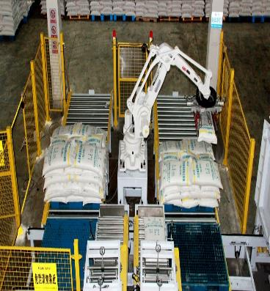
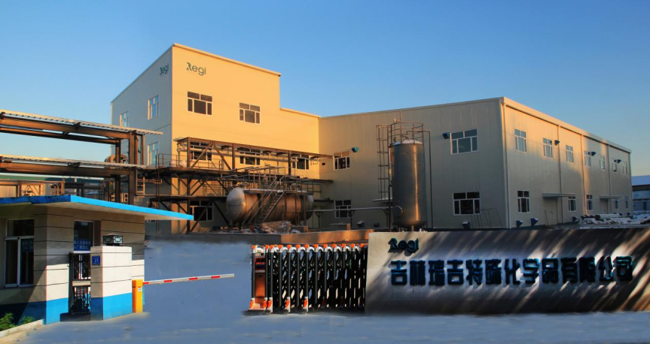

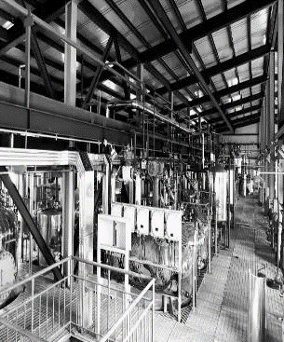
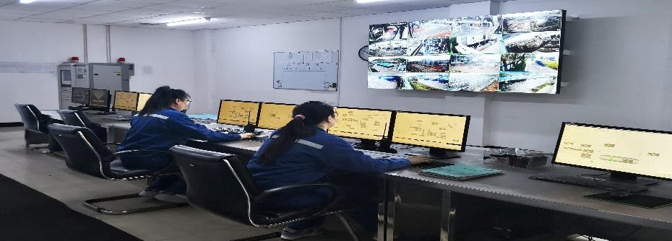
Contact person： Mr. Wu 15688961962
Mr. Ma 15590775520
Jilin Regi Performance Chemicals Co., ltd
Address: No.23, Longbei Road, Longtan
District, Jilin City
Mr. Wang18744213877
Mr. Yang 13478792362
Ms. Song 18302480616
THANK YOU FOR YOUR ATTENTION
Ms. He 18629978029

