Slide 1

OCEAN SHIP EX
FREIGHT FORWARDER

Slide 2

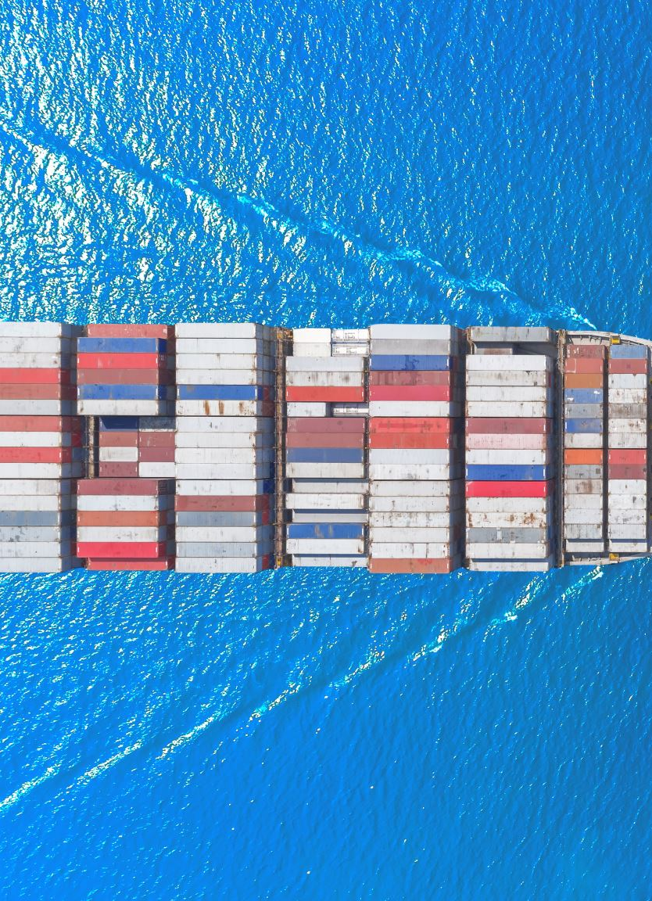
We organize shipments for corporations to get goods from the manufacturers or producers and ship them to a market, and often utilizing multiple modes for a single shipment.
We have been earning customer’s trust and favor by accumulated experience and outcome as a specialized Forwarder since we were founded, we have been trying to create the best suited service Sea transportation.
We always try to improve & develop our service conveniently as to become our customer’s best partner.

Slide 3
We understand that our clients and their businesses evolve constantly. At times, they would even pursue different ventures, that is why we at Ocean Ship CO. make it our priority to partner with you on this journey to take you and your business forward.
Through gained experience in sea help exporting as well as handling bulk cargo, we can offer you a wide variety of logistical solutions and concepts that are guaranteed to meet all your logistical needs.

Slide 4
Our Mission
Guaranteed arrival time: Freight forwarding comes with the peace of mind of knowing all shipments will have a guaranteed arrival time. Everything is coordinated ahead of time to adhere to a strict schedule, which is provided to all involved parties.
Fast: A professional freight forwarder knows how to move goods efficiently. Years of training and on-the-job experience have equipped them with the knowledge and skills to identify the quickest route while avoiding any unexpected disruptions and missed deadlines.
Experienced: Freight forwarders will also handle all the required documentation for both cross-country and international transportation. Failing to have the proper paperwork could lead to lengthy delays as the items become trapped in customs or the bank refuses to release the funds without the required identification. All shipping and export documentation will be prepared by a professional to ensure a smooth transaction. s needed and how to handle any unexpected snags that might arise during the course of events.
Safeguard your business: Can you afford to risk exposing your business to lawsuits, customer complaints or a major loss? Eliminate all risk by leaving the work to the experts. Freight forwarders take the guessing out of the process to keep your company protected at each step of the way. Freight forwarding services also include risk assessment and management, in addition to cargo insurance.
Cost effective: Many smaller businesses believe they can save money by dealing with all arrangements in-house. But that’s certainly not the case when it comes to freight forwarding in Egypt. Letting a professional make the preparations has the most money-saving potential. While a novice could possibly pull the job off, it would take significantly more time and cost more money in the long run, and it would not be a sustainable approach. This way, you can focus your time and efforts on other areas of your business.

Slide 5
OCEAN
FREIGHT
LAND TRANSPORTATION
CUSTOMS CLEARNCE
Our Shipping Commitment Cycle

Slide 6

CONTACT US
HEAD OFFICE
Emtedad El-Amal building,
Industrial area located in
Maadi, Autostorad road,
Shaà El-Thooban, Cairo, Egypt.
INFO@OCEANSHIP.CO
MOBILE: (+20) 1011778778
TEL & FAX: (+202) 27001971

