Slide 1

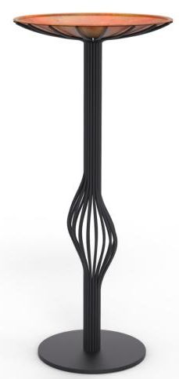

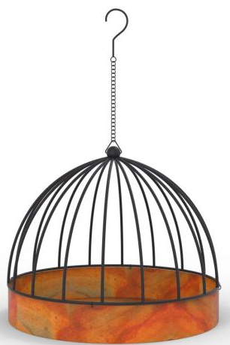
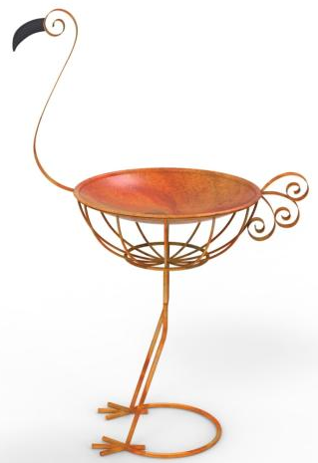
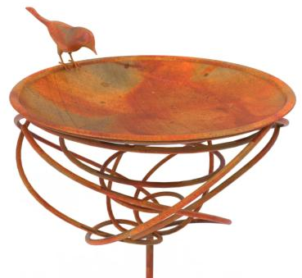
BIRD BATH

Slide 2
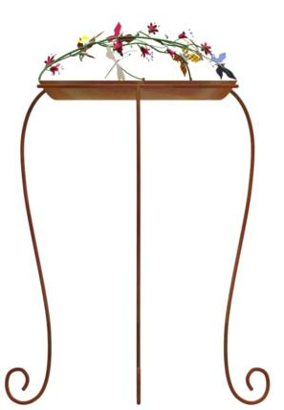
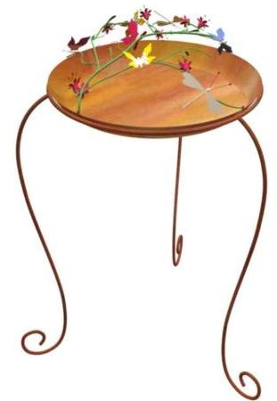
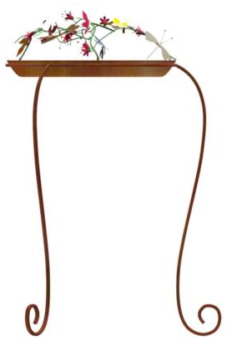
Style # : 70036
Description : Coloured Flowers Dome Birdbath

Slide 3
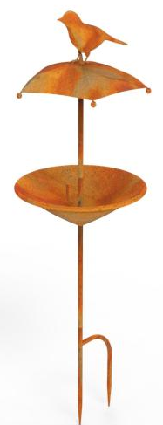
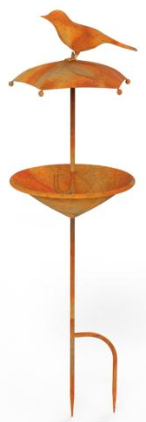
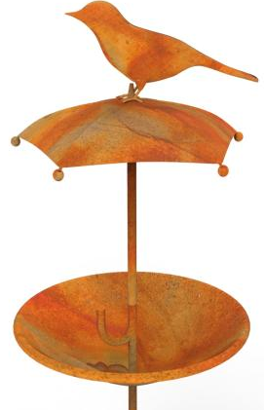
Style # : 71942
Description : Sparrow On Umbrella Birdbath

Slide 4
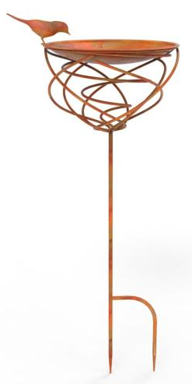
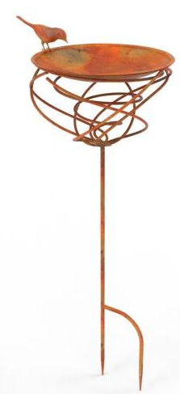
Style # : 72021
Description : Nest Birdbath

Slide 5
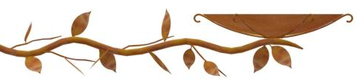

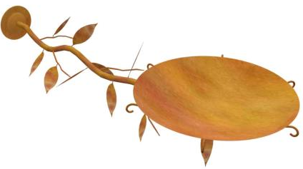
Style # : 70054
Description : Branch Birdbath

Slide 6
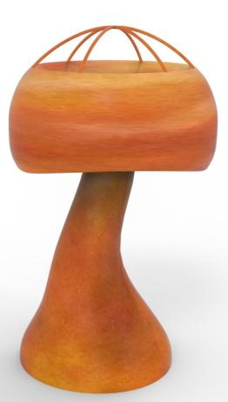
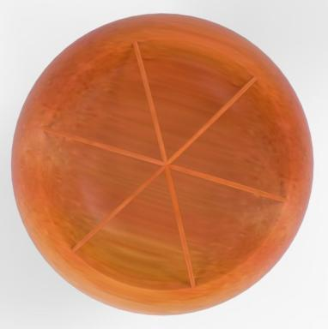
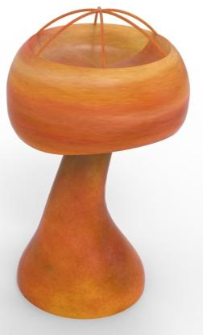
Style # : 70487
Description : Mushroom Birdbath

Slide 7
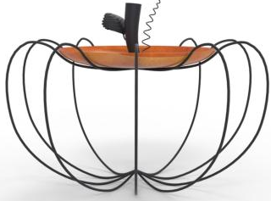
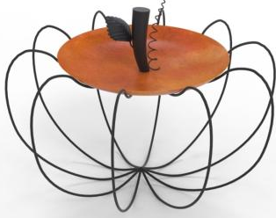
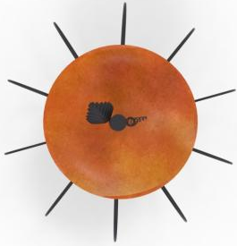
Style # : 70488
Description : Pumpkin Birdbath

Slide 8
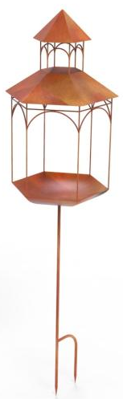
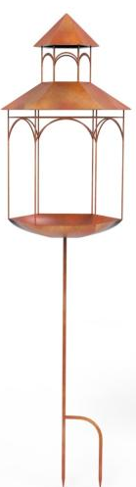

Style # : 70498
Description : Lantern Birdbath

Slide 9
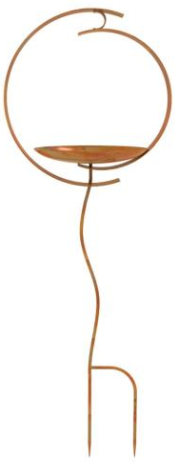
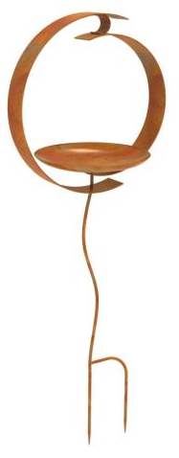
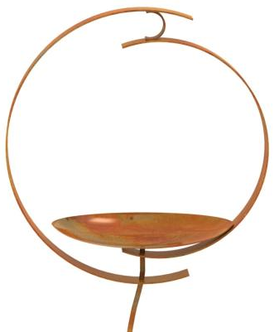
Style # : 71200
Description : Birdbath

Slide 10
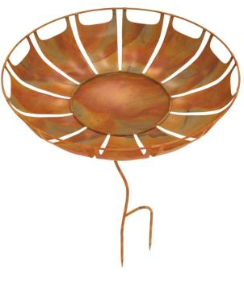
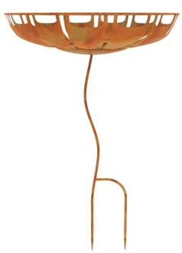
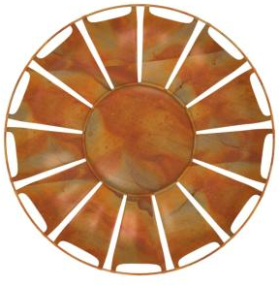
Style # : 71210
Description : Perforated Flower Birdbath

Slide 11
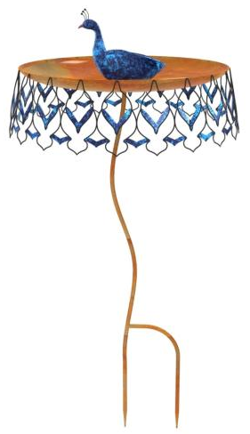
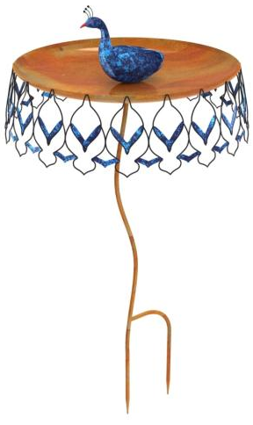
Style # : 71213
Description : Peacock Birdbath

Slide 12
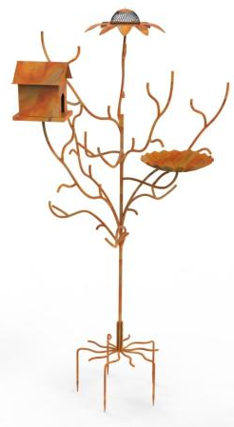
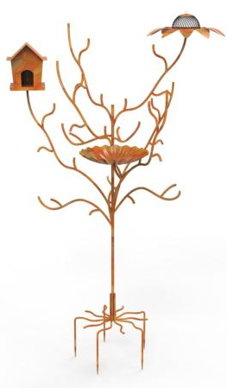
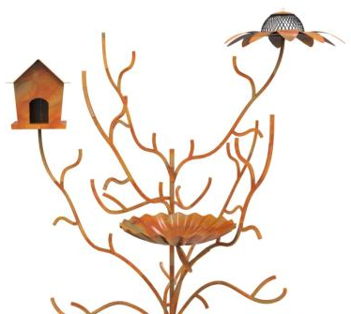
Style # : 71722
Description : Birdbath / Birdfeeder / Birdhouse

Slide 13
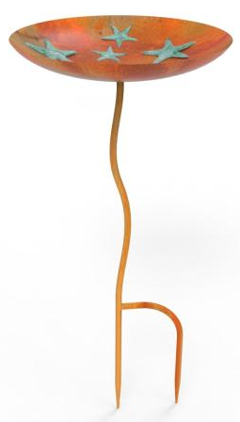
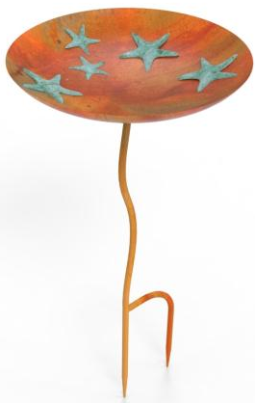

Style # : 71945
Description : Starfish Birdbath

Slide 14
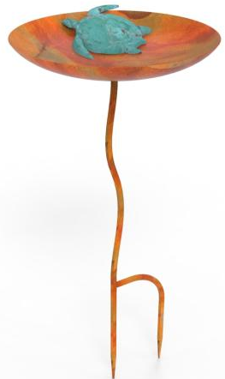
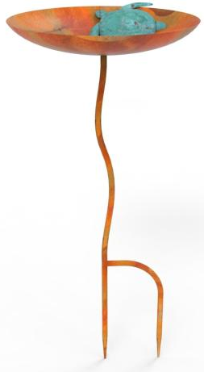
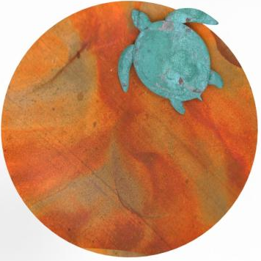
Style # : 71946
Description : Turtle Birdbath

Slide 15
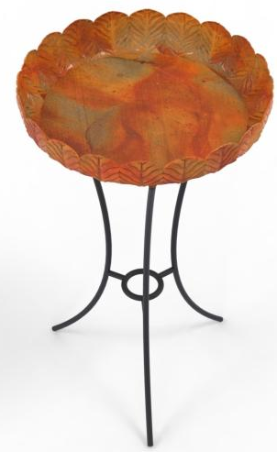
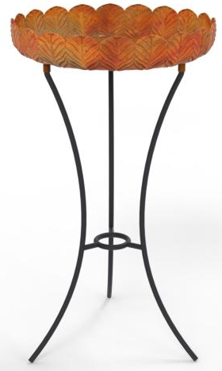
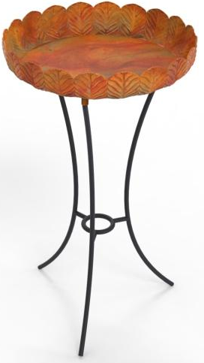
Style # : 71949
Description : Leaves Birdbath

Slide 16
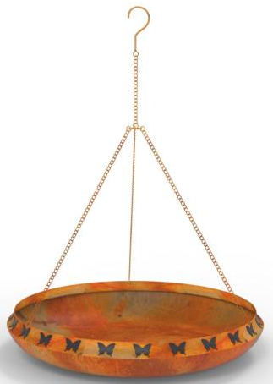
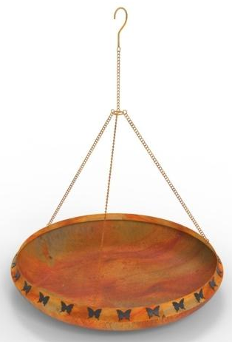
Style # : 71952
Description : Butterfly Pot Birdbath

Slide 17
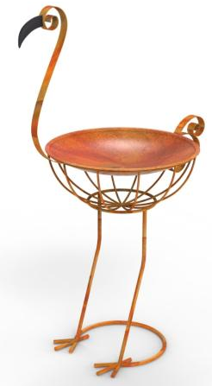
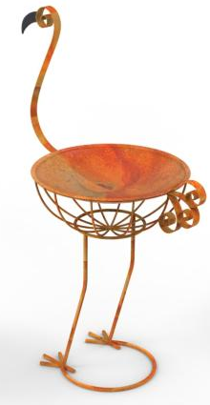
Style # : 71971
Description : Ostrich Birdbath

Slide 18
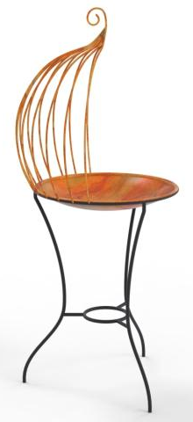
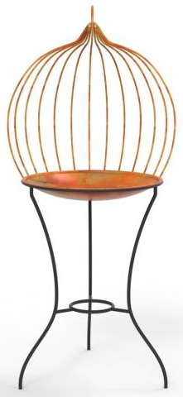
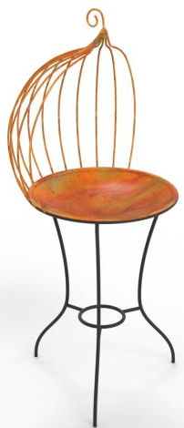
Style # : 71972
Description : Birdbath

Slide 19
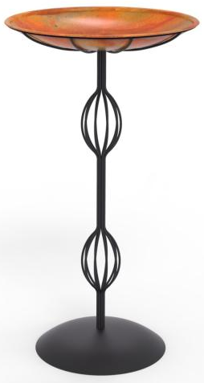
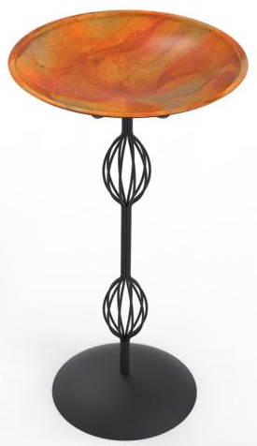
Style # : 71973
Description : Birdbath

Slide 20



Style # : 71987
Description : Birdbath On Branches

Slide 21



Style # : 71990
Description : Flower Bird Bath

Slide 22


Style # : 72010
Description : Birdbath

Slide 23

Style # : 72020
Description : Cage Birdbath

Slide 24


Style # : 72022
Description : Birdbath

Slide 25



Style # : 72026
Description : Flower Birdbath

Slide 26



Style # : 72030
Description : Birdbath

Slide 27


Style # : 72044
Description : Hanging Birdbath

Slide 28



Style # : 72048
Description : Birdbath

Slide 29


Style # : 72051
Description : Bottle Birdbath

Slide 30


Style # : 72262
Description : Flowers Birdbath

Slide 31



Style # : 72269
Description : Birdbath

Slide 32



Style # : 72720
Description : Garden Gate Birdbath

Slide 33


Style # : 72762
Description : Wall Mounted Birdbath

Slide 34


Style # : 72925
Description : Birdbath

