Slide 1



PT ADFEROS UNIVERSAL INDONESIA

Slide 2
CONTENT
1
Company profile
2
Visi dsn misi
3
Our Introduction
4
Spesifikasi produk
5
Structure organisasi

Slide 3
1
Company Profile

Slide 4
Profile
PT adferos was established on January 132023, pt adferos is a company which is engaged in the plantation ofcoconut plantation. We focus onquantity and quality of coconuts. We manage coconut plantationswith an area of approximately 3,883 tons/month..
In general, the coconuts that wewe produce, has a sweet tastefrom natural freshness.
We provide every single coconutwe believe that with everyyou consume you canfeel the warmth, the struggle,and freshness of the coconut..

Slide 5
2
vision and mission

Slide 6
Vision
To be the highest quality coconut exporting company and we are committed to supplying coconuts sustainably around the world..
.
Mission
Providing the best quality coconut needs throughout the world with customer satisfaction oriented.

Slide 7
3
Product specifications

Slide 8
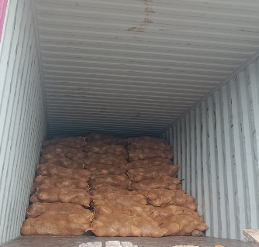
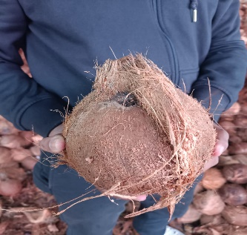
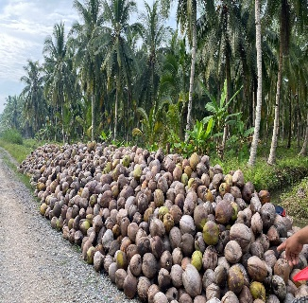
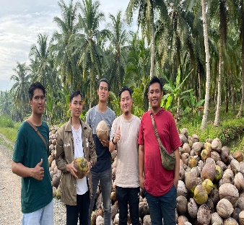
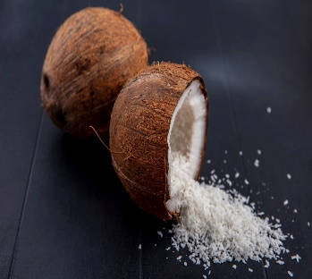

CHARUTUBIAO
Product specifications
Grade : High
Color: Natural Brone
Size (cm): 12-13 cm
Weight (ounces): 7 - 9 Ounces
Product Type : Tropical & Sub Tropical
Variety : Matured Coconut
Style : Fresh
Taste : Ripe & sweet
Feature : High Nutrition
Port : Tanjung Priok, North Jakarta
Quantity: 3,883 Ton/Month
CHARUTUBIAO
CHARUTUBIAO

Slide 9
4
Struktur organisasi

Slide 10
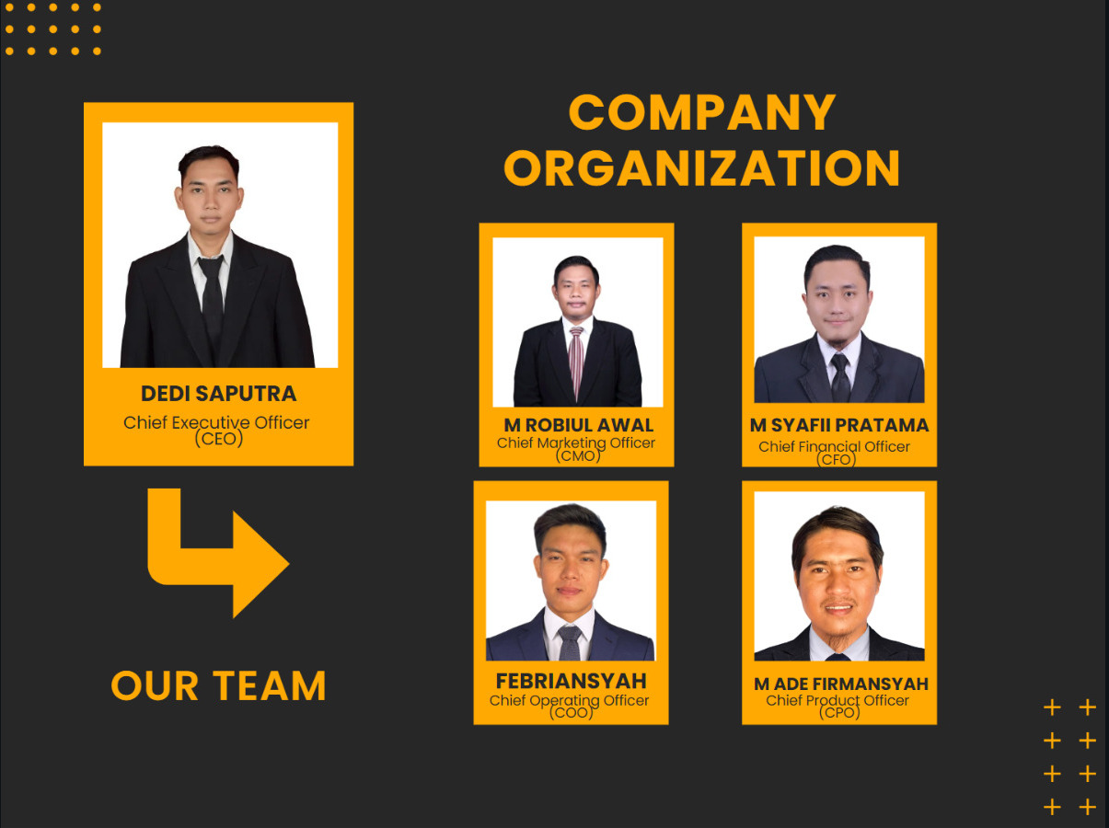
Struktur organisasi

Slide 11
THANK YOU
Contact Person : +62 88286706396 (Syafii_CFO)
Email : adferosuniversalindonesia@gmail.com
Website : www.adferoscoco.com

