Slide 1
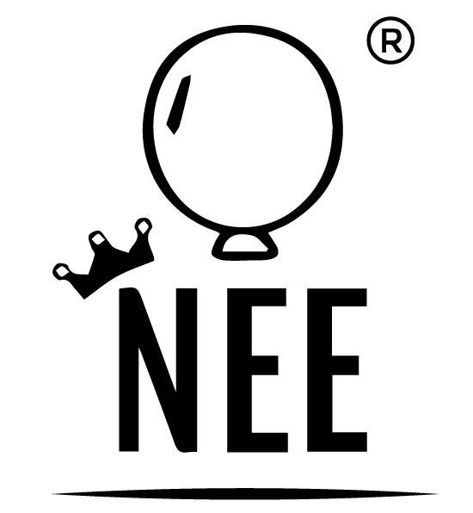
Nee brand was born to be the global trend
For great opportunity to invest
Your greater contribution to the wellness of our kind

Slide 2
Present Worldwide Facts on Nose Congestion
Feb 9, 2022 — Allergies: About one in five people in the UK have a condition called ... A problem with the structure of the nose: Nasal congestion
www.holly.com
Nose and Sinus Disorders | Michigan Medicine
https://www.uofmhealth.org › ear-nose-throat › sinus
Chronic sinusitis affects 31 million people in the U.S. and accounts for more than 16 million outpatient visits a year.
In India 1 out of 5 people has nasal congestion issue.
In China 7% of the total population has nose congestion issue.
In the future, all the numbers above-mentioned to increase dramatically.

Slide 3
Nee Nose Congestion Opening Device History
I, the founder and researcher Enkh-Amgalan.D (JAIST, Japan) have suffered with nasal congestion issue for 18 years, lived dependent on nasal drop, using 2 bottles a day.
I was diagnosed with deviated septum and had to take a surgery in 2016.
As an experienced researcher, I decided to find alternative healing method that potentially exists in the world.
In the result, I found a device that used in other treatment in USA as Cranical Facial Release (CFR), which is also advised for usage to open nasal congestion and saw the opportunity to make my own device.
It took me 6 months to gather all the necessary essential to make the nasal congestion opening device that I can use.
Within 5 days of usage of the device, I was freed from nasal drops breathing through my nose. Also I finally was able to blow my nose that I was unable to do for many years.
Thus, it helped me. I truthfully believe that nasal congestion issue, it’s process, functioning and solutions are the same for everyone and MY DEVICE can help to many people to breathe through their nose with fresh air.

Slide 4
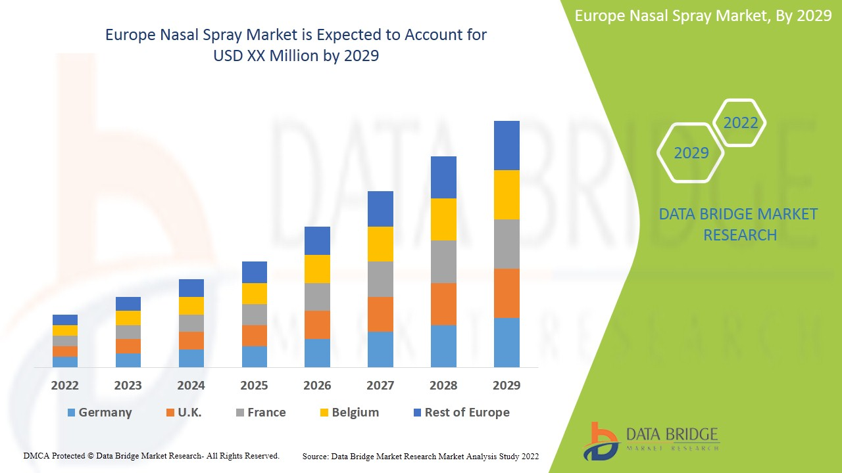
Increasing Nasal Spray = Increasing Buyers for Nee Blocked Nose Opener in Europe

Slide 5
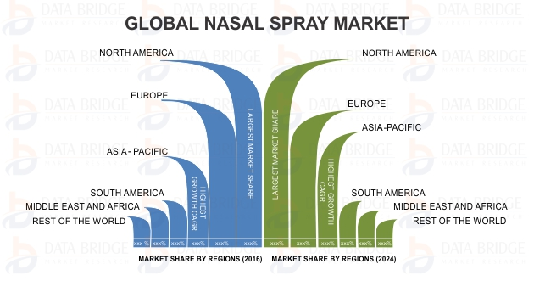
Potential Sales Market of Nee Blocked Nose Opener

Slide 6
Introduction to Nee Blocked Nose Opener

Slide 7
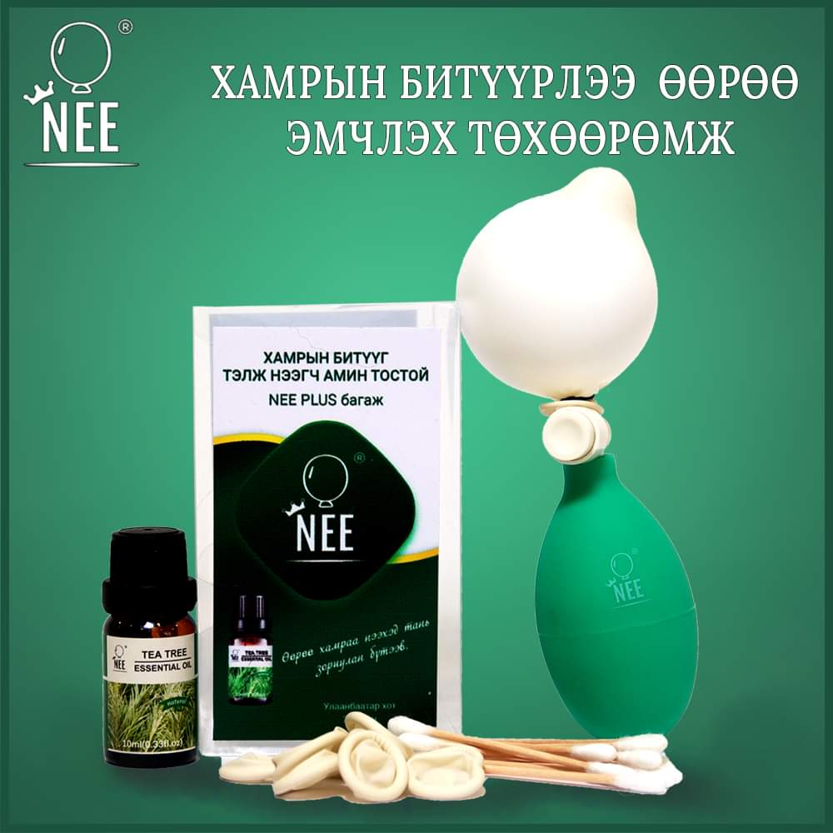
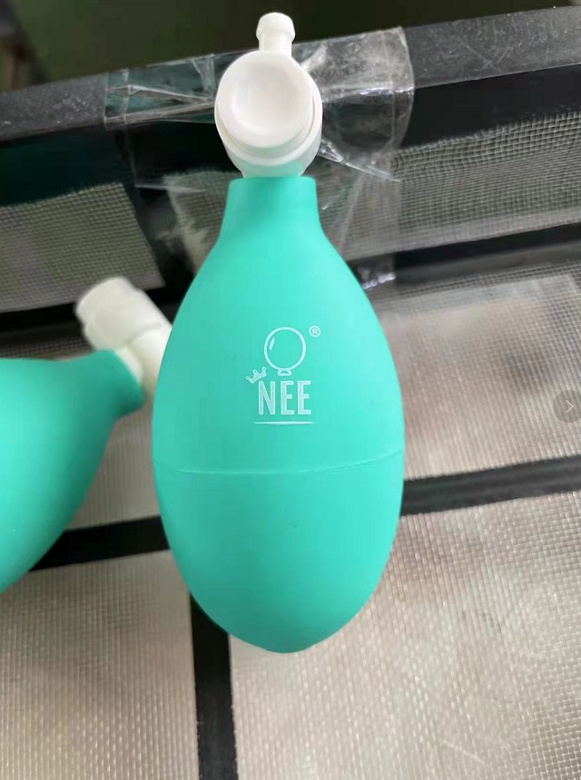
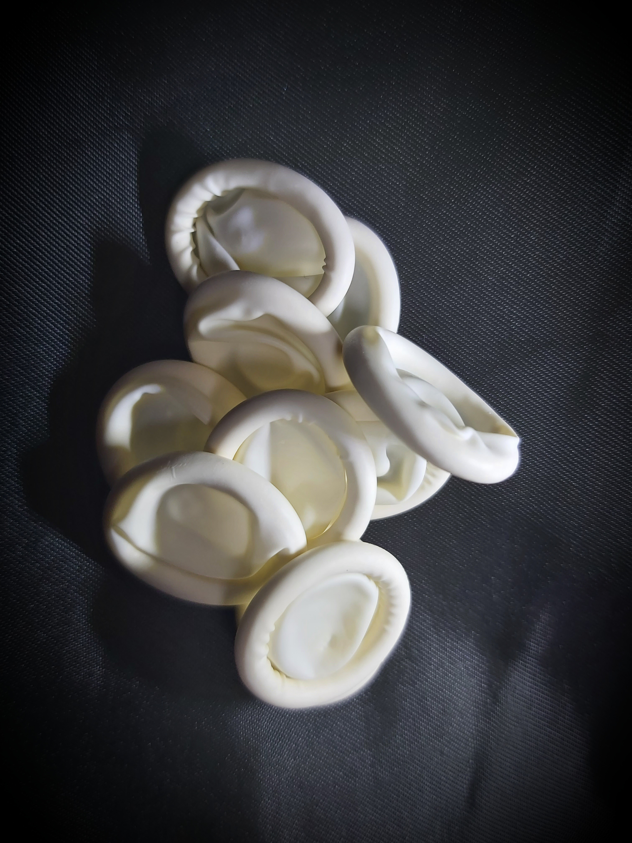
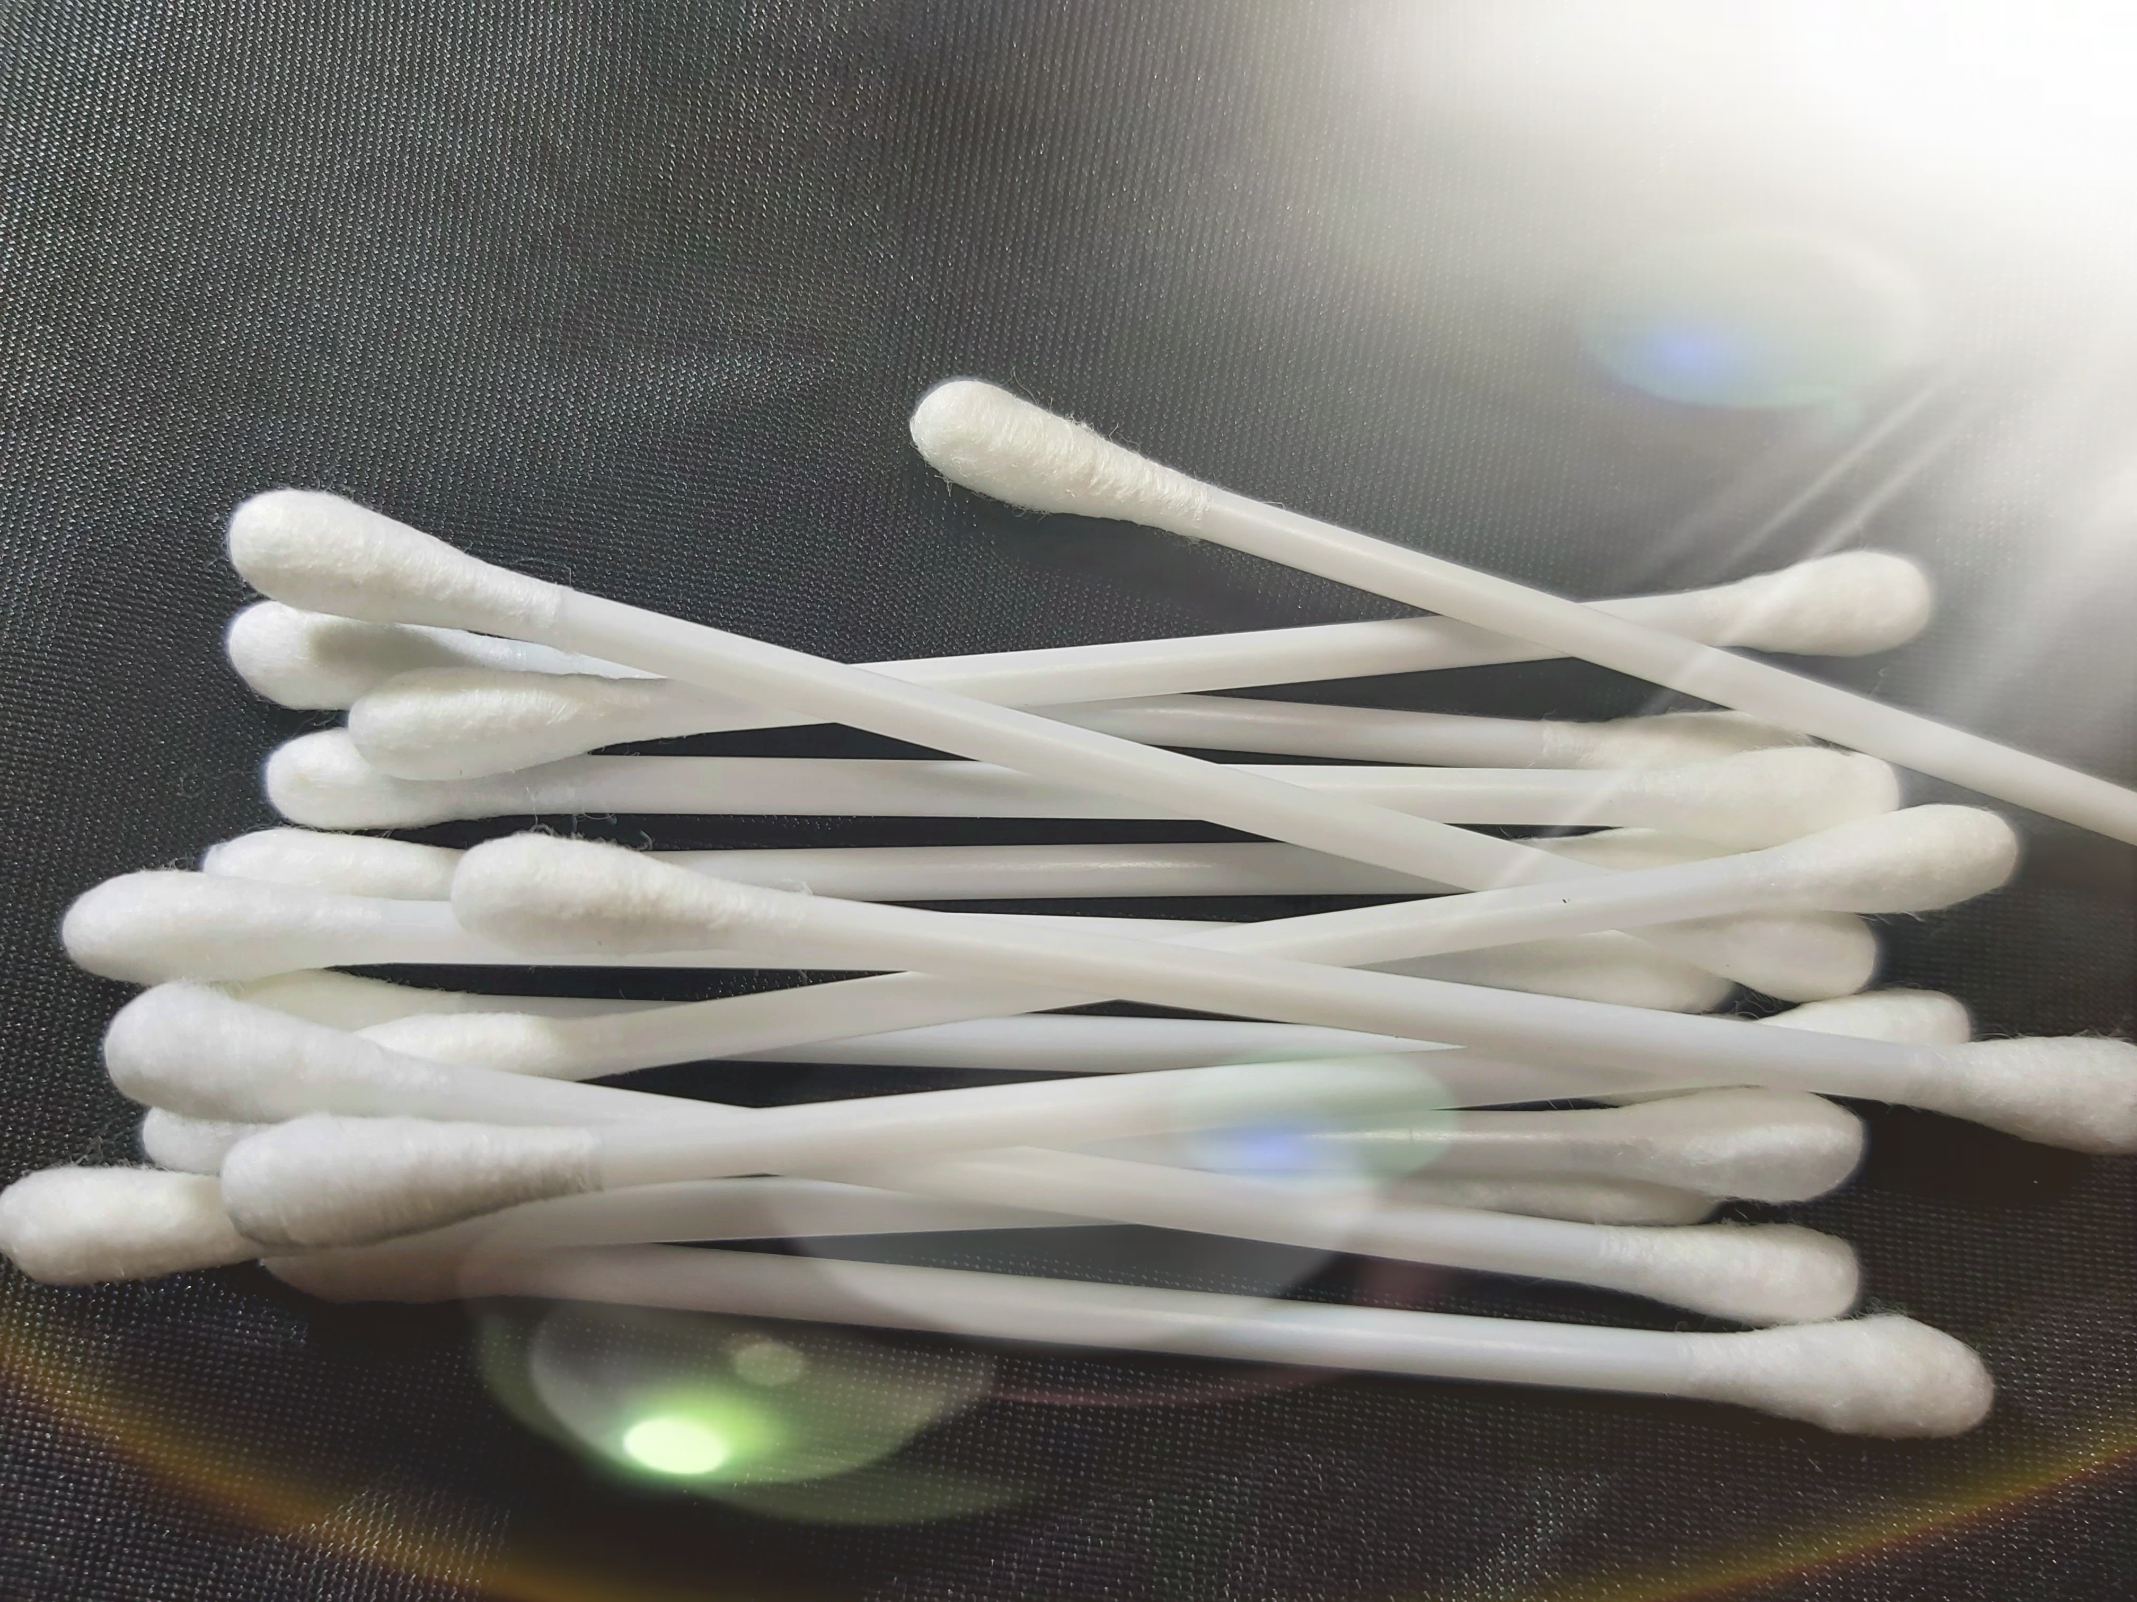
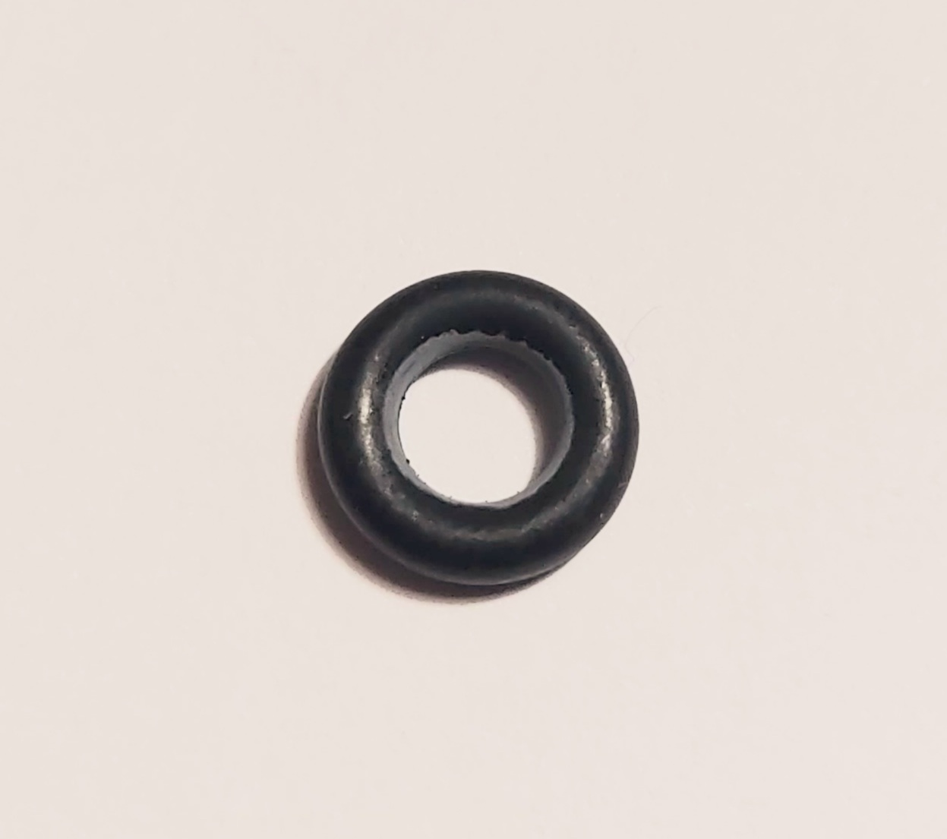
Main Parts:
Arm pump with press valve
Finger cot for medical use
Cotton stick
EDMP rubber O ring and Tea tree oil

Slide 8
What Nee Brand bringing to the table of global market?
Before, those who have nasal congestion had following options:
Use nasal drop, spray for prolonged period
Have surgery.
Now, Nee brand is offering a complete new solution to global consumers, who want to be freed from nasal drops/spray surgery. This product meets modern consumers demand that is DIY.
Also, Nee perfectly suites global consumer trend that is Natural as well. The reason is our device supports nose internal natural function as one of our one of the buyer’s testimonial.

Slide 9
Benefits of the Nee Brand
Breathing disorders
Sinusitis
snoring
Sleep apnea
Insomnia
Deviated nasal septum
Migraine
Vertigo,
Facial pain (Trigeminal Neuralgia)
Facial paralysis (Bell's palsy)
TMJ disorder
Post-Concussion Syndrome
Seizures
Other neurological disorders

Slide 10
Authorization of Nee Device
Nee brand had successfully obtained following patent from WPO official member organization, Mongolian Intellectual Property Organization:
  Blocked nose opening device
  Nee trademark for blocked nose opening device.

Slide 11
Nee Global Trend Plan
Open global trade and operational center in Europe.
Open assembly line in China.
Sell globally.

Slide 12
Why to Invest
It is first DIY healing device.
Nee blocked nose opener supports nose internal natural function.
It is sustainable market with annual repeating number.
The device usage is very simple that anyone can buy and open their nose.
The device is built on self trust that encourages self healing, eventually to build trust in own self.
10 and above % of our kind need to breathe freely through their nose for their enjoinment of wellness.
Those who can’t breathe through their nose, need our hand.

Slide 13
Gratefulness to you.
I deeply appreciate you for
partnering with us to
spread wellness of own kind.
With Respect and Inner Peace.

